Slide 1
A DBMS must be able to ensure that serializable and
recoverable schedules are allowed when being asked
to provide full protection
against concurrently running programs.

Slide 2
More schedule types
Serializable schedule over a set S of transactions is a schedule whose effect on any database consistency must be identical to that of some complete serial schedule over the set of committed transactions in S.
Recoverable Schedule: Schedule in which transactions commit only after if all transactions whose changes they read commit.
W(X)
.
.
Commit
R(X)
.
Commit
Time
Locking protocols are typically used to ensure serializable and recoverable schedules

Slide 3
Strict schedule: A schedule is strict if a value written by a transaction T is not read or overwritten by other transactions until T either commits or aborts.
Strict schedules are recoverable schedules
Strict and therefore recoverable
Recoverable but not strict
Time
T
T
W(X)
.
.
Commit or Abort
W(X)
.
R(X)
Commit
No R(X) or W(X) allowed
Read the shared object before T commit → not strict
W(X)
.
Commit
R(X) or W(X)
.
Commit

Slide 4
Options for DBMS to provide concurrency control
Lock-based Concurrency Control
Used by most relational DBMS
Timestamp-Based Concurrency Control
Multiversion Concurrency Control
Give serializable schedules
Used in Oracle 8.
Optimistic Concurrency Control
Assumption: Most transactions will not conflict with other transactions.
Not widely used.

Slide 5
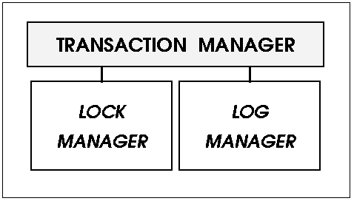
Lock manager provides concurrency control (protection against interferences from other transactions)
Before a shared object is used, a lock on that object must be granted by DBMS.
Maintain a lock table.
Several lock levels: database, tables, pages, tuples
A page = a disk block where you can store several rows
Disk block = unit of data retrieval from disk
Log manager provides recovery services.

Slide 6
Lock Management
Lock and unlock requests are handled by the lock manager.
Lock table entry for each object:
Transactions currently holding a lock
Type of lock held (shared or exclusive)
Pointer to queue of lock requests.
Locking and unlocking have to be atomic operations using operating system support such as semaphore.
Lock upgrade: A transaction that holds a shared lock can be upgraded to hold an exclusive lock if no other transactions hold a shared lock on the object.
Notes:
Rationale for lock upgrade
Queuing the request after transaction wanting the exclusive lock on the same object causes a deadlock.
Convoy: Most of the CPU cycles are spent on process switching. A transaction T holding a heavily used lock may be suspended
By the OS causing other transactions for this lock to wait in the queue (this queue is called convoy) until T is resumed.
Latch: short duration lock on a page to ensure that one process writes/read the pages to/from disk.

Slide 7
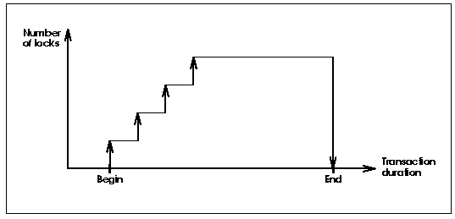
Strict 2PL
Strict 2PL is the most widely used locking protocol
Strict 2PL ensures strict and conflict serializable schedules

Slide 8
Strict Two-phase Locking (Strict 2PL) Protocol:
Each transaction must obtain a S (shared) lock on the object before reading, and an X (exclusive) lock on the object before writing.
If a transaction holds an X lock on an object, it can read the object without additional shared lock required; however, no other transaction can get a lock (S or X) on that object.
All locks held by a transaction are released when the transaction completes.
Requests to acquire and release locks are automatically inserted into transactions by DBMS.

Slide 9
S_{T}(O): Shared lock on object O
X_{T}(O): Exclusive lock on object O
In this case, strict 2PL results in serial execution of the two transactions.
T1 T2
T1 T2
X(A)
R(A)
W(A)
X(B)
R(B)
X(B)
W(B)
Commit
X(A)
R(A)
W(A)
X(B)
R(B)
W(B)
Commit
X(A)
R(A)
W(A)
T2 tries to get X(A) and cannot!
T2 has to be blocked waiting until T1 is done and releases all its locks.
All locks are released.
Xact Manager looks at the next transaction in the queue waiting for the lock and grants the lock.

Slide 10
Schedule A
Schedule B
T1 T2
X(A)
R(A)
W(A)
X(B)
R(B)
W(B)
Commit
X(A)
R(A)
W(A)
X(B)
R(B)
W(B)
Commit
T3 T4
S(A)
R(A)
S(A)
R(A)
X(B)
R(B)
W(B)
Commit
X(C)
R(C)
W(C)
Commit
Example of strict 2PL with interleaved actions.
Check whether A and B fit the definition of strict schedule!
Theorem: Schedule is conflict serializable if and only if its dependency graph (serializability graph) is acyclic.

Slide 11
Precedence Graph (Serializability Graph)
A precedence graph is used to capture potential conflict actions between the transactions in a schedule
A precedence graph for a schedule S contains:
A node for each committed transaction in S.
An arc from Ti to Tj if an action of Ti precedes and conflicts with one of Tj’s actions.
T1 T2 T3
R(A)
W(A)
Commit
W(A)
Commit
W(A)
Commit
T3
T1
T2
Cycle →Not conflict serializable!

Slide 12
Schedule A
T1 T2
X(A)
R(A)
W(A)
X(B)
R(B)
W(B)
Commit
X(A)
R(A)
W(A)
X(B)
R(B)
W(B)
Commit
Precedence Graph for Schedule A
T1
T2
Schedule A is conflict serializable.

Slide 13
Schedule B
T3 T4
S(A)
R(A)
S(A)
R(A)
X(B)
R(B)
W(B)
Commit
X(C)
R(C)
W(C)
Commit
Precedence Graph for Schedule B
T3
T4
Schedule B is conflict serializable.

Slide 14
Conflict Serializable Schedules
Schedule S is conflict serializable if S is conflict equivalent to some serial schedule.
Two schedules are conflict equivalent if:
They involve the same actions of the same transactions.
Every pair of conflicting actions of two committed transactions is ordered the same way.
Two actions conflict if they operate on the same data object and at least one of them is write.

Slide 15
Every conflict serializable schedule is serializable assuming that a set of objects does not grow or shrink.

Slide 16
Conservative 2PL
Technique: A transaction obtains all the locks that it will need when it begins. If it does not get all the locks, Xact does not hold any lock.
Advantage: Can also prevent deadlocks.
No need to rollback
Number of locks
Transaction Duration
Begin
End
Notes:
With strict 2PL, dead locks can occur
When lock contention is low, locks are held longer under Conservative 2PL.
When lock contention is high, Conservative 2PL can reduce the time that locks are held on average.

Slide 17
Transaction Models
Flat transaction: as we have seen previously: all or nothing; rollback everything
Flat transaction with savepoints: rollback to an earlier savepoint
Chained transactions: Inside a transaction is a chain of sub-transactions where commit of a sub-transaction begins the next sub-transaction; rollback is limited to the most recent committed sub-transaction
Ref: Jim Gray and Andreas Reuter: Transaction Processing: Concepts and Techniques

Slide 18
Lots to explore with transaction management
Other lock-based concurrency control
Non lock-based concurrency control
Different types of transaction models

Slide 19
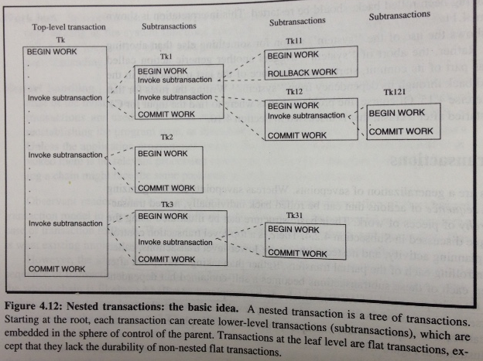
Transaction Models
Nested transaction: A tree of sub-transactions
Ref: Gray’s book

