Slide 1

DBMS Internals
Objective: Be able to do physical database design
Understand a generic DBMS architecture
Understand how query processing is done
Understand an index structure and how an index is used
Understand join algorithms
Understand how transaction management is done by DBMS
References:
Ramakrishnan and Gehrke. Database Management Systems, 3rd edition. McGraw Hill
[Ramakrishnan’s Slides for instructors who used his Database Management Systems book]
[M. Tamer Özsu et al., Principles of Distributed Database Systems, Springer]
[Kien A. Hua, Lecture notes]

Slide 2
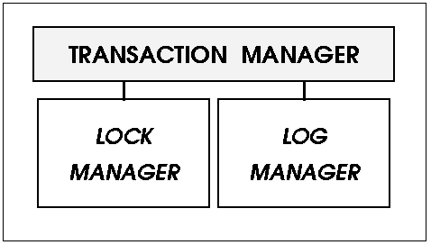
Structure of a DBMS
These layers must consider
concurrency control and
recovery
A typical DBMS has a layered architecture.
The picture shows one of several possible architectures.
Each DBMS has its own variations.
We’ll learn the principles and use MySQL as our use case DBMS.
Use these principles when you work with other relational DBMS.
Query Optimization
and Execution
Relational Operators
Files and Access Methods
Buffer Management
Disk Management
Access paths/methods: Ways to retrieve tuples from relations used in the query
DB
Notes:
File and Access Manager arranges records into pages
Query optimization has to figure out the fastest way (cheapest way) to execute your query
Relations are stored on disk; we need to bring them into memory

Slide 3
Objectives for a good relational database design
Reduce data redundancy
Reduce query response time, improving throughput (#queries/transactions executed per second)
There are times we cannot achieve both together.
We may have to allow some redundancy for faster performance.
Notes:
Query performance has several issues: how many tables to be linked together

Slide 4
How to improve query performance?
Query Rewriting and Physical Database Design
Look at how the slow queries are executed by DBMS
Rewrite the slow queries to utilize existing indexes
Create indexes on appropriate attributes to speed up the search for the rows that satisfy the query
Choose appropriate database engine
Increase database buffer pool
Choose how to store relations, e.g., striping across multiple disks, or sites where the portion of the data is frequently used
Physical database design

Slide 5
Data are stored on disks.
Disk accesses are much slower than RAM.
Need good strategies to retrieve the desired data to bring the desired data into memory and cache them
Database internals
Part 1

Slide 6
Example of System Catalogs
When you create a table, where is the table information kept?
It is kept in a system catalog.
Attr_Cat(attr_name, rel_name, type, position)
Position of an attribute is in the order of attribute in the SQL DDL statement used to create the relation
Used for semantic analysis!
Students

Slide 7
A relation is stored in a binary file (or multiple binary files) if DBMS is not configured to bypass OS.
A file is divided into pages (blocks).
A block is a unit of disk retrieval
The terms “page” and “block” is used interchangeably.
Tuples/rows/records are arranged in a page
Notes:
A relation is stored in which file

Slide 8
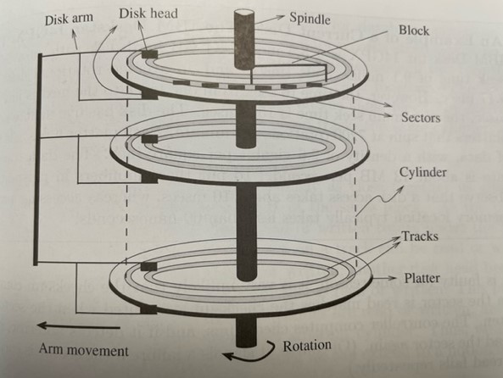
A disk block is a unit of data retrieval; it is a sequence of bytes.
The size of a disk block is set when the disk is initialized as a multiple of sectors. Sector size is fixed.
Typically, only one of the disk head reads/writes the data
A disk I/O involves moving the disk arm to the track with the desired disk block, rotating the desired block under the disk head, and actual reading/writing the data from/to the block.
Ramakrishnan and Gehrke. Database Management Systems, 3rd ed. Chapter 9
Notes:
Disk blocks are arranged in concentric rings called tracks on one or more platters.
The set of tall tracks with the same diameter is a cylinder.

Slide 9
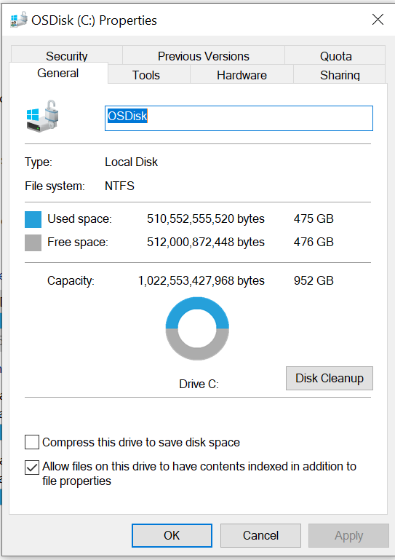
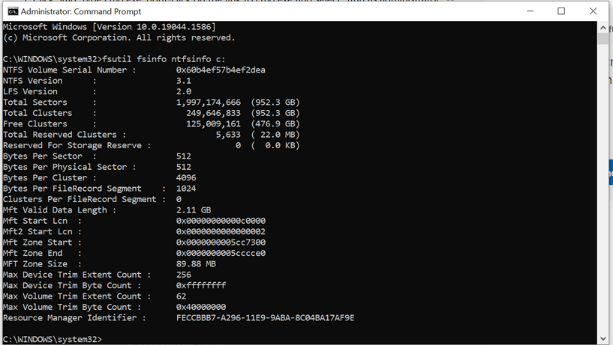
Bytes Per Cluster → Block size

Slide 10
Statistics are stored in System Catalog
Indexes are automatically created by some DBMSs when you specify some constraints.
Cardinality: Number of tuples/rows for each relation R
Size: Number of pages for each relation R
Index Cardinality:
Number of distinct key values for each index I
Index Size:
Number of pages for each index I
For example, for a B+ tree index, we take the number of
leaf pages to be the index size
Index Height:
Number of non-leaf levels for each tree index I
Index Range:
The minimum present key value and the maximum present key value for each index I
These statistics are updated periodically and they are used for estimating query cost.
B+Tree index
Index entry pages
Statistics about indexes
(Direct search)
Data Entry pages
("Sequence set")
relation

Slide 11
How to store a row in a disk block/page?
Logically, we think of a page as a storage space of a fixed size.
Row format
Fixed length
Variable length
Page format
For fixed length records
For variable length records

Slide 12
Fixed Length Row/Record Formats
Each record in the same relation takes the same amount of space.
Information about field/attribute types is stored in the system catalog.
Fi: Field/Attribute i; Li: Size of field i in bytes
Ex: emp(eid integer, name char(40))
The number of bytes per record is = 4 (size of integer)+40=44.
F1
F2
F3
F4
One row with four attribute values
L1
L2
L3
L4
Base address (B)
Address = B+L1+L2
Notes:
What happen with null? Still use 48 bytes.

Slide 13
Variable Length Record Format
Ex: emp(eid:integer, name:varchar(40))
VARCHAR: Variable length characters
Two alternative formats (#fields is fixed):
F1 F2 F3 F4
Can be used for fixed length fields
Or Variable length fields
4
$
$
$
$
Fields Delimited by Special Symbols
Field
Count
directory
F1 F2 F3 F4
Pointer here is the starting address of each field
Array of Field Offsets
Second format offers direct access to the i’th field, efficient storage
of nulls; but has small directory overhead.
Notes:
What happens with null? < 48 bytes; the second design, you can easily compute the record size

Slide 14
Two different page formats for Fixed Length Records
Packed bitmap page format
Unpacked bitmap page format
All records are stored consecutively in the packed bitmap page format.
Slot 1
Slot 1
Slot 2
Slot 2
. . .
Free
Space
. . .
Slot N
Slot N
1: a record exists
0: empty
Slot M
N
1
. . .
0
1
1
M
number
of records
M ... 3 2 1
number
of slots
Record id = <page id, slot #>. In the packed bitmap, moving records for free space management changes the record id (rid); may not be acceptable.
Notes:
Record id very important; advantage of packed bitmap format; disadvantage

Slide 15
Page Formats for Variable Length Records
Rid = (i,1)
Rid = (i,2)
Data for record 1
Data for record 2
Page i
Rid = (i,N)
Data for record N
Free space
1000
40
0
N
Offset
from the start
of free
Space in the page
N . . . 2 1
# slots
SLOT DIRECTORY
Record id (Rid) has the page number and the slot number.
Can move records to different location in a page without changing rid; so, attractive for fixed-length records too.

Slide 16
What are file formats used to store a relation?
Heap File (Unordered file): Suitable when typical access is retrieving all records. Data are not ordered
Sorted File: Best if records must be retrieved in some order, or only a `range’ of records is needed.
Hashed File: Good for equality selections.
The implementations depend on the underlying DBMS.

Slide 17
One implementation of a Heap File as a List
Linked list of pages full of records
Data
Page
Data
Page
Data
Page
Full Pages
Header
Page
Data
Page
Data
Page
Data
Page
Pages with
Free Space
The header page id and heap file name must be stored in some place.
Each page contains at least 2 `pointers’ plus data.
Pointers here are disk block locations.

Slide 18
Disk Manager
Higher levels call upon this layer to:
allocate/de-allocate a page on disk
A page or a block is a unit of disk retrieval
read/write a page
One page generally contains several tuples/rows/records
Notes:
Developer who does this really need to know OS well to support raw devices
If your disk is slow, performance suffers

Slide 19
The size of the database buffer pool impacts query performance!
Buffer Manager
Page Requests from Higher Levels
MEMORY BUFFER POOL
disk page
MAIN MEMORY
free frame
DISK
DB
choice of frame dictated
by replacement policy
Size of a frame equal to size of a disk page
Two variables associated with each frame:
Pin_count: Number of current users of the page
Dirty: whether the page has been modified since it has been brought into the buffer pool.
Notes:
Page replacement policy to choose which dirty page will be written to disk.

