Slide 1
Graph Databases/ Graph DBMS
Graph Database: Persistent collections of nodes and edges and their properties/attributes
Graph DBMS: Software that manages persistent collections of graphs
Graph data model is schema free
That means there is no need to define schemas/structures prior to entering the data
A declarative query language is used to retrieve nodes or edges that satisfy query conditions

Slide 2
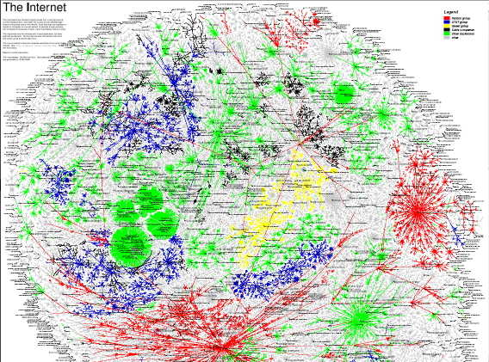
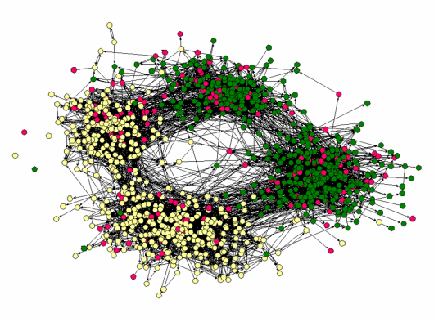
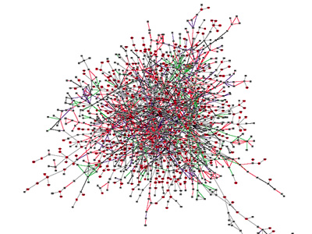
Many Real-World Data Seen as Graphs
Social networks: Facebook, LinkedIn, YouTube
Friendship Network
[Moody’01]
Internet Map
[lumeta.com]
Protein Interactions
[genomebiology.com]

Slide 3
When to USE GRAPH DBMS?
Queries focusing more on relationships and visualizing relationships reveals more information
Frequently used queries involve graph traversals
Starting from specific node(s) and traversing the graph
Reachable nodes from a given node
K-hop neighbors of a given node
Ending at specific node(s) and traversing back
Shortest-paths between nodes
Example: Social networks, identify communities

Slide 4
Graph Data Models
Property graph model
Neo4j supports this data model
Hypergraph model

Slide 5
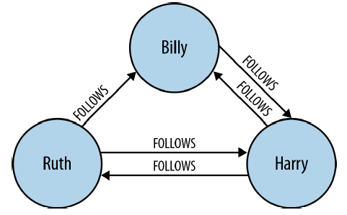
Graph Data Model: Property Graph Model
The model is a graph of nodes and directed edges
Nodes and edges can have properties/attributes
A node represents one instance (one entity in ER)
An edge represents a relationship between two nodes (binary relationships only)
Some graph database models can be more complex!
No explicit schema, but there is a way to group
nodes together
edges together
(Graph Databases - Neo Technology, 2013 p. 16)
[Neo4j online book on Graph Database Technology]
Notes:
This example shows three nodes and five edges.

Slide 6
Graph Query Languages
CRUD operations --- Create/Read/Update/Delete nodes, edges, properties and traverse graphs
Declarative language (tell DBMS what you want but not how to get what you want)
A standard query language, Graph Query Language (GQL), is being proposed.
Notes:
Query performance strongly depends on your graph data model (unlike RDBMS); cost-based optimization; indexes can be created

Slide 7
Neo4j Graph DBMS
Most popular and well documented graph DBMS to date
Property Graph Data Model
Query language: Cypher
Support ACID properties of transactions
Support JDBC and Object Grid Mapping (OGM) using their own library or through Hibernate OGM

Slide 8
Node/Edge Properties
Properties are key-value pairs where the key/attribute is a string.
Property values is either a primitive or an array of one primitive type
Type: boolean, byte, short, long, int, char, string
In Cypher, do not need to specify type; see https://neo4j.com/docs/cypher-refcard/current/ for Neo4j
Grouping of nodes are done by assigning them the same label
Grouping of edges are done by assigning them the same label
Properties of nodes can have constraints such as unique, or exist

Slide 9
Node/edge labels
Label is used to group a set of nodes together or a set of edges together
Nodes with the same label can have different properties
Edges with the same label can have different properties
Generally, we assign nodes with similar properties the same label
Benefits of using labels:
Used as pseudo schemas to easily view relationships between data in the database
Reduction of query processing time due to label indexing
Notes:
One can think of a label as a schema

Slide 10
HYPER-graph Data model
Philippe Cudré-Mauroux, Sameh Elnikety
Graph Data Management Systems for New Application Domains: Social Networks & the Web of Data, VLDB Tutorial, VLDB 2010
Hyper-edge
A traditional edge is binary
A hyper edge relates n nodes where n can be greater than 2
Order of the edges can be important
Child-of edge versus father, mother, child hyper-edge
Hyper-node
A traditional node represents one entity
Hyper node represents a set of nodes
Person node versus family hyper-node

Slide 11
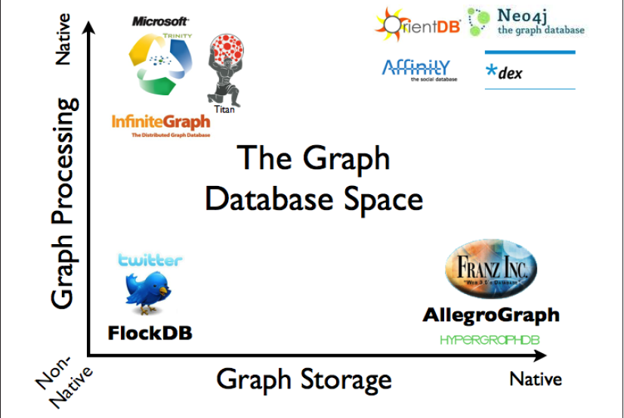
Different Graph DBMS
X-axis: Native for graph storage means that the DBMS implements its own storage that does not use relational DBMS or other DBMS as its storage backend
Y-axis: Native for graph processing means that the DBMS uses its own graph query language to get the data directly from the storage; it does not need to convert the query into the corresponding query to the backend DBMS
Internet source
Notes:
AllegroGraph and Dydra are RDF based
Twitter designed it specifically to store relationships and activity between users.

Slide 12
Examples of Graph DBMS
Titan (distributed GDBMS) – OTLP and OLAP (Online Analytical Processing) with BerkeleyDB, Cassandra and HBase support
Titan (Amazon) - Amazon DynamoDB storage backend
RDF (Resource Definition Framework) Graph Databases with SPARQL as the standard query language
Blazegraph
Sqlg
Stardog
GDBMS on Clouds (SaaS)
NuvolaBase
Dydra
CloudGraph

Slide 13
GRAPH DBMS IS not same as Graph Libraries
For graph libraries, you cannot do a query to select a portion of data you want. You have to load the entire data into memory every time
Standalone graph processing libraries
Stanford GraphBase 1994
LEDA, 1999
JDSL, 2001
FGL, 2001
The Boost Graph Library (BGL), 2002
NetworkX, 2008
Distributed graph processing libraries
Pegasus and Haloop
Apache GraphX
Google’s Pregel
Superstep
GraphLab

Slide 14
How to create a graph database?
Create a database
Create nodes inside the database
Create edges inside the database
Using Cypher statements
Import from a csv file or another database

Slide 15
Neo4j’s Cypher query language
Declarative language for Create, Read, Update, Delete nodes and edges
Reserved words like create, match are case insensitive, but labels and literals are case sensitive
Cypher has where clause and conditions like SQL, but they use node variables declared inside () and edge variables declared inside [] in Cypher queries
Learn concepts of bounded and unbounded variables

Slide 16
Create nodes with data
create (john:Employee {name: 'John', address: '232 Hilton Hall’})
The above statement creates a node with the label Employee with two properties(attributes): name and address and assign two corresponding values: 'John' and '232 Hilton Hall’
create (james:Employee {name: 'James', address: '226 Hilton Hall'})
Both john and james are node variables as they are declared inside the parentheses (). They are bounded to the nodes with the above properties.
The name of the label (e.g., Employee) is after the colon.

Slide 17
Constraints on nodes
Version 5.1.0
CREATE CONSTRAINT FOR (p:User) REQUIRE p.name IS UNIQUE
Ensure that the name property is unique; the constraint also creates a unique index
DROP CONSTRAINT FOR (p:User) REQUIRE p.name IS UNIQUE
CREATE CONSTRAINT FOR (p:User) REQUIRE p.name IS NOT NULL
Force DBMS to check to prevent the name property value from being null when a node is created or updated
call db.constraints
To see all the constraints in the database
call db.propertyKeys(): To see all the property names in the database

Slide 18
Create empty nodes
create ()
create (n) // create an empty node; n is a node variable that represents this empty node
create (n), (m) // create two empty nodes; n and m are nodes variables that represent the two empty nodes
// show the use of node labels
create (n:Person) // create a single empty node with the label Person
create (n:Person:Swedish) // create a single empty node with two labels Person and Swedish

Slide 19
Create an edge between two empty nodes
// the variables john and james are unbound (empty)
// after issuing the statement below, you get two empty nodes and an edge from john
// node to james node; KNOWS is the label of this edge
Create (john)-[:KNOWS]->(james);
Notes:
// create an edge between john and james nodes with the label FRIENDSHIP with the attributes since
CREATE (john)-[:FRIENDSHIP {since:['2014']}]->(james)

Slide 20
Create an edge between two nodes with data
// create nodes to represent John and James and
// assign the nodes the label Employee and
// create the edge between the two nodes
// john and james are node variables that are bound to the
// two employee nodes
create (john:Employee{name:'John'})-[:KNOWS]->(james:Employee{name:'James'})
Notes:
// create an edge between john and james nodes with the label FRIENDSHIP with the attributes since
CREATE (john)-[:FRIENDSHIP {since:['2014']}]->(james)

Slide 21
Create an edge between existing nodes
Bind node variables to existing nodes first. Then create edges between these bound node variables.
This is done using a Match statement to bind a node variable to a specific node
Notes:
// create an edge between john and james nodes with the label FRIENDSHIP with the attributes since
CREATE (john)-[:FRIENDSHIP {since:['2014']}]->(james)

Slide 22
Match statements
They are used for retrieving data
They can have similar where clause, order by clause like in SQL
They can be used with CREATE, DELETE, MERGE statements as well as match statements
They can be very complex

Slide 23
MATCH with a WHERE clause
MATCH (n) where n.name is null return n // find nodes with undefined name attribute
MATCH(n) where n.name='null' return n // find nodes with 'null' as the name value
MATCH (n) where n.name is not null return n.name ORDER BY n.name DESC
// find nodes that have both labels Person and Swedish
match (n:Swedish) where n:Person return n
// find nodes where the system created id of the node is 32; id() is a function
Match (n) where id(n)=32 return n;

Slide 24
MATCH with CREATE: Create an edge between existing nodes
MATCH (john:Employee{name: 'John'}) MATCH (james:Employee{name:'James'}) create (john)-[:HELLO]->(james) // only create the relationship
MATCH (john:Employee) MATCH (james:Employee) where john.name='John' and james.name='James' create (john)-[:HELLO]->(james)
The node variable john is bound to an employee node with John as the value of the name property.
The node variable james is bound to an employee node with James as the value of the name property.
Notes:
// create an edge between john and james nodes with the label FRIENDSHIP with the attributes since
CREATE (john)-[:FRIENDSHIP {since:['2014']}]->(james)

Slide 25
Import/export data from relational database (RDB)
Through csv files
RDB → Graph database
Export each table into a csv file with headers
Put the csv files in the import folder of Neo4j
Import node data from a csv file that has node data
Ensure proper node constraints are defined
Import edge data from a csv file that has edge data
Ensure proper edge constraints are defined

Slide 26
LOAD DATA from a csv file with headers in the first line
LOAD CSV WITH HEADERS FROM 'file:///c:/MyData/Teaching/ComS561/F2016/csv/test.csv' AS line
CREATE (:Artist { name: line.Name, year: toInt(line.Year)})
"Id","Name","Year"
"1","ABBA","1992"
"2","Roxette","1986"
"3","Europe","1979"
"4","The Cardigans","1992"
Be sure to check in Neo4j conf. setting to allow for loading of files from any local directory

