Slide 1
Outline
Graph Database Design
Neo4j: Query Execution Plan
Neo4j: Indexing
Neo4j supports JDBC with Cypher queries and ACID transactions
Neo4j supports Hybernate Object Grid Mapping (OGM)

Slide 2
Graph Database Design
Use the approach we did for relational database design
Requirement Collection and Analysis
ER
Convert ER to Property Graph Data Model
Consciously think about attribute names and data types, constraints
Physical Design
Create schema indexes
Add edges
Or
Skip ER, go directly to Graph Data Model
Potential problems:
Consistency of names and data types
Constraints as after-thought
Errors and redundancies
Notes:
Pak’s own recommendation: Use the same approach for relational database designs

Slide 3
From ER to Graph
Entity set→ Node label
Entities → Nodes
Assign attribute name and value (think of what data type to use)
Define constraints
Binary relationship set → edge label
Actual relationships → directed edges
Assign attribute name and value (think of data type to use)
For an n-way relationship set where n > 2, use a node label to model the relationship set
Directed edges going to/from the node
Notes:
This design method is based on Pak’s experience

Slide 4
Binary relationship sets
Graph Data Model
(pseudo schemas)
ER Model
sname
address
pid
pname
color
sid
SUPPLIES
Parts
Suppliers
Parts
Suppliers
Supplies
Use labels as the names of the rounded rectangle
Node label Suppliers has attributes: sid, sname, address
Node label Parts has attributes: pid, pname, pcolor
Edge label SUPPLIES has cost as the attribute
Unique constraints on sid and pid attributes
cost

Slide 5
3-Way relationship set
ERD
Graph Data Model
(pseudo schemas)
Bid
Bname
Aname
Aaddress
Aid
B
B
A
A
ABC
C
ABC
C
Cid
Cname
cost
Notes:
From Pak’s own experience: It does not matter the direction of the edges is
Node label A has attributes: aid, aname, Aaddress
Node label B has attributes: bid, bname
Node label C has attributes cid, cname
Node label ABC to model the three-way relationship set
:N-way edge label has attributes: cost (attributes of the N-Way relationship sets)

Slide 6
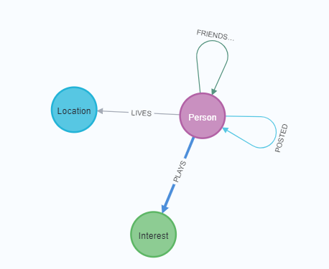
Neo4j’s way of showing pseudo schemas
To visualize the (pseudo) schemas and well as indexes
call db.schema.visualization()
Pseudo schemas for the social graph database

Slide 7
Other Graph Structures
Linked lists for modeling sequences
Tree structures
Time tree was used before indexes on node or edge properties were introduced
Can be used for keeping track of versioning
Notes:
Mentioned by the references in the last slide

Slide 8
Linked List
Need of traversing the sequence
Entities are linked in a sequence
Examples:
A series of events
Episodes of a TV series
Job history
Can add more edges to short cut the traversal
Event 1
Event 2
Event 3
Event 4
NEXT
NEXT
NEXT
Can add other edges to the first event, the last event, or some event in between

Slide 9
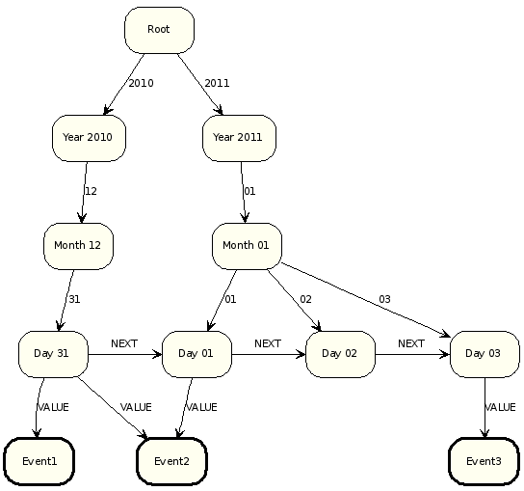
TREE STRUCTURE of TIME
Neo4j Manual
Time tree

Slide 10
Query Execution plans in NEo4j
To see a query execution plan without executing the query, explain [query]
Ex: explain match (n:User) return n
profile [cypher query] // will execute the query and show the plan and the time
Ex: profile match (n:User) return n

Slide 11
Indexing in Neo4j
To see indexes
SHOW INDEXES
Label index
Automatically created when creating a label
Other indexes --- called schema index
Unique index created automatically with the constraint unique
To create a schema index,
Single-property index
create index suppliersIdx for (s:Suppliers) on (s.sname)
drop index suppliersIdx
Current version allows multiple attributes (composite index)
See different types of indexes: https://neo4j.com/docs/cypher-manual/5/indexes-for-search-performance/#administration-indexes-types
Notes:
CREATE INDEX usrIdx FOR (u:User)
ON (u.name, u….);
Older version allows only one attribute as the search key attribute
call db.indexes() // depreciated; was used to see all the indexes

Slide 12
When index is used?
Automatically used for equality comparison of an attribute and a value without any function performed on the attribute
match (n:User) where n.name='Pak' return n;
Automatically used for the in operator
match (n:User) where n.name in ['Pak'] return n;
When specified in the query
match (n:User) using index n:User(name) where n.name='Pak' return n;
See Neo4j cheat sheet for the current version of other ways indexes are used
Notes:
Hint to use an index can be done in MySQL as well.

Slide 13
Final Thoughts
Compare and contrast among the property graph data model , the relational data model, and the entity-relationship model.
Similarities and differences between SQL and Cypher queries
How can a relational DBMS offer graph traversal?
When is it better to use a graph data model or a relational data model?

