Slide 1
More complex Cypher statements Some of these statements are obsolete Check Neo4 cheat sheet for more up-to-date Information

Slide 2
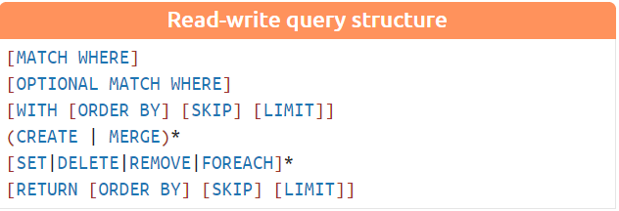
https://neo4j.com/docs/cypher-refcard/current/

Slide 3
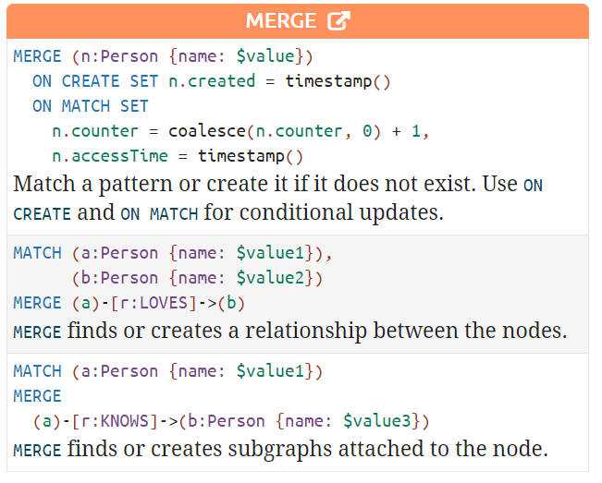
MERGE
See the class activity for loading data from csv files.
https://neo4j.com/docs/cypher-refcard/current/

Slide 4
MATCH with Delete
// Delete all nodes and edges
MATCH (n)
OPTIONAL MATCH (n)-[r]-()
DELETE n, r
Optional Match allows unmatched nodes or edges; what does not match is treated as null
// Remove the label person from any node
MATCH (n)
REMOVE n:Person
MATCH (n) where n.name is null delete n; // delete nodes with an undefined name
MATCH(n) where n.name=’null’ delete n; // delete nodes with the name value is a string ’null’.
Notes:
Try these queries on the social graph database you create for class participation

Slide 5
Modification of properties
SET (and REMOVE): Set values to properties and add labels on nodes using SET and use REMOVE to remove them.
match (n) set n.count=3 // set the count property value to 3
match (n) set n :newLabel return n; // add a newLabel to all the matching nodes
MATCH (n:Person) remove n:Person; // remove the Person label from all the nodes that used to have the Person label

Slide 6
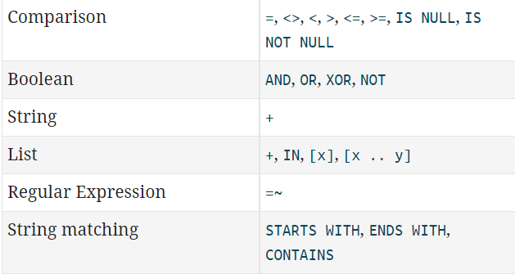
MATCH with a WHERE clause
// find nodes whose the name property value is either James or Liam
Match (n:Person) where n.name= 'James' or n.name='Liam' return n
https://neo4j.com/docs/cypher-refcard/current/

Slide 7
MATCH WITH Order by/LIMIT/SKIP
MATCH (n) RETURN n ORDER BY n.name // Order nodes in ascending order by name
MATCH (n) RETURN n ORDER BY n.age, n.name // Order first by age and then name
MATCH (n) RETURN n ORDER BY n.name DESC // Order nodes by name in descending order
match (n) return n order by n.name skip 2 limit 2
Skip the first two results
Return only two results

Slide 8
Graph STRUCTURE queries
// Find paths from James to his friends as well as his friends of friends
MATCH p= (a:Person{name:'James'})-[:FRIENDSHIP*1..2]->(x) RETURN p
// Find paths from James to his 2-hop friends
MATCH p= (a:Person{name:'James'})-[:FRIENDSHIP*2]->(x) RETURN p
Notes:
*1..2 variable length path from 1 to 2 hops
*2 just 2 hop path
(n)-[*]->(m) Variable length path of any number of relationships from n to m

Slide 9
Single shortest path
Find the shortest path between src and dst nodes within 5 hops
MATCH (src:Person {name:"James"}) match (dst:Person {name:"Carrie-Anne Moss" }), p = shortestPath((src)-[*..5]-(dst)) RETURN p
All shortest PAThs
MATCH (j:Person {name:"James" }) match (l:Person{name: 'Lana Wachowski'}), p = allshortestPaths((j)-[*..5]->(l)) RETURN p

Slide 10
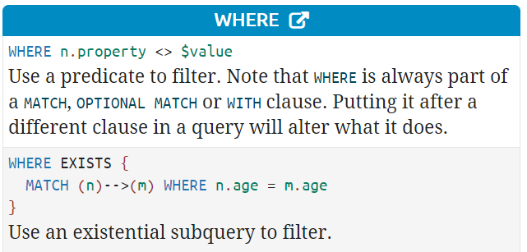
WHERE clause & NOT
Find all nodes without incoming/outgoing edges of any relationship
MATCH (n)
WHERE NOT (n)-->()
RETURN n

Slide 11
Aggregation used in return statement or with statement
MATCH (n{name:'James'})-[:FRIENDSHIP]->(x) RETURN count(*)
// only if n.property is an integer or real number attribute
MATCH (n:Person) RETURN sum(n.property) // Returns the sum of all the values in the property
MATCH (n:Person) RETURN avg(n.property) // Returns the avg of all the values in the property
MATCH (n:Person) RETURN max(n.property) // Returns largest of all the values in the property
MATCH (n:Person) RETURN min(n.property) // Returns smallest of all the values in the property

Slide 12
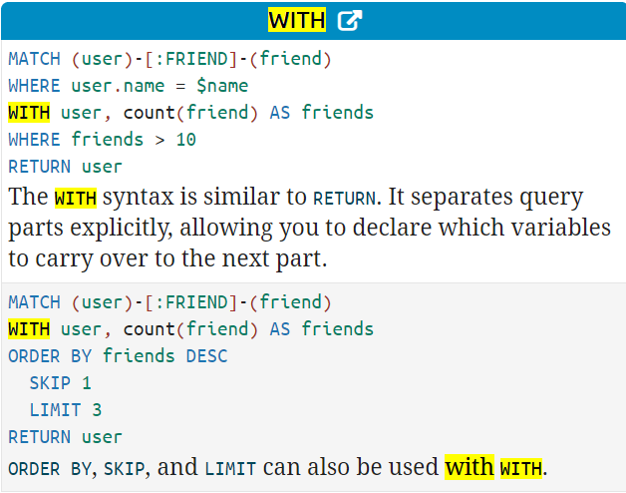
WITH clause
Automatic grouping when used with any aggregation
with <node/edge variable>, <aggregate function>
With <attribute>, <aggregate function>
Chain query sub-parts together
Only use with to extend what you really need, once you use “with” you need a new alias for the aggregated attribute
https://neo4j.com/docs/cypher-refcard/current/
Notes:
Grouping by node or edge variable is like grouping by a system-generated node id or edge id.

Slide 13
ODDS and ENDS
Keep the where clause closest to the related match()
If after “with” is an aggregation function (e.g., count()), the function is applied using the attributes before (and after?) the aggregation function for grouping

Slide 14
COLLECT
MATCH (n) where n.name <> 'null' with n order by n.name DESC return collect(n.name)
[World, Pernilla, John, John, James, David, Adam]
collect() combines all the results into a list, ignoring 'null'

