Slide 1
Query Execution Plans
Index-only access path and plans involve multiple relations

Slide 2
Index-only access path
Use only the index to answer the query
No need to retrieve data records since the data entries in the index contain all attributes needed for this query.
Conditions of Use:
All attributes mentioned in the query (SELECT, WHERE, GROUP BY, HAVING) are included in the search key for some dense index on the relation in the FROM clause.
Dense index means one data entry per data record
Sparse index means one data entry per page (having more than one record)

Slide 3
Plan using index only access path
Retrieve only data entries of the index
Suppose we have a dense index on saliors (rating, sid, age)
Example:
select rating, count(sid)
from sailors
where rating > 5 and age = 20
group by rating
index only

Slide 4
When using index may not be faster than full table scan?
If there are a large percentage of rows (in the relation) that satisfy the condition, the selectivity is large
Selectivity = Number of output rows/Number of input rows
Selectivity of
SELECT *
FROM EMP
WHERE DNO=10
= Number of rows with DNO=10
_________________________
Number of rows in EMP
If selectivity is closer to 1, a full table scan may be cheaper.

Slide 5
Queries involving multiple relations

Slide 6
Join Algorithms
Page-at-a-time Simple Nested Loops Join
Block Nested Loops Join
Indexed Nested Loops Join
Hash Join
Sort-Merge Join
…
Most DBMS supports variants of nested loops join algorithms

Slide 7
Relational algebra expressions when you have R inner join S on R.A=S.B; they both give the same results
R
S
S
R
R.A=S.B
S.B=R.A
Two plans if the simple nested loops join algorithm is supported; disk I/O costs are different.
Plan 1
Plan 2
(page at a time simple nested loops)
(page at a time simple nested loops)
R.A=S.B
S.B=R.A
R
S
S
R
R is on the left of the join operator; it is called the outer relation
S is on the right of the join operator; it is called the inner relation

Slide 8
Buffer Manager
Page Requests from Higher Levels
BUFFER POOL
disk page
MAIN MEMORY
free frame
DISK
DB
Use DB Buffer Pool for join operations

Slide 9
Page at a time Simple Nested Loops Join
Plan 1
(simple nested loops)
Memory
R.A=S.B
join condition R.A=S.B (e.g., Recipe.fid=Food.fid)
foreach page in R do // R: outer relation
foreach page in S do // S: inner relation
foreach r tuple in the buffer for R
foreach s tuple in the buffer for S
if r.A == S.B then add <r, s> to output buffer
1 page for R
R
S
1 page for S
R is the outer relation
S is the inner relation
Smaller cost when putting the smaller relation as the outer relation!
Whenever the output buffer is full, output the result
1 page output
Let |R| denotes the number of pages in R.
The entire R is scanned only one time.
The entire S is scanned |R| times.
Disk I/O Cost = |R|+|S|*|R| pages

Slide 10
Block Nested Loops Join
join condition R.A=S.B
Memory
Load B-2 pages of R from disk into the memory buffer pool
foreach block of B-2 pages of R do
foreach page of s in S do
// in memory
foreach r tuple in the buffer for R
foreach s tuple in the buffer for S
if r.A == S.B then add <r, s> to the output buffer
B-2 pages for R
R
(smaller relation)
Whenever the output buffer is full, output the result
Bring the bigger relation S one page at a time.
1 page for S
Optimal if the smaller of the two relations fit in B-2 pages of the memory
Output buffer
1 page
Cost=|R|+|S|*
B: Available memory in pages in the database buffer pool

Slide 11
If there are relevant indexes, there are more query execution plans.
Relational algebra expression when you have R inner join S on R.A=S.B
R
S
R.A=S.B
More plans if indexed nested loops join is supported by the DBMS
The number of additional plans depends on the number of indexes on the join attributes
Plan 3 if there is an index with S.B as the first attribute
Plan 4 if there is an index with R.A as the first attribute
(indexed nested loops join)
using index on S.B
(index nested loops join)
using index on R.A
R.A=S.B
S.B=R.A
R
S
S
R
For each row of R, R.A value is used to search for rows in S with the values of S.B=R.A
For each row of S, S.B value is used to search for rows in R with the values of S.B=R.A

Slide 12
Indexed Nested Loops Join
join condition R.A=S.B (e.g., Recipe.fid=Food.fid)
foreach page of R in R do // R: outer relation; bring in from disk one page at a time
foreach tuple r in the buffer for R do
use the value of r.A to search the index built on S.B
for all matching s tuples in S
add <r, s> to the output buffer
output the result whenever the output buffer is full
Memory
1 page for R
1 page for S
1 page output
Considered only when there is an index on either R.A or S.B
The one with the index on the joining attribute is used as the inner relation
Cost depends on what index is used
Notes:
1.2 I/O per tuple is typically used for hash-based index using alternative (1)
Use the

Slide 13
Selectivity of a join of two relations R and S
= Number of rows as a result of the join
_____________________________
Number of rows in R (|R|) x Number of rows in S (|S|)
R has 1000 rows
S has 1000 rows
Suppose R joins S output 10 rows
Selectivity = 10/(1000x1000)
SELECT *
FROM R, S
WHERE R.rid=S.rid;

Slide 14
Relational algebra expression for two join operators
DBMS generates left deep plans for a query involving more than two relations
(R
S)
Z
R.A=S.B
S.C=Z.D
(join algorithm)
S.C=Z.D
(join algorithm)
R.A=S.B
… Other left deep plans
R
S
Z
A left deep plan is a query execution plan where the right operand of each join operator must be a relation not an output from another operator

Slide 15
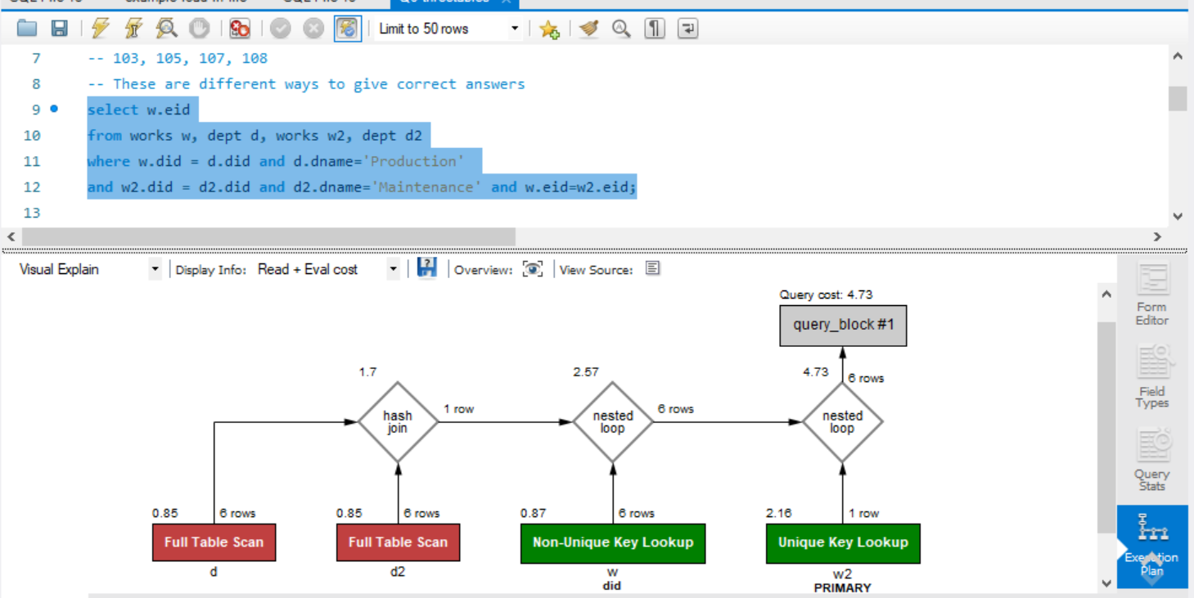
MySQL example
Notes:
D and d2 do not match on any attribute. This hash join is probably a cartesian product of d and d2.
Index nested loop joins are used to join with w using the index w.did (created because the foreign key constraint). The result is joined with w2 using index nested loops join using the primary index on w2.

Slide 16
Extra info
Enumeration of Left-Deep Plans
Pass I: Enumerate all single-relation plans.
Retain the cheapest plan(s) for each relation.
Cheapest plan where tuples are not in any order (Plan A).
Cheapest plan where tuples are in a sort order (Plan B) if exists
If plan B is cheaper than plan A, retain only plan B.
Left deep plan is a query execution plan where the right operand (input) of each join operator must be a relation

Slide 17
Extra info
Enumeration of Left-Deep Plans (Cont’d)
Pass II:
Generate all two-relation plans by considering each single-relation plan after Pass I as the outer relation and every other relation as the inner relation.
For each join method, determine the best access method for B. Consider the plans that involve the join attribute of B.
If a sort-merge join is used and the access method for B does not produce the result in a sorted order according to the join attribute of B, a cost of sorting must be included.
More pass is required if you have more relations left to be joined

