Slide 1
Complex SQL Queries (Part 2)
Queries involve group by and having clauses
Queries involve sub-queries in and exists
Queries involve set operations
Disclaimer: Lecture notes are provided as is. They are intended for personal use by students of COMS 363 Fall 2022. They are not to be posted publicly or shared with anyone outside of this class without the instructor’s written permission.
Reference:
Chapter 5 of Database Management Systems, 3rd edition by Ramakrishnan and Gherke, McGraw-Hill Higer Education, 2003.
Some slides by Profs. Thitivatr Patanasakpinyo and Kien A. Hua

Slide 2
Group By, Having, Set operators

Slide 3
GROUP BY and HAVING
So far, we’ve applied aggregate operators to all (qualifying) tuples (i.e., the tuples that satisfy the condition(s) in the WHERE clause.
Sometimes, we want to apply them to each of several groups of tuples. We use the group by clause.
We use the having clause to select some group that satisfies the condition.

Slide 4
SELECT [DISTINCT] target-list
FROM relation-list
WHERE qualification
GROUP BY grouping-list
HAVING group-qualification
The target-list contains
(i) attribute list
(ii) Aggregate functions (e.g., MIN (S.age)).
****The attribute list (i) must be a subset of the grouping-list.
Intuitively, each answer tuple corresponds to a group, and these attributes must have a single value per group. (A group is a set of tuples that have the same value for all attributes in grouping-list.)

Slide 5
GROUP BY and HAVING CLAUSES
Emp(eid, ename, salary)
GROUP BY | Specify the grouping-list to apply an aggregation function per group | GROUP BY eid GROUP BY ename
HAVING | Specify group-qualification when you want to use an aggregation function GROUP BY must be used | HAVING COUNT(*) > 5 HAVING AVG(Salary) > 200000
Important: Unlike the where clause condition, the condition in the having clause is for the whole group.
The above example will only return the group where the average salary of the people in that group is more than $200K.

Slide 6
Conceptual Evaluation with Group By and Having Clauses
SELECT [DISTINCT] target-list
FROM relation-list
WHERE qualification
GROUP BY grouping-list
HAVING group-qualification
The cross-product of relation-list is computed.
Tuples (rows) that fail qualification are discarded.
Unnecessary fields are deleted, and the remaining tuples are partitioned into groups by the value of attributes in the grouping-list. Each group has the same value of these attributes.
The group-qualification is then applied to eliminate some groups. Expressions in group-qualification must have a single value per group!
In effect, an attribute in group-qualification that is not an argument of an aggregate operation also appears in grouping-list.
One answer tuple is generated per qualifying group.

Slide 7
SET OPERATORS

Slide 8
SET OPERATORS
Used when the set operands are union compatible
Same number of columns
Corresponding columns have the same data type
Unlike basic SQL queries,
Duplicates are eliminated
To allow duplicates
Use UNION ALL, INTERSECT ALL, or EXCEPT ALL
Existing DBMS do not implement all of what are in SQL standards

Slide 9
Syntax & Meanings (Set)
Syntax | Meaning | Example
UNION | Union two result sets using union properties; duplicates are eliminated Important: The two sets must be union compatible. | SELECT e1.eid FROM Emp e1 WHERE e1.Salary > 20000 UNION SELECT e2.eid FROM Emp e2 WHERE e2.Salary <= 75000
UNION ALL | Same as UNION, but duplicates are not eliminated.
13

Slide 10
Syntax & Meanings (Set)
Syntax | Meaning | Example
INTERSECT | Return results that are in both sets. The two sets must be union compatible. Duplicates are eliminated. For two different people who satisfy the query, but have the same name, the query will return only one row with that name. | SELECT e1.ename FROM Emp e1 WHERE e1.Salary > 20000 INTERSECT SELECT e2.ename FROM Emp e2 WHERE e2.Salary <= 50000
INTERSECT ALL | Same as INTERSECT, but duplicates are not eliminated.
MySQL does not support INTERSECT
13

Slide 11
Syntax & Meanings (Set)
Syntax | Meaning | Example
EXCEPT (MINUS) | Return the results that are only from the first set. The two sets must be union compatible. Duplicates are eliminated. The example returns the names of employees whose salary is greater than 50000 | SELECT e1.ename FROM Emp e1 WHERE e1.Salary > 20000 EXCEPT SELECT e2.ename FROM Emp e2 WHERE e2.Salary <= 50000
EXCEPT ALL | Same as EXCEPT, but duplicates are not eliminated.
Some DBMS implement EXCEPT; some implement MINUS; they give the same result.
13

Slide 12
Nested Queries
A nested query is a query that has another query embedded within it (a WHERE clause, a FROM clause, and a HAVING clause)
The embedded query is called a subquery.
IN | Return true when the attribute value is a member of the specified set generated from the subquery | WHERE eid IN (SELECT eid FROM Emp WHERE salary < 50000)
EXISTS | Return true when there exists a member in the result set of the subquery. | WHERE EXISTS (SELECT * FROM Dept)

Slide 13
EXISTS with Correlation
Find the names of all employees who work in department with did of 2.
SELECT e.ename
FROM Emp e
WHERE EXISTS (SELECT *
FROM works w
WHERE w.did=2 AND w.eid=e.eid)
Outer query
Inner query or subquery
Notice that e in the subquery is defined in the outer query. This is where correlation occurs
The subquery is evaluated for each row in Emp.
Notes:
Select e.ename
From emp e, works w
where e.eid=w.eid and w.did=2

Slide 14
EXISTS without Correlation
SELECT e.ename
FROM Emp e
WHERE EXISTS (SELECT *
FROM works w
WHERE w.did=2)
Outer query
Inner query or subquery
The subquery does not use any table in the from clause of the outer query.
As long as there are some employees who work in department with did=2, the subquery returns true and the query returns all the employee names regardless of which department they work for.

Slide 15
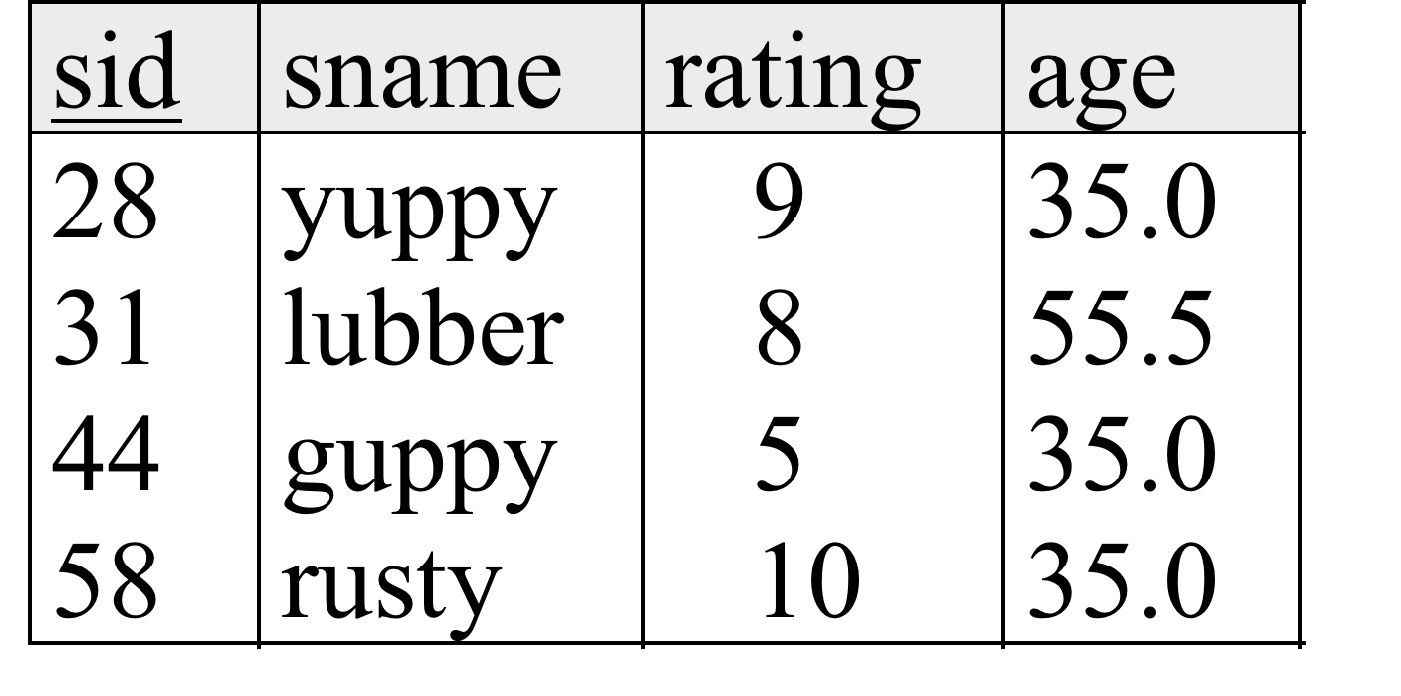
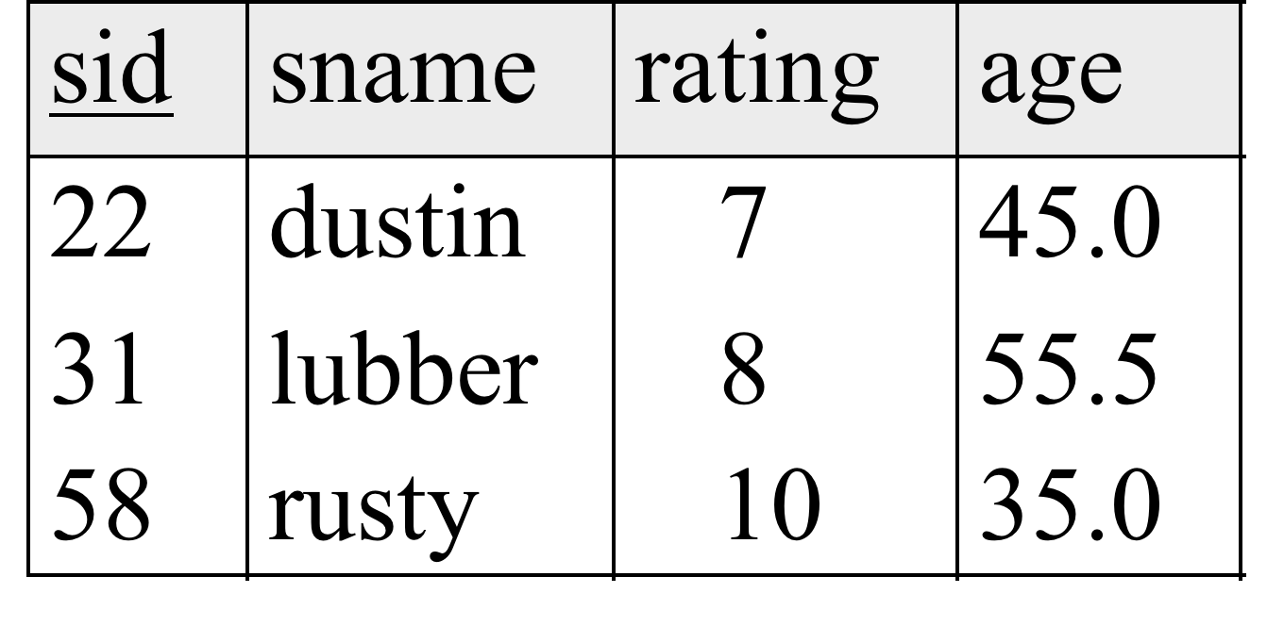
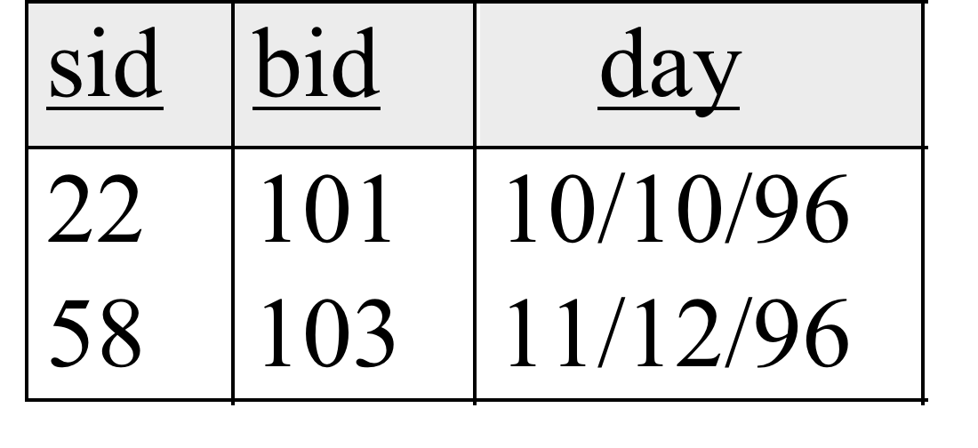
MORE EXAMPLES
Sailors(sid integer,sname char(10),rating integer, age real, primary key(sid))
Boats(bid integer,bname char(10),color char(10), primary key(bid))
Reserves(sid integer,bid integer,day date, primary key(sid, bid, day), foreign key(sid) references Sailors(sid), foreign key(bid) references Boats(bid))
S1: Sailors
instance
R1
B1
S2: Sailors instance at a different time
Notes:
create table sailors (sid integer, sname char(10), rating integer, age real, primary key(sid))
create table Boats (bid integer, bname char(10), color char(10), primary key (bid))
create table reserve(sid integer, bid integer, day date, primary key(sid,bid,day))
insert into sailors values (22, "dustin", 7, 45.0);insert into sailors values (31, "rubber", 8, 55.5);insert into sailors values (58, "rusty", 10, 35.0);
insert into boats values (101, "Interlake", "red");insert into boats values (102, "Clipper", "green");insert into boats values (103, "Marine", "red");
insert into reserve (22, 101,"10/10/96");insert into reserve (58, 103, "11/12/96");

Slide 16
EXAMPLE: INNER JOIN
Find names of sailors who’ve reserved boat #103.
SELECT S.sname
FROM Sailors S
INNER JOIN Reserves R
ON S.sid = R.sid
WHERE R.bid=103
Both queries give the same result.
SELECT S.sname
FROM Sailors S, Reserves R
WHERE S.sid=R.sid and R.bid=103
Matching on the foreign key and the primary key is also an inner join

Slide 17
EXAMPLE: IN
Find names of sailors who’ve reserved boat #103.
SELECT S.sname
FROM Sailors S
WHERE S.sid IN (SELECT R.sid
FROM Reserves R
WHERE R.bid=103)
subquery
or inner query

Slide 18
EXAMPLE: NOT IN
Find names of sailors who’ve not reserved a red boat.
SELECT S.sname
FROM Sailors S
WHERE S.sid NOT IN (SELECT R.sid
FROM Reserves R
WHERE R.bid IN ( SELECT B.bid
FROM Boats B
WHERE B.color='red')
Can you come up with other ways?

Slide 19
EXAMPLE: EXISTS with correlation
Find sailors with at most one reservation for boat #103.
SELECT S.sname
FROM Sailors S
WHERE EXISTS (SELECT distinct R.bid
FROM Reserves R
WHERE R.bid=103 AND S.sid=R.sid)

Slide 20
Can also use NOT IN, NOT EXISTS.
Other operators: op ANY, op ALL
Op can be =, >, <

Slide 21
EXAMPLE: Aggregation functions in the SUBQUERY in the where clause
Find the name and the age of the oldest sailor.
SELECT S.sname, S.age
FROM Sailors S
WHERE S.age= (SELECT MAX(S2.age)
FROM Sailors S2)

Slide 22
EXAMPLE: SUBQUERY in the HAVING clause; condition for the group
Find the rating and the age of the youngest sailor within that rating; the sailors must be over 18 such that for each rating, there are at least 2 sailors (of any age)
SELECT S.rating, MIN (S.age)
FROM Sailors S
WHERE S.age > 18
GROUP BY S.rating
HAVING 1 < (SELECT COUNT (*)
FROM Sailors S2
WHERE S.rating=S2.rating)

Slide 23
EXAMPLE: ANY
Find sailors whose rating is greater than that of some sailor named Horatio.
SELECT *
FROM Sailors S
WHERE S.rating > ANY (SELECT S2.rating
FROM Sailors S2
WHERE S2.sname='Horatio')
Return an empty set if no sailor named Horatio.

Slide 24
EXAMPLE: ALL
Find the sailors with the highest rating.
SELECT *
FROM Sailors S
WHERE S.rating >= ALL (SELECT S2.rating
FROM Sailors S2)
IN is equivalent to = ANY.
NOT IN is equivalent to <>ALL.

Slide 25
EXAMPLE: ALL
Find sailors whose rating is greater than that of every sailor called Horatio.
SELECT *
FROM Sailors S
WHERE S.rating > ALL (SELECT S2.rating
FROM Sailors S2
WHERE S2.sname='Horatio')
Return all rows in Sailors if there are no sailor named Horatio.

Slide 26
How do we represent a graph in RDBMS?
A
How to do graph traversal queries?
E.g., find all nodes reachable from node A.
B
C
D
E
F
G
H
I
SQL does not support recursive queries.

Slide 27
For other complex queries
Stored procedures
Database triggers
API with programming languages
ODBC for C/C++
JDBC for Java
Python
…

