Slide 1
Constraints on Relationships
Recall that constraints on entity sets are primary keys and candidate keys (if exists)
Notes:
Real-world data are complex. We model these constraints to help us truly represent the real-world. For most of these constraints, we can declares them in a model-specific DBMS such as relational DBMS and have the DBMS enforce the constraints for us. As a result, we have data that are less error-prone and avoiding duplicates.

Slide 2

Relationship sets also have constraints. These constraints applies to all the relationships in a relationship set.
Two types of constraints
Structural constraints including key constraint
Participation constraints

Slide 3
Structural Constraints
Cardinality Ratio Constraint specifies the number of relationships that an entity can participate in.
Relationship set is a set of relationships.
When seeing a diamond shape, imagine a set of lines where each line represents a relationship connecting a pair of dots.
Imagine that the dots are the primary key values of the involving entity sets.
Person
Person
mother
child
1-to-1
1-to Many
1:n
Many-to-1
n:1
Many-to-Many
m:n
marriage
Biological mother-child
Child biological-mother
Students-clubs
Notes:
A relationship is an association between two or more entities. And when we see a diamond shape, think about multiple lines in side it where a line represents an association (relationship). We don’t draw out these lines in the ER diagram.

Slide 4
When seeing a `supply` diamond shape, imagine a set of lines representing individual relationships.
Each line connects a triplet of dots representing one primary key value from suppliers, one primary key value from parts, and one primary key value from projects.
N-Way Relationship sets
SID
SNAME
PID
PNAME
Suppliers
supply
Parts
N>=2
Projects
Each supply relationship is uniquely identified by sid, pid, and jid.
JNAME
JID
Supply is a 3-way relationship set
Notes:
When to use 3-way relationship set? When you need all three entity sets in that relationship.

Slide 5
Structural Constraints
For m:n relationships without any other constraints, use a diamond notation without any arrows going into the diamond or any bold lines
A student belongs to zero or more clubs.
A club has zero or more students
SID
NAME
CID
CNAME
Students
Belong_to
On-campus Clubs

Slide 6
Structural Constraints
For 1-to-n or 1-1 relationships, use key constraints. Each key constraint is represented by an arrow originating from an entity set toward the corresponding relationship set.
Key constraint specifies that each entity of an entity set can participate in at most one relationship in a relationship set.

Slide 7
Structural Constraints
Real-world requirement
A department can have at most one manager. In other words, each department can participate at most once in the manage relationship.
An employee can manage several departments.
A specific example
G can manage more than one department
DeptA cannot have more than one manager; same for Dept B
ER diagram
Visualization to help think about these specific examples inside the diamond shape.
since
name
dname
ssn
lot
did
budget
G
DeptA
Manage
Employees
Departments
DeptB
Manage
1:n
Notice the arrow is coming from the n side

Slide 8
Structural Constraints
For 1-to-1 relationships without any other constraints, use the key constraints on both sides.
A department can have at most one manager.
An employee can manage at most one department.
since
name
dname
ssn
lot
did
budget
ER
Employees
Manage
Departments
1:1
****The arrow always points toward a relationship set.

Slide 9
Participation Constraint:
Total participation: Every entity in the entity set must participate in the relationship set.
E.g., Every department must have a manager.
ER-Notation: (bold line)
Partial participation (thin line); not requiring that all entities in the entity set participate
Requirement:
Every department must have at most one manager.
since
name
dname
ssn
lot
did
budget
Employees
Manage
Departments
Requirement:
An employee can manage at most one department.
The bold arrow represents the key constraint and the total participation
of the department entity set

Slide 10
These constraints impact the design of the corresponding relational schemas.
Be sure that your ER model capture all the user’s requirements.

Slide 11
More complex concepts
(Part 2)
Notes:
To discuss in the next class.

Slide 12
Weak Entity Set
A weak entity set is a set of weak entities.
Each weak entity must be associated with exactly one owner entity.
Example: For tax purpose, a child is associated with a person he/she depends on.
Weak entity set does not have its own primary key. It only has a partial key that uniquely identifies each entity within the same owner entity. The partial key is not able to identify each entity in the entire weak entity set.
To uniquely identify a weak entity, we need the primary key of the owner entity together with the weak entity partial key.

Slide 13
Weak Entity Set
A partial key has a dashed underline below the attribute name.
The attribute pname is the partial key of the weak entity set “Dependents”. Dependents of different employees can have the same name.
To uniquely identify each dependent, we need both the employee SSN and pname.
***Notice the key constraint and the total participation from “Dependents”
name
ssn
lot
cost
pname
DOB
Employees
Policy
Dependents
Owner entity set
Identifying relationship set
Weak entity set

Slide 14
ISA (`is a’) Hierarchies
With no other constraints written, this ISA relationship set indicates the following.
An employee cannot be both hourly_emps and contract_emps
There can be other types of employees.
name
ssn
lot
Employees
hourly_wages
hours_worked
ISA
contractid
Hourly_Emps
Contract_Emps
Hourly_Emps ISA Employees; Contract_Emps ISA Employees
ISA notation is used to model the class sub-class relationships.
****Both Hourly_Emps and Contract_Emps have all the attributes of the Employees entity set.
Houly_Emps entity set has two extra attributes, hourly_wages and hours_worked.
Contract_Emps entity set does not have hourly_wages nor hours_worked, but have contractid.

Slide 15
ISA (`is a’) Hierarchies
Reasons for using ISA:
To add attributes specific to a subclass: Eg., only Contract_Emps has contractid
A subclass can participate in relationships that its parent class does not
**** With ISA notation, a sub-class entity set does not need its own primary key. It inherits the primary key from its parent entity set.
In this example, the primary key for Hourly_Emp is SSN.
The primary key for Contract_Emp is SSN.

Slide 16
Constraints on
ISA (`is a’) Hierarchies
name
ssn
lot
Employees
hourly_wages
hours_worked
ISA
contractid
Hourly_Emps
Contract_Emps
Overlap constraints:
Can Joe be an Hourly_Emps as well as a Contract_Emps entity? (Allowed/disallowed)
Covering constraints:
Does every Employees entity also have to be an Hourly_Emps or a Contract_Emps entity? (Yes/no)
Default value: no;
Otherwise write Hourly_Emps and Contract_Emps COVER Employees
Default value: no overlap; otherwise,
write Hourly_Emps OVERLAPS Contract_Emps.

Slide 17
name
Aggregation
ssn
lot
Employees
Aggregation allows us to treat a relationship set as an entity set for the purpose of participating in (other) relationships.
Aggregation is used when we have to model a relationship involving a relationship set.
Monitor
until
started_on
since
dname
pid
pbudget
did
budget
Projects
Sponsor
Departments
Monitor is a distinct relationship, with a descriptive attribute.
Notes:
Observe that the diamond are between two or more rectangles; no diamond shapes connecting other diamond shapes; therefore, we need a dashed rectangle to make the relationship set appear like an entity set.

Slide 18
Considerations when using ER diagram
ER design is subjective. There are often several ways to model a given scenario!
Analyzing alternatives can be tricky, especially for a large enterprise. Common choices include:
Entity vs. attribute, entity vs. relationship, binary or n-ary relationships, whether or not to use ISA hierarchies, and whether or not to use aggregation
Software tools are available, e.g., ERWin (not free), IBM Rational Rose (not free), MySQL Workbench
Many of these tools assume that your data model is going to be mapped to relational database management systems (RDBMS).

Slide 19
Limitations of ER notations
Cannot enforce constraints on individual relationships or entities.
For instance, there are no ER notations for specifying that only a particular employee “A” is allowed to monitor the sponsorship relation of department “COMS” on project “P”?
Currently, no DBMS that directly implement ER model. So, we need to convert an ER diagram to another data model with DBMS support.

Slide 20
Final Thoughts
Other books use slightly different notations
Commercial software uses slightly different notations for drawing relationship sets
Extended ER diagrams may include data types for each attribute; they are used for converting the diagram to DBMS specific data models

Slide 21
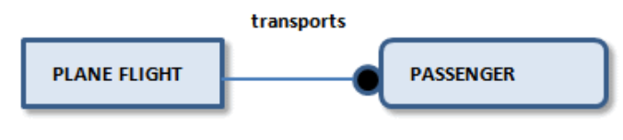
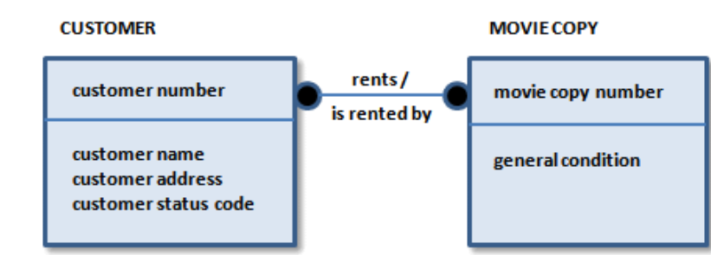
Example of ERWIN ER notations
1:n identifying relationship is represented by
Weak entity set
m:n is represented by
Notes:
Round cornered rectangle represents a weak entity set

Slide 22
Use Ramakrishnan’s notations for all exercises, assignments, and exams

