Slide 1
SEED Workshop
Buffer Overflow Lab

Slide 2
Outline
Principle
High Level Picture
Program Memory Layout
Function Stack Layout
Function Call Chain
Practice
Vulnerable Program
Task Breakdown
Environment Setup
Run Tasks
Run the Exploit

Slide 3


High Level Picture

Slide 4



High Level Picture

Slide 5


High Level Picture

Slide 6


High Level Picture

Slide 7

High Level Picture

Slide 8



High Level Picture

Slide 9

High Level Picture

Slide 10


High Level Picture

Slide 11
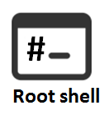
High Level Picture

Slide 12
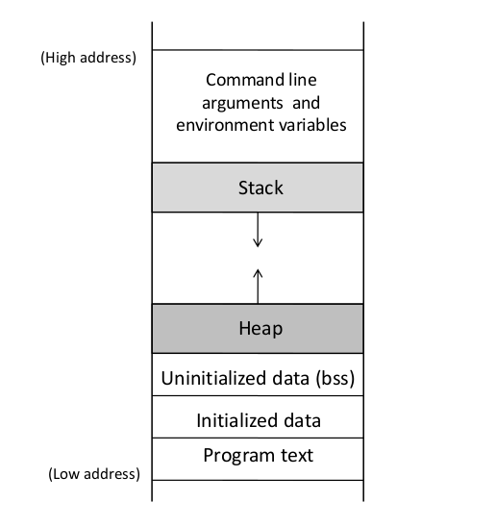
Principle
Program Memory Layout

Slide 13
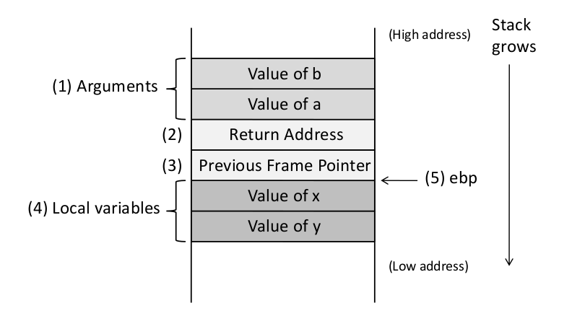
Function Stack Layout
void func(int a, int b)
{
int x,y ;
}

Slide 14
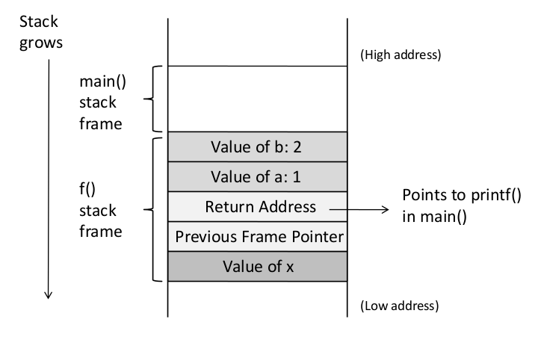
Function Call Chain
void f(int a, int b)
{
int x;
}
void main()
{
f(1,2);
printf("hello world");
}

Slide 15
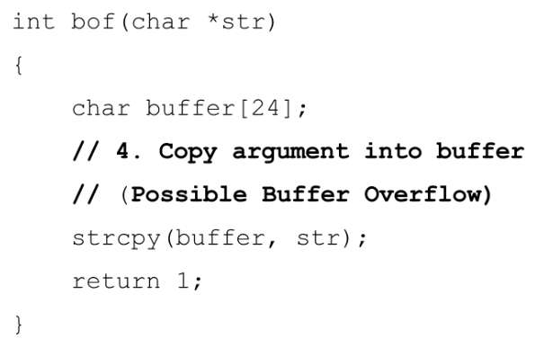
Practice
Vulnerable Program (stack.c)
int main(int argc, char **argv)
{ char str[517];
FILE *badfile;
// 1. Opens badfile
badfile = fopen("badfile", "r");
// 2. Reads upto 517 bytes from badfile
fread(str, sizeof(char), 517, badfile);
// 3. Call vulnerable function
bof(str);
printf("Returned Properly\n");
return 1;
}

Slide 16
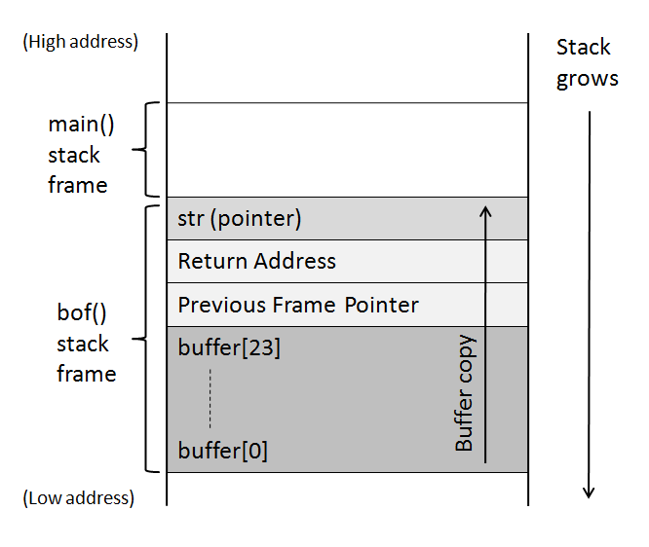
Buffer Overflow in stack.c

Slide 17
Program Behavior
Show program behavior for badfile of length:
< 24 bytes
> 24 bytes

Slide 18
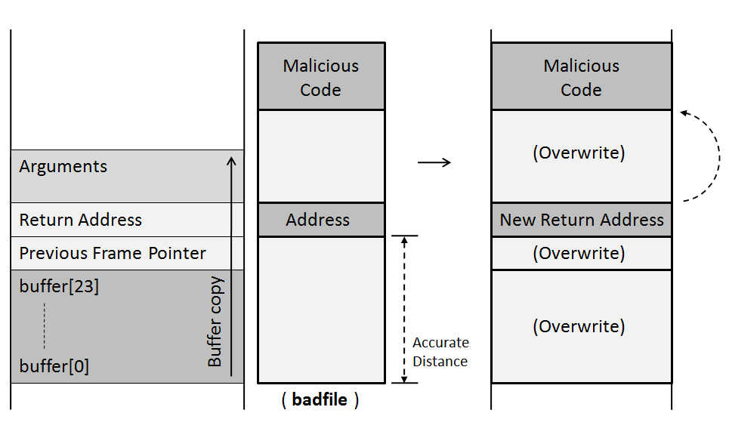
Goal

Slide 19
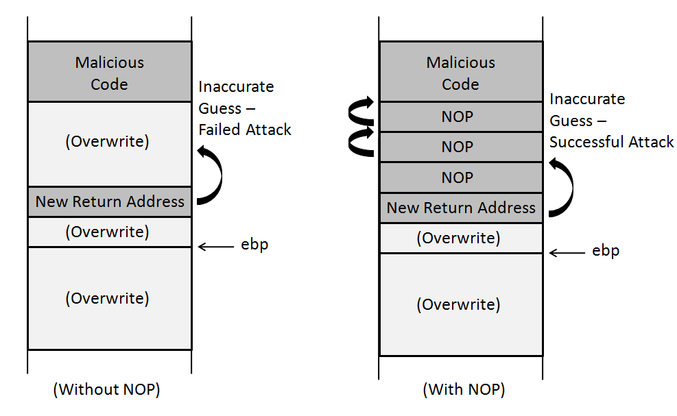
Use of NOP’s

Slide 20
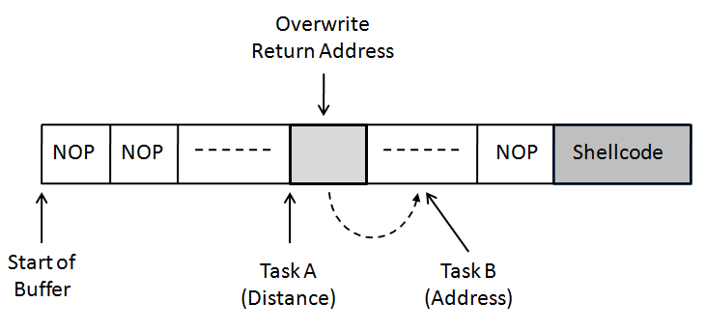
Task Breakdown - Prepare “badfile”

Slide 21
Environment Setup for Tasks
Turn off address randomization (countermeasure)
% sudo sysctl -w kernel.randomize_va_space=0
Compile set-uid root version of stack.c
% gcc -o stack -z execstack -fno-stack-protector stack.c
% sudo chown root stack
% sudo chmod 4755 stack

Slide 22
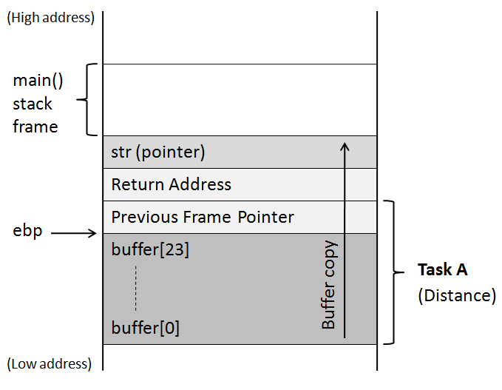
Goal - Task A

Slide 23
Goal - Task A

Slide 24
Goal - Task A
Need for debugging
Buffer size may exceed 24 bytes at run time
Need accurate buffer size

Slide 25
Goal - Task A
Need for debugging
Buffer size may exceed 24 bytes at run time
Need accurate buffer size
Compile debug version of stack.c
% gcc -z execstack -fno-stack-protector -g -o stack_dbg stack.c

Slide 26
Task A
Start debugging using gdb
Set breakpoint
Print buffer address
Print frame pointer address
Calculate distance

Slide 27
Task Breakdown - Prepare “badfile”

Slide 28
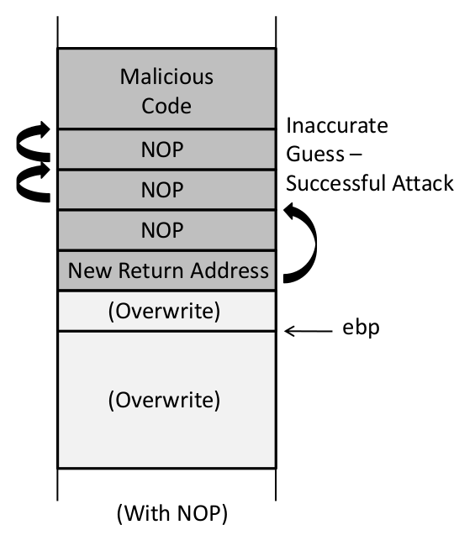
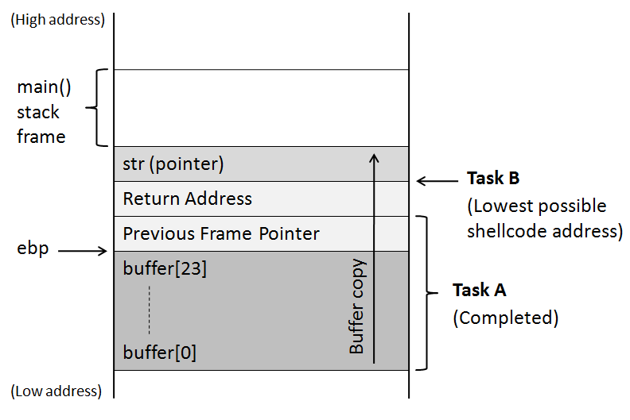
Goal - Task B

Slide 29
Task B

Slide 30
Task B
Calculate lowest address for shellcode
Add offset

Slide 31
Task Breakdown - Prepare “badfile”

Slide 32
Construct the badfile - exploit.c
void main(int argc, char **argv)
{
// Initialize buffer with 0x90 (NOP instruction)
memset(&buffer, 0x90, 517);
// From tasks A and B
*((long *) (buffer + <distance - task A>)) = <address - task B>;
// Place the shellcode towards the end of buffer
memcpy(buffer + sizeof(buffer) - sizeof(shellcode), shellcode, sizeof(shellcode));
}

Slide 33
Run the exploit
Compile and run exploit.c to generate badfile
Run set-uid root compiled stack.c

Slide 34
Countermeasures
ASLR
StackGuard
Non-Executable (NX) Stack
For each of these, refer to lab description or research.

