Slide 1
Overview
The objective of the website is to allow users to comfortably prepare and continue their university life.
A course selection tool will help them decide their courses, alongside a timetable page so they can make sure that it works for them.
The user will have a task manager to make sure they know what they have to do and not get stressed by workload.
On top of this, their will be a page for frequently asked questions for getting help.
Overall, this website aims to make the educational university experience an easier time.

Slide 2

Name: Zihao Li Age: 18 Gender: Male region: easterner
Persona-1
Introduction
He is an international student from a non-English speaking country, and this is his first time studying abroad. He usually enjoys sports and is social. He is fluent in the basic functions of a computer and has learned a simple programming language…
Scenario
He had the experience of choosing courses at school in high school when there were very few options available, so it was easy to complete the selection process, especially since the language used was his native language. However, he is finding it hard to manage the timings and find the correct courses for himself in a different country and is looking for a simple way to manage his education.

Slide 3

Name: Anong Age: 18 Gender: Female region: easterner
Persona-2
Introduction
She is a non-native English-speaking international student, and her religion is Buddhism. She has had previous experience of studying abroad. Her hobbies include reading and fitness, and she is not very good at making friends with others. She does not use computers much, so she is not sure about the basic operation and logic of computers…
Scenario
During her high school years, she undertook her studies in Canada. The school had a wide range of elective courses, and she had a lot of trouble choosing them, which did not go well. She has decided that she is going to try and find a way to make sure she picks her courses well, although she is hoping that the way she finds is easy on a computer.

Slide 4

Name: Daniel Age: 18 Gender: Male region: Westerner
Persona-3
Introduction
He is a native of the UK, where he grew up and went to school. He is very familiar with the British way of teaching and has no language or cultural barriers. He enjoys watching films and playing video games in his spare time. However, he has no interest in computers and only uses them to play games…
Scenario
Daniel grew up in a high school where there was only a set of choices. He did not have to pick his own timetable, that was done by school administrators, so he is not well-versed in organizing his subjects and finds it difficult to manage such a wide range of options. He can't decide what subjects to take, on top of determining if he can avoid timetable clashes. He is looking for an easier way to visualize all his options and their respective time slots.

Slide 5
Specification
User can create, edit, delete an account.
User can sign in and log out of their account.
User can choose available courses which they want.
User can view the real-time situation of the courses selecting.
User can get an own task manager.
User can mark in the task manager.
User can get notification from task manager.
User can search the relative information of their university.

Slide 6

A high-level system architecture diagram
User
Client
Middleware
Database

Slide 7
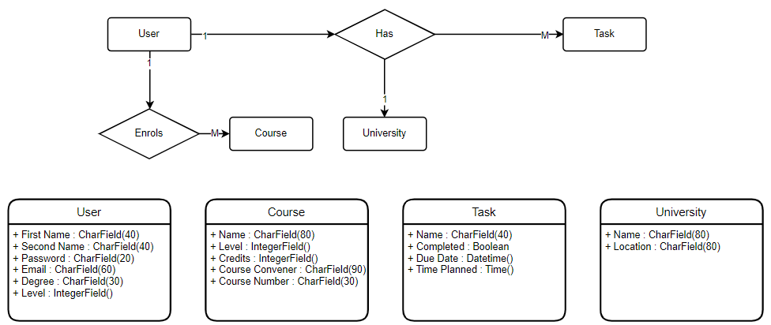
ER Diagram

Slide 8
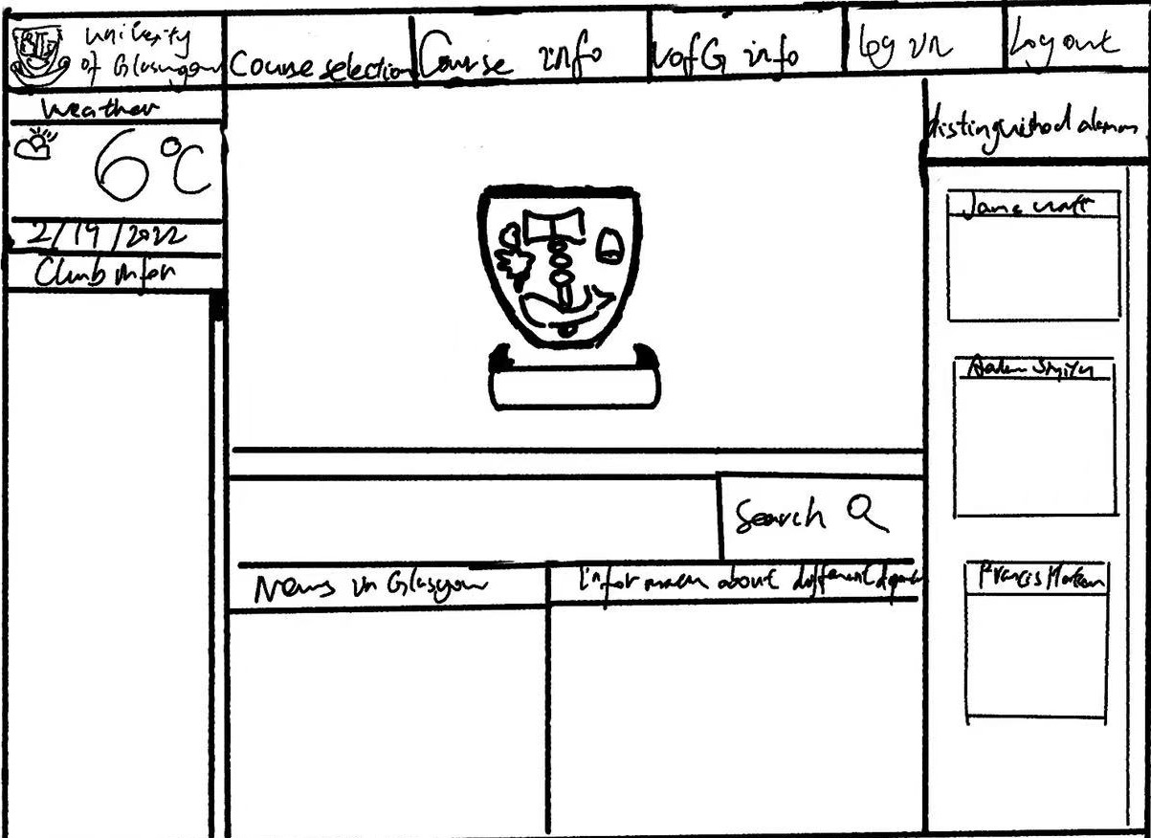
Wireframes

Slide 9
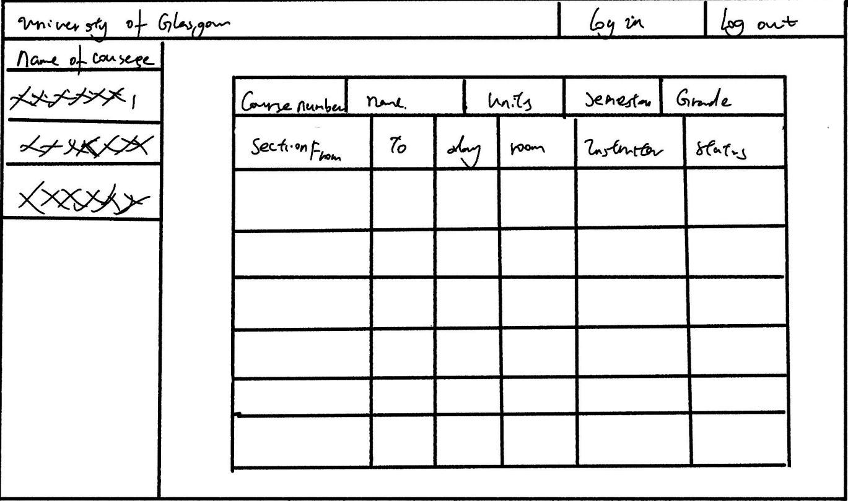
Wireframes

Slide 10
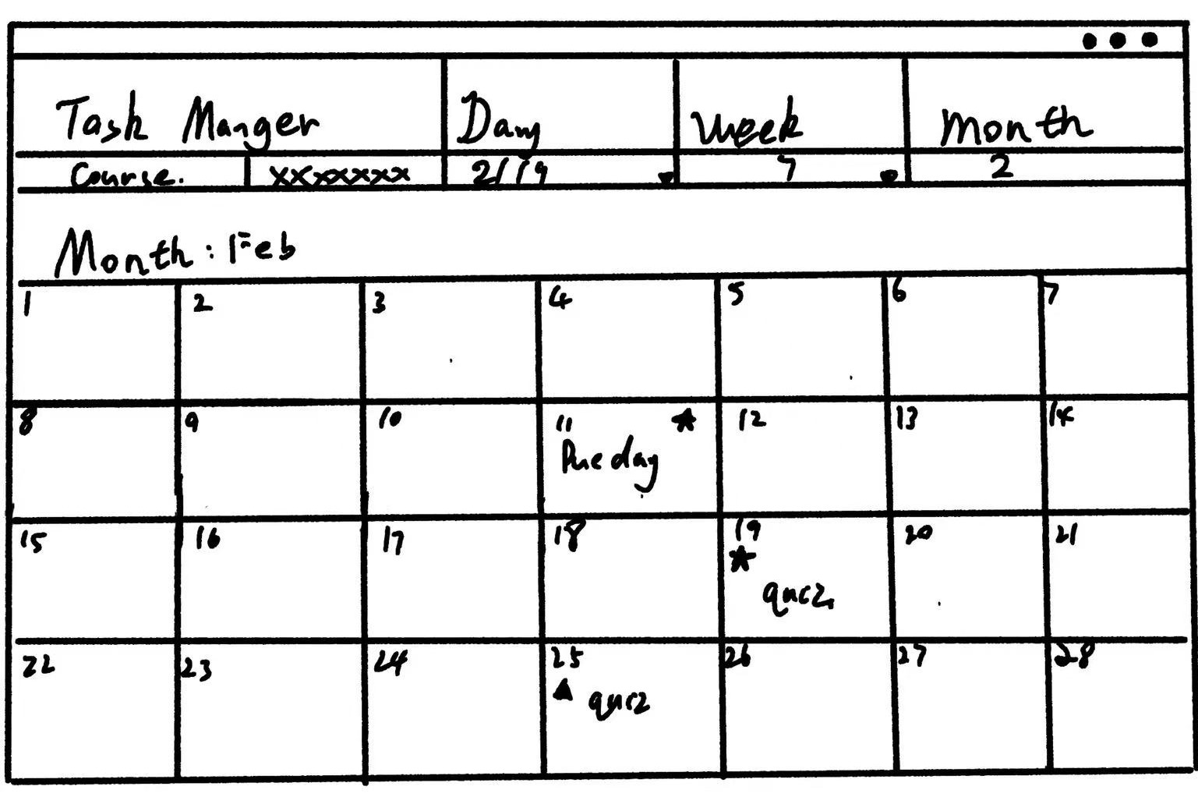
Wireframes

Slide 11
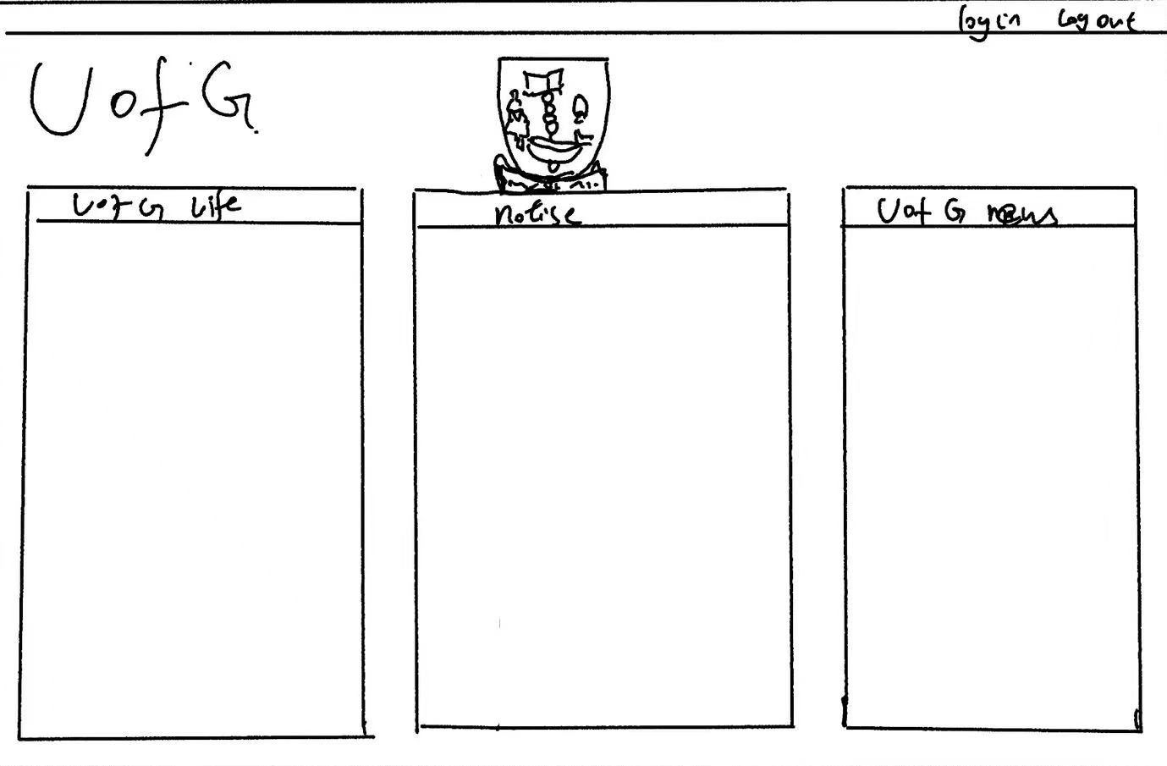
Wireframes

Slide 12
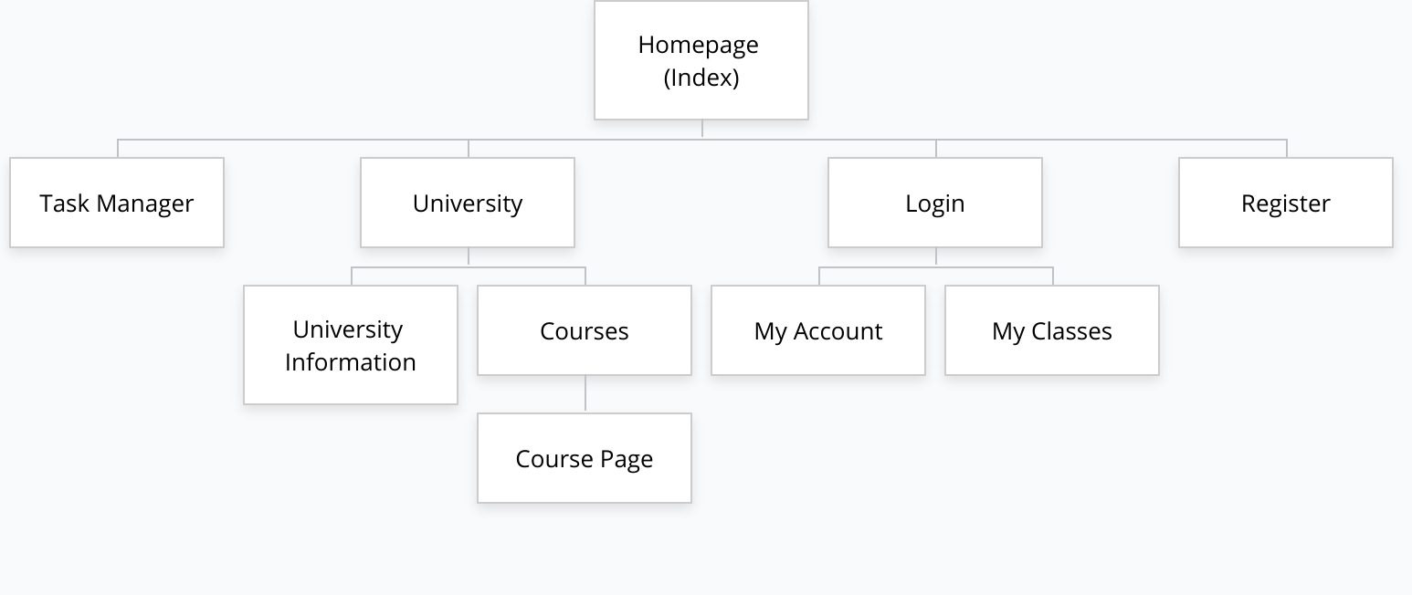
Site Map

Slide 13
Site URL
/taskmanager
/university - /university/courses - /university/courses/course - /university/information
/login - /login/account - /login/classes
/register

