Slide 1
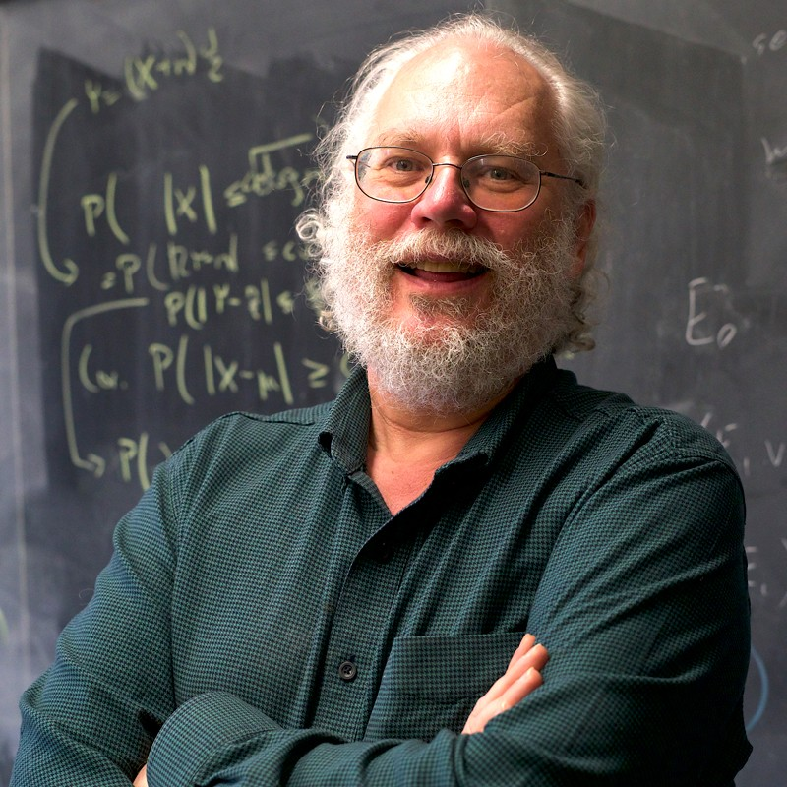

Shor’s Algorithm
15

Slide 2
What Is It?
It factors numbers

Slide 3
RSA
1. Finding factors is hard
2. Using factors is easy

Slide 4
Factoring
N

Slide 5
Factoring
N
O(N)

Slide 6
Factoring
N
n = log2N
O(N)

Slide 7
Factoring
N
n = log2N
O(N)
O(2^{n})

Slide 8
Euclidean Algorithm
- c. 300 BC
- “The Euclidean algorithm calculates the greatest common divisor (GCD) of two natural numbers a and b”

Slide 9
Euler's Theorem
a^{Φ(N)} = 1 (mod N)

Slide 10
Euler's Theorem
a^{x} = 1 (mod N)

Slide 11
Euler's Theorem
a^{x} = 1 (mod N)
a^{x} - 1= 0 (mod N)

Slide 12
Euler's Theorem
a^{x} = 1 (mod N)
a^{x} - 1= 0 (mod N)
(a^{x/2} + 1)(a^{x/2} - 1)= 0 (mod N)

Slide 13
Euler's Theorem
if a^{x} = 1 (mod N) then
there is a high chance
a^{x/2} ± 1 is a factor of N

Slide 14
Finding X
f(x) = a^{x} (mod N)

Slide 15
Finding X

Slide 16
Finding X
f(0) = a⁰ (mod N) = 1

Slide 17
Finding X
f(0) = a⁰ (mod N) = 1
f(r) = f(0+r) = f(0) = 1

Slide 18
Finding r
f(x) = a^{x} (mod N)

Slide 19
Finding r
f(x) = a^{x} (mod N)
U |y> = |ay mod N >
f(x) = U^{x}|y>

Slide 20
Quantum Operator
U |1> = |7>
U² |1> = |4>
U³ |1> = |13>
•
•
•
U^{r-1} |1> = |1>
|y> = |1>
a = 7
N = 15

Slide 21
Super Position
|u0> = U|y> + U²|y> + ••• + U^{r-1}|y>

Slide 22
Super Position
|u0> = 1/sqrt(r) (U|y> + U²|y> + ••• + U^{n-1}|y>)

Slide 23

Super Position
|u0> = 1/sqrt(r) (U|y> + U²|y> + ••• + U^{n-1}|y>)

Slide 24
Super Position
|u0> = U|y> + U²|y> + ••• + U^{n-2}|y> + U^{n-1}|y>
U|u0> = U²|y> + U³|y> + ••• + U^{n-1}|y> + U^{n}|y>
U|u0> = U²|y> + U³|y> + ••• + U^{n-1}|y> + U|y>
U|u0> = U|y> +U²|y> + ••• + U^{n-2}|y> + U^{n-1}|y>
U|u0> = |u0>

Slide 25
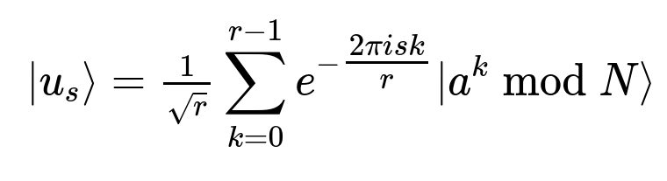
Quantum Fourier Transforms

Slide 26
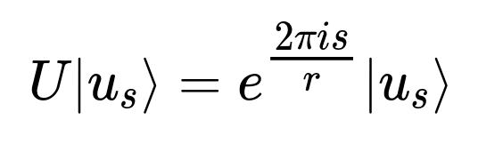
Quantum Fourier Transforms

Slide 27
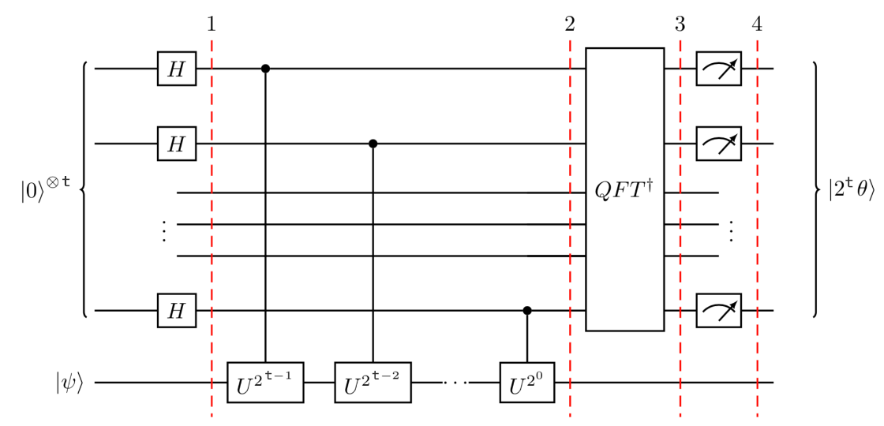
Quantum Phase Estimation

Slide 28
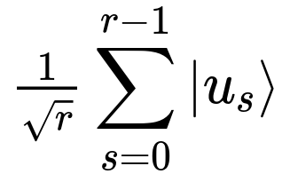
Quantum Phase Estimation

Slide 29
Quantum Phase Estimation
= |1>

Slide 30
Measured Phase
s/r * 2^t

Slide 31
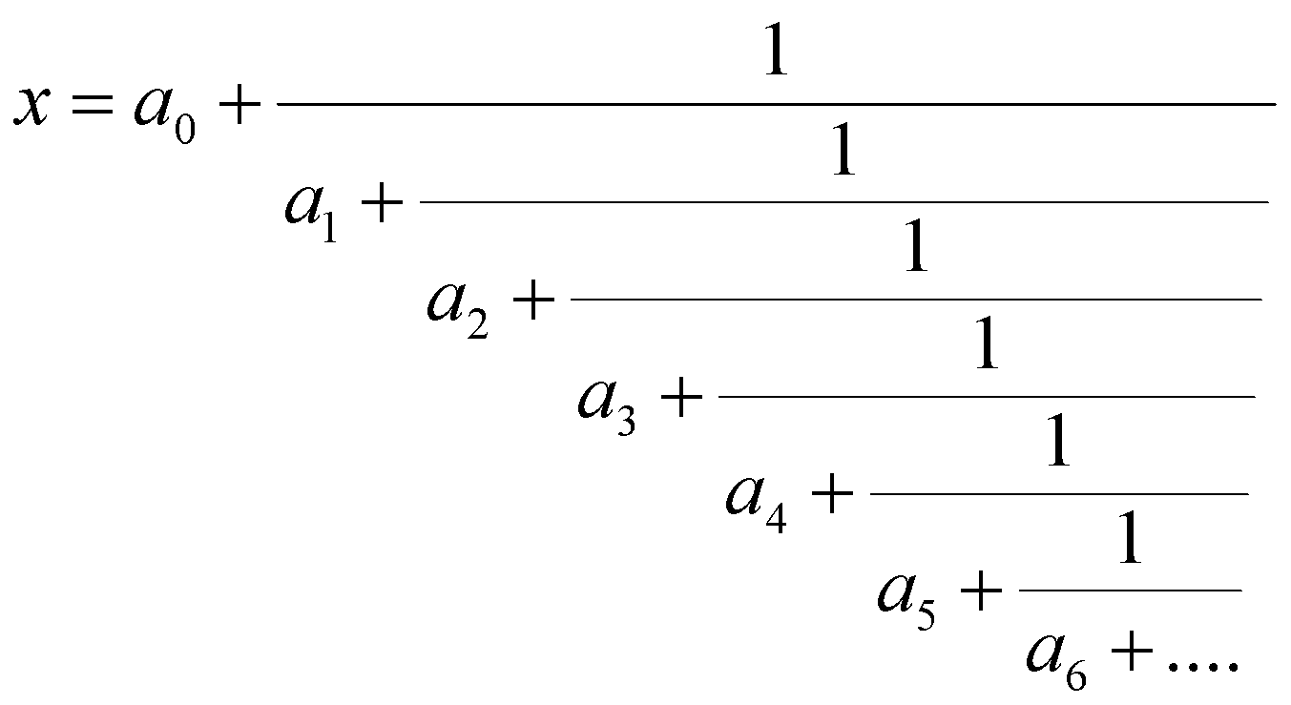
Continued Fractions

Slide 32
Recap
1. Guess some number a
3. Classically check if a is factor
2. Find period of f(x) = a^x (mod N)
3. Check if a^(r/2) ± 1 is factor
4. Repeat

Slide 33
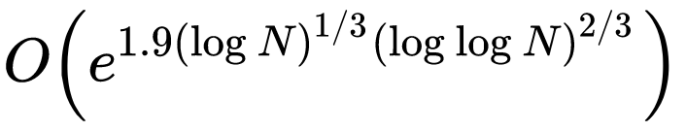
Recap
Classical (GNFS):
Quantum (Shor’s):

Slide 34
Code
github.com/SamScherf/shors-algorithm

Slide 35
Questions

Slide 36
References
1. https://en.wikipedia.org/wiki/Shors_algorithm
2. https://qiskit.org/textbook/ch-algorithms/quantum-fourier-transform.html#generalqft
3. https://qiskit.org/textbook/ch-algorithms/quantum-fourier-transform.html#generalqft
4. https://qiskit.org/textbook/ch-algorithms/quantum-fourier-transform.html

