Slide 1
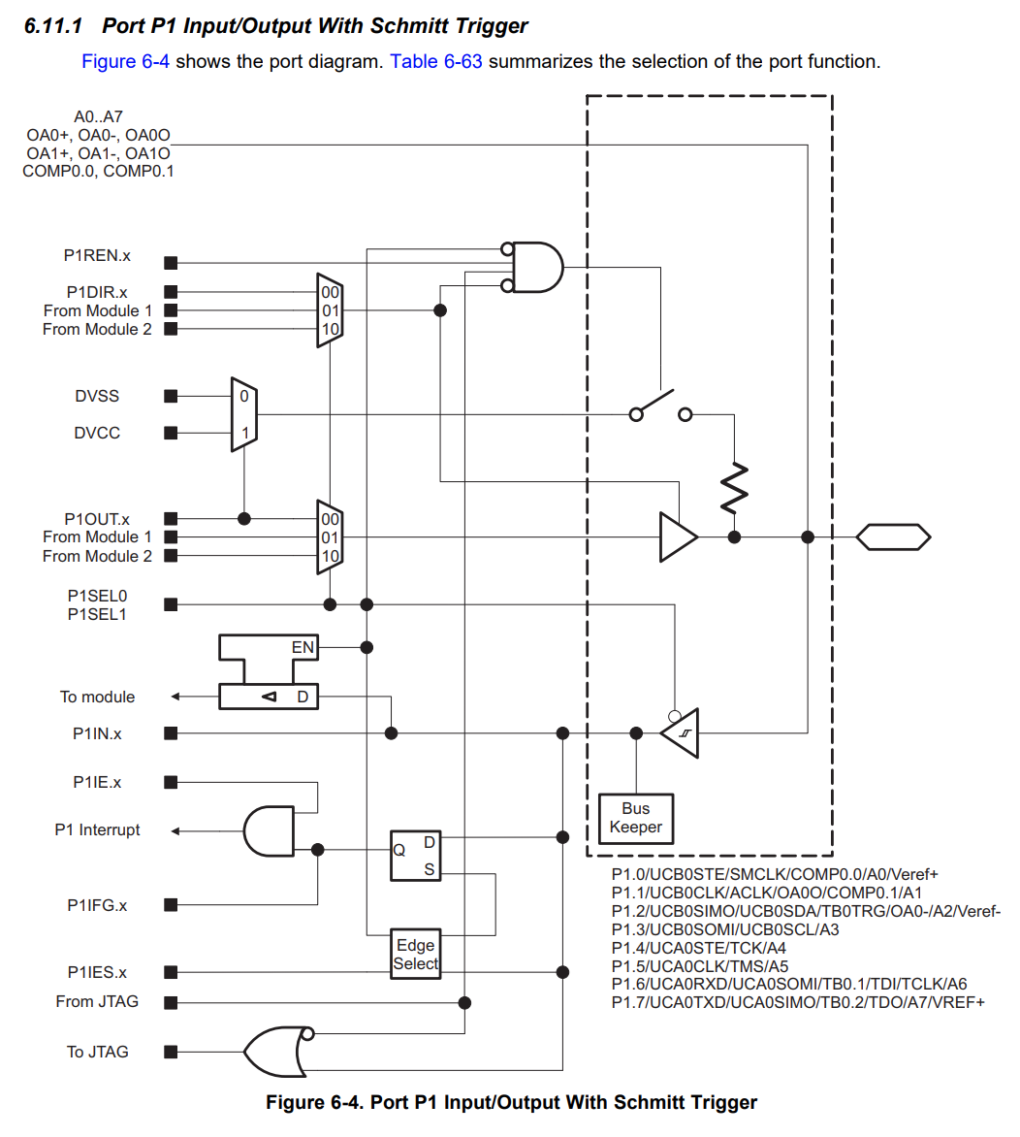
A3
P1REN.3
P1DIR.3
P1OUT.3
P1IN.3
P1IE.3
P1IFG.3
P1IES.3

Slide 2
A3
P1REN.3
P1DIR.3
1
P1OUT.3
P1IN.3
P1IE.3
P1IFG.3
P1IES.3

Slide 3
A0
P1REN.0
P1DIR.0
1
P1OUT.0
P1IN.0
P1IE.0
P1IFG.0
P1IES.0

