Slide 1


Intro to Multi-Threading
Sam Shue, PhD
Demo Code and Slides:
https://github.com/SamShue/Intro-to-MultiThreading

Slide 2

Demo Code and Slides:
https://github.com/SamShue/Intro-to-MultiThreading

Slide 3



I have an application in C++ that extracts edges from several user-specified images.
Gaussian Blur +
Laplacian Edge Detection

Slide 4
Collect File Name
Current
Application Flowchart
Open Image File
Run Edge Detection
Save New Image File
Collect File Name
Open Image File
…

Slide 5

Application Demo

Slide 6
Problem: The process of detecting the edges takes a long time, and so does the user typing in the file name.
Desire: I would like to collect user input while the program also processes the image in the background

Slide 7
Collect File Name
Desired
Application Flowchart
Open Image File
Collect File Name
Run Edge Detection
Open Image File
Save New Image File
Collect File Name
Run Edge Detection
…
Save New Image File

Slide 8
How do we get our application to simultaneously execute different lines of code?
Answer: Threads!

Slide 9
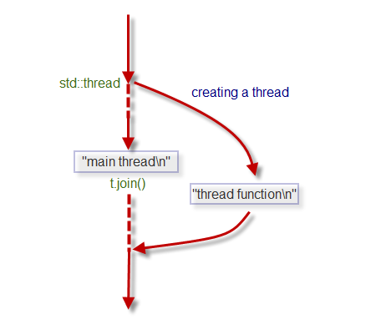
Threads allow lines of code to be executed simultaneously
We can organize our code into functions, give the thread the function to execute, and continue executing other code while the thread works at the same time

Slide 10



How do we make a thread in C++?
Step 0: Include standard thread library
Step 1: Organize simultaneous behavior into functions
Step 2: Create thread object and give it the function to execute

Slide 11

What do we do if we need data that a thread is operating on?
We can wait for a thread to finish with the “join” function
The “join” function will stall the code until the thread is finished

Slide 12
C++ Thread Demo

Slide 13
Let’s thread our image processing application
We’ll functionalize the edge detection algorithm and file access
A thread will then call the function once the user specifies the file

Slide 14
Threaded
Application Demo

Slide 15
Success!
The user input can be collected while at the same time the image is processed!
But wait… what happened to our images?

Slide 16
Our image processing functions share a temporary buffer when working on images…
When multiple threads run at the same time, they both use this same buffer and write over each others’ data!
This is called a race condition
time
Thread 1
Thread 2
Shared buffer

Slide 17


Solution: We need to lock the data!
Thread 1
Thread 1 locks the buffer
Thread 1 releases lock
Thread 2
Thread 2 waits because the data is locked
Thread 2 can now lock the buffer
Shared buffer

Slide 18

This kind of lock is called a mutex (short for MUTual Exclusion)
A mutex can be locked by a thread to secure a resource
If another thread tries to lock a mutex that is already locked, it will stall until it can acquire the lock

Slide 19




How do we make a mutex in C++?
Step 0: Include mutex library
Step 1: Create global mutex object
Step 2: Lock and unlock the mutex to secure the resource

Slide 20
Mutex Locked
and Threaded
Application Demo

Slide 21
How does the computer simultaneously execute multiple threads?
The operating system manages memory for each thread and then swaps back and forth between each thread

Slide 22
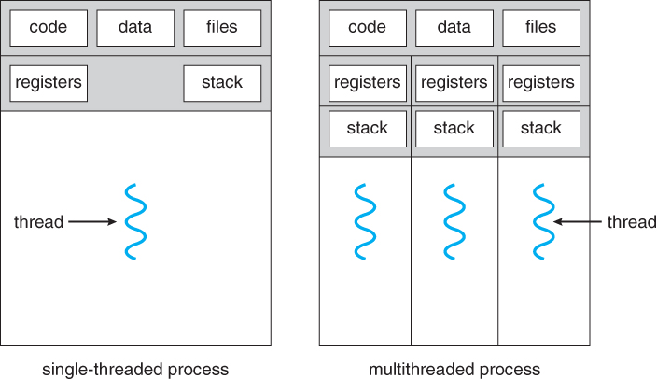
The operating system creates separate stack space for each thread
Other memory space is shared (heap, data, bss)

Slide 23
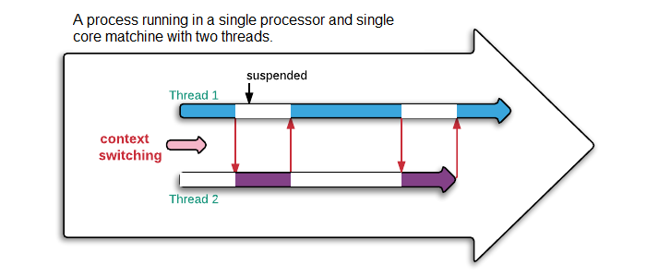
The operating system’s thread scheduler lets each thread have execution time on the CPU
Notes:
Source: https://www.logicbig.com/quick-info/programming/multi-threading.html

Slide 24
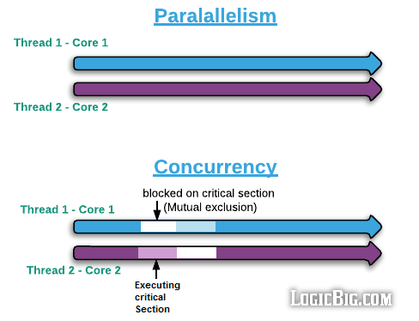
A single-core CPU will have to run threads concurrently
Multi-core CPUs can run threads in parallel
Notes:
Source: https://www.logicbig.com/quick-info/programming/multi-threading.html

Slide 25
Thank You for Coming!
Questions?

