Slide 1
Bank data analysis
Samyak Meshram

Slide 2
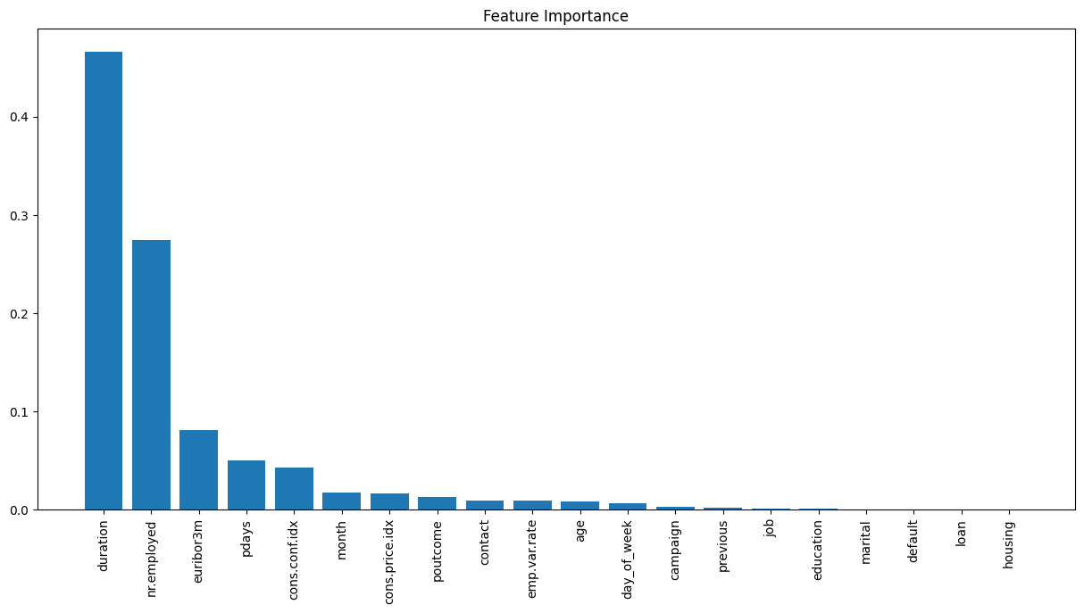
Feature Importance

Slide 3
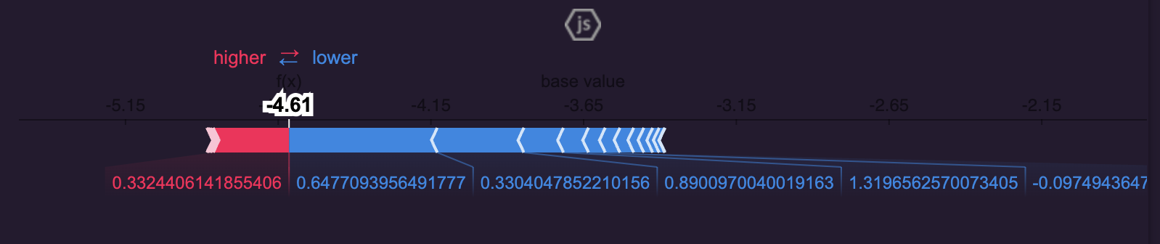
Shap visualization for Observation #4

Slide 4
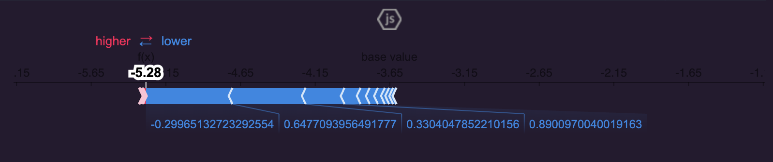
Shap visualization for Observation #20

