Slide 1
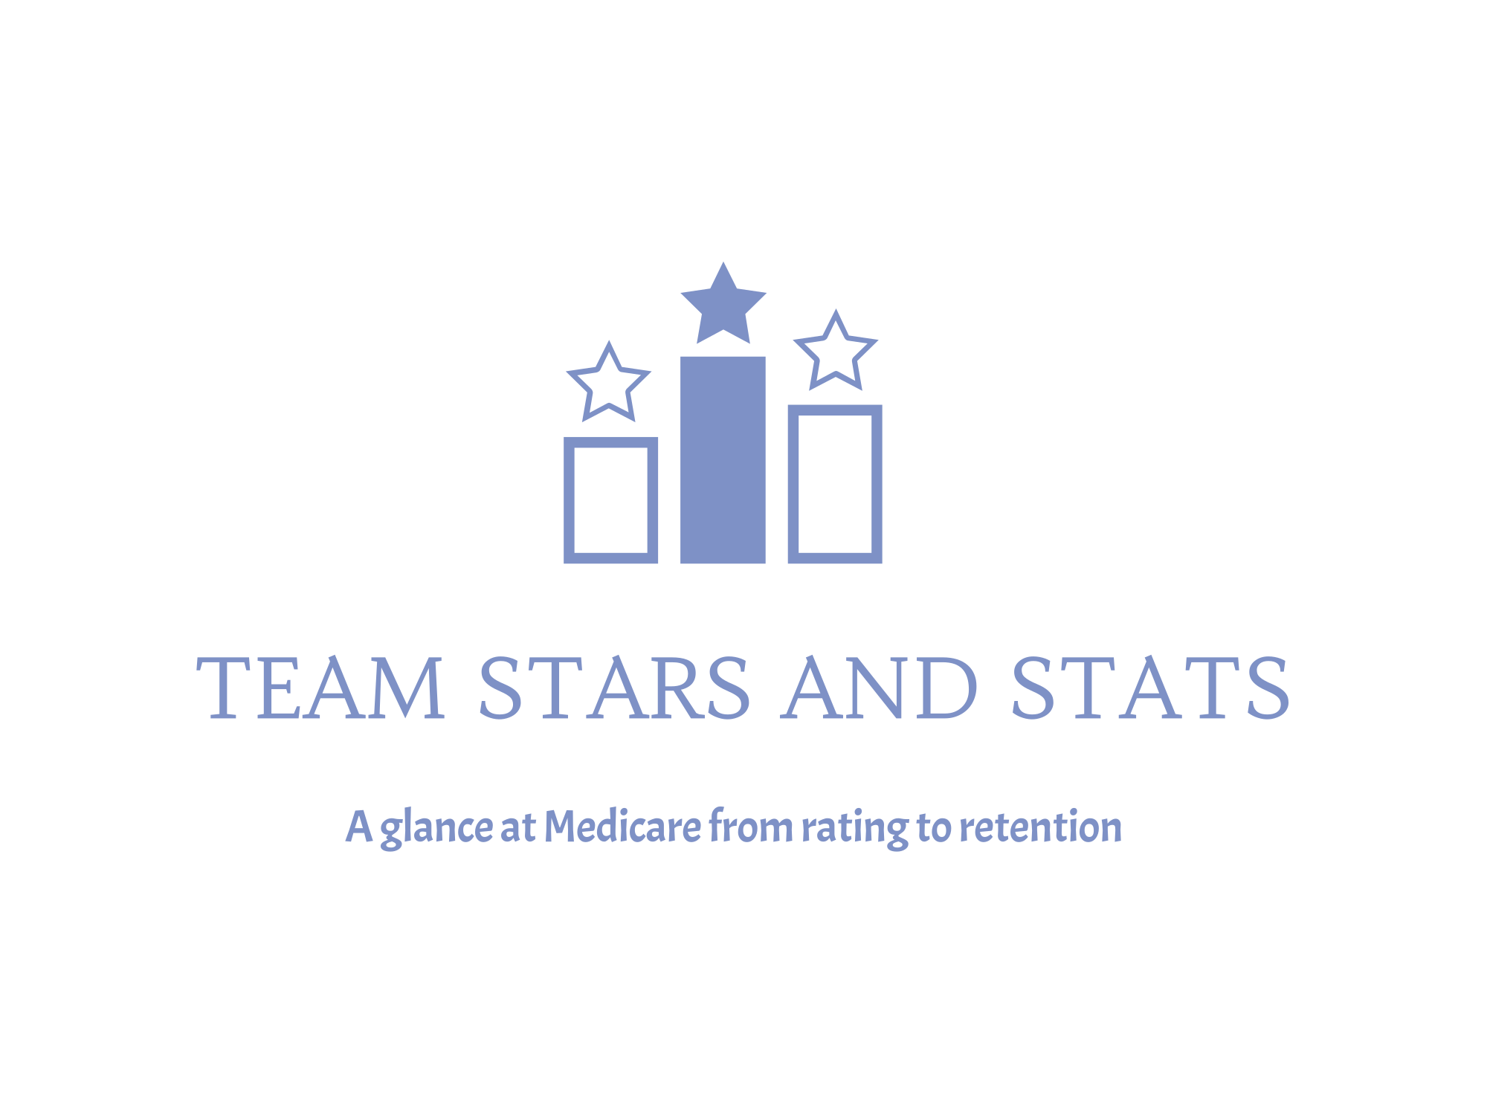
Sam Sims Sean Daily Kathryn McAtee Vraj Patel

Slide 2
Project Brief
Star ratings are synonymous with the world of consumerization, influencing opinions and purchasing behavior – but is the same true in the world of healthcare? Team Stars & Stats plan to look under the hood of Medicare Plan star ratings – ratings typically aggregated as one overall number but represent individual value of care scores that consumers weigh differently.
By analyzing and modeling this vast data set, we want to understand if star ratings actually show correlation to enrollment choice, while predicting which plans, or plan benefits, may be popular in the future.
Do star ratings drive consumer choice?
If they do, which insurer will people predominantly go with the following year?
Which sub-category of coverage has the largest impact on a plan's Star Rating or on Enrollment?
SCOPE: CMS Medicare Data (Star Rating and Enrollment Data) 2013-2023

Slide 3
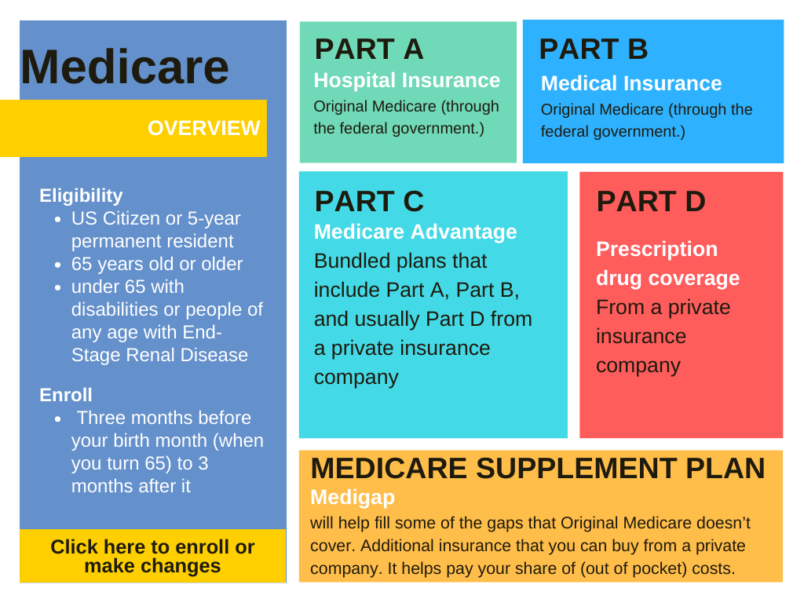

What is Medicare?
Medicare is a federal health insurance program that helps people pay for health care, generally, aged 65 and older. It's managed by the Centers for Medicare & Medicaid Services (CMS).
Important things to note:
Medicare covers certain health care services and supplies, but not all medical expenses
You pay part of the costs through premiums, deductibles, and coinsurance
OUR FOUCS: Medicare Parts C & D

Slide 4
Medicare by the Numbers
68 Million people enrolled in Medicare as of 2024
54% of eligible population were enrolled in Medicare Advantage Plans
Enrollment continues to see increased enrollment year over year (aging population)
MA plans projected to grow to 60% of the eligible population in the next 5 years
With so many engaged and enrolled, and with such a large growth rate,
there must be high satisfaction and great, easy to understand coverage, right?...

Slide 5
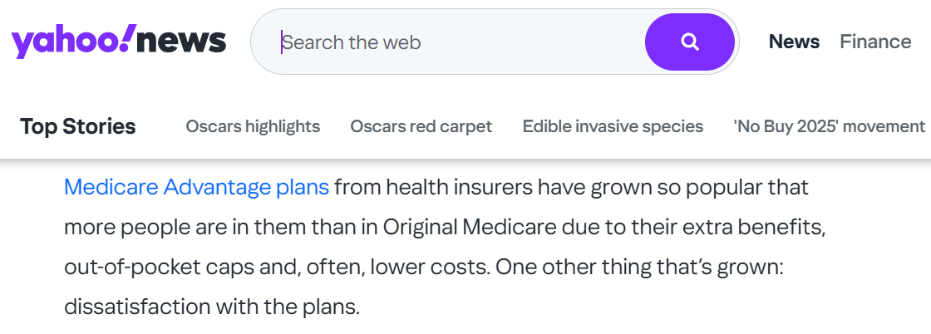

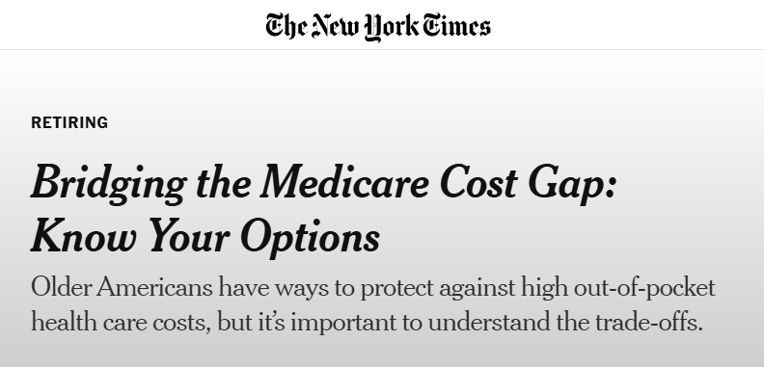
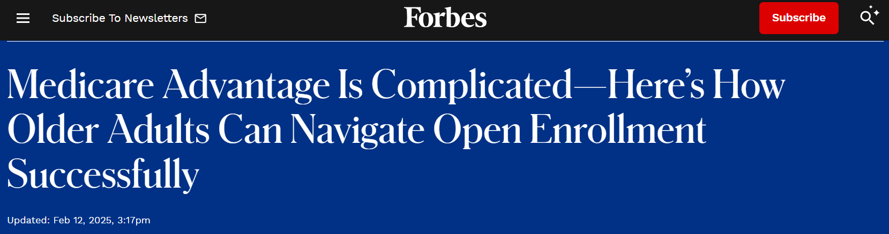
Notes:
Analysts attribute the slow growth mainly to cost and coverage complexities, but is that all? We wanted to look at the aggregated star ratings, and consumer enrollments, to see if we could better understand the impact star rating and coverage potentially had on enrollment.
Enrollment increasing; population 65 & over increasing, but ease of selecting the right plan and why still remains… confusing.
What if we could help seniors understand how to pick a plan, or what to look for in coverage?

Slide 6
EDA Brief: 4 Datasets being used
CMS Medicare Star Ratings by plan
Medicare Monthly Enrollments
Census Data
Measure_stars sheet
Domain_stars sheet
Summary_rating sheet
CPSC_Contract_Info
CPSC_Enrollment_Info
Population 65 and above by FIPS
* 9 categories, 42 key sub-categories
Key takeaways, Analysis, & Mitigation Plans from EDA:
CMS Medicare Star Rating File format changed in 2020; a few notable changes:
Removal of separate Spring and Fall files; combined into one file moving forward
Additional data included (disenrollment & disenrollment reason data)
Difference in number of total sub-categories year by year (between 30 and 34 total), with discrepancies such as the inclusion of a foreign call center
Column naming varies year by year depending on number of columns
CMS Medicare Enrollment Data
Files missing for March, April, May, June, November 2017, and August 2018
Data organized differently 2013-2016 vs. 2020 and after.
Only a few years of Medicare Disenrollment is publicized in the CMS files. It did not become a mandatory reporting requirement until the passing of the 21st Century Cures Act, starting in 2020, so we excluded this data from the modeling.
Creation of Data Rules to address gaps in the data
Data Rules:
Starter Values:
“Not Enough Data Available”: 2.5
“Not Applicable”: 0
“Plan too new to be measured”: TBD
Combine data sheets above on:
Contract Name
Organization Marketing Name
Parent Organization
Divide enrollment by 65 & over population to ensure ‘level playing field’ across states
Create ranges for popularity, for ex:
>5k popular
2-3k mid-popular
1-2k not popular

Slide 7
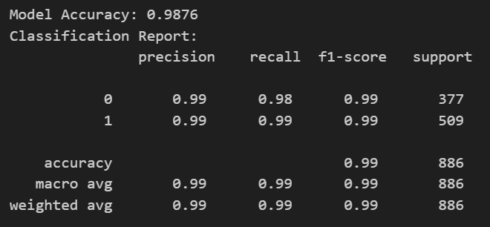
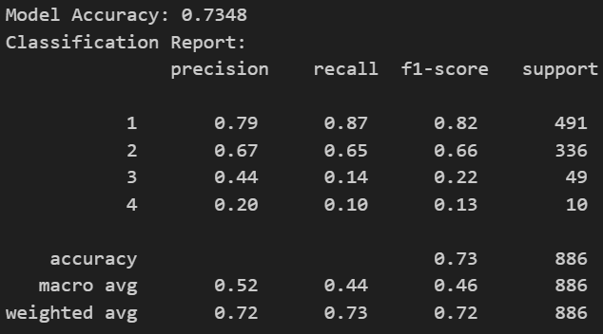
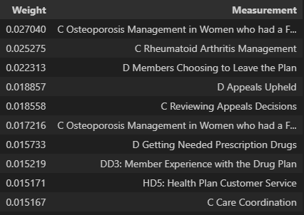
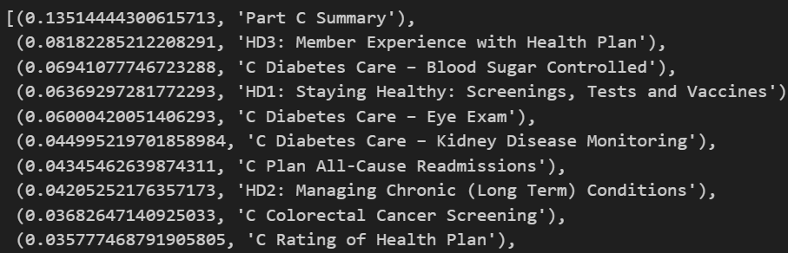
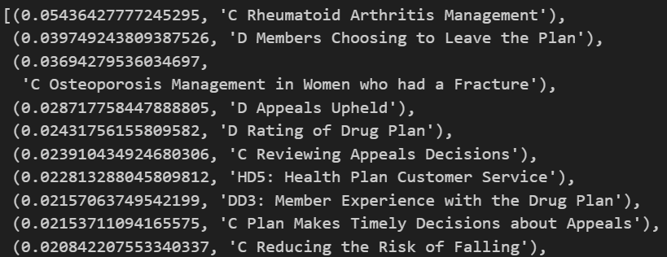
Models Used
1
2
3
Overall Star Rating:
Linear Regression & Random Forest
Enrollment:
Linear Regression & Random Forest
Enrollment:
Random Forest
Goal: Understand how well Plan Quality can be predicted based on the Overall Star Rating of a Plan.
Goal: Understand how well Enrollments can be predicted based on the YOY Enrollments of a Plan.
Goal: To find which features have the highest importance to determining accuracy of model
Models Used:
Linear Regression (accuracy)
Random Forest (feature importance to tell how much each feature contributes to making accurate predictions)
Models Used:
Linear Regression (accuracy)
Random Forest (feature importance to tell how much each feature contributes to making accurate predictions)
Models Used: Random Forest
Accuracy:
Accuracy:
Accuracy:
Feature Importance:
Feature Importance:
Feature Importance:

Slide 8
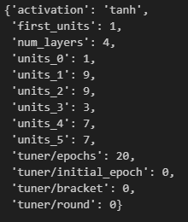

Models Used
4
5
Standardized Enrollment:
Deep Learning Model
Standardized Enrollment:
Keras-Tuner
Goal: To find how well accurate Standardized Enrollment is against the rest of the data
Goal: Find the best model parameters for greatest accuracy
Models Used: Machine/Deep learning and Model Optimization
Models Used:
Accuracy: Epochs accuracy attempts:
Attempt No. 1: 72%
Attempt No. 2: 72%
Attempt No. 3: 73%
Feature Importance: Running the model with different numbers in each of the hidden layers for each attempt. Changing the selection for the activation of the Relu, Tanh, and Sigmoid. Leaving the Sigmoid as the Output Layer for better results.
Accuracy:

Slide 9
Lessons Learned
Though the CMS data set was fairly complete, there were other hurdles the team spent a lot of team working through:
Data Size
Manual, Time Consuming Data Pulls (zipped, in multiple folders and files, by month, for 10 years)
Inconsistencies in data files and column structure
The importance of Data Dictionaries – large data set, not always with clearly labeled data to visually represent in Tableau
Other potential drivers of enrollment worth analyzing:
Insurance Advertising Impacts
Brand Recognition and Familiarity
Broker Outreach
Price
Disenrollment

Slide 10
Additional Info

Slide 11
DATA
Medicare Monthly Enrollments (2013-2024)
https://www.cms.gov/data-research/statistics-trends-and-reports/medicare-advantagepart-d-contract-and-enrollment-data/monthly-enrollment-contract/plan/state/county
CPSC_Contract_Info_2024_04.csv
Organization Type
Plan Type
Offers Part D
SNP Plan
EGHP
Organization Name
Organization Marketing Name
Plan Name
Parent Organization
Contract Effective Date
CPSC_Enrollment_Info_2024_04.csv
Contract Number
Plan ID
SSA State County Code
FIPS State County Code
State
Enrollment
Census Data (PI Census)
Population 65 and above by FIPS
CMS Medicare Star Ratings by plan (2007-2025, with a focus on 2013-2024)
https://www.cms.gov/medicare/health-drug-plans/part-c-d-performance-data
Measure_stars sheet
Contract ID
Organization Type
Contract Name
Organization Marketing Name
Parent Organization
9 Categories & Star Rating at Sub-Category Level:
HD1: Staying Healthy: Screenings, Tests and Vaccines (4 sub-cat)
HD2: Managing Chronic (Long Term) Conditions (14 sub-cat)
HD3: Member Experience with Health Plan (6 sub-cat)
HD4: Member Complaints and Changes in the Health Plan's Performance (3 sub-cat)
HD5: Health Plan Customer Service (3 sub-cat)
DD1: Drug Plan Customer Service (1 sub-cat)
DD2: Member Complaints and Changes in the Drug Plan’s Performance (3 sub-cat)
DD3: Member Experience with the Drug Plan (2 sub-cat)
DD4: Drug Safety and Accuracy of Drug Pricing (6 sub-cat)
Domain_stars sheet
Contract Number
Organization Type
Contract Name
Organization Marketing Name
Parent Organization
9 Categories & Star Rating at Category Level (same 9 as above)
Summary_rating sheet
Contract Number
Organization Type
Contract Name
Organization Marketing Name
Parent Organization
SNP
Disaster % (2 cols)
Part C Summary
Part D Summary
Overall
Disenrollment Reasons (available for 2020 and after)
Contract Number
Organization Marketing Name
Contract Name
Parent Organization
Problems Getting the Plan to Provide and Pay for Needed Care
Problems with Coverage of Doctors and Hospitals
Financial Reasons for Disenrollment
Problems with Prescription Drug Benefits and Coverage
Problems Getting Information and Help from the Plan
Data Rules:
Starter Values:
“Not Enough Data Available”: 2.5
“Not Applicable”: 0
“Plan too new to be measured”: TBD
Combine data sheets above on:
Contract Name
Organization Marketing Name
Parent Organization
Divide enrollment by 65 & over population to ensure ‘level playing field’ across states
Create ranges for popularity, for ex:
>5k popular
2-3k mid-popular
1-2k not popular

Slide 12
Final Analysis
Key Themes from Tableau:
High Plan Enrollments does not equate to High Plan Star Rating
High Issuer Enrollments does not equate to the best plans

Slide 13
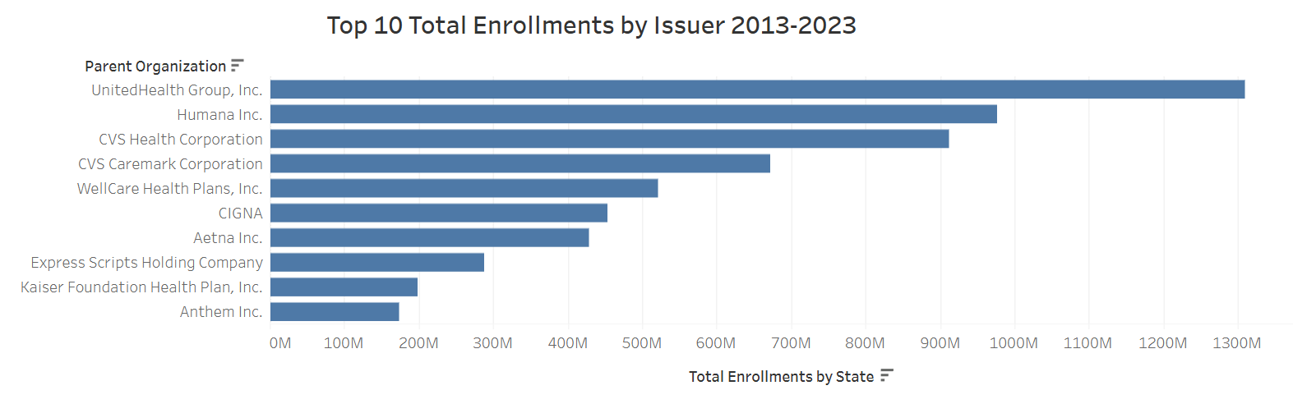
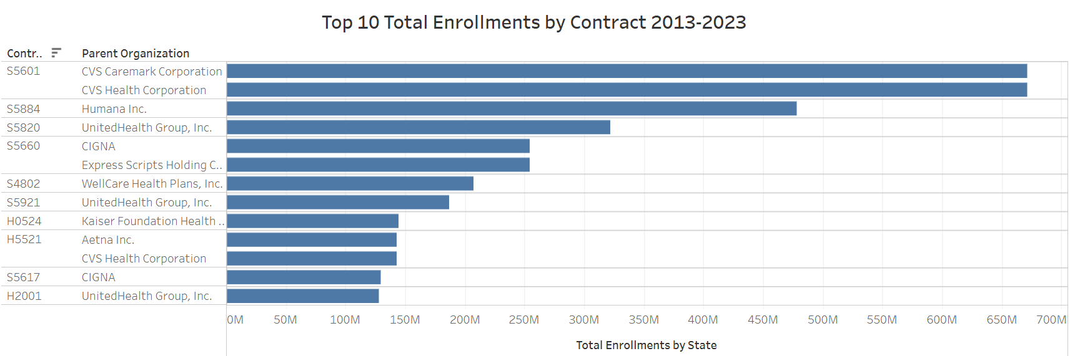

Slide 14
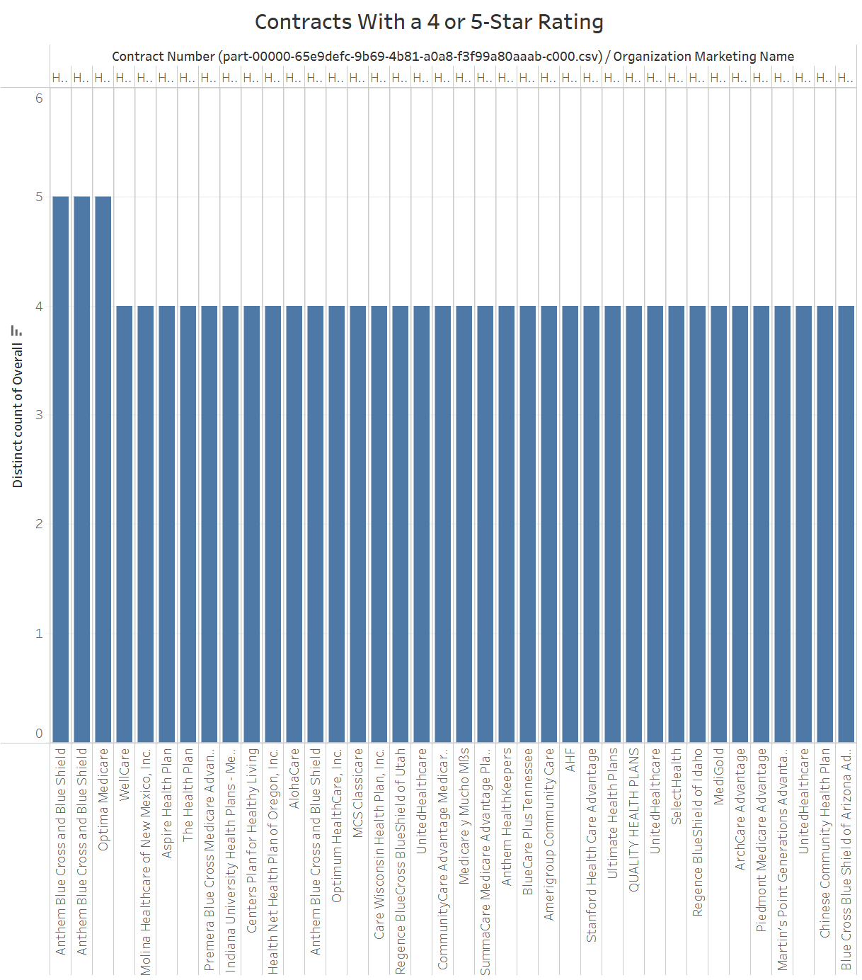
Based on quick analysis and visualization of the past 10 years of data, plans that have a 5 Star Rating do not equate to having a higher total enrollment.
H4590
H0755

Slide 15
Final Analysis
Key Themes from models ran on Star Rating vs. Enrollment:
Star Rating
(Linear Regression & Random Forest)
Enrollment
(Linear Regression & Random Forest)
Data 3rd Party Generated
98% Model Accuracy
A good indicator that a plan’s quality can accurately be predicted, with Part C, various screenings, condition coverage & management, and ratings leading the top features in making accurate predictions.
Data based on Consumer Enrollments
73% Model Accuracy
A good indicator that a plan’s quality can accurately be predicted, with condition management and coverage (predominantly for women), various customer service needs, and ratings leading the top features in making accurate predictions.
High accuracy model with high predictability based on coverage
Moderate accuracy model with higher predictability based in female coverage, ratings, and customer service
Until Plan Rankings can be sourced directly from Consumers, there will continue to be a disconnect in what Plans qualify as a 5-star plan vs. what Consumers look for in a high ranked plan. Enrollment popularity leads with niche coverage, customer service, and rankings, whereas CMS Star Rating predictability leads with coverage.

