Slide 1

Advantages and disadvantages of being a franchise partner
Bendegúz nagy

Slide 2
Franchise?
A franchise is a type of license that grants a franchisee access to a franchisor's proprietary business knowledge, processes and trademarks, thus allowing the franchisee to sell a product or service under the franchisor's business name.
WHAT IS A
WHY IS IT BETTER THAN JUST START A NEW INDEPENDENT BUISNESS? →

Slide 3

The risk of failure is reduced
Your business is based on a proven idea. You can check how successful other franchises are before committing yourself.
Notes:
The risk of business failure is reduced by franchising. Your business is based on a proven idea. You can check how successful other franchises are before committing yourself.

Slide 4
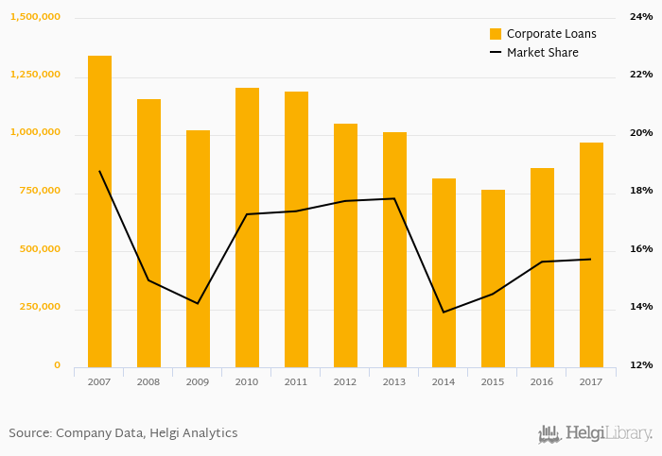
Established market share
The franchises are usually established and recognized buisnesses, therefore there will be no need for market testing
Notes:
The franchises are usually established and recognized buisnesses, therefore there will be no need for market testing

Slide 5

They provide training and support
They provide you chances to improve and help you to run your buisness as successful as possible
TIPS AND TRICKS
Notes:
They provide you chances to improve and help you to run your buisness as successful as possible. Usually you pay some percentage of your income to your franchiser, so their goal is also to make you outstanding. You can benefit from communicating and sharing ideas with, and receiving support from, other franchisees in the network.

Slide 6


compete with big businesses
A franchise enables a small business to compete with big businesses, more so than an independent small business, due to the pool of support from the franchisor and network of other franchisees.

Slide 7
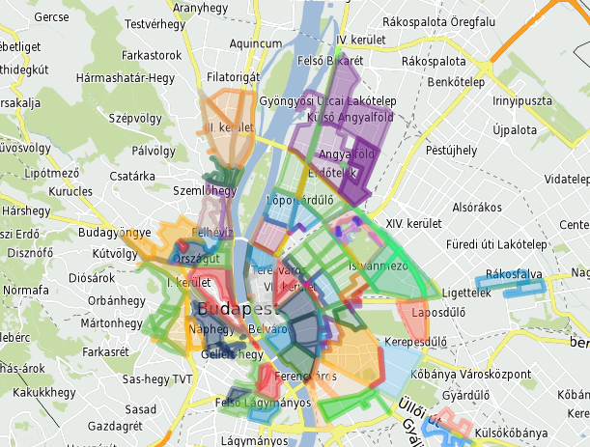
exclusive rights
You usually have exclusive rights in your territory. The franchisor won't sell any other franchises in the same territory.
Notes:
You usually have exclusive rights in your territory. The franchisor won't sell any other franchises in the same territory. For example where i work the other partners cant advertise themselves in our territory

Slide 8
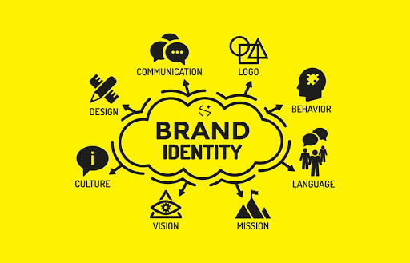
recognised brand name and trademark
You benefit from any advertising or promotion by the owner of the franchise - the 'franchisor'.
Notes:
The people know your company and the brand is already hyped up

Slide 9
If Franchise is that profitable, why should we invest in independent companies?
Franchise fee
Restrictions
franchisor monitoring
inflexible nature of a franchise
Notes:
Costs may be higher than you expect. As well as the initial costs of buying the franchise, you pay continuing management service fees and you may have to agree to buy products from the franchisor.
The franchise agreement usually includes restrictions on how you can run the business. You might not be able to make changes to suit your local market.
You may find that after some time, ongoing franchisor monitoring becomes intrusive.
The franchisor might go out of business.
Other franchisees could give the brand a bad reputation, so the recruitment process needs to be thorough.
You may find it difficult to sell your franchise - you can only sell it to someone approved by the franchisor.
All profits (a percentage of sales) are usually shared with the franchisor.
The inflexible nature of a franchise may restrict your ability to introduce changes to the business to respond to the market or make the business grow.

Slide 10

Thank you for your attention!
Sources:
https://prezi.com/qqeoclq955av/advantagesdisadvantages-of-a-franchise/
https://www.business.qld.gov.au/starting-business/buying-business/buying-franchise/advantages-disadvantages

