Slide 1
Web Application Re-Imagined for Today’s Demanding End Users
Keith Elder
Director, Software Engineering, @QuickenLoans
http://keithelder.net
@keithelder
http://deepfriedbytes.com - Podcast

Slide 2



Deep Fried Bytes is an audio talk show with a Southern flavor hosted by technologists and developers Keith Elder and Chris Woodruff. The show discusses a wide range of topics including application development, operating systems and technology in general. Anything is fair game if it plugs into the wall or takes a battery.
http://deepfriedbytes.com

Slide 3
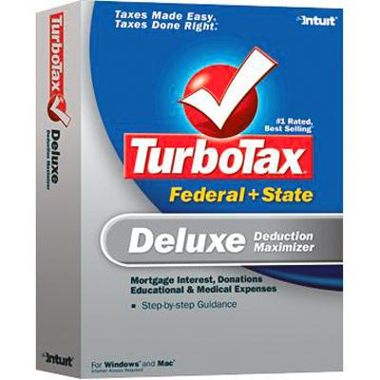

Quicken Loans

Slide 4
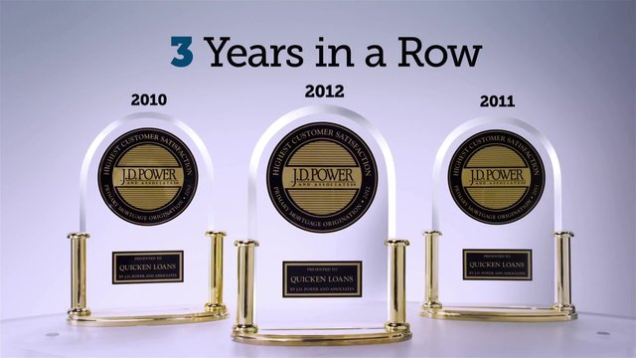

2013
4 Years in a Row

Slide 5
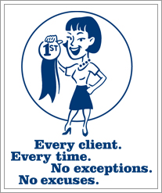
Quicken ISM
Notes:
At Quicken Loans we do not have mission statements. We have ISMS. Tying in our JD Power awards this is the ISM that drives us and why we are #1 in client satisfaction. This ISM is what also drives me in building amazing applications that make sure when a client is supposed to get an email, they get it, each and every time. Or a text message alert from our platform each and every time.

Slide 6
My Goal
Get you thinking different about how you build your applications.

Slide 7
Disclaimer!
The following are not the thoughts of my employer even though they are still Engineered To Amaze.

Slide 8
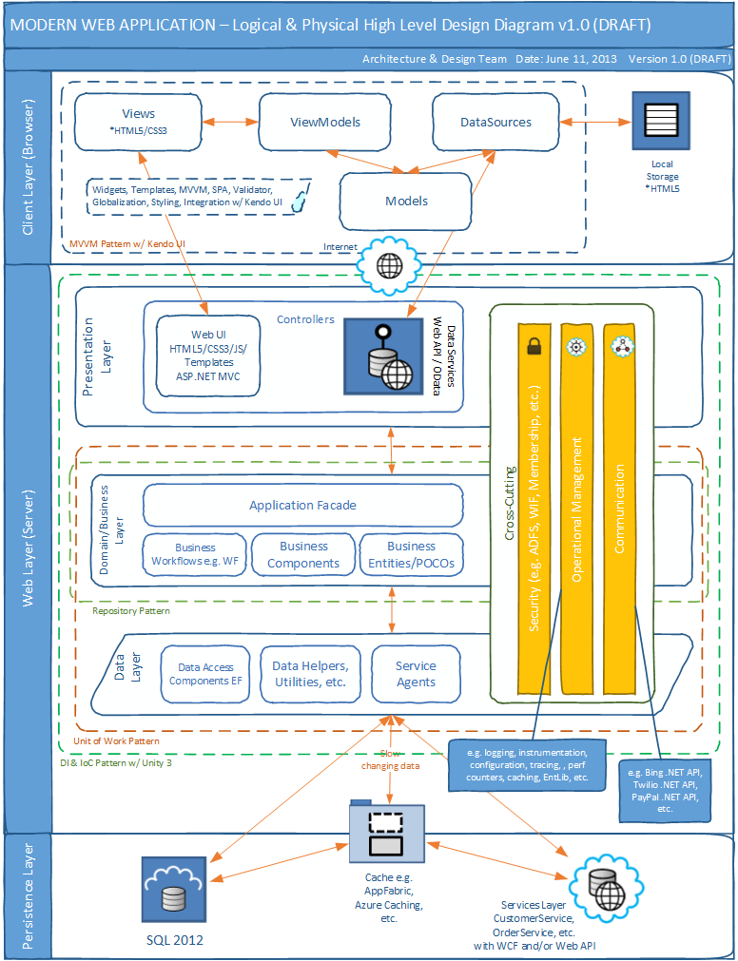
Notes:
While this is primarily an architecture talk we are not going to be talking about this kind of stuff like IRepository, Unit of Work, etc. And even though this slide deck has every known buzz word known to man kind in it, if you build an app like this, it doesn’t work as we’ll learn. It is setup for failure right from the beginning. So let’s ignore patterns and practices for now and move on.
Let’s look at a few architectures and talk about how they work.

Slide 9

Web Request
Web Server
Blog Architecture
Database
Fetch Data

Slide 10
Web Request
Enterprise Blog Architecture
Web Server
Database
Fetch Data
Cache

Slide 11
Web Request
Load Balancer
Super Enterprise Blog Architecture
Web Farm
Fetch Data
Database Cluster
Cache Cluster
Notes:
Even though there are countless applications built using the architecture in these last 3 slides, those applications are still not setup to provide end users what they really want.
And these applications are setup to not scale and handle large bursts of traffic and long running business transactions. Parts of the system are going to fail as we’ll look at and there is no way to recover them either.
Here’s a question though.

Slide 12
What has happened in the last several years that end-users have figured out we could have been giving them all along?

Slide 13
Real-time Updates and Push Notifications

Slide 14

He exposed our secret to the world.

Slide 15

Notes:
This is no longer *good enough* for our demanding end-users.

Slide 16
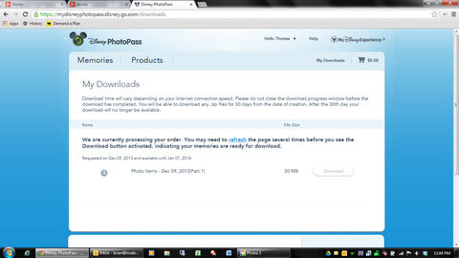

Slide 17
Get angle brackets (html)
Services
Architecture
Web Server
Get curly braces (data)
REST API
Fetch Data
Database
Cache
Notes:
As web developers we’ve finally realized we need an API for our apps. Smart Client devs have known this all along. And by API we don’t mean SOAP APIs either as those were never meant to work on the web.
So we started recently creating a services architecture into our apps.

Slide 18
Web Server
Get angle brackets (html)
Queued Services
Architecture
Get curly braces (data)
Fetch Data
REST API
Database
Queue
Pub/Sub
Cache
Windows Service
Notes:
We no longer build single monolithic applications any longer. Anyone caught doing so shall be terminated immediately.
Adding another level of abstraction with queues gives us the ability to do some pretty amazing things.

Slide 19


Slide 20
Three Applications
Web UI
REST API
Windows Service
Composite Application Monolithic

Slide 21
Monolithic apps are out. Composite applications are the new norm.

Slide 22
It is all about messaging.
The only way to get them to all talk to one another.

Slide 23
Demo

Slide 24
Web, API, Backend
Roles they each serve.

Slide 25
Web UI
Borrows from the learnings of the *Smart Client* era. Doesn’t do anything but display html and data to the screen.

Slide 26
REST API
The Web UI interacts gets and stores data through here. There are no other means of it getting or retrieving data.
Provides a means for other UIs (mobile, tablet, other systems) to interact.

Slide 27
REST API
Handles request/reply where absolutely necessary
Primary job in life is to fan out calls
Generates messages to be processed
Commands
Events
Does minimal work as possible to return to caller as fast as possible
Everything else is handled by backend Windows Services

Slide 28
REST API
Design considerations
Assume everyone is going to attack you
Who is invoking you
Metrics / Stats
Identification of caller
Who are you and what can you do?
Security
More than SSL may be required
Document it
Help your clients, give them something other than just the API

Slide 29
REST API Calls
Option 1 – Request / Reply
Get data / Store data
Create and send any commands and events to message queue
Return
Option 2 - Async
Store data
Get data (pulling credit is a good example)
Create and send any commands to message queue
Return

Slide 30
Windows Service(s)
The message processor(s). Processes commands and events that have been placed either in the queue or topic (pub/sub). Also creates and fires off commands and events.

Slide 31
NOTE: Use pub/sub to communicate to all of your distributed services commands like reset cache etc.
Queue
Pub/Sub
Windows Service
Windows Service
Windows Service
Database
Cache
REST API
Web Site

Slide 32
Why are we doing this?

Slide 33
Build for failure.
Build for speed.

Slide 34
Business Domain
Loan system
Saves clients
When a client is saved we are instructed by the business to do the following:
Save to database
Send client data to vendor for snail mail marketing
Send welcome email
Run client qualification (lots of moving pieces)

Slide 35
public ClientWithQualification SaveNewClient(Client c)
{
SaveToDatabase(c);
NotifyVendorForMailing(c);
SendWelcomeEmail(c);
var cq = new ClientWithQualification(c);
cq.Qualification = QualifyNewClient(c);
return cq;
}
private ClientQualification QualifyNewClient(Client c)
{
var qual = new ClientQualification();
qual.Weather = GetWeather(c);
qual.FacebookData = GetFaceBookData(c);
qual.TwitterData = GetTwitterData(c);
qual.ClosingMetrics = GetClientClosingBIData(c);
return qual;
}
Notes:
Who has written code like this? Many of you I know have. Probably every single person that is reading this.
While it is easy to read and doesn’t looking that scary, what it is doing is essentially saving a client’s information into the system.
There are multiple steps to saving a new client. The first is to get it into the database. The next is we need to notify another system we have a new client, then we need to send an welcome email and then we need to run qualification.
While all of this is happening what is happening in the UI to the client? NOTHING.
Even if we run all of this multi-threaded, we still have to wait until everything completes before we can return to the client.
Not only that but this code is riddled with failure. Let’s look at the next slide where I added comments to all failure points.

Slide 36
public ClientWithQualification SaveClient(Client c)
{
SaveToDatabase(c); //failure
NotifyVendorForMailing(c); //failure
SendWelcomeEmail(c); //failure
var cq = new ClientWithQualification(c);
cq.Qualification = QualifyNewClient(c); // multiple failures
return cq;
}
private ClientQualification QualifyNewClient(Client c)
{
var qual = new ClientQualification();
qual.Weather = GetWeather(c); //failure
qual.FacebookData = GetFaceBookData(c); //failure
qual.TwitterData = GetTwitterData(c); //failure
qual.ClosingMetrics = GetClientClosingBIData(c); //failure
return qual;
}

Slide 37
Problems
Failure is inevitable
Crossing boundaries
Http isn’t a transactional protocol
Recovery

Slide 38
Using Our Queue with Request/Reply
[Transaction]
public object Post(Client client)
{
((DbSet<Client>)_db.Clients).Add(client);
((DbContext)_db).SaveChanges();
var event = Mapper.Map<ClientCreatedEvent>(client);
Task.Run(() =>
{
_sender.Send<ClientCreatedEvent>(event);
}
);
return client.Id;
}

Slide 39
Using Our Queue Async
[Transaction]
public object Post(Client client)
{
var cmd = Mapper.Map<CreateClientCommand>(client);
Task.Run(() =>
{
_sender.Send<CreateClientCommand>(cmd);
}
);
return client.RequestId;
}

Slide 40
Commands or Events
We only have to worry about two message types.

Slide 41
Commands
Messages that describe an action that is to be performed.

Slide 42
Commands
<CreateClientCommand> … client data elements … </CreateClientCommand>
<QualifyClientCommand> … qualification data elements … </QualifyClientCommand>

Slide 43
Events
Messages that describe an action that was performed.

Slide 44
Events
<ClientCreatedEvent> … client data elements … </ClientCreatedEvent>
<ClientChangedEvent /> (existing client was changed)
<ClientQualificationCompletedEvent />

Slide 45
Event
Queue
Message Router
ClientCreatedEventHandler
Handle(IEvent event);
Notes:
Messages that come into the queue are then pushed to the windows service(s) and are then handed off to a message router.
The message router merely looks at the root element to get its type, then deserializes that XML back into an Object.
The object is then passed to its handler (which is a class with the word *handler* appeneded to it).
The Handle method is then invoked in this class and the actions of that event or command are then carried out.
The example above shows an Event flowing into a system.
Events can trigger other commands and other events as well that will flow back into the message router as we’ll see on the next slide.

Slide 46
Queue
Message Router
ClientCreatedEventHandler
Handle(IEvent event);
ClientQualificationCommand
Notes:
Once an event is received that notifies us that we need to run qualification. Thus a new command is created and placed on the queue.

Slide 47
Workflow of Commands / Events
Fires the CreateClientCommand
ClientCreatedEvent
Fires the NotifyVendorCommand
NotifyVendorCompletedEvent (push)
Fires the SendEmailCommand
SendEmailCompletedEvent (push)
Fires the QualificationCommand
QualificationCompletedEvent (push)
Notify UI all processing is completed

Slide 48
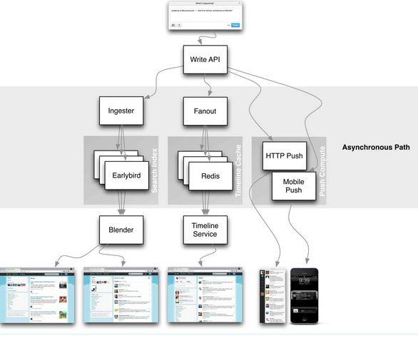

Slide 49
IIS/AngularJS
Technologies
SignalR
Service Stack Wep API
SQL /
NOSQL
RabbitMQ
RabbitMQ
App Fabric
Top Shelf

Slide 50
Demo
StartR – http://github.com/keithelder/StartR

Slide 51
Web Application Re-Imagined for Today’s Demanding End Users
Keith Elder
Director, Software Engineering, @QuickenLoans
http://keithelder.net
@keithelder
http://deepfriedbytes.com - Podcast

