Slide 1
Workshop #4
Data Visualization with ggplot2() transposing some data

Slide 2
Presentation Contents
Quick review
Time for your questions and week 3 homework solutions
ggplot basics
Transposing data (wide to long)
ggplot with a grouping variable
Longer R lab today with some review from week 2
Learning objectives:
Understand basic data visualization in R using ggplot
Understand pivot_longer command for transposing data in r

Slide 3
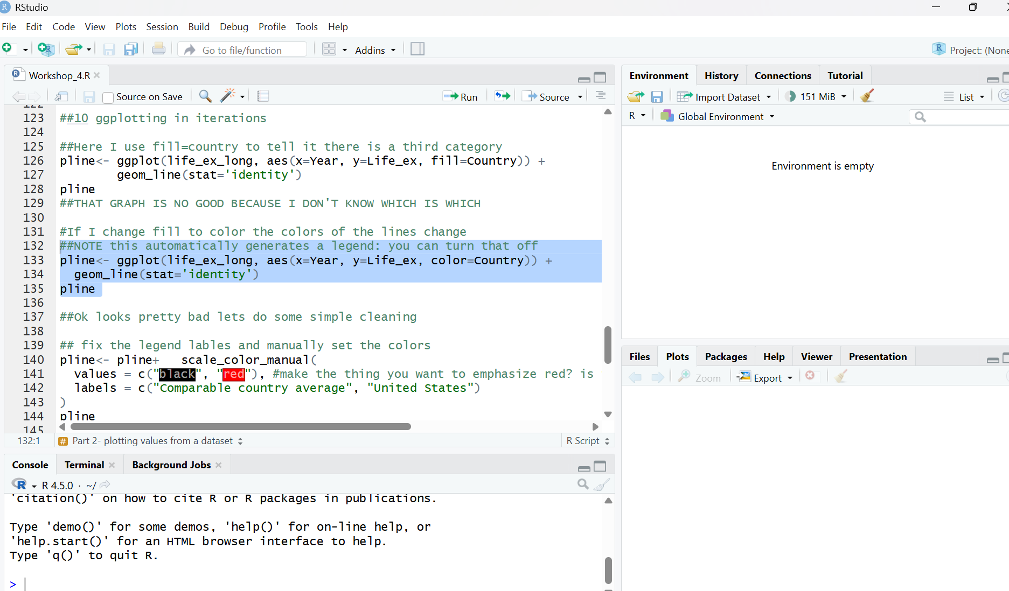
Review: What have we learned??
The R has many panes (pains?)
Packages are bundles of code, which can contain functions
Functions are bits of code that you perform on objects
Objects are things you make in r like data frames and plots
When you make objects they appear in the environment window
Scripts are the programs where you save the code you wrote

Slide 4
Review: some specific things we learned
table() makes ugly tables that just show frequencies
This works btw for proportions: prop.table(table(data$took_GLP1,data$has_diabetes),margin=2)
aggregate() lets you aggregate continious variables by categorical ones
We learned a couple de duplication and data cleaning functions/ methods

Slide 5
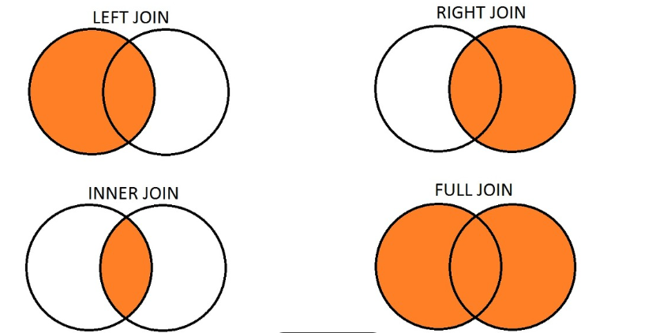
Types of joins in statistical software
Also called outer join
ANTI JOIN

Slide 6

Question time

Slide 7
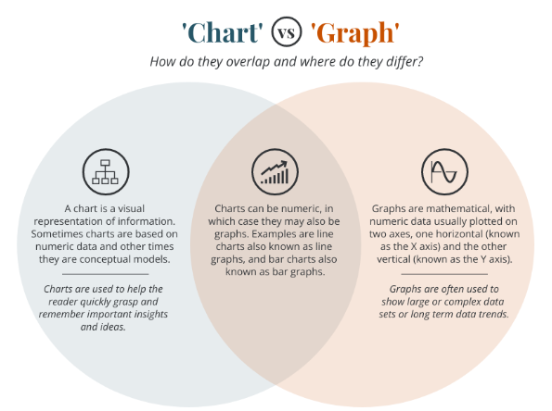
Data Visualization with ggplot2 in R studio

Slide 8
Some basic ingredients
aes: stands for aesthetic mapping- this is where you tell r which columns (variables) are going to be in the graph
Outside aes() is where we usually “hardcode” additionally properties of the graph, and where I will add additional things
This is where you tell ggplot your x and y axis
geoms: how your data are rendered- to oversimplify the type of graph you are making
Line graph, bar graph etc
attributes: Additional things you manipulate outside of the aes() parentheses to change the appearance of the graph
We will do this iteratively to clean up our graphs today

Slide 9
Syntax breakdown: things in ggplot()
pbar<- ggplot(data3, aes(x=took_GLP1, y=egfr)) + geom_bar(stat='summary',fun='mean')
The function
The data
Put the plot into an object called “pbar”
Type of graph
Types of statistics that can be in your plot will go here
Plus sign means do this as well, easier in iterations after this
aes contains our X and Y variables

Slide 10
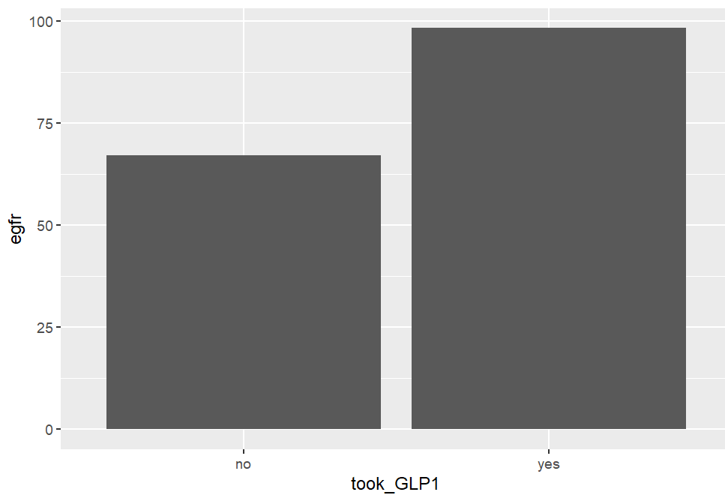
The graph that code on last slide makes
The code (again):
pbar<- ggplot(data3, aes(x=took_GLP1, y=egfr)) + geom_bar(stat='summary',fun='mean')
I know its terrible– We will make a batter graph

Slide 11
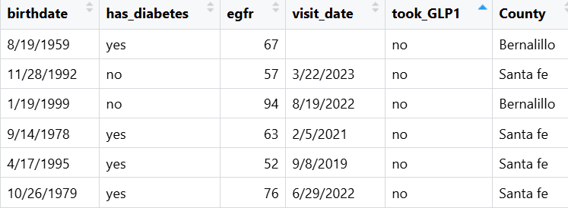
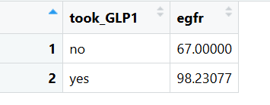
The stuff inside the geom()
geom_bar(stat='summary',fun='mean’)
This tells us what statistic to plot
stat=‘summary’ means ggplot2 calcs stats for you
stat=‘identity’ means it plots the actual values in your data
I will show this a couple different ways once we get to R
raw data where ggplot2 calculates the means (stat= ‘summary’, fun=‘mean’)
Aggregate data where I calculated the means (stat= ‘identity’)

Slide 12
ggplot with a grouping variable

Slide 13
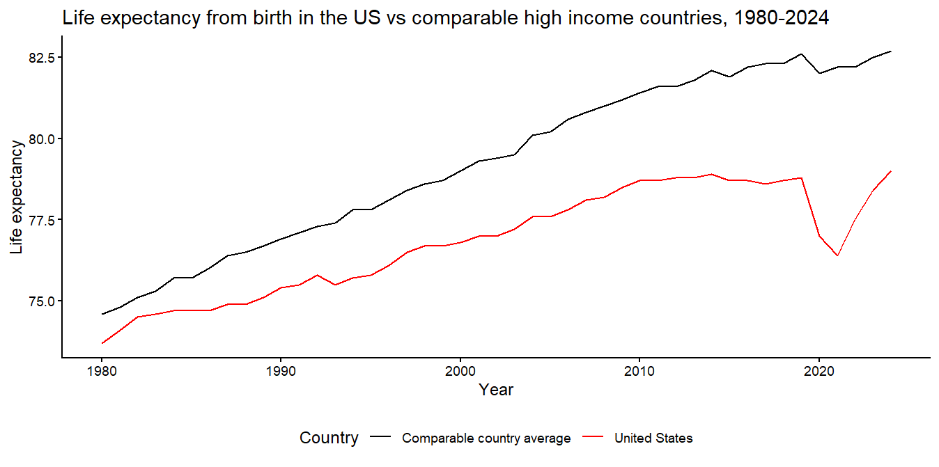
What a graph might look like
Y
X
Group

Slide 14
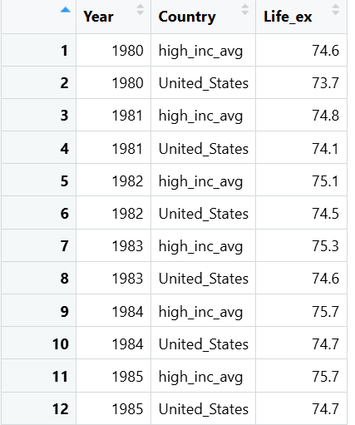
Adding a grouping variable
pline<- ggplot(life_ex_long, aes(x=Year, y=Life_ex, color=Country)) + geom_line(stat='identity')
X
Group
Y
Similar syntax but we have added the group variable
Type of graph
There are some options here, more next slide

Slide 15
Adding a grouping variable continued
Aesthetic | What it Affects? | Common Geoms | Implicit Grouping?
fill | Polygons will be different colors or patterns | Bars, boxes, violins | Yes- bars and boxes will be different colors
color | Lines will be different colors or patterns | Lines, borders | Yes, lines will be different colors
group | R knows that is the grouping variable, but does not differentiate | all | R knows these are groups but won’t split them unless you do so elsewhere

Slide 16
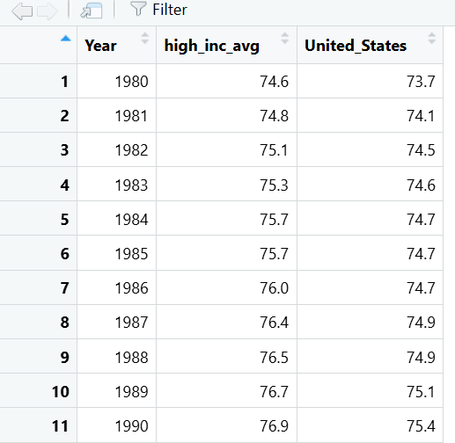
Transposing data
Data can be wide or long
R is looking for a grouping variable that specifies the category
We will go wide to long today
X
Group
Y
Note: year is repeated and the columns become a categorical variable in the long data

Slide 17
Code to transpose wide to long
life_ex_long<-life_ex2 %>% #the pipe says do this next
pivot_longer( #pivot longer is the transpose function
cols = c(high_inc_avg, United_States), # The columns you want to collapse
names_to = "Country", # The name of the new column for old headers
values_to = "Life_ex") # The name of the new column for cell values

Slide 18
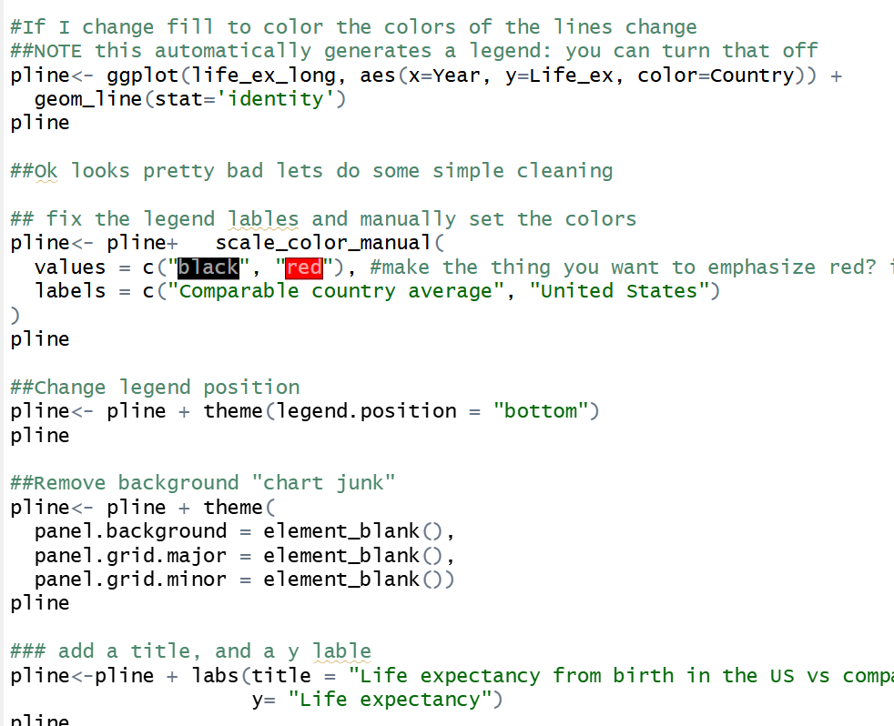
The iterative process
I do this by creating an object and iteratively adding things to it
This makes it easier for me to figure out when/ where/ why it brakes
You can do all this in one step

Slide 19
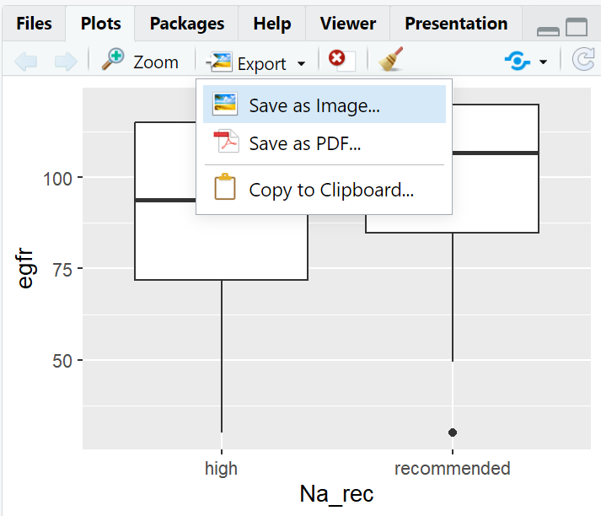
Postscript: exporting the figure
I will show this live, it’s a point and click menu
You can also use ggsave, which I will show in code

Slide 20
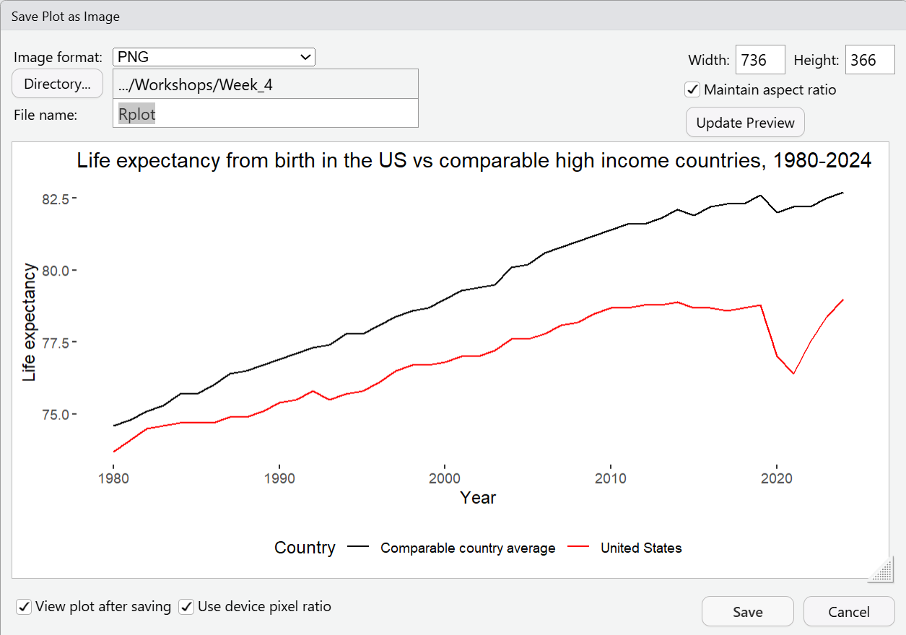
Plot export window

Slide 21
More resources:
https://github.com/rstudio/cheatsheets/blob/main/data-visualization.pdf
https://ggplot2.tidyverse.org/
https://github.com/erikgahner/awesome-ggplot2

Slide 22

EMAIL ME YOUR QUESTIONS?
samswift@salud.unm.edu
Next week: Markdown and a loop

