Slide 1
Workshop #3
Review (LOTS), slowing it down, subsetting and Joins

Slide 2
Presentation Contents
You talk, I listen (10-15 mins)
Important syntax (reviewed)
Reading in data (reviewed in r)
Deduplicating and capitalizing (reviewed in r)
Joins (Matching)
R demo
Subsetting data
R demo
Learning objectives
Students will:
Review reading data in
Review a simple deduplication function
Review a capitalization function
Understand logic of sub setting
Understand logic of joins
I added bonus code at the bottom of the program for those that want more advanced stuff

Slide 3
Updated workshop schedule
Session 3. (Sept 1st 2026): REVIEW, joining datasets, and basic statistical analysis in R
Removed: more advanced and different data cleaning functions, time math, deduping with distinct()
Session 4. (Sept 8th 2026): Data visualization with ggplot2
Session 5. (Sept 15th 2026): Automating reports with R markdown, and for loops (time permitting)
Removed: Analysis using survey weights, R shiny, APIs, Github

Slide 4

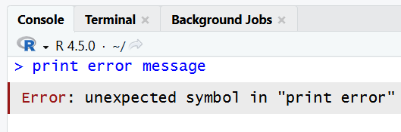

You talk, I listen
Lets specifically go over errors people are getting and where people are stuck
Available to talk about other things too but I only want to spend 10-15 mins here

Slide 5

Error and troubleshooting listening time

Slide 6
Review: Important Syntax
The arrow operator <- creates objects
Like this: newdata<-olddata
The dollar sign $ refers to a variable within a data set
Like this: dataset$variable
Functions usually wrap other stuff in parenthesis ()
Like this: function(dataset$variable)
Like this sqrt(4)
Filepaths tell R where our data are saved:
data<-read.csv("C:/YOUR_FOLDER/YOUR_SUB_FOLDER/names_n_dx.csv")

Slide 7

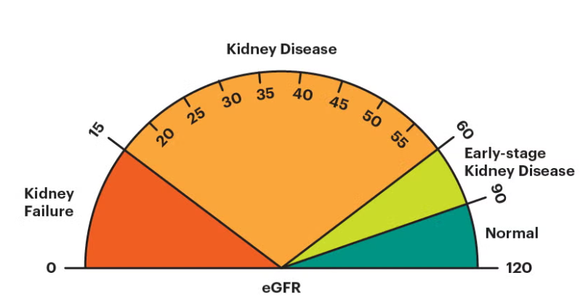
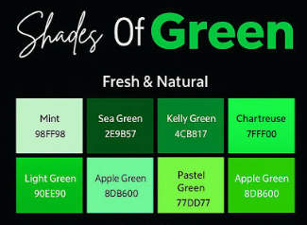
Todays task
Today we have two datasets
One is our week 2 data and one is new
Week 3 data has the favorite colors and holidays of the people in week 2
Our task today is to join them.

Slide 8
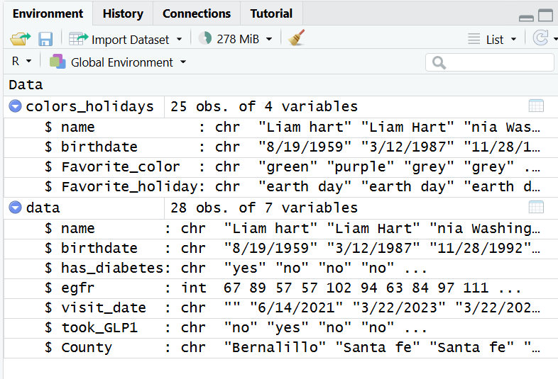
Variables in the datasets
Dataset 1:
name
birthdate
Did they take medicine (yes/no)
Dataset 2:
name
birthdate
visit date
has_diabetes (yes/no)
egfr
took_GLP1
THESE DATA ARE SIMULATED BY CHAT GPT- NOT REAL HIPPA!!!

Slide 9
Why should we match obs across datasets?
Common task in data science not really doable in Excel
Lots of imaginable use cases:
Imagine we want to link clinical encounters with mortality data…
Imagine we want to link data on wildfire smoke from monitors to person level zip code…
Imagine we want to link multiple records from the same patients together…
THIS IS THE ONE FROM TODAY
Just to practice coding

Slide 10
Merging two files together- the basics
Unique_ID | Hat
1 | Stetson
4 | Ballcap
6 | Top hat
8 | Pirate hat
Unique_ID | Accessory
4 | Hot dog
6 | Monocle
8 | Parrot
1 | Horse
Unique_ID | Hat | Accessory
1 | Stetson | Horse
4 | Ballcap | Hot dog
6 | Top hat | Monocle
8 | Pirate hat | Parrot

Slide 11
Ingredients needed
2 (or more!) datasets
Unique identifier to merge datasets
Unique identifiers must be formatted the same!

Slide 12
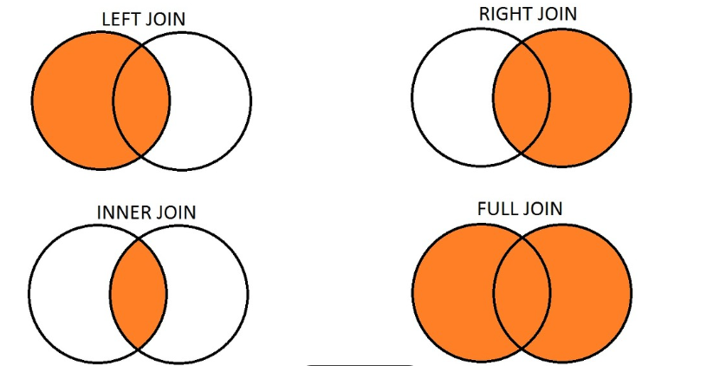
Types of joins in statistical software
Also called outer join
ANTI JOIN

Slide 13
The code
Joined_data <- inner_join(data1, data2, by=c("id" = "id"))
Joined dataset
Dataset #1
Unique IDs- present in both datasets
Type of join
Dataset #2

Slide 14
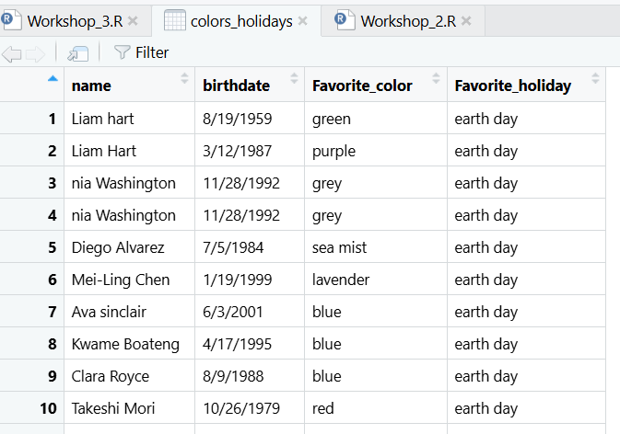
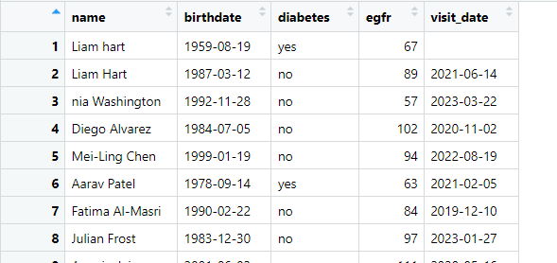
Our data
Maybe we can match on name and birthdate?

Slide 15
Merging the data
both_inner_2<-inner_join(data2,colors_holidays2, by = c("name" = "name", "birthdate" = "birthdate"))
New dataset
Type of join
Old dataset #1
Old dataset #2
Unique Identifiers (notice there are two)

Slide 16
Subsetting
Basic idea- we are going to remove some rows or columns
Removing columns
Removing rows

Slide 17
Why would you subset?
Keep only variables that you want for an analytical dataset
Remove missing data
Keep data meeting a certain condition (favorite color = blue) etc
Create datasets to be stacked or joined later
I am sure many other reasons

Slide 18
Example: Earth day only
earth_day<-subset(both_inner_2, Favorite_holiday=="earth day")
New dataset
Subset function
Old dataset
Condition
Note annoying double ==
Sometimes R uses single and sometimes double, its annoying
Usually double == when describing conditions

Slide 19
Questions?
Lets move to R

