Slide 1
Workshop 5
Loops, Markdown and Quarto

Slide 2
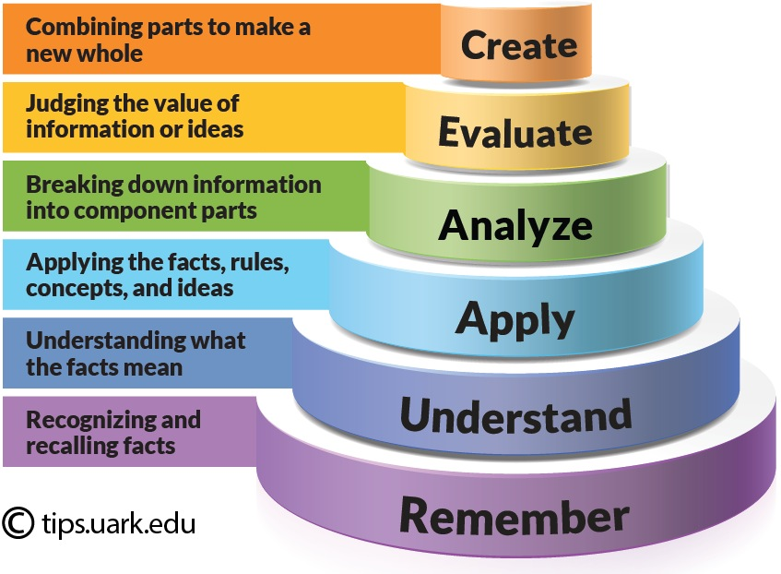
Presentation Contents
Review time– I was asked to do a quick review of last week for Runnels
Loops- the very most basic concepts
Making a document with Quarto- the very most basic concepts
Blooms Taxonomy

Slide 3
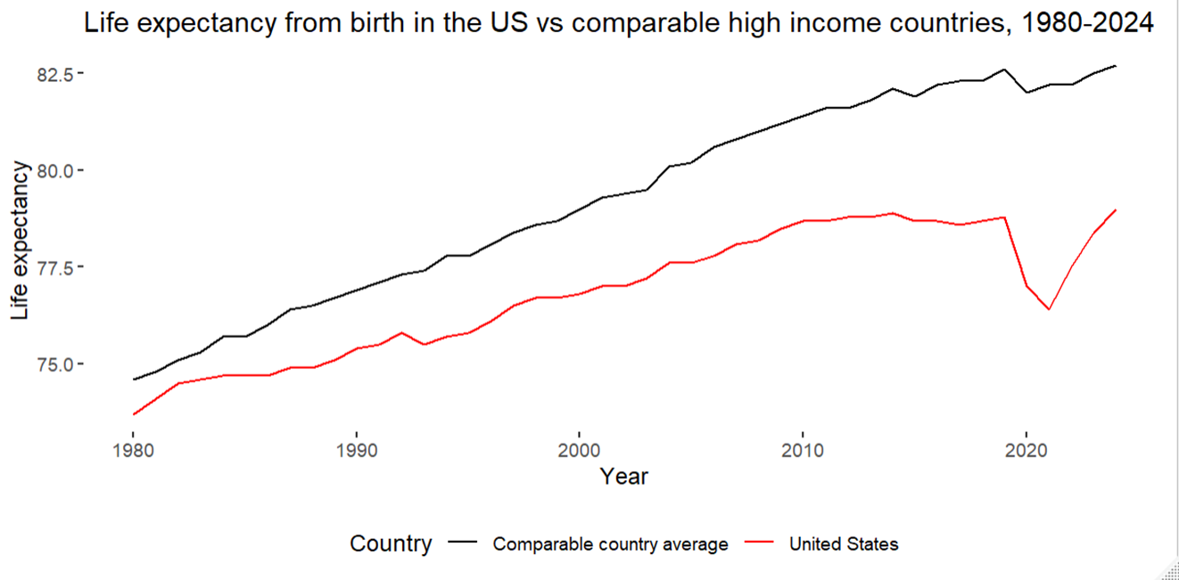
Review time?
I can jump back into the ggplot stuff from last week

Slide 4
Part 1: Loops
Specifically: for loops

Slide 5
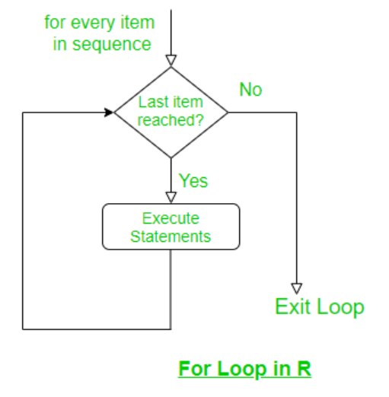
Why do we need loops?
Iterate over variables (columns)
Iterate over observations (rows)
Do a task many times –
  Run a bunch of different regressions
  Like bootstrapping if you are into this
Iterate over datasets
Helpful picture of for loop
(in my opinion)

Slide 6
The for loop
The for loop is used when we know the exact number of iterations required. It iterates over a sequence such as a vector, list or numeric range.
for (value in sequence)
{statement}

Slide 7
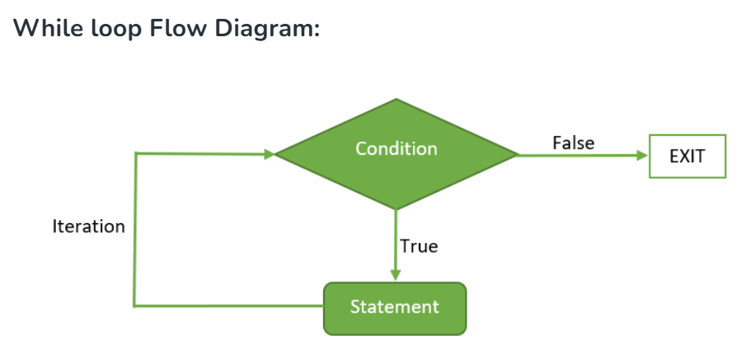
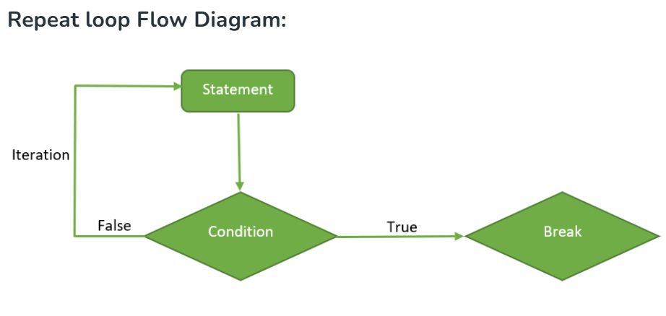
Other types of loops in R
The while loop runs as long as a specified condition holds TRUE. It is useful when the number of iterations is unknown beforehand
The repeat loop executes indefinitely until explicitly stopped using the break statement. To terminate the repeat loop we use a jump statement that is the break keyword.
Source: https://www.geeksforgeeks.org/r-language/loops-in-r-for-while-repeat/

Slide 8
Basic for loop syntax
for (i in 1:5)
{print(i)}
Sequence we are iterating through
“i” a placeholder variable, which will appear again in the function below
For- the type of loop we are using today
Everything inside the loop says what to do
For- the type of loop we are using today

Slide 9
Iterating through columns
for (i in 1:ncol(life_ex))
This says go from the first column to the end
for (i in 2:ncol(life_ex))
Go from the second column to the end
1 | 2 | 3 | 4 | …ncol

Slide 10
Iterating through rows
for (s in 1:nrow(df))
1 | 2 | 3 | 4 | 5
2
3
4
5
6
7
8

Slide 11
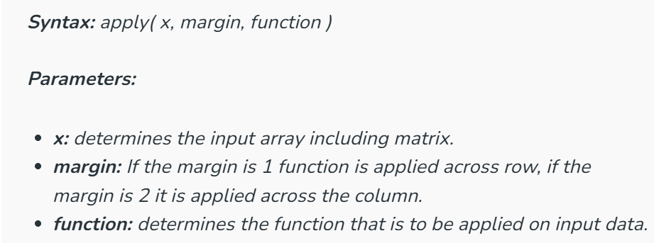
Addendum: apply() and lapply()
The apply() function lets us apply a function to the rows or columns of a matrix or data frame.
  Basically it (and functions like this) can be used to do a really similar thing
Other versions of this are lapply(), sapply(), tapply()
https://www.geeksforgeeks.org/r-language/apply-lapply-sapply-and-tapply-in-r/

Slide 12
Other stuff about loops
Different strategies may perform differently
For loops are generally recommended for columns, not rows due to computer slow down issues
One source I read says apply family is preferred
I had no real problems running a pretty complex for loop on a dataset of about 16,000 obs.
Your experience may vary, let me know any insights for future workshops

Slide 13
Part Deux: Markdown and Quarto
Also flextable is in the code: but I won’t go over it because I don’t have enough time

Slide 14

What is Markdown/ Quarto?
R Markdown is a file format for making dynamic documents with R.
An R Markdown document is written in markdown (an easy-to-write plain text format)
Quarto is the next generation tool to help make these types of files
Quarto is a posit product that helps write the markdown for you
  Posit is what the software company that made RStudio changed its name to

Slide 15
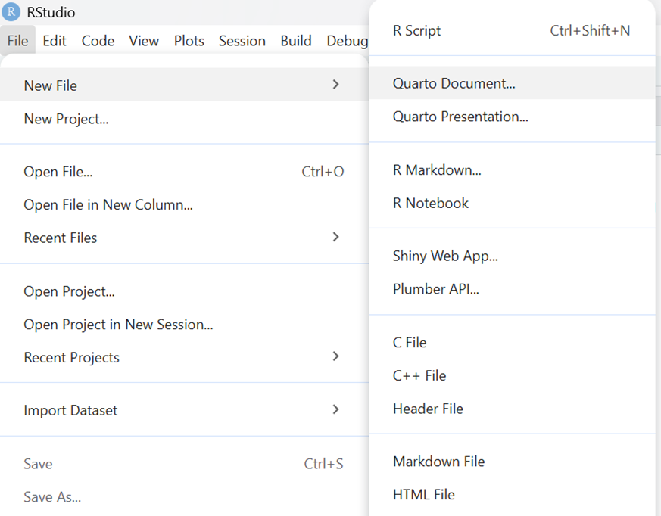
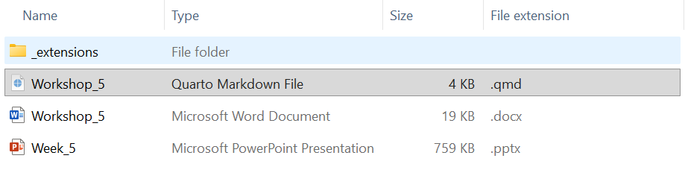
These are file types in R
Note the different options in creating a file, and the different extensions
Markdown was .rmd
Quarto is .qmd

Slide 16
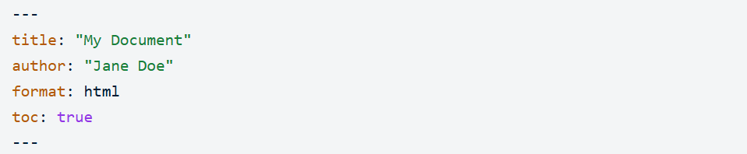
What is in the Header
The header of the Quarto document sets the global configurations
It is a block of YAML (a coding language) code
It is wrapped by three dashes ---
You can set some options and themes here, and you must have this block
Quarto writes it for you but you need to edit

Slide 17
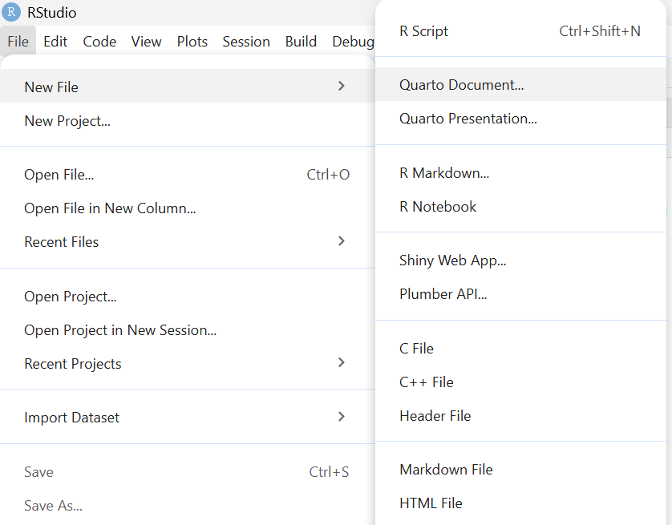
Creating the Quarto file
File>New File>Quarto Document

Slide 18
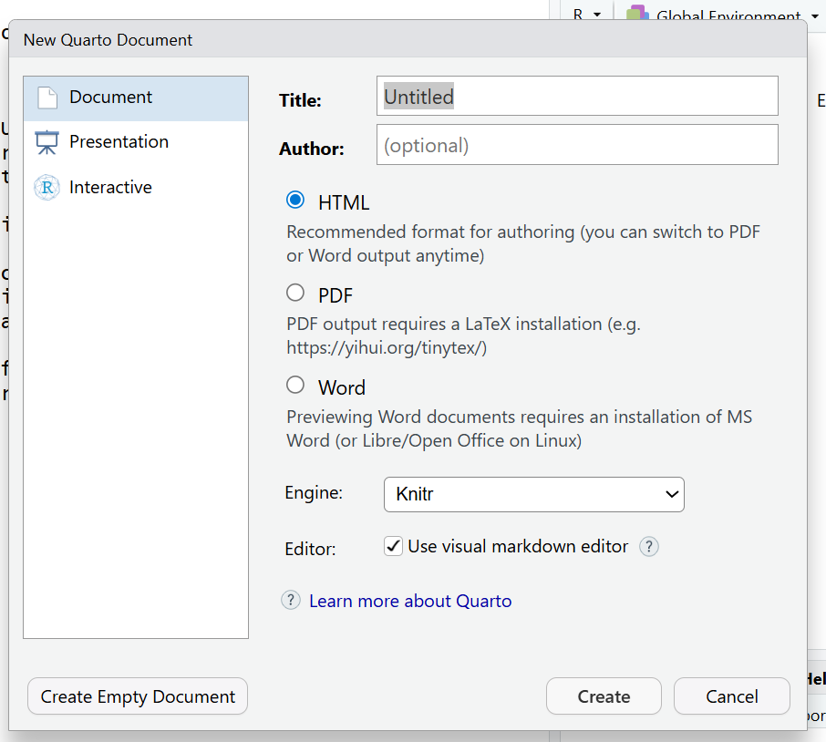
Some options
I chose word for this
Knitr is the engine for R
Jupyter is the engine for Python

Slide 19
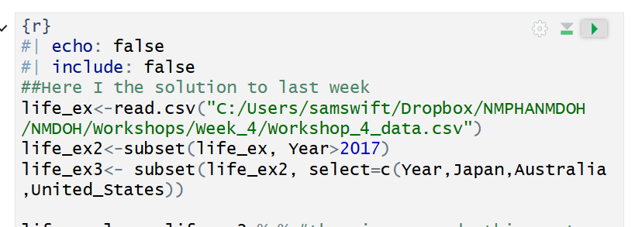
Coding in chunks
Markdown and Quarto allow you to organize and run code in chunks
Many of my friends code this way even when they are not making a report
Run code button

Slide 20
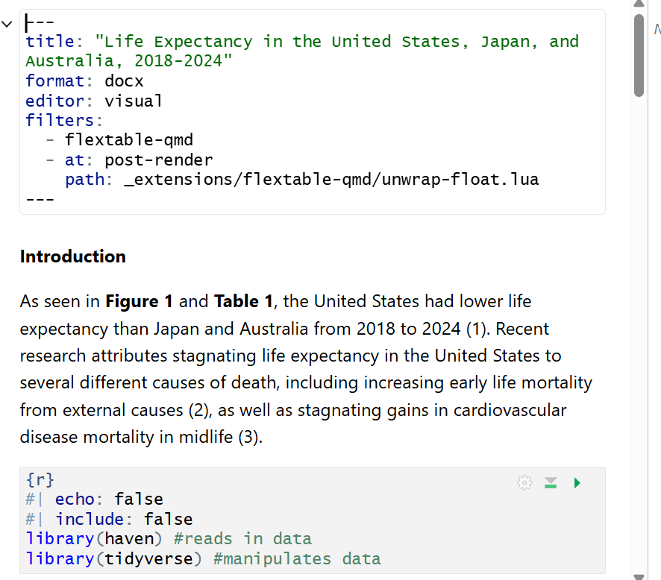
How it looks
Header that sets the global configurations
Text outside of the code chunk will appear in the document
R code that makes the actual graphs

Slide 21
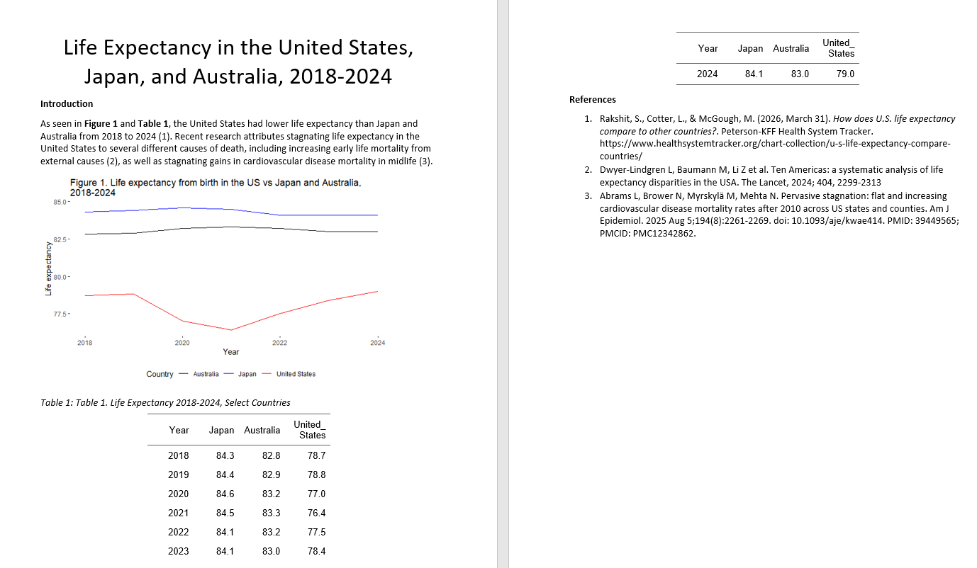
Finished document
Quarto will render this document in the same file you saved the code in

Slide 22
R lab will not be what I showed you
For learning Quarto– I will have everyone create a document and play with it on your own.

Slide 23
Resources:
A book on Quarto
https://quarto.org/docs/computations/r.html
A whole book on flex table (looks fun to read!):
https://ardata-fr.github.io/flextable-book/index.html

Slide 24

Questions?? Lets keep in touch!!
samswift@salud.unm.edu

