Slide 1
Workshop #1: Welcome to the R environment
What is R and how
do we open it, why would
we use it, and how?

Slide 2


About Me- Sam Swift, PhD, MPH
Emergency Medical Technician
UNM MPH
NMDOH Epidemiologist
University of Miami PhD (Social Epidemiology)
UNM Postdoc
Causal Inference Enthusiast
SAS & R, some Stata, ArcGIS, & Mplus
UNM Assistant Professor

Slide 3
Questions about the Workshop???
Email me!!!
samswift@salud.unm.edu

Slide 4
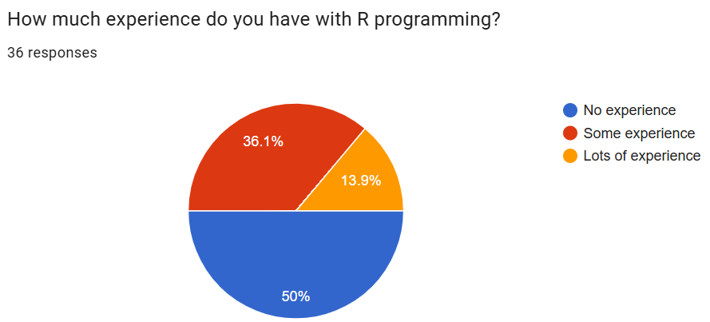
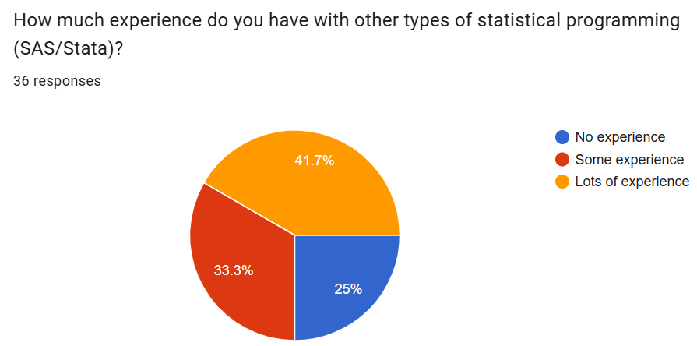
Survey Results (I know pie charts are bad)
25% have no coding experience at all
Today may be basic for the lots of experience people, but we can ramp up

Slide 5
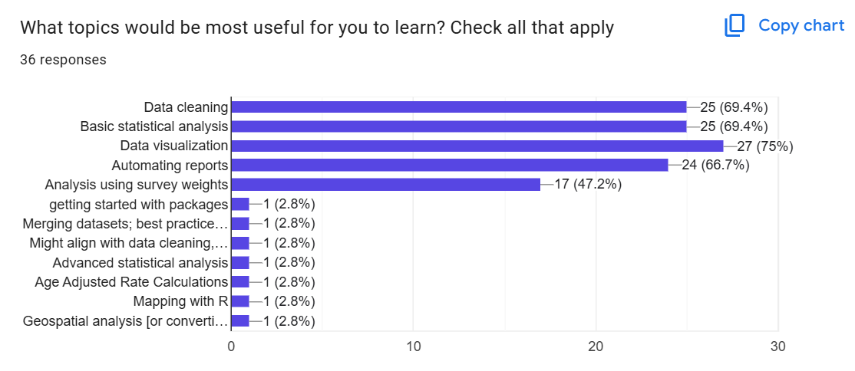
More survey results

Slide 6

Final (select) survey results
What should I cover?
Basic: Syntax, data viz- merges
More advanced: github, R shiny, functions similar to macros, mapping, multiple imputation
What helps you learn?
Instructor having empathy
Not too much info
Hands on/ interactive work/ homework
STOP DURING LECTURE FOR Qs

Slide 7
Presentation contents
Learning objectives
Be able to save data on your computer and read data into R studio
Understand the definitions of:
Objects
Functions
Scripts
Packages
File paths
Comments
What is R/ R studio
Objects
Functions
Scripts
Packages
Paths
Comments
Todays 4 key concepts

Slide 8
Workshops outline
Session 1. (August 2026): R basics, including what each window pane means, different menus, syntax, and packages
Session 2. (August 2026): R basics review, introduction to data cleaning and variable creation
Session 3. (August 2026): Intermediate data cleaning, joining datasets, and basic statistical analysis in R
Session 4. (September 2026): Data visualization with ggplot2
Session 5. (September 2026): Automating reports with R markdown and integration with GitHub
Survey weights here as well?
Loops?

Slide 9

Class Repository
https://github.com/SamSwift505/NMDOH_R_WORKSHOPS_26
All materials will be available here
Later we do a little more with github

Slide 10
Installing R and R studio
We need R and R studio to do this!
Instructions on how to install both R and R studio are below points A1-A3 here:
https://rstudio-education.github.io/hopr/starting.htmlLinks to an external site.
A video on installing R and R studio
https://youtu.be/Tb3R4GLJ45U
To run R Studio on your computer, you need to have both R and R Studio installed.
Both of these are applications that you download
You need admin privileges!

Slide 11
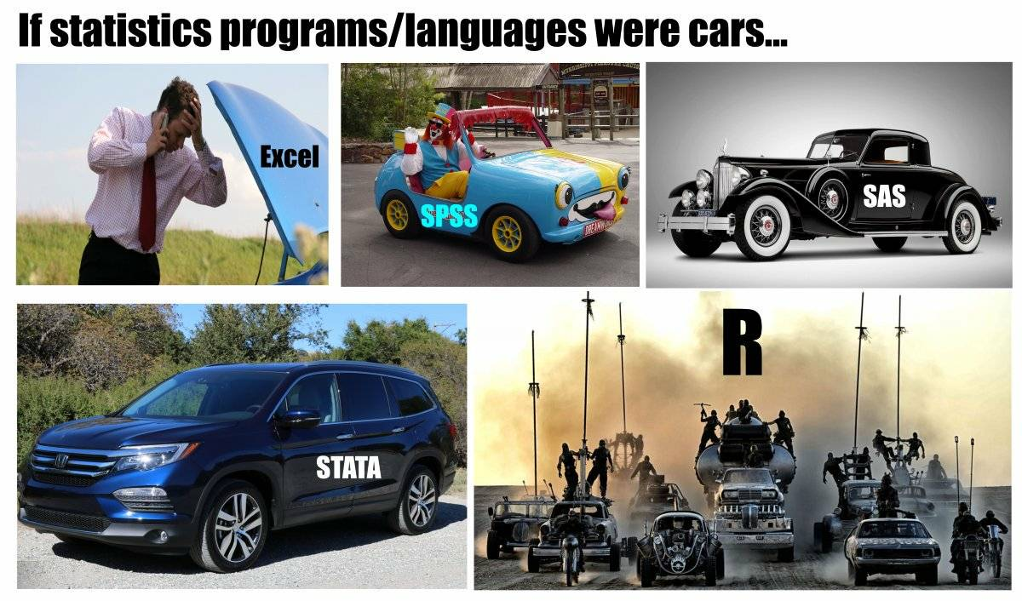
Entertaining meme

Slide 12







Language &
Environment
Statistics
What is
FREE!
?
Community
Customizable
Online Training
https://www.r-project.org/
Notes:
R is a language and programming environment that can be used for statistical computing and graphics. It was developed by statisticians so it is particularly well suited for statistical analysis. It can also be used as a storage facility.
One big advantage of R is that it is open source so it is free
There is a large online community to support users
R is customizable using “packages” that can be downloaded as needed. R has over 10,000 packages in the Comprehensive R Archive Network (CRAN) repository.
There are a number of online trainings, manuals, and books that are freely available online to support users

Slide 13

There are Some Disadvantages to R/ R studio
Can be less intuitive to learn then other programs
Updates require maintenance
Security
Can be slower than other languages
Some packages are not great quality
Memory management
Notes:
While there are many advantages to working in R, it is also important to note that there are some disadvantages

Slide 14
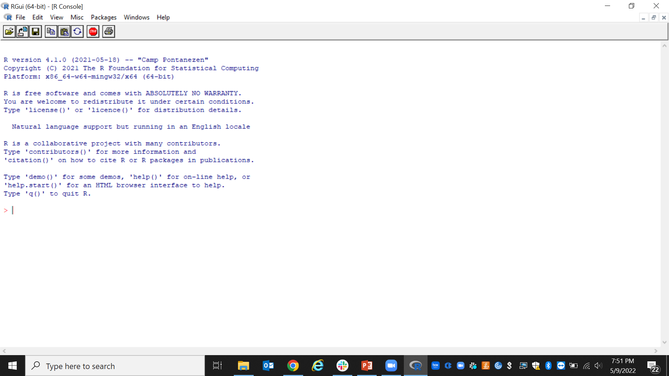
R vs R studio- Why do we need both?
By installing R, you install the code that R studio runs on
R studio us a “user friendly” (?) interface that we use to code in R
It is possible to work directly in the R Console, but it is clunky!

Slide 15
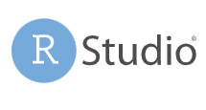
Plots
Code History
Best software ever!!! (For now)
Auto-Completion
Code/Script Editor
Cheat- sheets
https://www.rstudio.com/

Slide 16
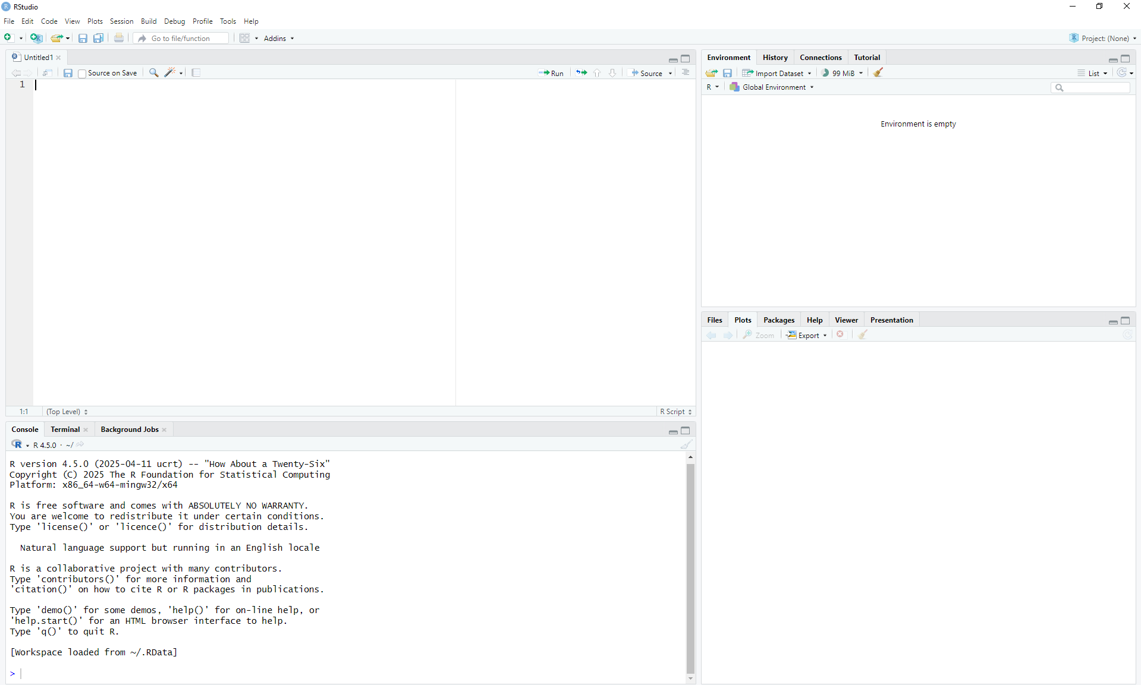
The script panel is where permanent programs can be saved
Objects you create will be saved here to the “global environment”
You can also freely code in the console here
Help/ packages/Plots will appear here, also you can access packages and the help window from here

Slide 17
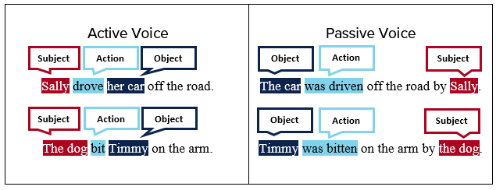

Code has syntax
Think of lines of code like learning a new language
To teach you this I do a special segment called
By the end of this class you will know some basic words and structure, I do not expect you to speak the language
Also please don’t use passive voice
Syntax Breakdown

Slide 18
Key Terms
Objects - Everything you store in R - datasets, variables, a list of village names, a total population number, even outputs such as graphs - are objects which are assigned a name and can be referenced in later commands.
Functions - A function is a code operation that accept inputs and returns a transformed output.
Packages - An R package is a shareable bundle of functions.
Scripts - A script is the document file that hold your commands.

Slide 19
Objects
Objects are things you make, like datasets, tables, graphs and more
The arrow operator (less than, dash) is what we use to assign things into objects
That operator looks like this
<-
The syntax we will use to make objects will look like this:
object_name <- value

Slide 20
Objects Continued
There are lots of different types of objects
We will mostly use data frames (datasets)
And plots (graph/plots)
Today I will show a simple “value” object
There are also many other more advanced ones
Vectors
Matrices
Lists (data frames are special lists)
Arrays
Don’t worry about memorizing these, just know that in R we make objects

Slide 21
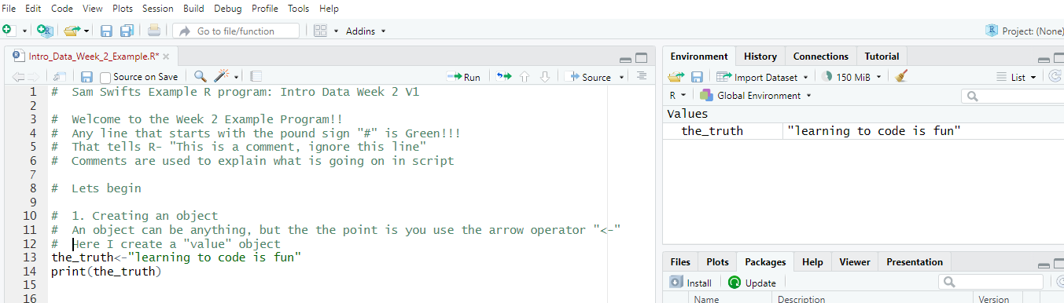
Objects Continued
When you make an object, it will appear in the top right “environment window”
The object appeared up here in “Environment”
I ran this code

Slide 22
Syntax Breakdown
Break it down
the_truth<-"learning to code is fun"
Like parenthesis, if you open quotes you must close them
The object we created, can be named anything AS LONG AS THERE ARE NO SPACES
A string of text- the computer knows its text because its in quotes
Our friend the arrow operator, says take what follows and put it in the object

Slide 23

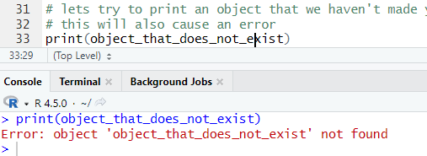
Error messages
If you make a mistake, R will error out!!!
Usually this happens with angry red text in the console window, or an X on the line where the error is
Errors are your friends– they help you learn!!

Slide 24
Debugging Errors
Our class is a community of practice
Lets work together in class discussions to help
Do not be embarrassed
If no one helps I will help
You can also paste errors into google (which I will demonstrate)
You can also ask AI but its often wrong

Slide 25
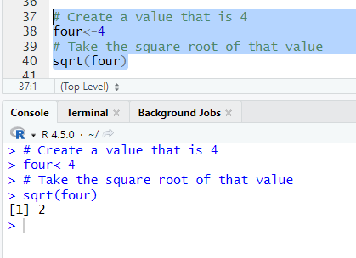
Functions
Functions preform tasks and operations
A function often wraps around an object, using parenthesis
Example:
Break it down
sqrt(four)
An object I made that is the number 4
The function– Note the parenthesis wrapping the object
Square root of 4 is 2

Slide 26

Packages
From your reading:
“An R package is a shareable bundle of code and documentation that contains pre-defined functions.”
This is the most exciting thing about R!!
In this class we will use three:
tidyverse (next week)
dplyr (next week)
ggplot2

Slide 27
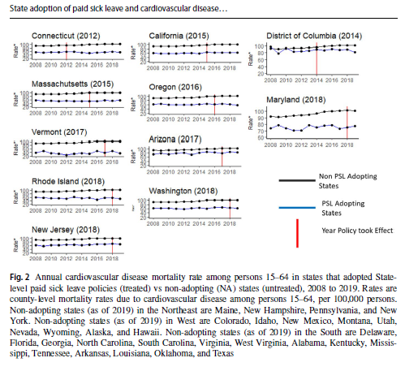
Ok… so what is a package??
Basically installing a package is like downloading more functions within R studio
Once you install ggplot2, you get access to a lot of amazing data visualization functions
Once you download it, its there forever, but you need to ask R studio to load it in each session (shown in 2 slides)

Slide 28
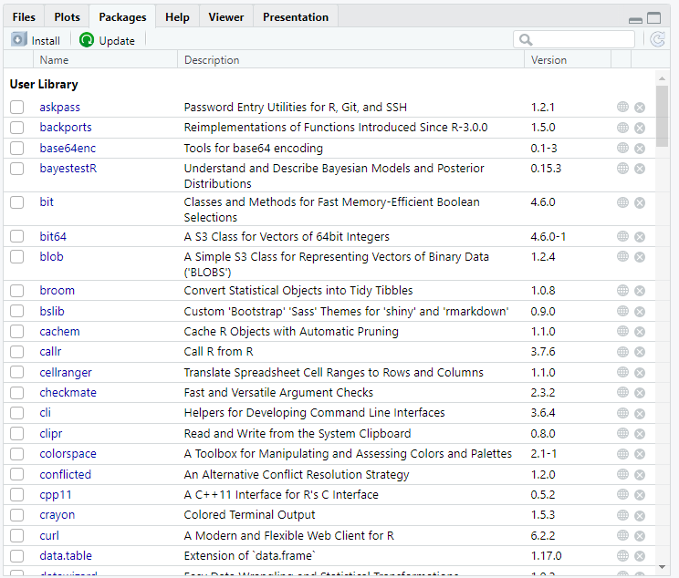
Downloading Packages
In the “packages” tab you can search for and download packages
You install it once using install.packages function
You can also type:
install.packages("<package name>") into the console
Once the package is downloaded, the contents can be made available by using:
library(<package name>)
You call the package in using the library function in every time

Slide 29

SYNTAX BREAKDOWNNNN
Function to install the first time
This is a comment, a line that does nothing but is used for documentation/ notes (starts with a hashtag)
The package we are installing/ using
Function to read package in every time- you must do this at the beginning of every R session

Slide 30

Commonly Used Packages
tidyverse: A collection of packages designed for data manipulation
dplyr: Shortcuts for sub-setting, summarizing, rearranging, and joining data
tidyr: Changing the layout of the data sets
stringr: Tools for regular expressions and character strings
lubridate: Makes working with dates and times easier
ggplot2: Create graphics
R Markdown: Can be used for automated reporting. Reports can be exported as HTML, pdf, or MS Word document

Slide 31
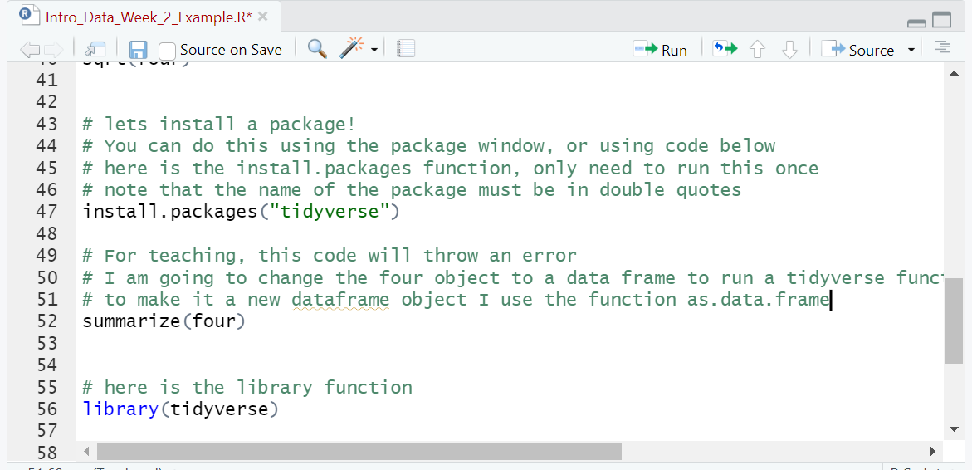
Scripts
By coding in the “scripts” window you have a file that you can come back to in later sessions
All statistical software has something like this
You will be required to save an upload a script for the homework
Red text means your version is unsaved
The run button will run highlighted code

Slide 32
File paths and reading in data
One of the hardest things for new users of statistical software is reading in data
For this workshop, there are three broad steps
Download the data from GitHub (demonstrated in video today)
Save the data in an organized place on your computer
Use code to tell R studio where the data is and read it in as a new object.
File paths are a key concept for the week- we use these to read data in and out

Slide 33
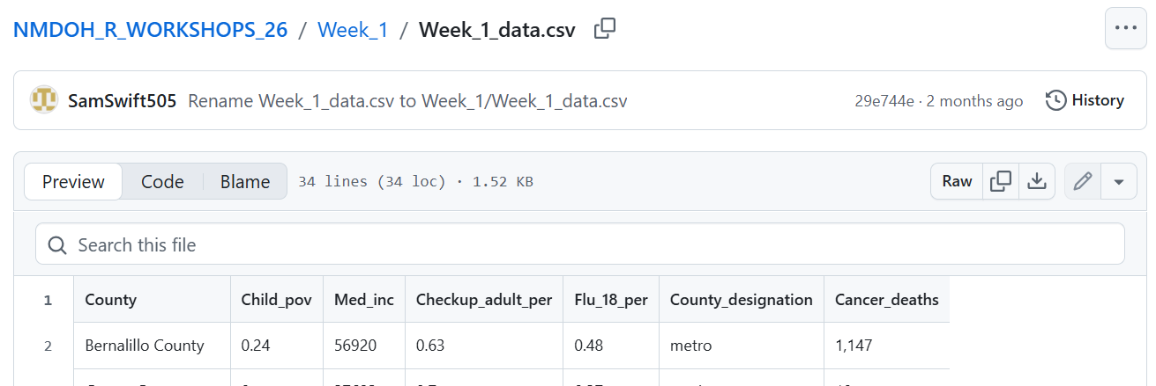
Downloading the data from github
Double clicking this downloads your data

Slide 34
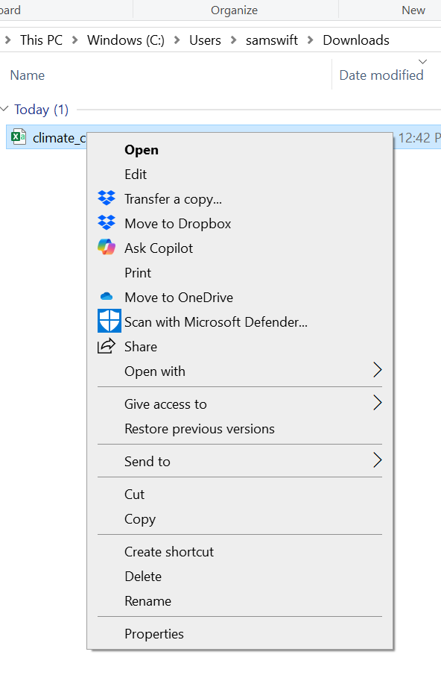
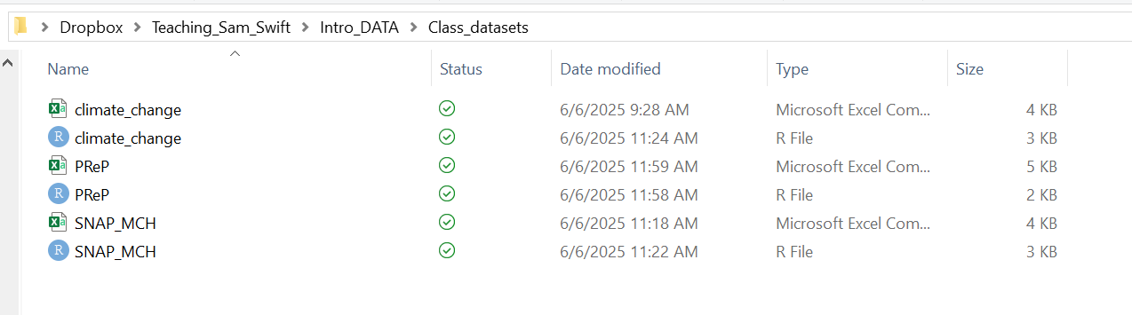
Save the file somewhere organized
There are different ways to save the downloaded folder, which I will show on the video

Slide 35
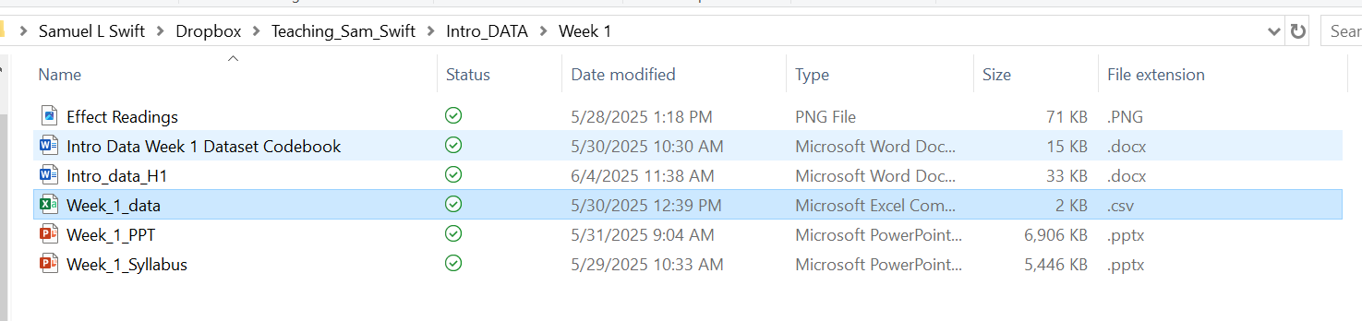
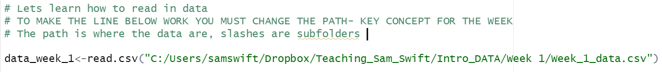
WHERE YOU SAVE IT IS THE FILEPATH
Looks like this in windows file explorer
Looks like this in R studio

Slide 36

File extensions
In general, they tell us a lot of stuff about what type of file we are using
In datasets, they can tell us about the statistical software we are using,
The datasets file extensions also tell us the delimiter
R packages can read in data from any statistical software

Slide 37
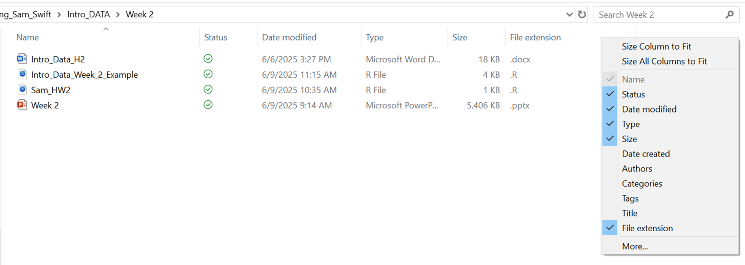
Add extensions to windows explorer/ finder
Windows explorer: https://lazyadmin.nl/win-11/show-file-extension-windows-11/
Finder (Mac): https://support.apple.com/guide/mac-help/show-or-hide-filename-extensions-on-mac-mchlp2304/mac

Slide 38
Anyway, Delimiters
Delimiters: Delimiters are characters that mark the boundaries between individual pieces of data within a file.
In this class we use CSV because the data are simple and do not cause problems for learners
.csv: Indicates comma-separated values.
.txt: Indicates a general text file, which can also be a delimited file.
.tsv: Indicates tab-separated values.
.psv: Indicates pipe-separated values.

Slide 39
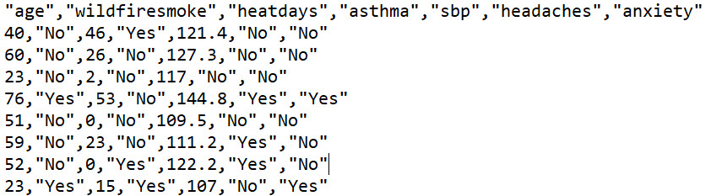
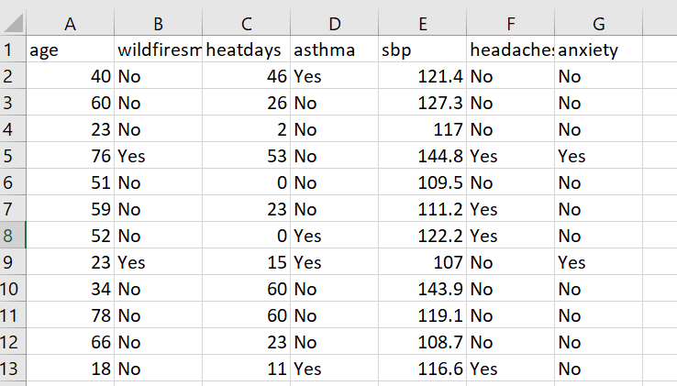
CSV behind the scenes
What looks like this in Excel
I will only use CSV in this class, and this is why
Looks like this in its raw form, which is easy for different software to understand
Note the commas!

Slide 40
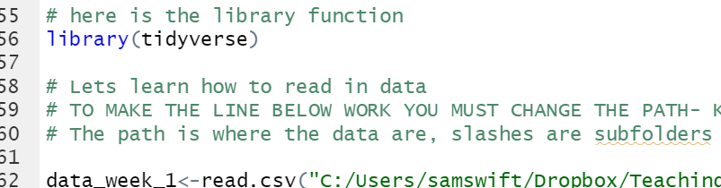
Comments
Comments start with this symbol #
(AKA octothorpe, pound sign, hashtag)
These are used to document your code
If you highlight these and run them nothing happens
These are extremely useful for
Reproducible science
Trying to be a good teacher teaching people to code for first time
You will type your HW answers as comments this week

Slide 41

Running Code
To run code, you can highlight a line of code and push the run button
If there are open parenthesis on two lines, you need to highlight both
You can also click on a line and push control+enter
Command+enter on Mac
They made this button way too small!!!

Slide 42

Open Source: A Blessing and A Curse
It is a scientific innovation that anyone, anywhere can write packages
This increases reproducibility, shared knowledge, and innovation
It also means sometimes syntax may vary slightly
In extreme cases, packages can be wrong (none that we will be working with)

Slide 43

Questions?? Lets go to R
EMAIL ME MORE QUESTIONS:
samswift@salud.unm.edu

