Slide 1
Workshop #2
R Basics, Summary Statistics, Data Manipulation, Data Cleaning

Slide 2
Presentation Contents
Quick review of last week
Creating new datasets and sub setting
Variable creation and data cleaning
Summary statistics in R
Aggregating variables by other variables
Learning Objectives
Students will apply functions for:
Sub setting
Variable creation
De-duplication
Basic data cleaning
Basic summary statistics
*All functions today come from tidyverse package
Schedule:
8-8:30 slides
8:30- 8:45 Sam demonstrates R
8:45- close interactive R time

Slide 3
Review Content

Slide 4
What is an object? (in R!!)
The part of the sentence that the verb is acting on
The thing you yell in the court room when the lawyers are out of order
The part of R where you save programs you write
Things that you make in R using the arrow operator <- such as datasets and plots
All of the above

Slide 5
What is a function? (in R)
A nice party after work with appetizers and polite conversation
A self contained block of code that can perform actions, like a square root, or more advanced data cleaning
The part of R where you save programs you write
Things that you make in R using the arrow operator <- such as datasets and plots
None of the above

Slide 6
What is a Package? (in R)
A structured collection of compiled functions, code and documentation that you load into R to write certain types of code
Something fun you get to unwrap on seasonal holidays
A and C
Things that you make in R using the arrow operator <- such as datasets and plots
None of the above

Slide 7
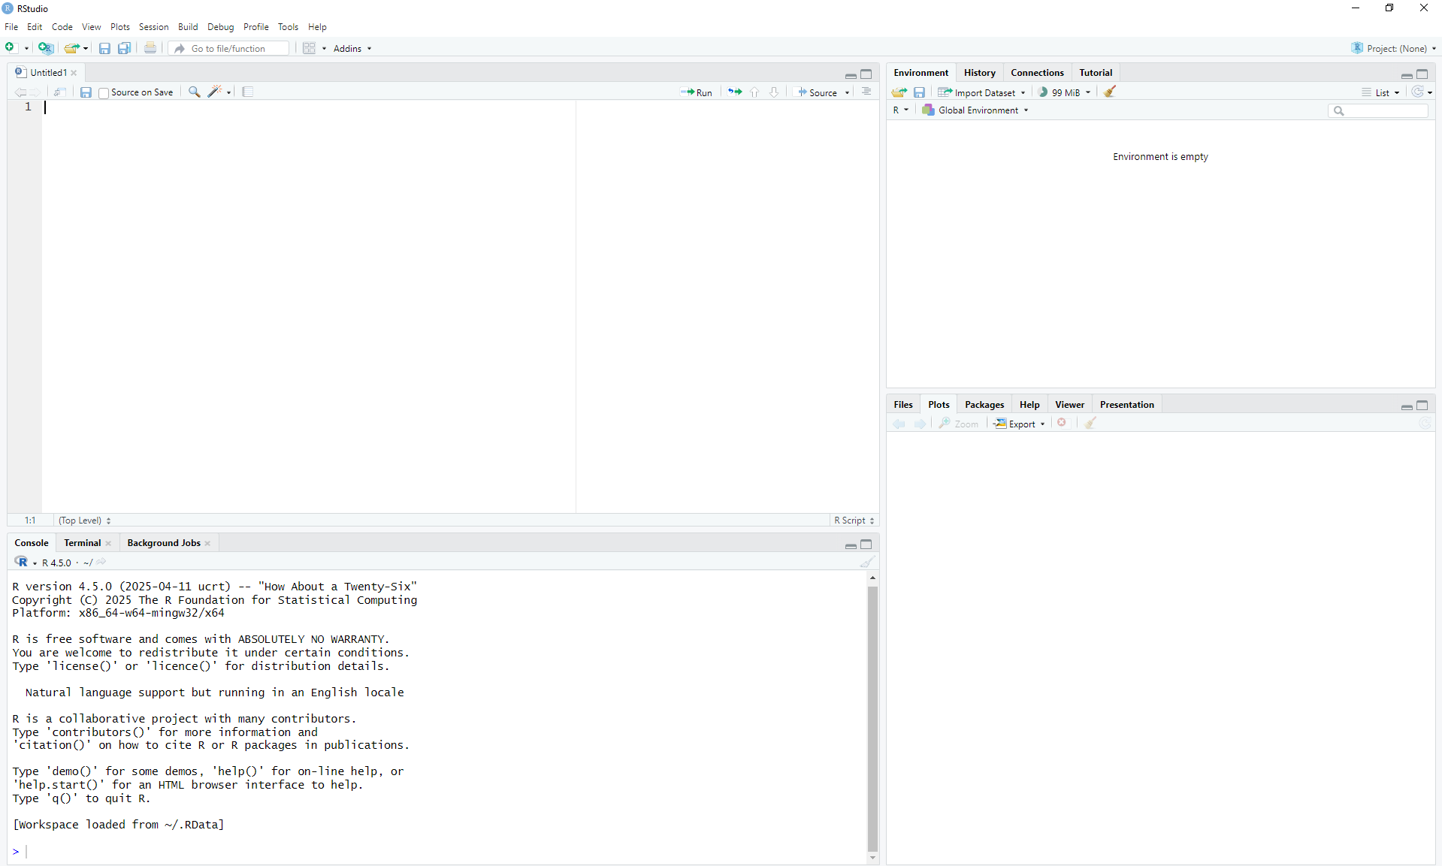
Name that pane!?!?
The script panel is where permanent programs can be saved
Objects you create will be saved here to the “global environment”
You can also freely code in the console here
Help/ packages/Plots will appear here, also you can access packages and the help window from here

Slide 8
Important Syntax
The arrow operator <- creates objects
Like this: newdata<-olddata
Functions usually wrap other stuff in parenthesis ()
Like this: function(dataset$variable)
Like this sqrt(4)
Filepaths tell R where our data are saved:
data<-read.csv("C:/YOUR_FOLDER/YOUR_SUB_FOLDER/data.csv")

Slide 9
New Content!

Slide 10
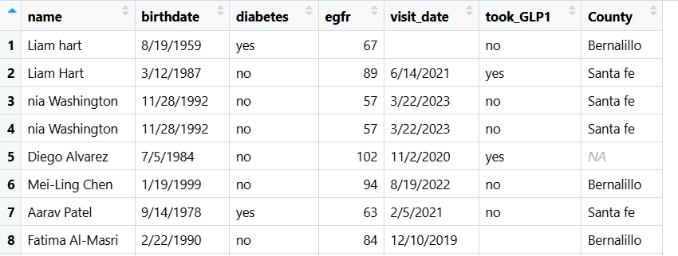
Todays data
Made up and partially AI simulated data from some clinics in NM
Info on estimated glomerular filtration rate (a measure of kidney function) and GLP-1 use
Take a minute to look at the data and let me know what you notice/ think about these data in the chat.

Slide 11

Oh no, there are problems with our data!
Duplicates
Problems with the cases of the names
Two people with same name?
Different coding for missing
Impossible values
WE CAN SOLVE THESE PROBLEMS!!!

Slide 12

Introducing.. The dollar sign
$
The dollar sign refers to variables within a dataset
Like this: dataset$variable
We can use this to examine and create variables
We can use this for data cleaning!!
We can use this for simple statistics on variables

Slide 13
Summary stats (lets look at the data)

Slide 14
Introducing: data.frames and dollar signs
When you read your csv in it creates a “data.frame” object by default
Dataframes are easy to work with data formats in R
You can also turn some objects into dataframes
The dollar sign ($) says “the thing after this is a variable within this dataframe”
The dataframe which is this weeks dataset
summary(data$egfr)
The variable we are summarizing
summary() function
Note the parenthesis
$ tells us a variable from the data.frame is coming next

Slide 15
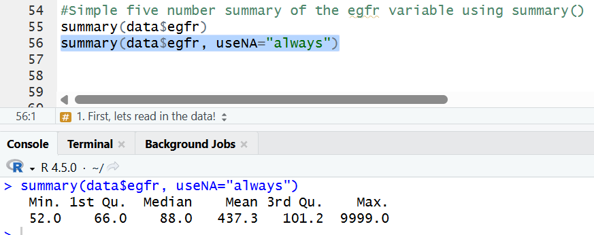
Summary function for continuous variables
Do you see anything possibly wrong here?

Slide 16
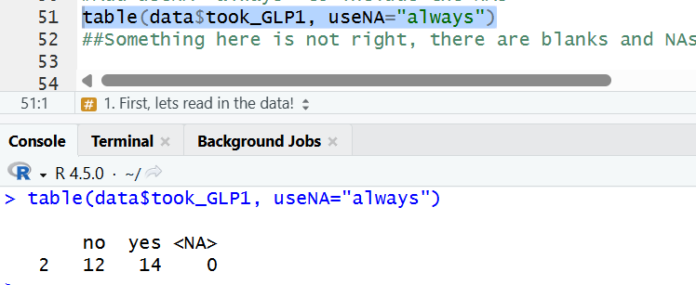
table() function for categorical variables
table(data$took_GLP1, useNA="always")
A function (make a table)
Include NAs in the table
$
Our variable
Our dataset

Slide 17
Lets clean these data🧹

Slide 18
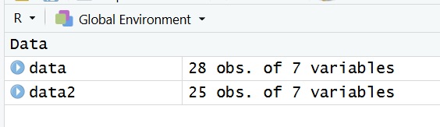
Removing duplicates
unique() function will keep only unique
Here I make a new dataset with only unique
data2<-unique(data)
<-
This means it removed two duplicates
New dataset
Old dataset
unique() function

Slide 19
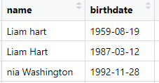
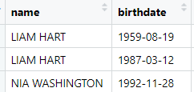
Changing capitalization
toupper() function capitalizes the whole variable
data$name<-toupper(data$name)
Dataset$variable
function
Dataset$variable
Here I am writing over the original variable, you can also create a new variable

Slide 20
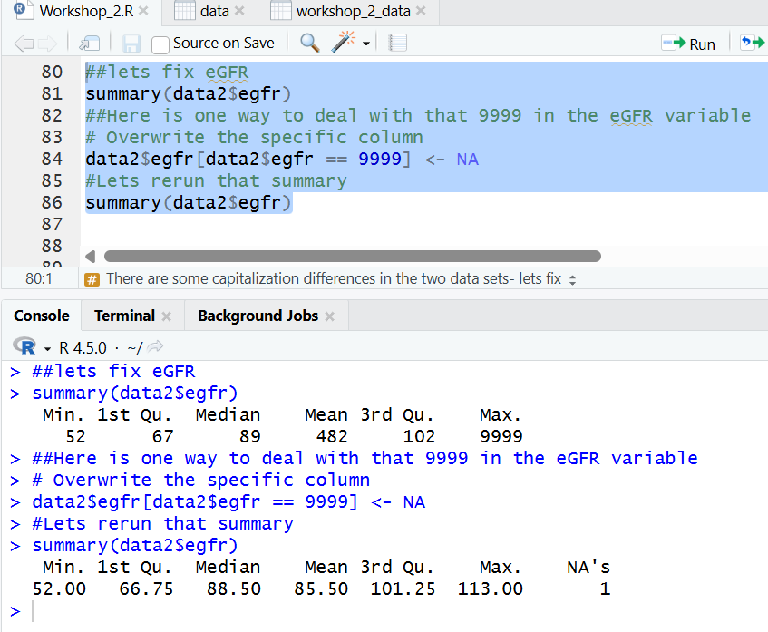
One way to write over NAs
These brackets just say “when this variable is this value, do this”
data2$egfr[data2$egfr == 9999] <- NA
There are many other ways to do this– maybe you can try some later today!!

Slide 21
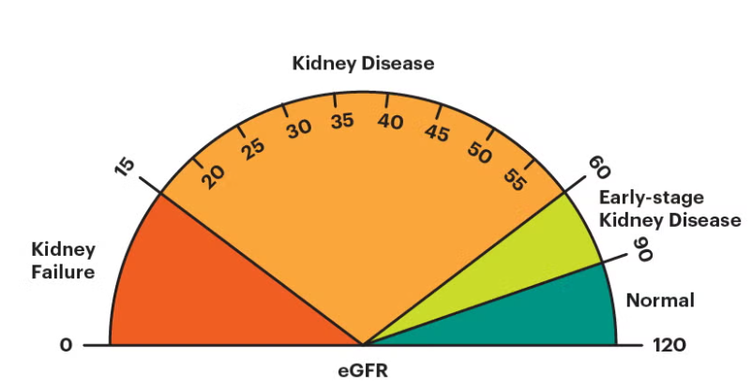
Lets make a categorical cutoff for EGFR
eGFR
Recommended cutoffs at 90 for reduced function, 60 for kidney disease
Continuous in our dataset, lets make it categorical

Slide 22
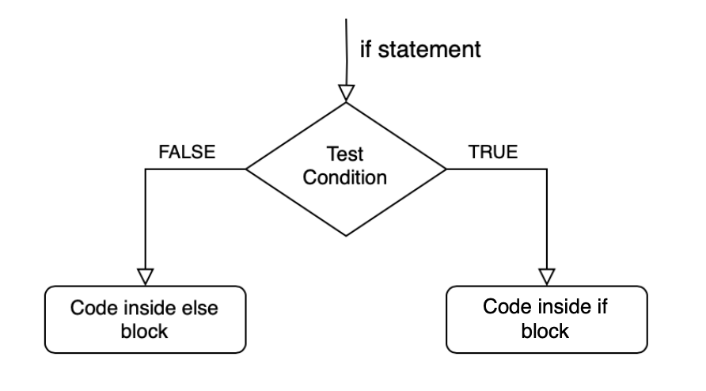
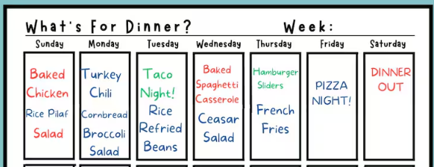
If else logic
Classic coding logic
I prefer case_when in r or select when in SQL
If else says “if this” do this, “else” do that
This can cause problems when “else” is multiple different things

Slide 23
Making a new variable: option 1
Syntax breakdown
Value of new variable if below cutoff
data2$kidney_function <- ifelse(data2$eGFR > 90,c("normal"), c("reduced"))
The arrow operator (make an object that is a new variable in this dataset)
yourdata$yourOLDvariable
Value of new variable if above cutoff
The cutoff, note “>” greater than sign
yourdata$yourNEWvariable
ifelse function which says “if this do this, if not do that”

Slide 24
Making a new variable: Option 2
tidyverse must be run in the session to do this
Library(tidyverse) must run first
Then
data2 <- data2 %>%
mutate(kidney_3cat=case_when(egfr<=60~"kidney disease", egfr<=90 & egfr >60~ "early stage kidney disease", egfr>90~"normal",
TRUE~NA))
Take your dataset and write over it with a new dataset (NOTE THE ARROW)
This thing just means “do this next” in tidy verse
The name of the old variable, the cutoff and the new value
The name of the new variable
If conditions are not met, make it NA
case_when is similar to
Ifelse, it means when this do this, when this do this

Slide 25
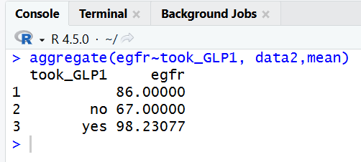
Aggregating a continuous variable by a categorical one
What if I want the mean eGFR in each category of sodium intake
(or means for the topics you are working on in your data)
Enter, the aggregate function
aggregate(eGFR~took_GLP1, data2,mean)
The statistic you want
Can be means, sums, medians, etc
Here is a mean
The function
The categorical variable you want the continuous variable grouped by
The continuous variable you want aggregated
Your data

Slide 26
A table with two variables
Pretty similar to one variable
table(data2$has_diabetes, data2$kidney_function, dnn=c("has_diabetes", "Kidney function") )
First variable
Second variable
This code at the end adds some nice labels, (optional) which appear in same order as the variables did earlier in this code
table() function

Slide 27
Next week:
Next week I will do a little more data cleaning before transitioning into joins/ merges
Bing your own data and we can do some live collaboration!

Slide 28
LETS CODE
Email me with questions:
samswift@salud.unm.edu

