Slide 1




Open-Domain Search Assistant
Gonçalo Antunes
53044
João Diogo
50483
Samuel Viegas
53600

Slide 2
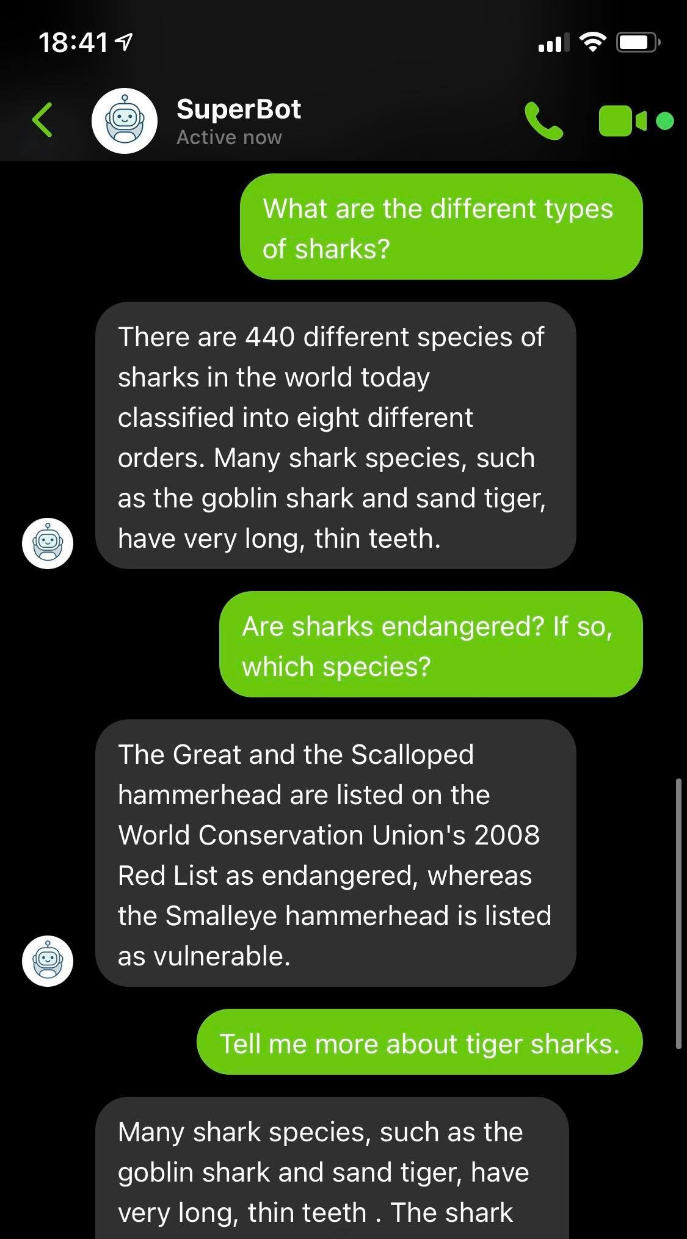

CHATBOT
How are these answers generated?

Slide 3

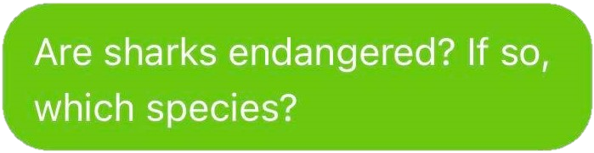
CHATBOT
Great white sharks on way to endangered. Great white sharks off the coast of California are safer, at least for now. Great white sharks may be listed as endangered species. California To Consider Listing Great White Shark As Endangered Species. Calif. (…)
Status January 10, 2005 ( www.redlist.org) The Red List of the IUCN (The World Conservation Union) contains the names of endangered animal and plant species, and unfortunately includes many shark species. The degree of endangerment to the various species is determined on the basis of seriously documented criteria (see Red List Criteria). (…)
50 shark species are listed as vulnerable, endangered, or critically endangered by the IUCN, but only the Great White, Whale, and Basking sharks are protected internationally by CITES (the Convention on International Trade in Endangered Species).
Doc. 1
Doc. 2
Doc. 3
Hammerhead shark is probably the weirdest type of sharks. There are nine species of hammerhead sharks that inhabit all oceans of the world. Hammerhead sharks can be found both in deep and shallow waters. Out of nine species, two are listed as endangered (great hammerhead and scalloped hammerhead) and one as vulnerable (golden hammerhead) species.
Hammerhead sharks can be found both in deep and shallow waters. Out of nine species, two are listed as endangered (great hammerhead and scalloped hammerhead) and one as vulnerable (golden hammerhead) species. People pose the greatest threat for the survival of the hammerhead sharks. (…)
Some of the most common predators are dusky shark, great white shark, tiger shark, and bull shark. Mostly the calves fall victim to these enemies. Another reason as to why these species are becoming endangered is that dolphins also suffer from parasites and diseases.(…)
Great White Shark's Endangered Species Listing Proposed In California. SAN FRANCISCO, Feb 6 (Reuters) - The California Fish and Game Commission voted on Wednesday to recommend protection of the great white shark, the world's largest predatory fish, in waters along the Pacific Coast, under the state's endangered species law.
Doc. 4
Doc. 5
Doc. 6
Doc. 10
Well, there are 9 different species of Hammerhead Sharks : Winghead shark Scalloped bonnethead White fin hammerhead Scalloped hammerhead Scoophead Great hammerhead Bonnethead Smalleye hammerhead Smooth hammerhead The Great and the Scalloped hammerhead (…)
Although the skipjack tuna itself is considered a fully sustainable commercial fish, they catching methods used for fishing are the topic of debate. (…)
Squalene is shark liver oil that had been used as one of the most common moisturizers in cosmetics before sourcing began endangering the species and a plant-based version became viable for products. Squalene is derived by hydrogenation of squalene
Doc. 7
Doc. 8
Doc. 9

Slide 4
CHATBOT
Status January 10, 2005 ( www.redlist.org) The Red List of the IUCN (The World Conservation Union) contains the names of endangered animal and plant species, and unfortunately includes many shark species. The degree of endangerment to the various species is determined on the basis of seriously documented criteria (see Red List Criteria). (…)
50 shark species are listed as vulnerable, endangered, or critically endangered by the IUCN, but only the Great White, Whale, and Basking sharks are protected internationally by CITES (the Convention on International Trade in Endangered Species).
Great white sharks on way to endangered. Great white sharks off the coast of California are safer, at least for now. Great white sharks may be listed as endangered species. California To Consider Listing Great White Shark As Endangered Species. Calif. (…)
Hammerhead shark is probably the weirdest type of sharks. There are nine species of hammerhead sharks that inhabit all oceans of the world. Hammerhead sharks can be found both in deep and shallow waters. Out of nine species, two are listed as endangered (great hammerhead and scalloped hammerhead) and one as vulnerable (golden hammerhead) species.
Doc. 2
Doc. 3
Doc. 1
Doc. 4
Great White Shark's Endangered Species Listing Proposed In California. SAN FRANCISCO, Feb 6 (Reuters) - The California Fish and Game Commission voted on Wednesday to recommend protection of the great white shark, the world's largest predatory fish, in waters along the Pacific Coast, under the state's endangered species law.
?
Hammerhead sharks can be found both in deep and shallow waters. Out of nine species, two are listed as endangered (great hammerhead and scalloped hammerhead) and one as vulnerable (golden hammerhead) species. People pose the greatest threat for the survival of the hammerhead sharks. (…)
Doc. 10
Doc. 5
Squalene is shark liver oil that had been used as one of the most common moisturizers in cosmetics before sourcing began endangering the species and a plant-based version became viable for products. Squalene is derived by hydrogenation of squalene
Some of the most common predators are dusky shark, great white shark, tiger shark, and bull shark. Mostly the calves fall victim to these enemies. Another reason as to why these species are becoming endangered is that dolphins also suffer from parasites and diseases.(…)
Although the skipjack tuna itself is considered a fully sustainable commercial fish, they catching methods used for fishing are the topic of debate. (…)
Well, there are 9 different species of Hammerhead Sharks : Winghead shark Scalloped bonnethead White fin hammerhead Scalloped hammerhead Scoophead Great hammerhead Bonnethead Smalleye hammerhead Smooth hammerhead The Great and the Scalloped hammerhead (…)
Doc. 9
Doc. 6
Doc. 8
Doc. 7

Slide 5
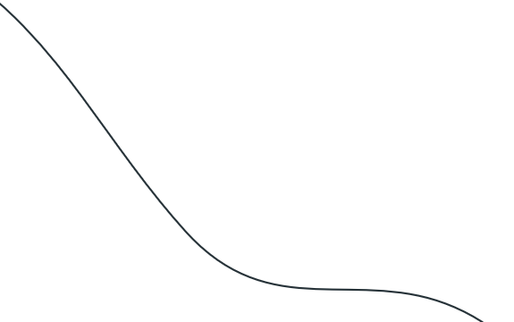
CHATBOT
Context
Sharks
Music
Netflix

Slide 6
CHATBOT
Entities

Slide 8
Dataset de Perguntas e Respostas

Slide 9

Perguntas
Json
Repositório Github
(sem sujeitos subentendidos ou pronomes na pergunta)
Python Pickle
Respostas
Retrieval das 10 melhores respostas usando LMD (Language Model with Dirichlet smoothing)
Json
Dataset Microsoft + Wikipedia MSMARCO E CAR

Slide 10
Extração de entidades

Slide 11

Para a extração de entidades usamos um Name Entity Linker disponível via web. Enviamos os pedidos para o servidor e é retornada uma resposta com as entidades presentes. O Name Entity Linker que usamos é o DBpediaSpotlight.
Python Pickle
Resposta REST
Iterando e enviando um
Pedido REST por cada pergunta e/ou resposta
Servidor Dbpedia Spotlight
“Parsing” dos campos da resposta REST
Junção de entidades em que só mudam as letras minúsculas ou maiúsculas
Entidades

Slide 12

Entidades

Slide 13
Coleção das entidades
AllEntityMatrix
Entidade | Vetor de posição da entidade
Cancer | [1,1,0,1,0,0,0,0]
Lharynx | [1,1,0,1,0,0,0,0]
Throat | [1,1,0,1,0,0,0,0]
[0]
…
…
[ n -> numero de tópicos ]

Slide 14
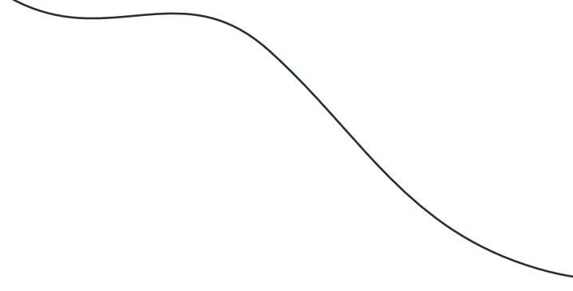
Entidade | Vetor de posição da entidade
Cancer | [1,1,0,1,0,0,0,0]
Lharynx | [0,1,1,1,1,0,0,0]
Throat | [0,1,0,1,0,0,1,0]
Conteúdo do vetor de posição das entidades
Modo Normal
Pergunta | R1 | R2 | R3 | R4 | R5 | R6 | R7
1 | 1 | 0 | 1 | 0 | 0 | 0 | 0
0 | 1 | 1 | 1 | 1 | 0 | 0 | 0
0 | 1 | 0 | 1 | 0 | 0 | 1 | 0

Slide 15
Entidade | Vetor de posição da entidade
Cancer | [1,1,0,1,0,0,0,0]
Lharynx | [0,1,1,1,1,0,0,0]
Throat | [0,1,0,1,0,0,1,0]
Aperfeiçoamento do modo 2 + 3 :
Modo 2 : Aperfeiçoamento tendo em conta a pergunta que introduz o tópico ( 1º pergunta )
Modo 3 : Aperfeiçoamento tendo em conta as entidades que aparecem em todas as perguntas
Modo Normal
Aperfeiçoamento do modo 2 + 3
Pergunta ( P1 ) | R1 | R2 | R3 | R4 | R5 | R6 | R7
1 | 1 | 0 | 1 | 0 | 0 | 0 | 0
0 | 1 | 1 | 1 | 1 | 0 | 0 | 0
0 | 1 | 0 | 1 | 0 | 0 | 1 | 0
P2 | P3 | P4 | P5
1 | 1 | 1 | 1
1 | 0 | 1 | 0
0 | 1 | 0 | 0

Slide 16
Construção da Matriz de entidades

Slide 17
Entidade | Vetor de posição da entidade
Cancer | [1,1,0,1,0,0,0,0]
Lharynx | [0,1,1,1,1,0,0,0]
Throat | [0,1,0,0,1,0,1,0]
1. Iterando pelo numero de entidades
2. Retira-se o vetor de posição
[1,1,0,1,0,0,0,0]
[0,1,1,1,1,0,0,0]
[0,1,0,0,1,0,1,0]
4. Constrói-se a Transposta ( linhas da antiga matriz são agora as colunas )
3. Constrói-se a matriz de ocorrências
Respostas | Cancer | Lharynx | Throat
Resposta 1 | 1 | 1 | 1
Resposta 2 | 0 | 1 | 0
Resposta 3 | 1 | 1 | 0
Entidade | Resposta 1 | Resposta 2 | Resposta 3
Cancer | 1 | 0 | 1
Lharynx | 1 | 1 | 1
Throat | 1 | 0 | 0
Foco nas respostas
Foco nas entidades

Slide 18
Com a matriz de ocorrências e a transposta, multiplicam-se essas matrizes e obtêm-se a matriz de entidades.
Ocorrências
Entidade | Resposta 1 | Resposta 2 | Resposta 3
Cancer | 1 | 0 | 1
Lharynx | 1 | 1 | 1
Throat | 1 | 0 | 0
Matriz de Entidades
Entidade | Cancer | Lharynx | Throat
Cancer | 3 | 1 | 2
Lharynx | 1 | 6 | 3
Throat | 2 | 3 | 2
Transposta
Respostas | Cancer | Lharynx | Throat
Resposta 1 | 1 | 1 | 1
Resposta 2 | 0 | 1 | 0
Resposta 3 | 1 | 1 | 0

Slide 19
Aplicação do Pagerank

Slide 20
Entidade | Cancer | Lharynx | Throat
Cancer | 3 | 1 | 2
Lharynx | 1 | 6 | 3
Throat | 2 | 3 | 2
Pagerank
Pela página da Wikipédia da entidade, contam-se os links para fora dessa página e os links de outras páginas para dentro da página da entidade.
Scores
[ 0,18384 0,04506 0,10345 ]
No final, obtêm-se um score ponderado da importância da entidade.
[ Cancer Lharynx Throat ]

Slide 21
Re-rank das Respostas

Slide 22
Sendo que temos um peso ponderado de cada entidade, podemos usar essa “importância” calculada e reordenar as respostas.
Usamos a transposta por ter as respostas como foco e somamos a importância das entidades que estão presentes nessa resposta. (onde existe um 1)
Transposta
Scores
Respostas | Cancer | Lharynx | Throat
Resposta 1 | 1 | 1 | 1
Resposta 2 | 0 | 1 | 0
Resposta 3 | 1 | 1 | 0
[ 0,18384 0,04506 0,10345 ]
[ Cancer Lharynx Throat ]
Nova Ordem:
Resposta 1
Resposta 3
Resposta 2
Resposta 1 : 1 * 0,18384 + 1 * 0,04506 + 1 * 0,10345 = 0,33235
Resposta 2 : 1 * 0,04506 = 0,04506
Resposta 3 : 1 * 0,18384 + 1 * 0,04506 = 0,2289

Slide 23
Original
Respostas | Conteúdo | Scores
Resposta 1 | “Throat cancer is originated in the Lharynx. ” | 0,33235
Resposta 2 | “The Lharynx is near the pharynx and can suffer infection.” | 0,04506
Resposta 3 | “Lharynx cancer is one type of cancer.” | 0,2289
Dataframe ordenado por “Scores”
Reordered
Respostas | Conteúdo | Scores
Resposta 1 | “Throat cancer is originated in the Lharynx. ” | 0,33235
Resposta 3 | “Lharynx cancer is one type of cancer.” | 0,2289
Resposta 2 | “The Lharynx is near the pharynx and can suffer infection.” | 0,04506

Slide 24
Summarization

Slide 25
Usando um modelo de NLP já treinado, com a especificação de Text Sumarization, conseguimos obter um texto final concentrado das 3 melhores respostas. Usamos o modelo BART.
Reordered
Respostas | Conteúdo | Scores
Resposta 1 | “Throat cancer is originated in the Lharynx. ” | 0,33235
Resposta 3 | “Lharynx cancer is one type of cancer.” | 0,2289
Resposta 2 | “The Lharynx is near the pharynx and can suffer infection.” | 0,04506
BART Text Sumarization Model
“Throat cancer is one type of cancer that is originated in the Lharynx and easily spread and infect all body.”
Resposta final do nosso agente a uma pergunta

