Slide 1
華語文教學應用軟體競賽 五、文本中錯別字偵測改錯系統 NTNU-NCU 中文錯別字 偵測改錯系統
曾元顯, 李龍豪
李葵慶, 林郁綺, 吳玟萱
2018/10/06

Slide 2
大綱
背景動機
系統架構
功能描述
系統展示

Slide 3
背景動機

Slide 4
英文的拼字檢查功能，發展已經有四十多年
MS Word的英文拼字檢查功能，也推出十幾年了
但是MS Word裡，一直沒有中文的錯別字檢查功能
=> 中文的錯別字自動偵測與改錯相當困難

Slide 5
中文的學習人口越來越多
臺師大希望有相關的教育學習應用軟體， 或是發展相關的語料資源以及支援技術

Slide 6
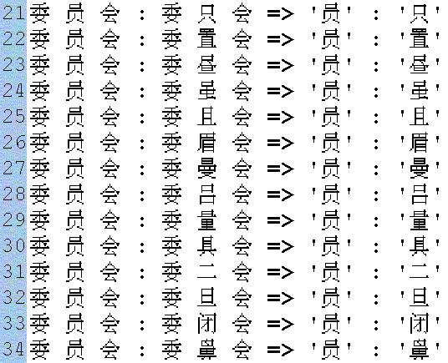
過去我們針對OCR辨識文字，有做過類似研究
Some term pairs detected by the procedure.
All the terms denote the same word: “Committee”
Yuen-Hsien Tseng, "Error Correction in a Chinese OCR Test Collection," Proceedings of the 25th International ACM SIGIR Conference on Research and Development in Information Retrieval - SIGIR '02, Aug. 11-15, Tampere, Finland, 2002, pp.429-430.

Slide 7
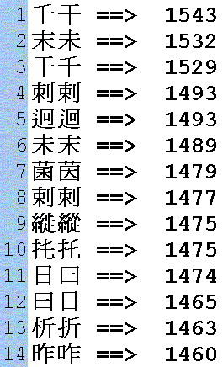
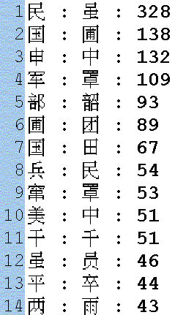
Some lists of 4720 confusing pairs given by an OCR software company
Some lists of confusing pairs
detected by our procedure

Slide 8
但是在召回率、精確率之間不易同時提升
而且對於各種應用情境，所使用的技術不同
中文的錯別字偵測、改錯，跟語法、語意有關

Slide 9
為了鼓勵這類研究，我們發展相關語料， 主辦了一些國際評比活動
Shih-Hung Wu, Chao-Lin Liu, and Lung-Hao Lee (2013). Chinese Spelling Check Evaluation at SIGHAN Bake-off 2013. In Proceedings of SIGHAN'13, pp. 35-42.
SIGHAN 2013 Bake-off Dataset: http://ir.itc.ntnu.edu.tw/lre/sighan7csc_release1.0.zip

Slide 10
Liang-Chih Yu, Lung-Hao Lee, Yuen-Hsien Tseng and Hsin-Hsi Chen (2014). Overview of SIGHAN 2014 Bake-off for Chinese Spelling Check. In Proceedings of CLP'14, pp. 126-132.
CLP 2014 Bake-off Dataset : http://ir.itc.ntnu.edu.tw/lre/clp14csc_release1.1.zip

Slide 11
Yuen-Hsien Tseng, Lung-Hao Lee, Li-Ping Chang, and Hsin-Hsi Chen (2015). Introduction to SIGHAN 2015 Bake-off for Chinese Spelling Check. In Proceedings of SIGHAN'15, pp. 32-37.
SIGHAN 2015 Bake-off Dataset: http://ir.itc.ntnu.edu.tw/lre/sighan8csc_release1.0.zip

Slide 12
今年參賽，希望培養學生，延續這樣的研究

Slide 13
核心功能描述
核心功能：
輸入：一句中文句子
輸出：偵測輸入句子中的錯字，並給出候選字
基本的演算法：
以資料驅動方式，偵測、改錯
正確的斷詞語料越多，效果越好
透過雲端大數據技術，讓客戶端軟體彈性使用
以 RESTful API 當作輸入、輸出之溝通媒介

Slide 14
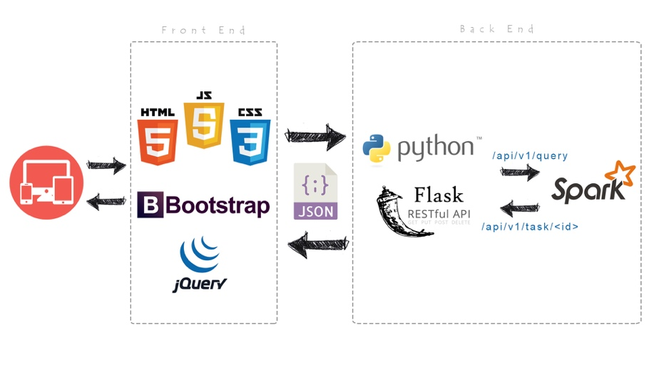
系統架構

Slide 15
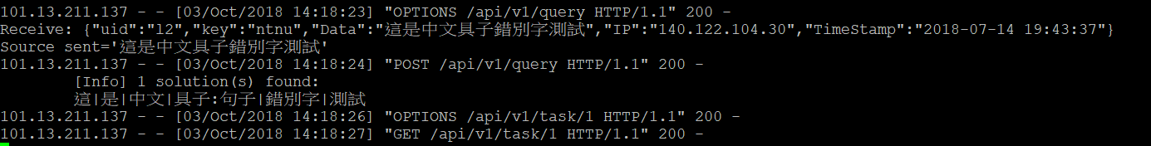
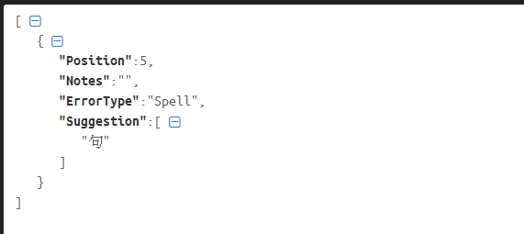
System Design (Web service)
We adopt “Flask” to implement the web service (index.py). Currently, we open two interfaces:
/api/v1/query : Receive query from front end. One received data example as below:
/api/v1/task/<task_id> : Front end will use this API to retrieve processed result. One output example as below:
Backend/Frontend exchange data
in json format.
Processed result
The word position in sentence
The reason of suggestion
Character list for suggestion

Slide 16
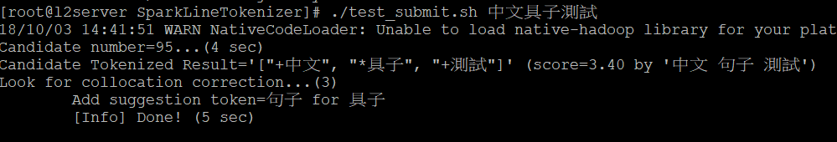

System Design (Sentence Processor)
The backend integrated two approaches in processing sentence:
Adopt Spark in handling big data with tons of pre-processed sentences. So we can pick up the sentence with best similarity and look for possible suggestion/correction if any. (Check test_submit.sh)
Implement TPS (Token Path Search) algorithm to look for best tokenized result based on given sentence.
The sentence in corpus with best similarity from input sentence.
Look for suggestion by difference between two sentences.
The algorithm will look for best tokenized result and seek suggestion during searching process.

Slide 17
Approach 1 – Spark Solution In Action
Here we will introduce the working flow of first approach which currently have corpus with up to 435,901 preprocessed sentences. It is intuitively that more large the corpus, the great performance this approach can reach.
Pro:
The algorithm is simple and it is data driven solution
NER (Name Entity Recognition) task is quite straight forward in this solution.
The solution is built on Big-data platform for better scalability, extensibility and better fault tolerance.
No training is required.
Con:
If the quantity of corpus doesn’t reach certain scope, the performance of this solution may be low. Need more experiment to bring in more accuracy data.
It needs cluster to process the big data which means the cost and environment preparation may not be friendly to normal user.

Slide 18
Approach 1 – Spark Solution In Action
Let’s take a few examples to know how this solution work. Firstly, let’s take a look at perfect match as our first example. Consider one tokenized result from our corpus:
{BRAND} 去年 {MONTH} 營收 為 {ANUM} 元
# ./test_submit.sh 台積電去年八月營收為一百萬元
…
Candidate number=2,846...(5 sec)
Candidate Tokenized Result (score=13.00 by '{BRAND} 去年 {MONTH} 營收 為 {ANUM} 元'):
+台積電:{BRAND}
+去年
+八月:{MONTH}
+營收
+為
+一百萬:{ANUM}
+元
Here we got 2,846 candidate matching from corpus. The algorithm will pick up the one with highest score. For example here, the record “{BRAND} 去年 {MONTH} 營收 為 {ANUM} 元” is selected with highest score as 13. So we have perfect match here. The tokenized result is on the left. The token with prefix “+” means it is matched.
Here we can also notice that the token “台積電” is recognized as “BRAND”; “八月” is recognized as “MONTH” and “一百萬” is recognized as “ANUM” (A number)

Slide 19
Approach1 – Spark Solution In Action
Then let’s take a look at partial match(1) as our second example below. Consider one tokenized result from our corpus:
在 今天 的 比賽 中 人才輩出
# ./test_submit.sh 在今天的比賽中人才倍出
…
Candidate number=570...(4 sec)
Candidate Tokenized Result (score=10.20 by '在 今天 的 比賽 中 人才輩出'):
+在
+今天
+的
+比賽
+中
*人才倍出
Look for collocation correction...(6)
Add suggestion token=人才輩出 for 人才倍出
Here we got one token “人才倍出” missing during matching. Then we will use collocation to look for suggestion and select the candidate with best similarity to feedback.

Slide 20
Approach1 – Spark Solution In Action
Then let’s take a look at partial match(2) as our third example below. Consider one tokenized result from our corpus:
容 大家 給 我 一點 時間 熟悉
# ./test_submit.sh 容大家給我一點時間考慮
…
Candidate number=177...(5 sec)
Candidate Tokenized Result (score=12.80 by '容 大家 給 我 一點 時間 熟悉'):
+容
+大家
+給
+我
+一點
+時間
~考慮
Here we got one token “考慮” missing during matching. However, according to the context and collocation, it is ever seen in corpus that the token “考慮” coexist with “時間”. Therefore, we use a special prefix “~” to indicate this occasion.

Slide 21
Approach 1 – Spark Solution In Action
Then let’s take a look at partial match(3) as our fourth example below. Consider one tokenized result from our corpus:
今天 的 電影 相當 好看
# ./test_submit.sh 今天的電影好看
…
Candidate number=261...(4 sec)
Candidate Tokenized Result (score=7.40 by '今天 的 電影 相當 好看'):
+今天
+的
+電影
+好看
The algorithm can handle extra token “相當” here from candidate during matching.

Slide 22
Approach 2 – Token Path Search (TPS) In Action
Here we will introduce the working flow of second approach which leverage 213,931 unique words we build/collect form the corpus. Basically, TPS is an algorithm to look for all possible words path to constitute the sentence.
Corpora: 國家教育研究院500萬字語料 + 中研院 500 萬字平衡語料
Pro:
The algorithm is simple and it is data driven solution
The execution cost is low and the execution time is fast compared to first approach.
No training is required.
Con:
Current algorithm version doesn’t take semantic meaning into consideration. (Greedy search)
May fall for ambiguous sentence
Under exhaustive search window, the algorithm may be slow.

Slide 23
Approach 2 – TPS In Action
Let’s take a few examples to know how this solution work. Firstly, let’s take a look at perfect match as our first example.
# ./tc.sh 台積電去年八月營收為一百萬元
…
[Info] 124 solution(s) found:
…
台積電|去年|八月|營收|為|一百萬|元
The TPS will look for all possible token path to constitute the given sentence. Our example here will find a token path as below:
台積電|
營收
...
去年|
上生
...
八月|
...
營收|
為|
一百萬|
元

Slide 24
Approach2 – TPS In Action
Let’s take a few examples to know how this solution work. Secondly, let’s take a look at partial match as our next example.
# ./tc.sh 台積電去年八月盈收為一百萬元
…
[Info] 218 solution(s) found:
…
台積電|去年|八月|盈收:營收|為|一百萬|元
台積電|去年|八月|盈收:盈餘|為|一百萬|元
For example here, the TPS will be blocked at token “八月”. Then it will try to look for all possible tokens after token “八月” with highest similarity with “盈收” and use the found token(s) to continue searching. (Here we got two candidates “營收” & “盈餘”)

Slide 25
混淆字集（1/4）
混淆字集：做為錯別字之推薦字
建立依據：
錯誤實例
字形
字音
混淆詞表：
據中研院平衡語料庫3.0版的詞頻統計，最後得出4743個漢字常用字，做為詞表
混淆字集每一列的第一個字為詞表字，而每一個詞表字後面則會接續前十名容易混淆的字

Slide 26
混淆字集（2/4）
錯誤實例：
依據 SIGHAN Bake-off Dataset (2013-2105) 之測試集，統計實際錯別字出現的次數
 | 2013年 | 2014年 | 2015年 | 2013~ 2015
錯別字實例總數量 | 350 | 5280 | 3142 | 8772
不重複之錯別字數量 | 267 | 2176 | 1560 | 3394
1. 的：得(161)、地(32)、個(5)、色(3)、了(2)、德(2)、熱(1)
2. 在：再(67)、宰(4)、地(1)、採(1)、治(1)、載(1)、遭(1)
…
3394 …

Slide 27
混淆字集（3/4）
字形：
依「全字庫」 得出詞表中4743個常用字之部件組成，再計算與詞表中其他字的 Jaccard相似度
字音：
依「全字庫」得出詞表中4743個常用字之發音
若有一字多音的狀況則依「中文詞庫(八萬目詞) 」統計最為常見的發音
再依發音部位做為座標，計算字與字之間的發音差距，以得出發音的相似度

Slide 28
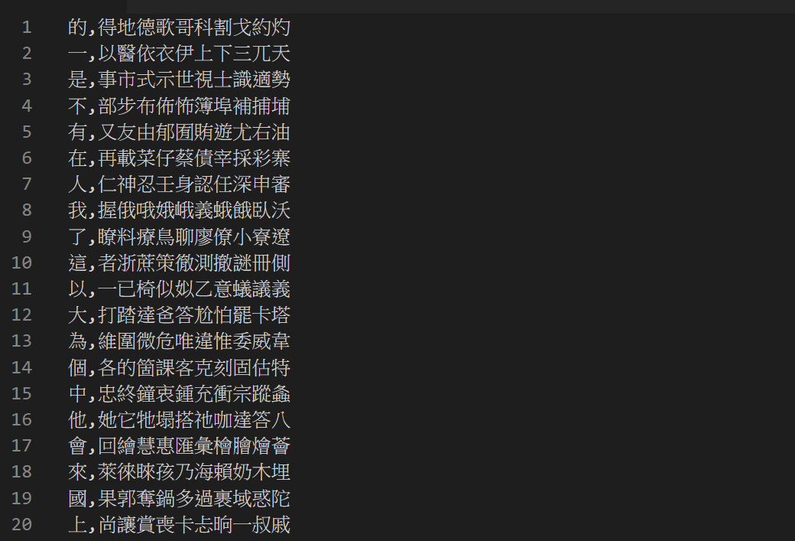
混淆字集（4/4）
最後以「錯誤實例的出現次數」+「字形相似度」+「字音相似度」排序得出前十名的易混淆字

Slide 29
前端技術（jQuery）
jQuery是一套跨瀏覽器的JavaScript函式庫，簡化HTML與JavaScript之間的操作。
主要用途：
控制DOM元素：$('select')
Ajax請求：$.ajax()
JSON解析：jQuery.parseJSON()
Ajax預設為同步執行，非同步寫法: async: false

Slide 30
前端技術（Bootstrap）
Bootstrap是用於網站和網路應用程式開發的開源前端框架，包括HTML、CSS及JavaScript，提供各種元件及Javascript擴充套件，並符合響應式。
<link rel="stylesheet" href="https://maxcdn.bootstrapcdn.com/bootstrap/3.3.7/css/bootstrap.min.css">
使用元件：
按鈕(Buttons)、下拉選單 (Dropdowns)、互動視窗 (Modal)、進度條 (Progress)

Slide 31
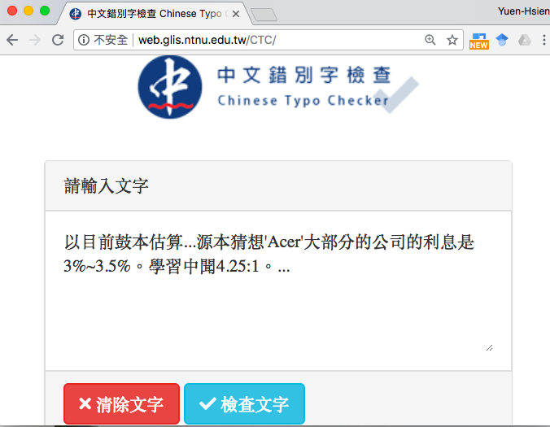
目前的用戶端系統畫面

Slide 32
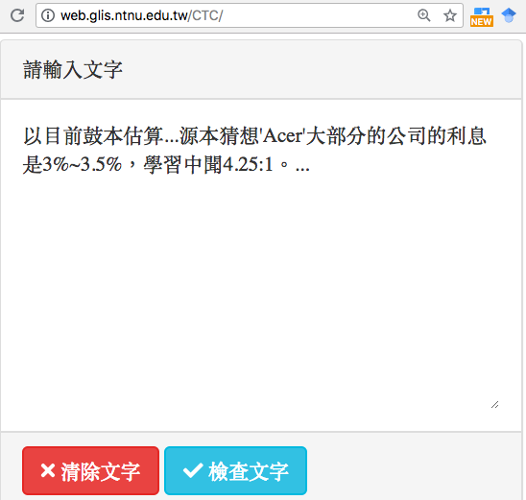
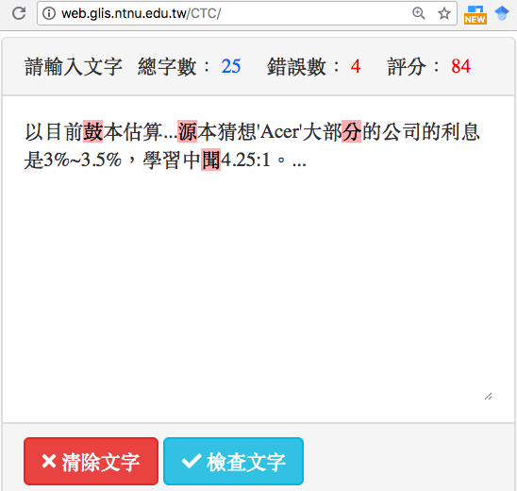
實作之使用介面展示（1/3）

Slide 33
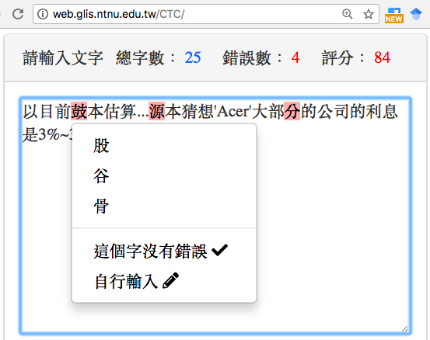
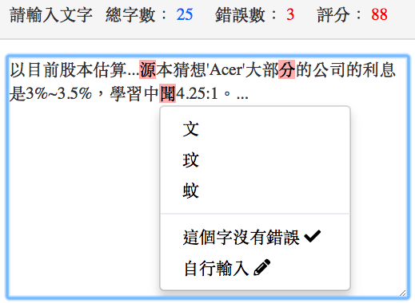
實作之使用介面展示（2/3）

Slide 34
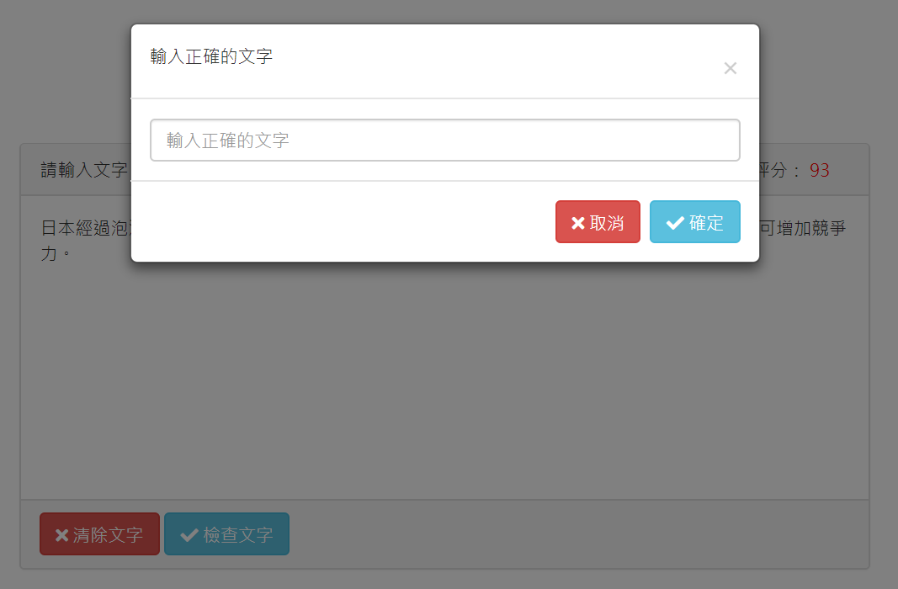
實作之使用介面展示（3/3）

Slide 35
系統展示

Slide 36
後續工作
目前僅將整個系統流程實作出來，用以展示
後續工作
增加斷詞語料，增進精確、召回率，降低誤判
調校系統效率，提升回應速度
正式評估成效
未來工作
實作各種演算方法，提升成效

