Slide 1
HiBaby
-- A proposed solution for preganent anxiety and loneliness

Slide 2
Outline
Problems
Situations
HiBaby
Test
Benefits

Slide 3
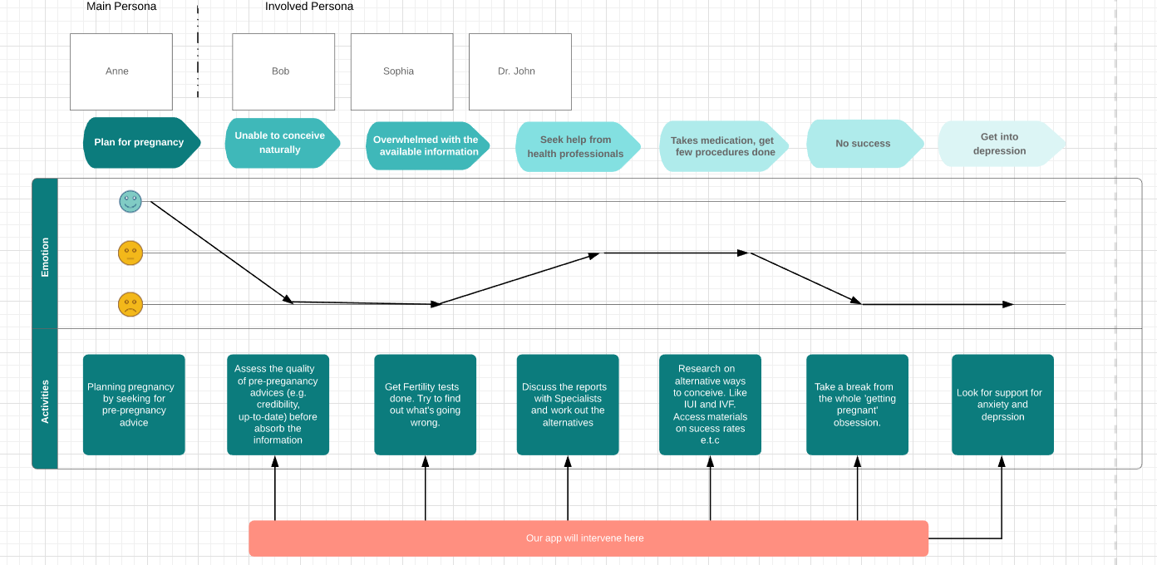

Problems
“Antenatal depression”: 6% of pregnant women in Australia
Lacking social & family supports (busy parents with lonely young women)
Burst of authorized & unauthorized info. V.S. Difficult to get a consultation services
Leading to still-birth, life-long mental health problems or even suicide

Slide 4
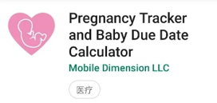
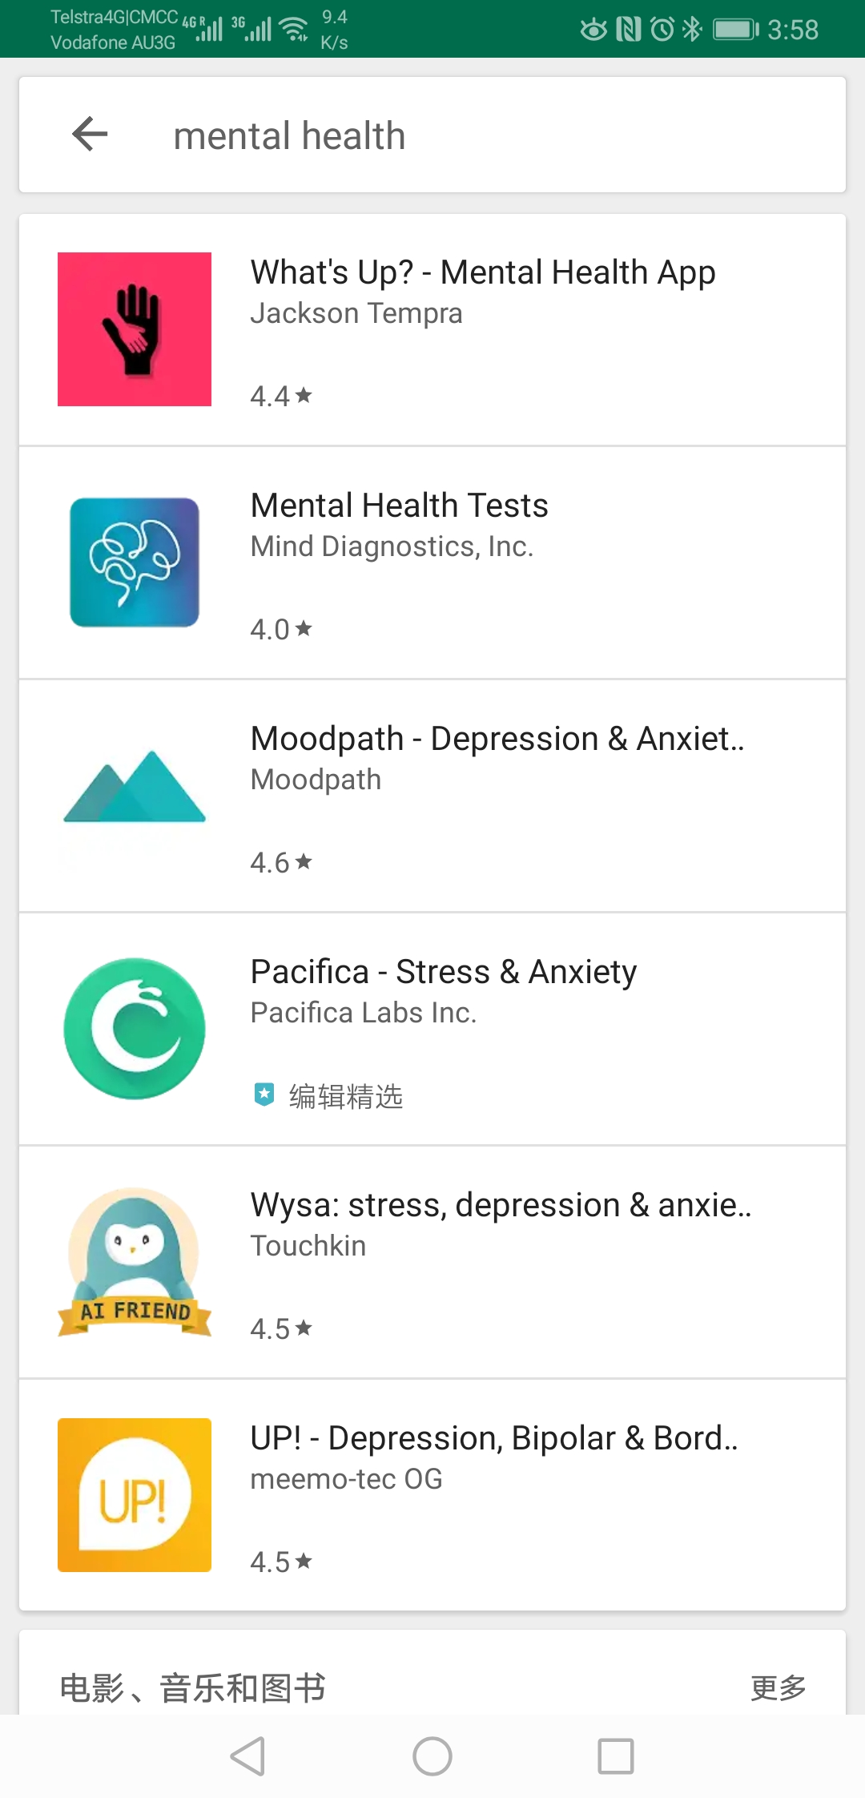
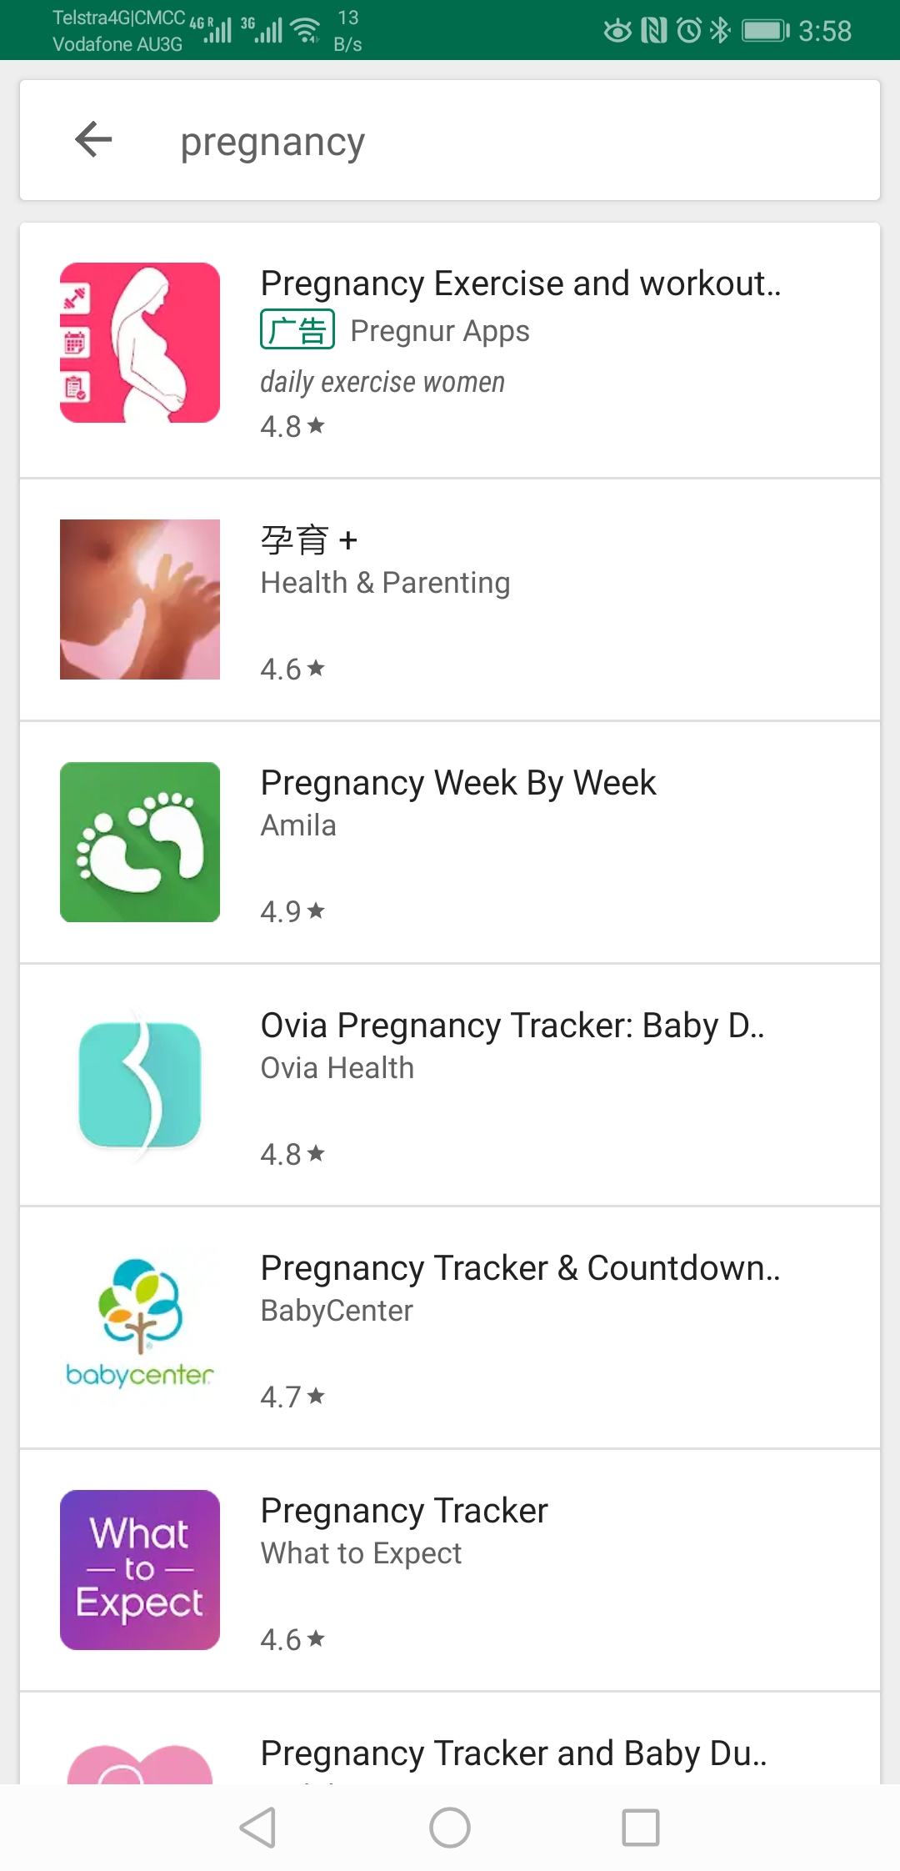
Situations
Social media: Quality of info?
Behavior: searching instead of communicating
Pregnancy apps. In the markets: User-specific guidance? QoI? Level of details?
Psy. Apps: Case of pregnancy?
Our own app. containing all 3 features is needed.

Slide 5
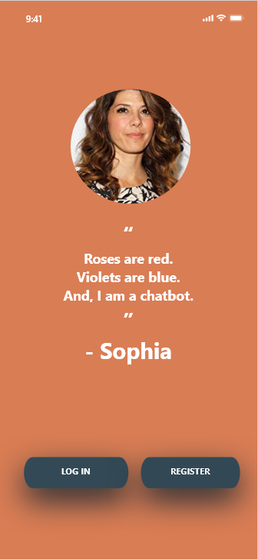
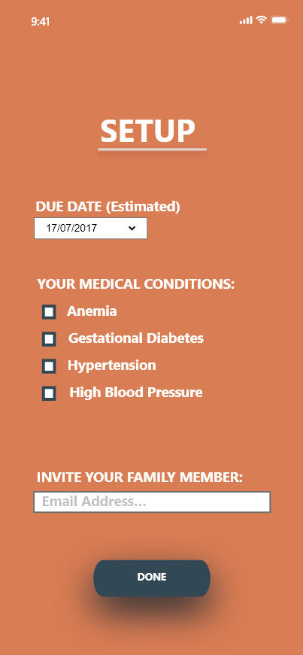
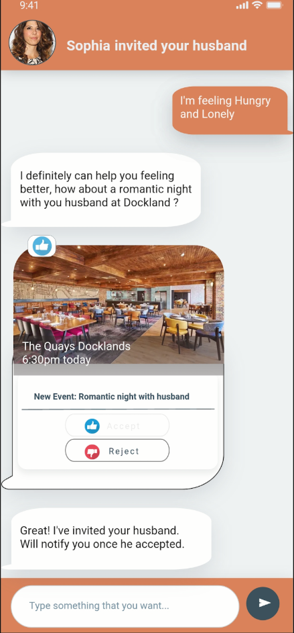
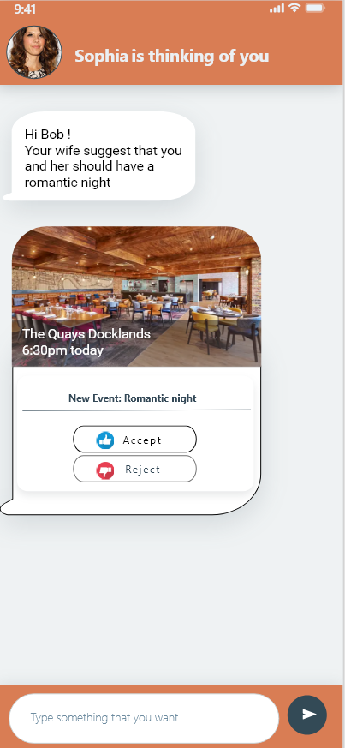
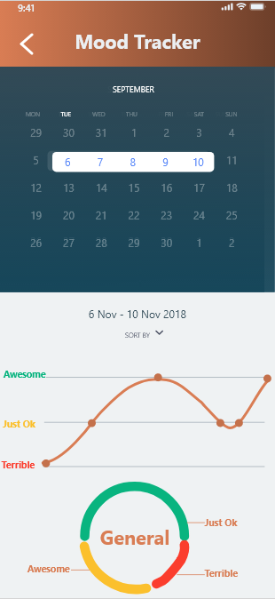
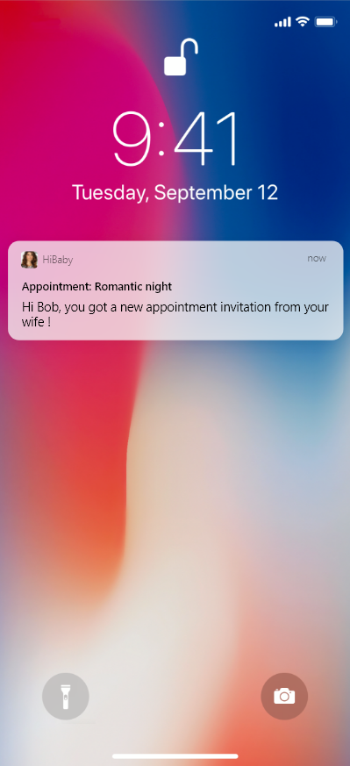
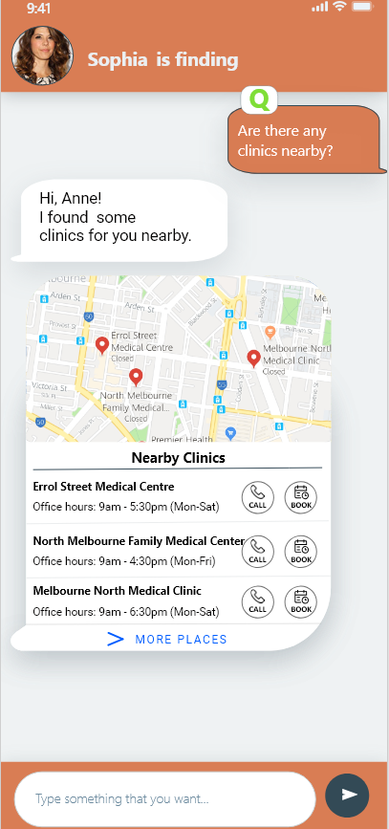
HiBaby I
Feature 1: User centric and interactive support via a
characterised chatbot
With pregnant woman at the center

Slide 6
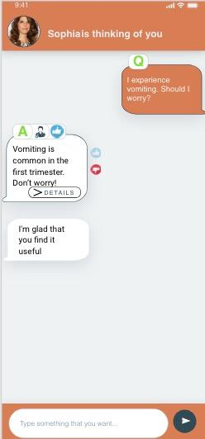
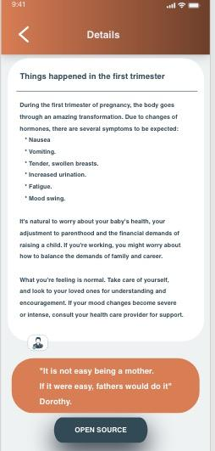
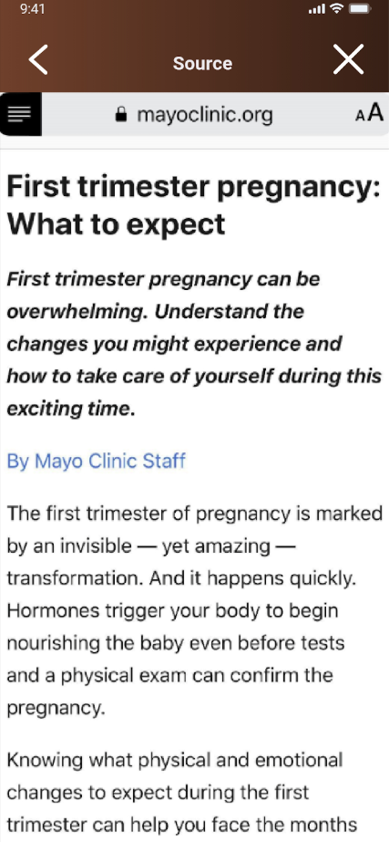
HiBaby II
Feature 2: Hierarchical info.
Provide authorized info.
User can not only “get I want”, but also “get I want only”

Slide 7
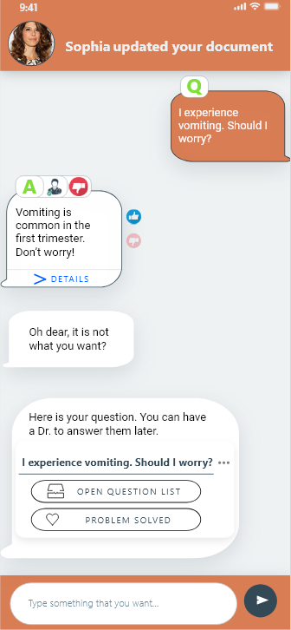
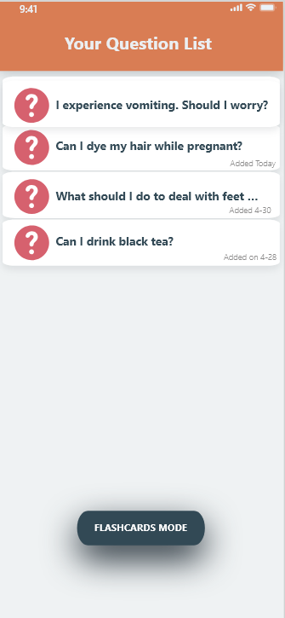
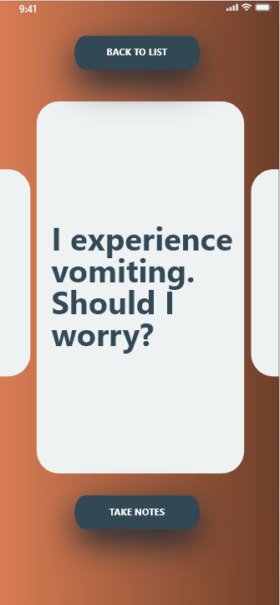
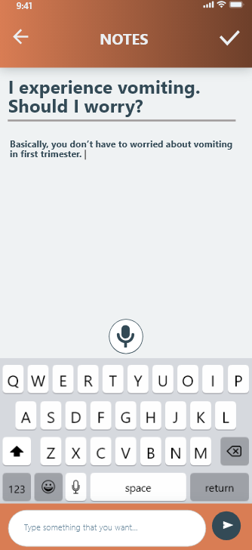
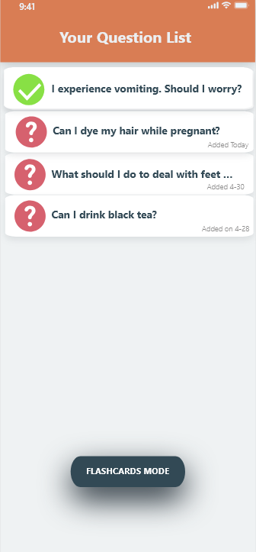
HiBaby III
Feature 3: Smart Q & A
Stored “question list”
Share your concerns as you wish

Slide 8
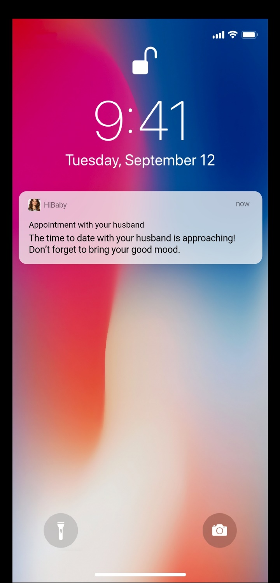
Intended Benefits
Families: Safe & less stressful journey + better relationships
Clinical work flows: Reduced
Overall HS: Effective

Slide 9

Tests
Before testing: Greeting & welcome & purposes of testing
Test case 1: Preg. women vomiting
Test case 2: Preg. women lonely
Test case 3: Preg. women leg swollen
Test case 4: Caregiver accept invitation
Test case 5: Caregiver searches info. about conceiving

Slide 10
It is time to try “HiBaby”

