Slide 1

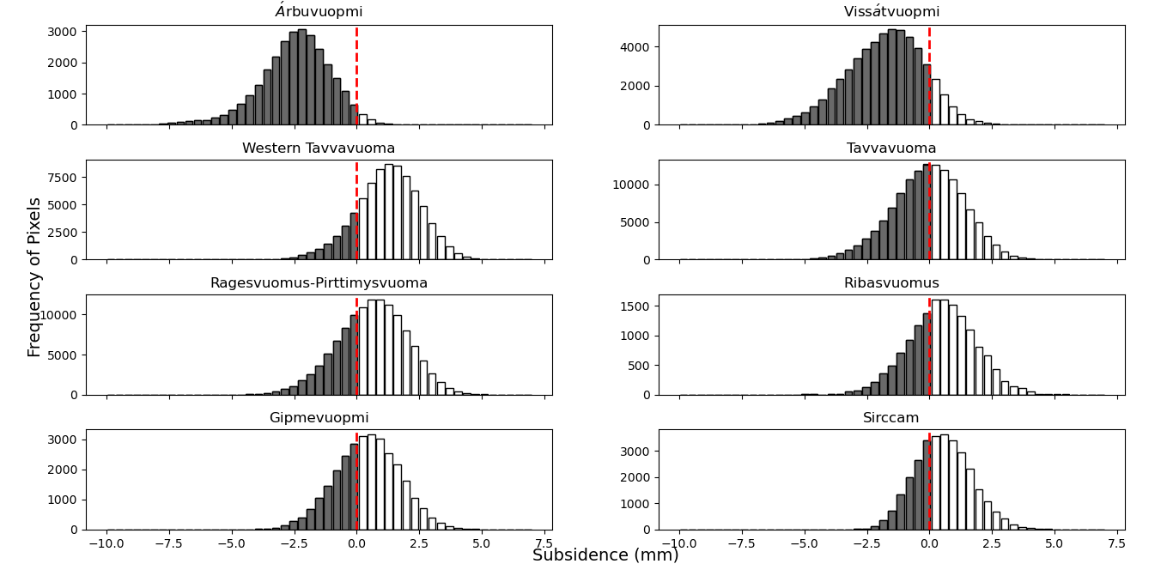

Slide 2


Slide 4
The Old version

Slide 5

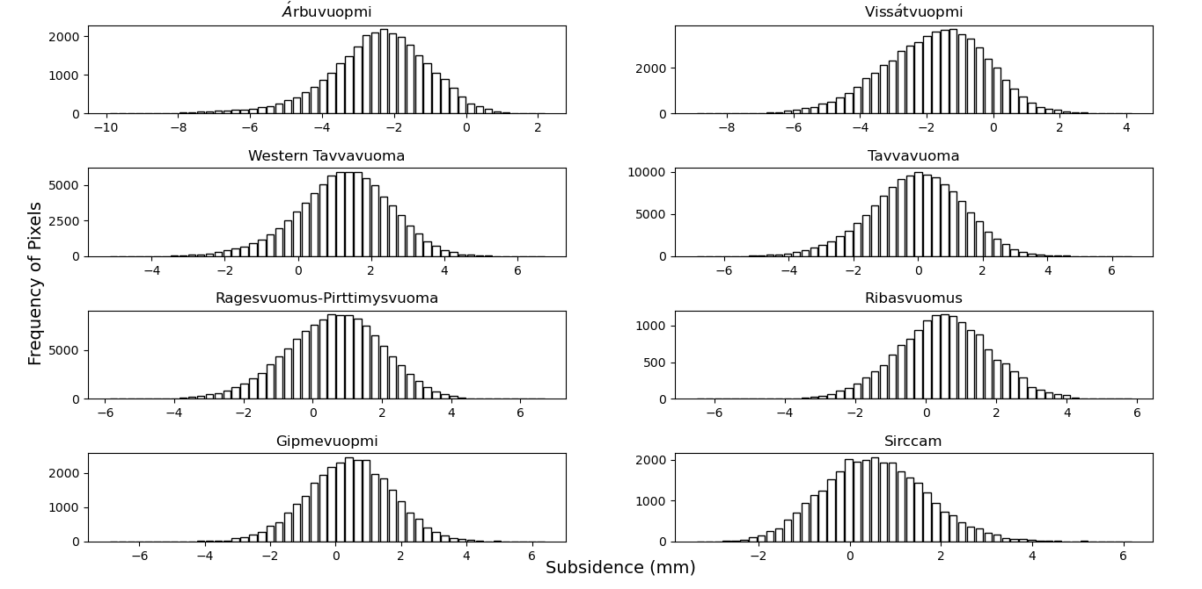

Slide 6
