Slide 1
Lab1 back propagation

Slide 2
Outline
back propagation
dataset
code

Slide 3
Outline
back propagation
dataset
code

Slide 4
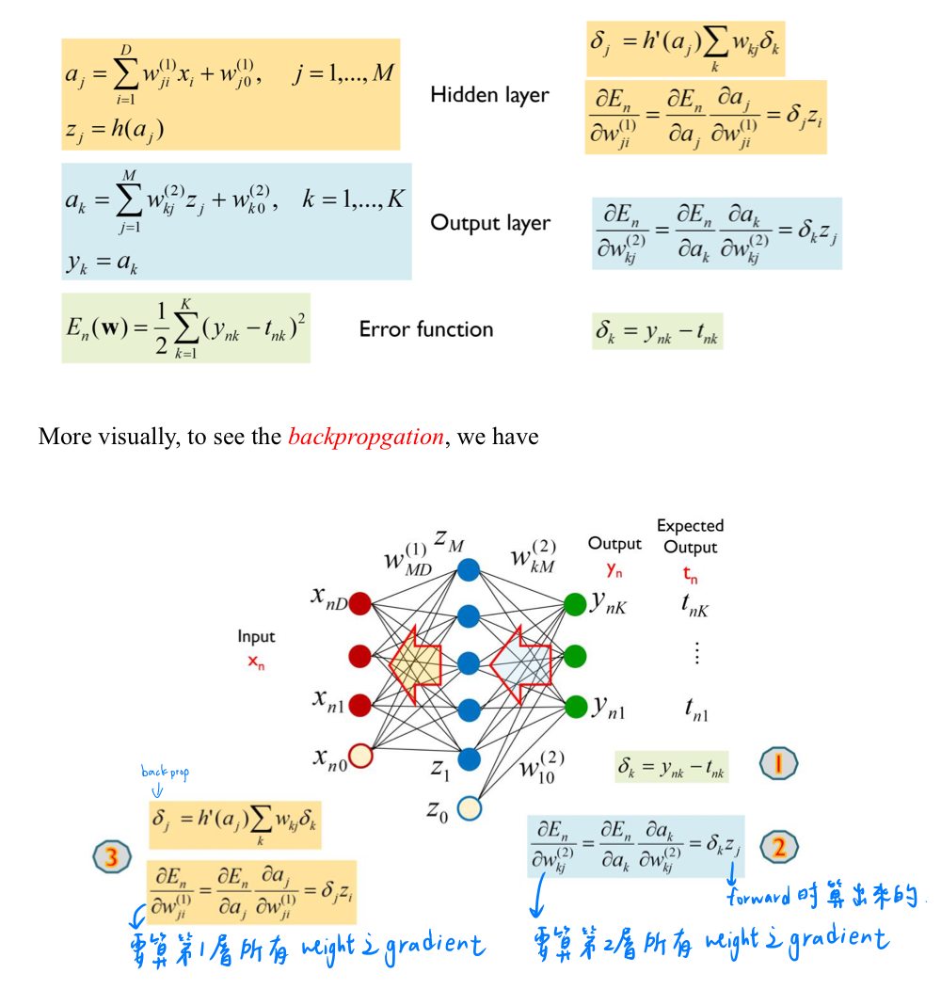

back propagation
$$θ=θ−η\frac{∂L}{∂θ}$$
沿著 gradient 的反方向走
Learning rate

Slide 5
Outline
back propagation
dataset
code

Slide 6
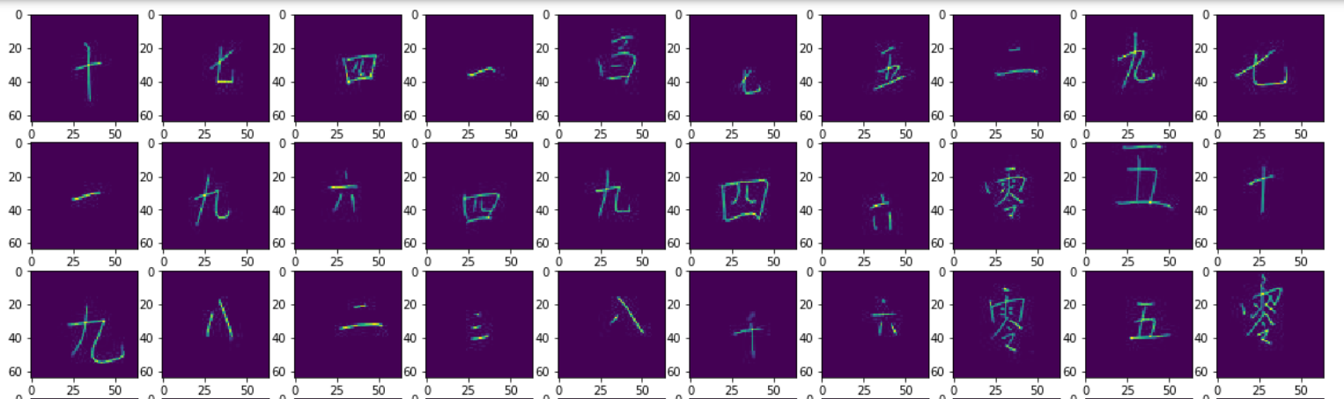
dataset
Classification
Classes: 13, image size =64*64
Training: 11500, Testing: 1500

Slide 7
Outline
back propagation
dataset
Code

Slide 8
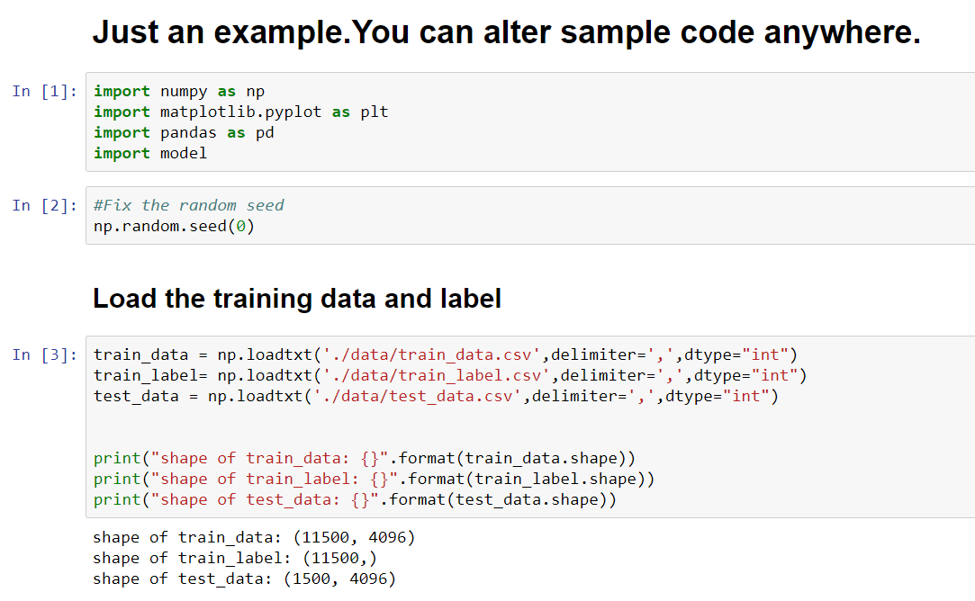
Code

Slide 9
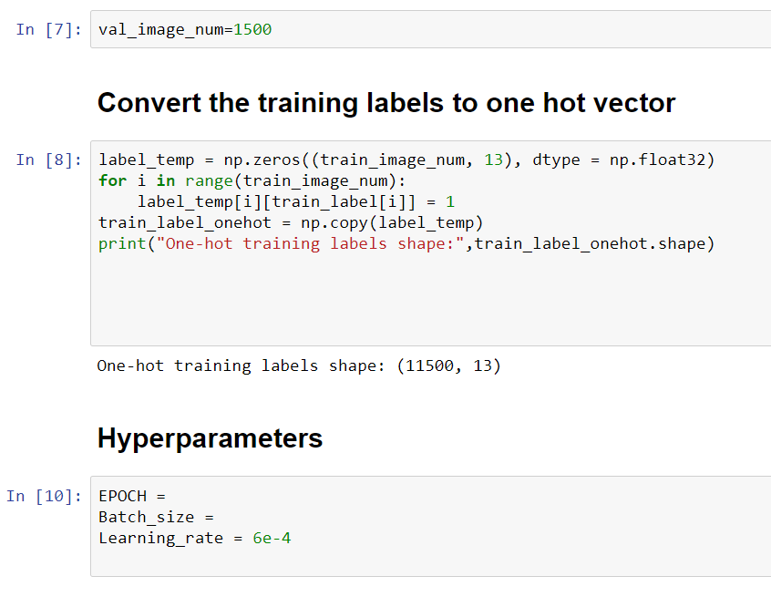
Code

Slide 10
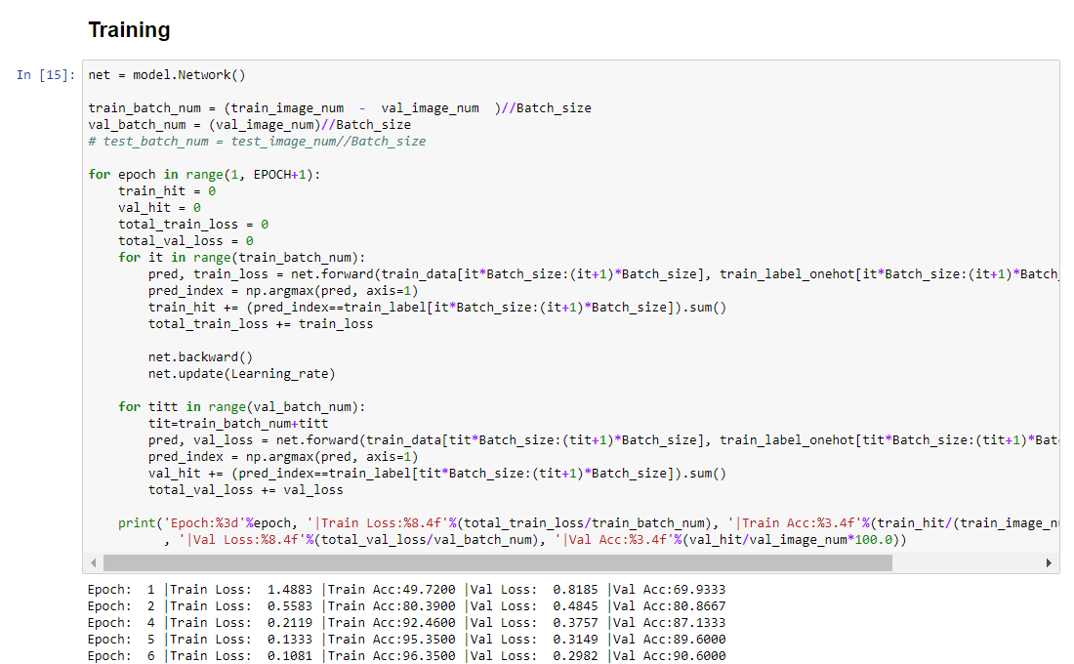
Code

Slide 11
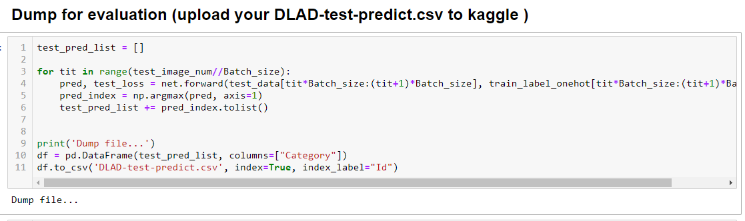
Code
Make sure your prediction type is int not float

Slide 12
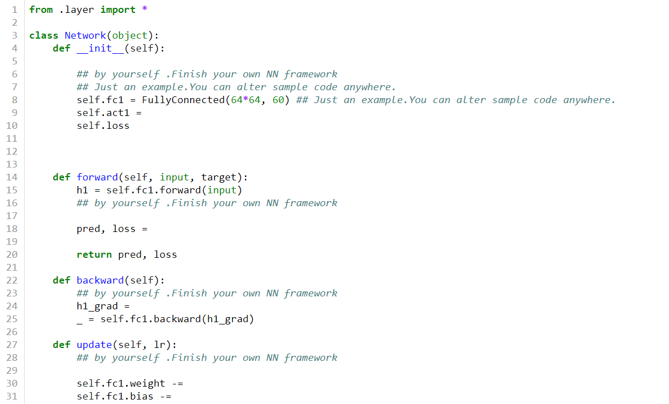
Code network.py

Slide 13
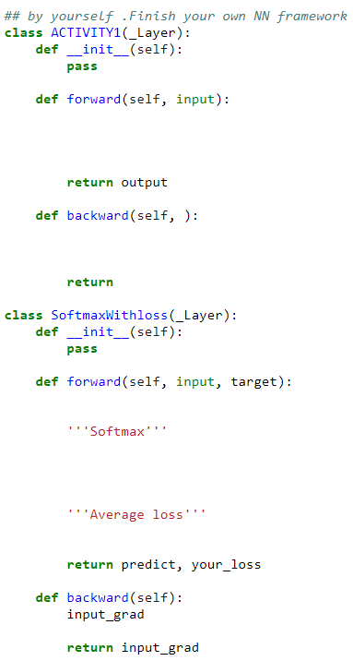
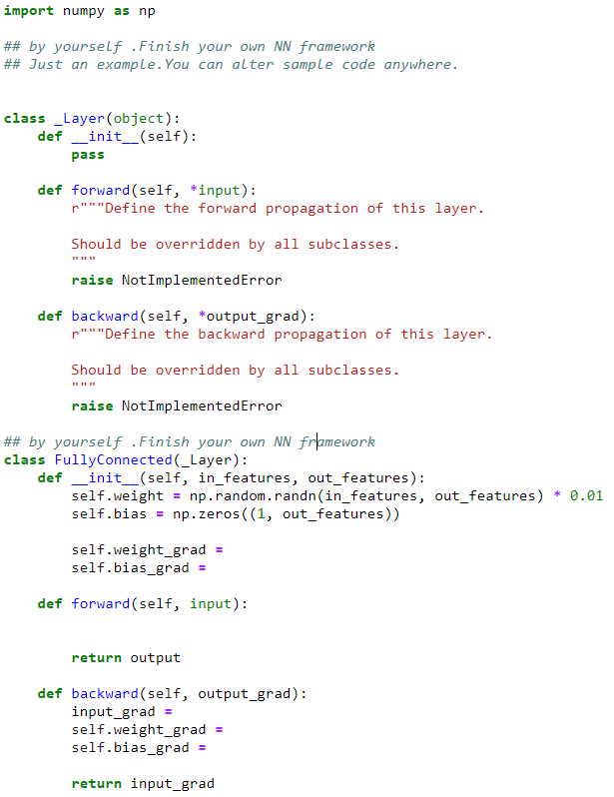
Code layer.py

Slide 14
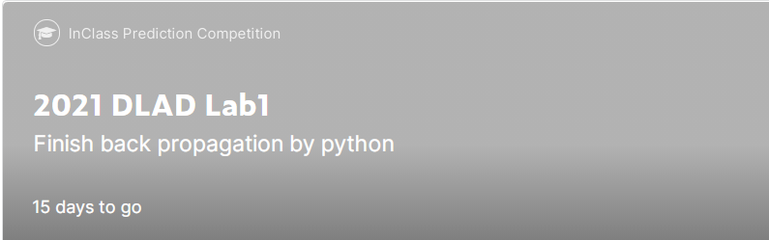
Join the Kaggle competition
Competition URL:
https://www.kaggle.com/t/03ee99fa6e414de6867ede14092bf2f5
Upload your test prediction
Check your team name

Slide 15
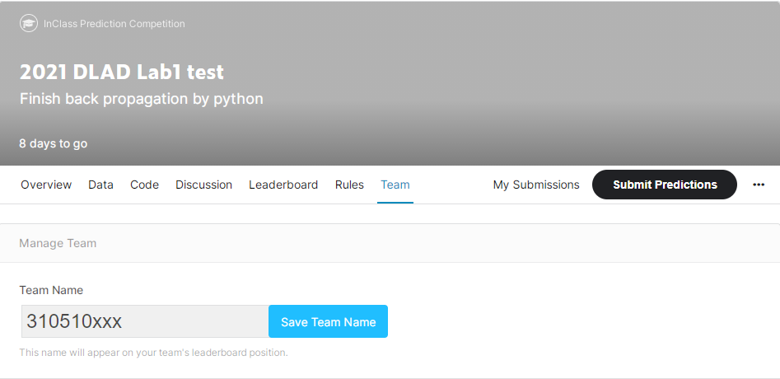
Notice!!!
Change your team name to your ID
If TA can not find your ID, you will loss 40% of score in this lab directly

Slide 16
Assignment Regulation
Please use jupyter notebook to finish this lab (.ipynb)
Only Python3.6 available
You don’t need to use GPU in this lab
Package available
numpy
pandas
Scikit-learn
Pytorch ,tensorflow , keras

Slide 17
Reminder
Submit Deadline : 2 weeks (11日/10月/2021 11:59 PM)
You need to submit your code and result to New E3
Hand in your code and in the following format(4 files)
Lab1_studentid.ipynb
network.py
layer.py
Lab1_report_studentid.pdf

Slide 18
Lab1 Grading policy
Lab1
Submit your homework to E3 and kaggle(40%),test accuracy must >80%
performance (40%)
report(20%)
請勿抄襲 (抓到以0分計算)

Slide 19
Lab1 report
How to improve the accuracy (list your method )
Loss function ?
Your network?
Activation function?
Etc…

Slide 20
Shut down your kernel !!!!!
Remember to SHUTDOWN the kernel
To release resources for others.

Slide 21

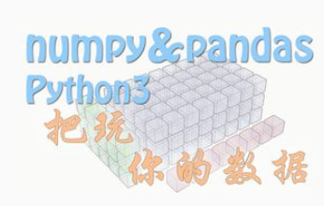
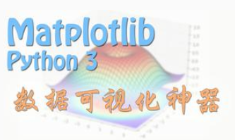
Lab0 Overview
You need to be familiar with jupyter python and useful library
numpy, pandas, matplot, etc
If you are not familiar with python, I strongly recommend you to see 莫凡’s python tutorial. (or other online materials)
https://morvanzhou.github.io/

