Slide 1
Web Design
Year2_Deaign&Build_2020
Group 62

Slide 2
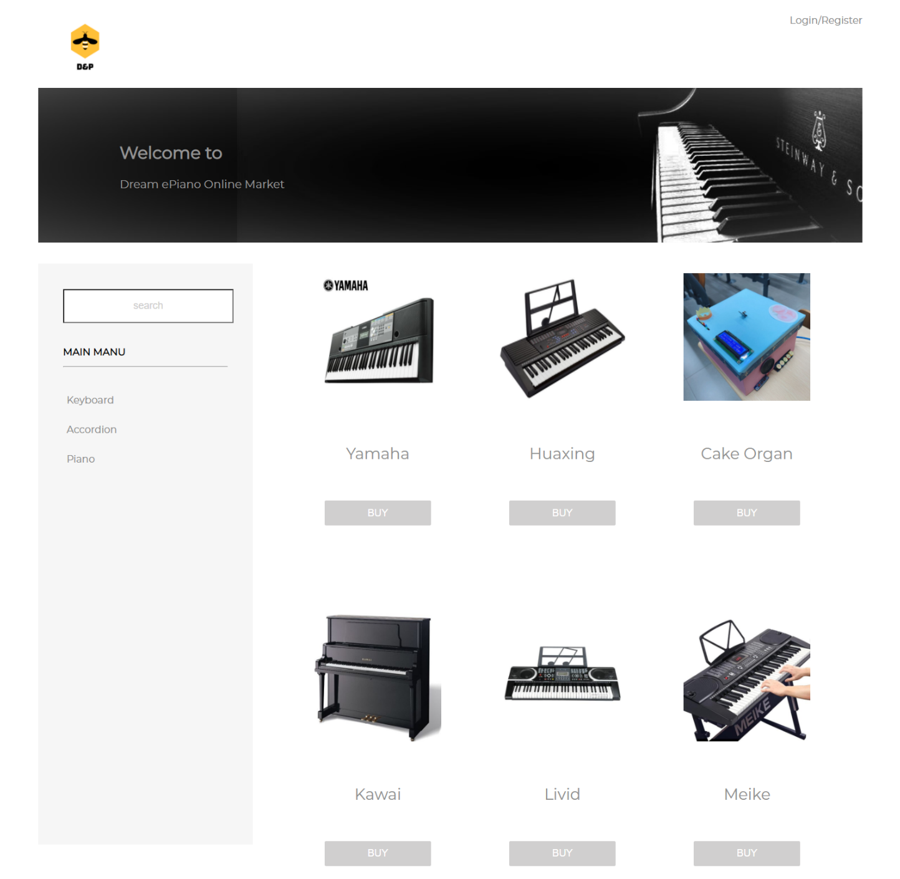
Home Page
Notes:
Our website design is mainly based on black and white, and the creative inspiration comes from the piano keys.
We looked through some website like Yamaha to learn from their web design, functional design and so on. The entire website pays more attention to our products and uses a flat style to make the website look more friendly and efficient.
As the company’s main page, we put logo at the top of our website,
users can view company and product introductions for free. Before users register and log in, they can browse products at will to get product recommendations so that users can better understand the company.
The left side of the main page is the side bar, you can click buttons to choose the product types. Like “Keyboards”
If you want to login or register to become a new member, just click the Login/Register button

Slide 3

Foot Bar
Notes:
The foot bar shows QM, BUPT and YAMAHA logos. Also shows our contact information, like Email, Telephone and location.
What’s more, you can click the privacy agreements or user agreements to check the detail information.

Slide 4
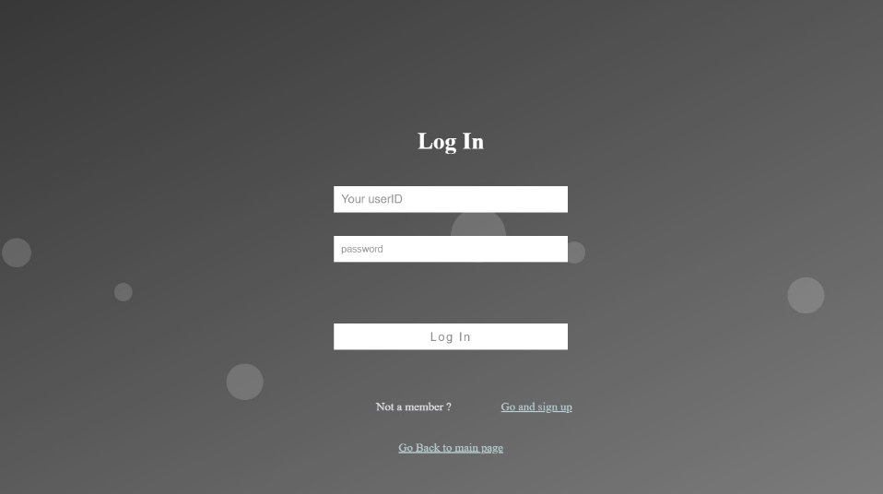
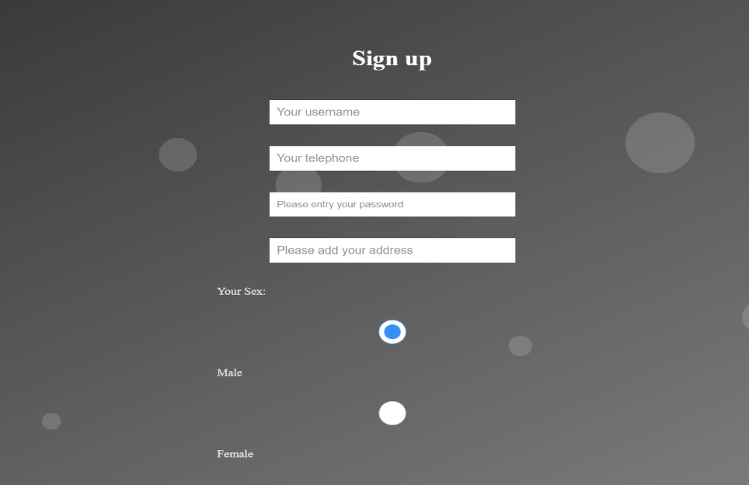
Login & Register Page
Main page
Login page
Sign up page
Notes:
After click the Login/register button, you will come to this page to login or register by enter the username, telephone number, password and address to complete your registration.

Slide 5
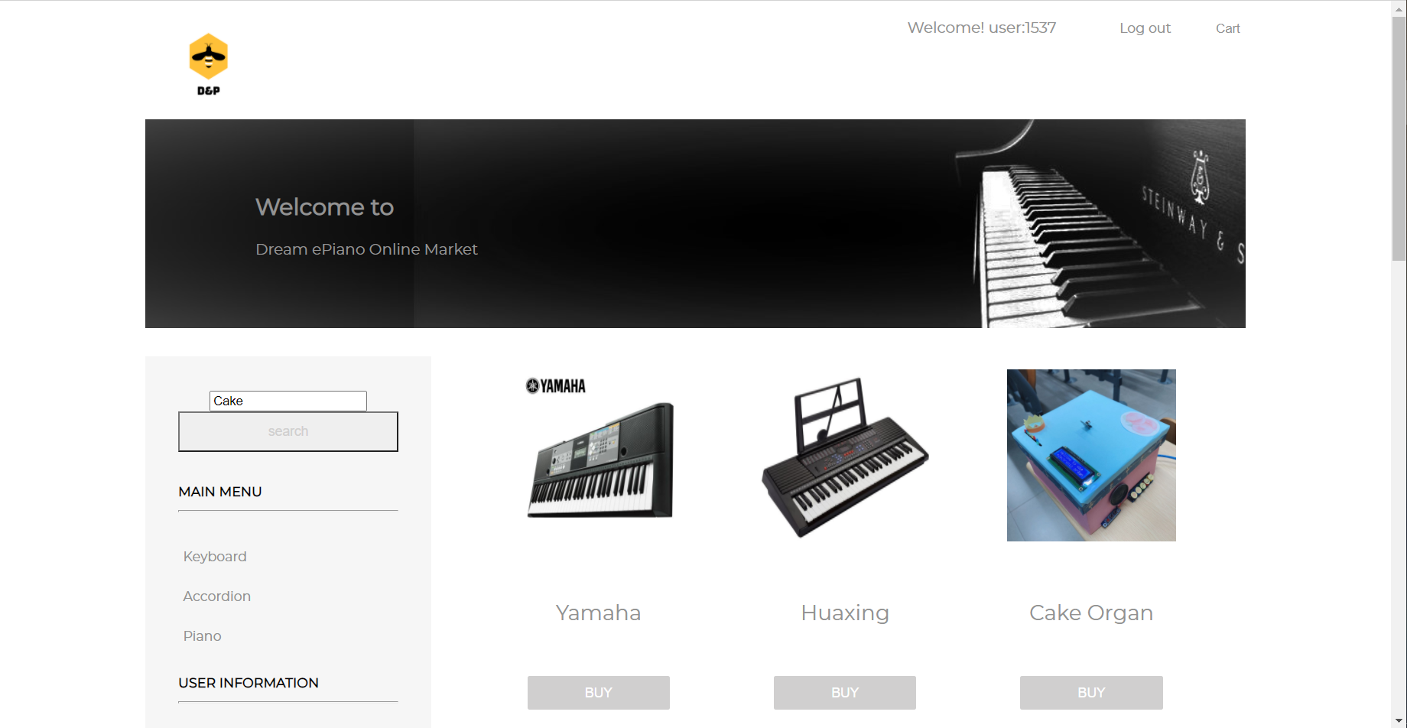
Notes:
After the login process, you can see the Welcome information which indicates that have already logged in.

Slide 6
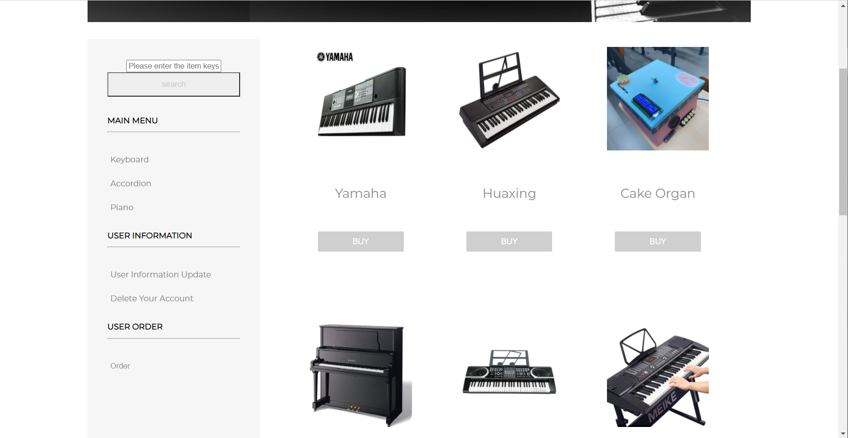
Notes:
You can check the User information side bar to select the user function like update and delete.
You can also search the products that you like at this page.

Slide 7
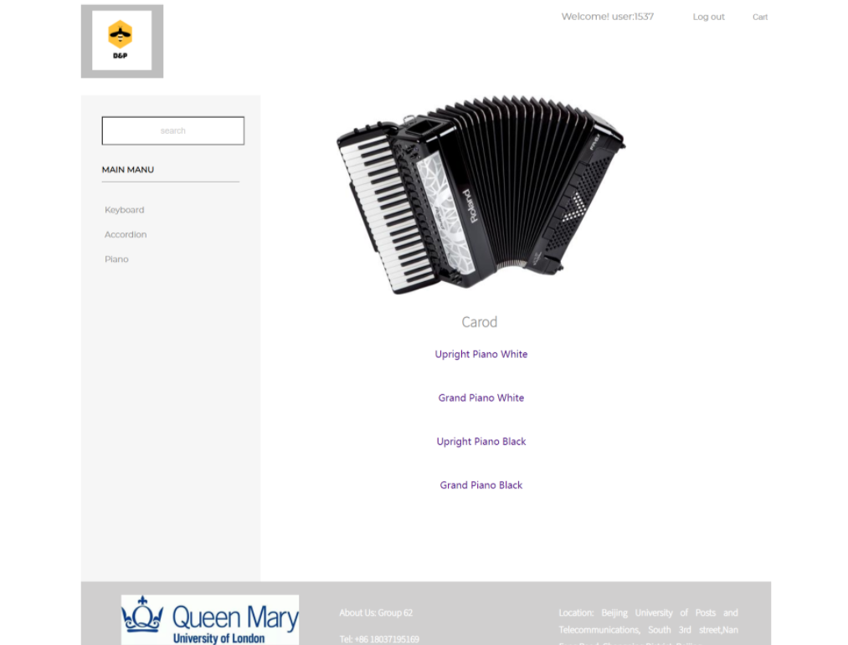
Product List Page
Main page
Notes:
In addition to the recommended products on the homepage, each series has many products. You can customized the products you want, for example choose the favorite color you like or choose different models.

Slide 8
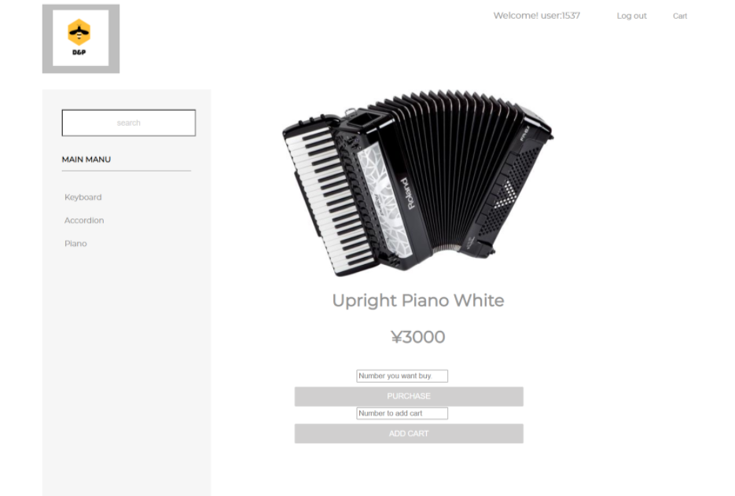
Product List Page
Notes:
Users can click the button to enter the details page, make a purchase or add to the shopping cart. the servlet will check your input validation.
There is a shopping cart button at the top of the page which allow users to view and edit the items in the shopping cart after logging in.

Slide 9
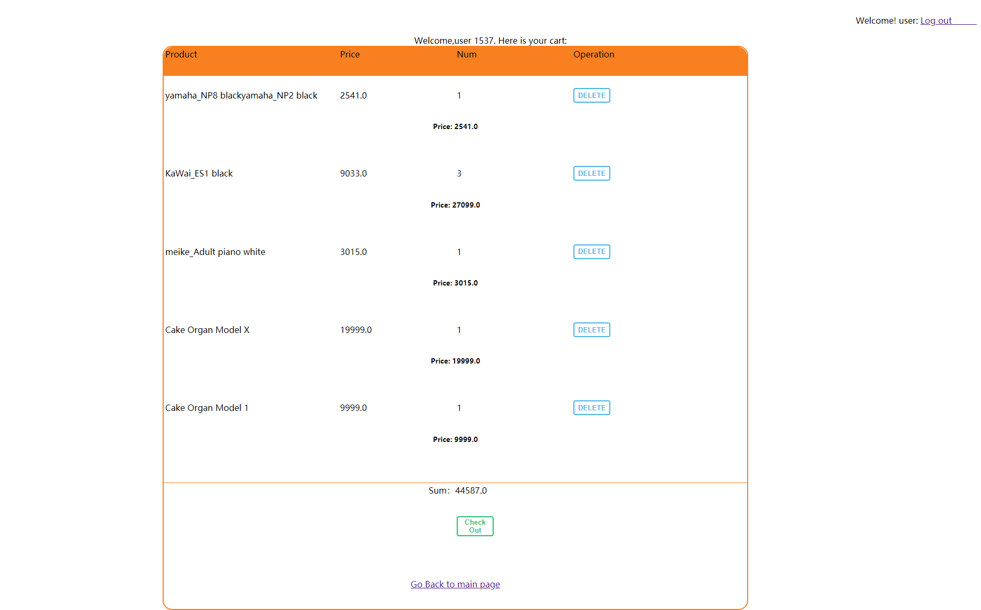
Cart Page
Main page
Notes:
There is a shopping cart button at the top of the page which allow users to view and edit the items in the shopping cart after logging in. The shopping cart page displays the name, quantity and price of the product in detail. User can click Check out button to check out.

Slide 10
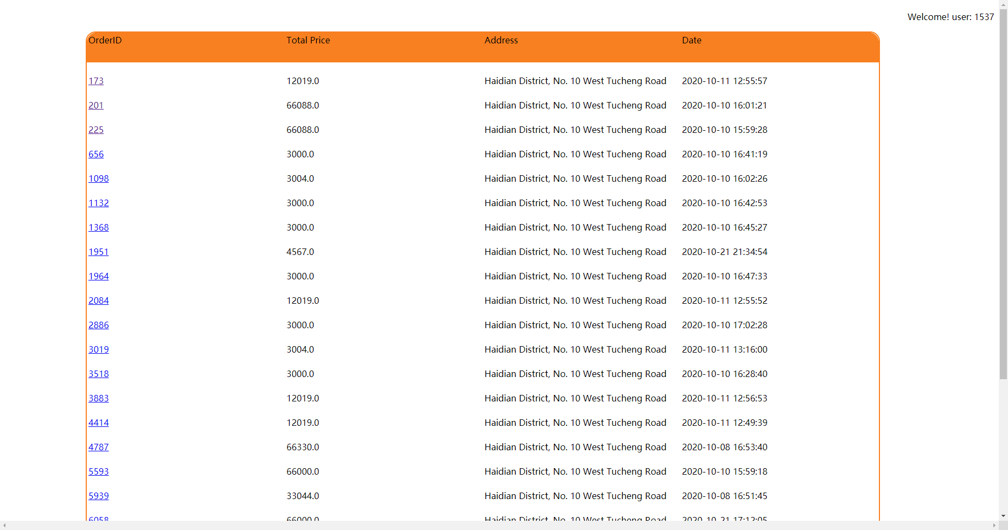
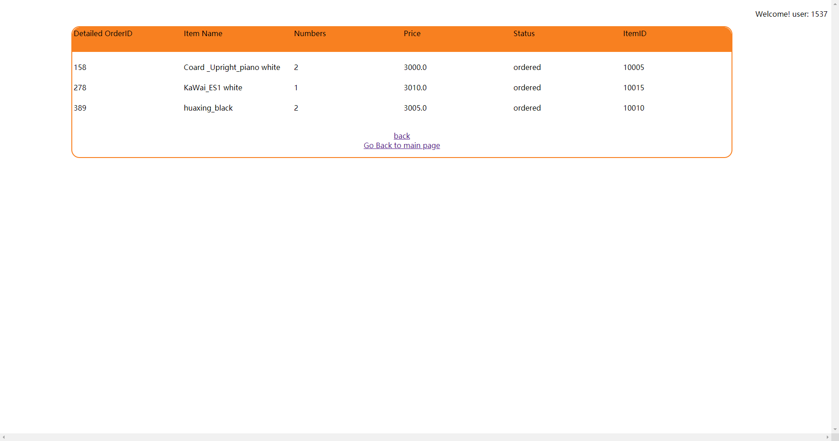
Order & Detail Order Page
Order Page
Main page
Detail Order Page
Notes:
After the user submits the order, the website will generate an order and a detailed order. On the order page, users can see the total price, time, and shopping address of the submitted order.
The user can jump to the detailed order page by clicking on the order number. The name, quantity, price and status (ordered, delivered, signed) of all the products purchased by the user at a time can be displayed.

Slide 11
Thank You for Listening

