Slide 1
Transportation Management System
Sama Sammar
Aya Zayed
Assala AboSamra
Malak AboSaifain

Slide 2
Presentation Outlines
Introduction
Background
Problem Statement
Goals and Objectives
Main Contribution
Methodology
Software Requirements Specification (SRS)
Conclusion & Future Work

Slide 3
1.Introduction
The Transportation Management System (TMS) is designed to enhance the management of transportation services.
It provides real-time tracking, booking and route optimization to improve transportation efficiency.
The system supports passengers, transportation companies and drivers by providing a technological solution for scheduling and tracking.

Slide 4
1.1 Background
Traditional transportation systems face challenges like manual scheduling, inefficiency, and delays. The Transportation Management System (TMS) aims to optimize routes, improve tracking, and enhance booking services using real-time GPS, automated scheduling, and online payments. This system reduces wait times, increases efficiency, and enhances passenger satisfaction.

Slide 5
1.2 Problem Statement
1.2 Problem statement:
The Problem: Inefficient and disorganized transportation management leads to delays and high costs.
Who It Affects: Passengers: Difficulty finding available transportation and long waiting times.
Transport companies: Inefficient transportation management.
Drivers: Poor coordination and inefficient routes.
Impact: Increased congestion.
Wasted time and resources.
Poor customer satisfaction.
Solution: Technological transportation management system that provides real-time tracking, optimized routes and automated scheduling.

Slide 6
1.3 Goals and objectives
Goals:
Improve user experience through seamless booking and tracking.
Improve transportation efficiency through route optimization.
Support business growth for transportation companies through analytics.
Objectives:
Provide real-time GPS tracking.
Enable automated scheduling and booking.
Integrate e-payment solutions.
Reduce congestion and travel time.

Slide 7
1.4 Main Contributions
How TMS improves transportation: Reduces wait times by optimizing schedules and Optimizes transport management for transport companies, Provides electronic payments for easy ticket purchasing.
How TMS improves health: It is based on reducing congestion by predicting road conditions and improving routes, which reduces carbon dioxide emissions at intersections and rotors where congestion.
Comparison with traditional systems: Old systems rely on manual operations while TMS uses automation and data analytics to improve performance. Also, Uses AI-driven demand forecasting ,Integrates seamless digital payments (credit cards, mobile wallets), Provides automated emergency handling & rerouting in case of disruptions.
Benefits for Society:
Passengers: Reduce waiting times and ensure reliable transportation.
Transport Companies: Maximize transport utilization, reducing fuel costs.
Drivers: Better route optimization, leading to higher efficiency.
Environment : Lower emissions due to optimized travel planning.

Slide 8
2. Methodology
To gather system requirements, we used interviews, surveys, and analysis of existing systems to identify user needs.
After collecting requirements, we reviewed and analyzed them to ensure feasibility and resolve conflicts.
We then validated the requirements through stakeholder feedback and prototypes.
Finally, we documented all specifications in the SRS, covering functional, non-functional requirements, and system models, ensuring a well-structured and optimized transportation system.

Slide 9
3. SRS
Functional Requirements:
User Authentication: Secure login and user access control.
Booking & Payment: Online reservations and payment integration.
Real-time GPS Tracking: Live vehicle tracking and estimated arrival times.
Non-Functional Requirements:
Performance: System response time ≤ 2 sec.
Security: Data encryption and access control.
Usability: User-friendly interface with easy navigation.

Slide 10
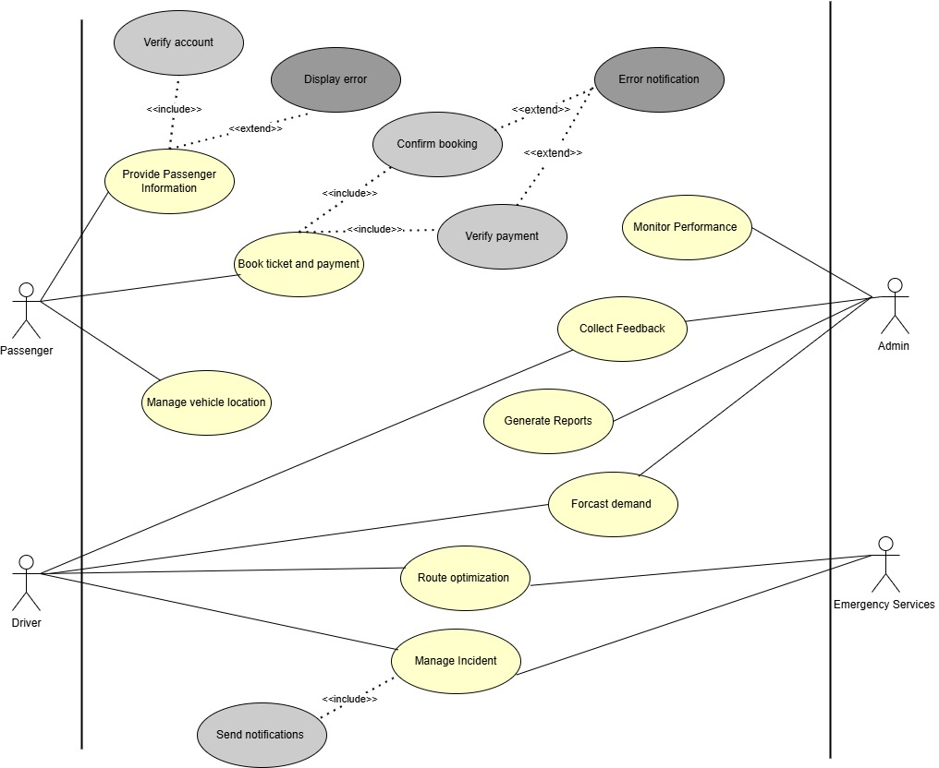
Use Case Diagram

Slide 11
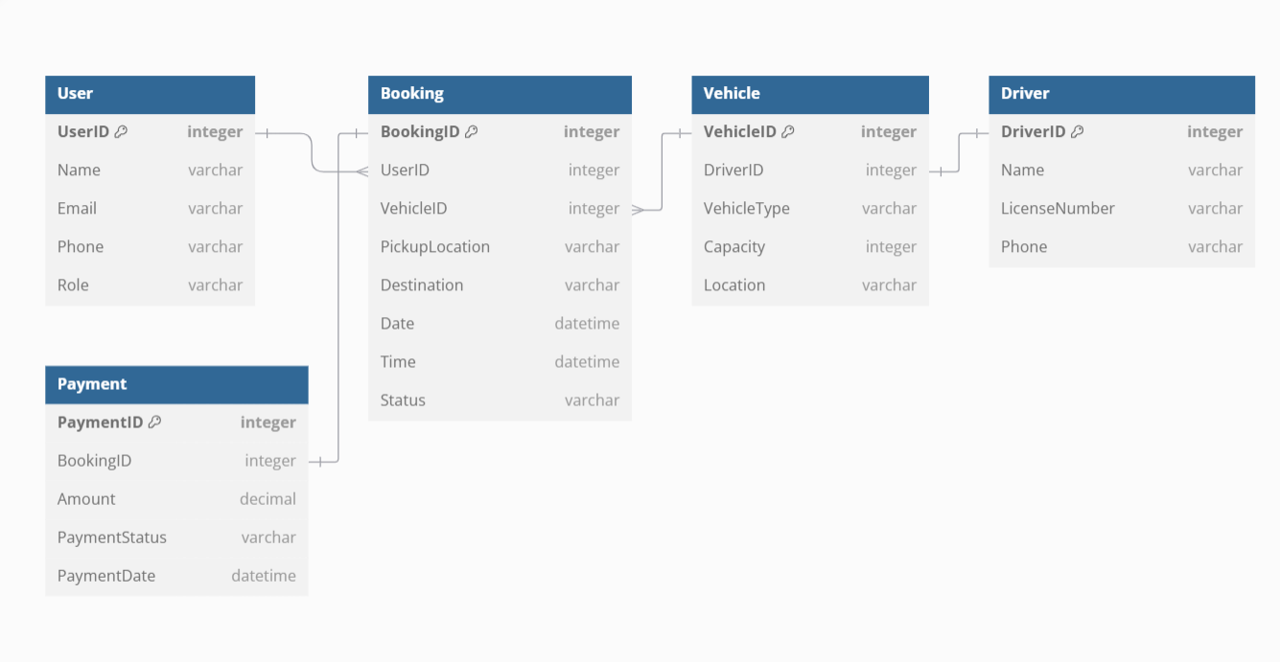
Class Diagram

Slide 12
4. Conclusion and Future Work
Summary of Achievements:
Developed a real-time transportation management system.
Integrated GPS tracking, booking, and payment solutions.
Enhanced efficiency for passengers and transport providers.
Future Enhancements:
AI-based route optimization to further reduce travel time.
Integration with additional payment methods.
Advanced analytics for predictive demand forecasting.

Slide 13

Thank you!

