Slide 1
Messages from the Quran: Why I love This Book!
By Sama Haitham
Arab American University
January 2025

Slide 2
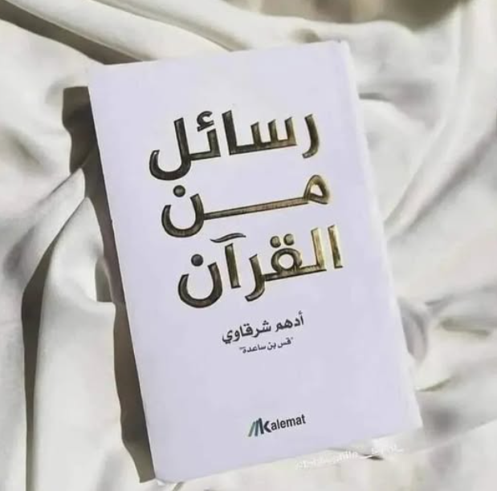
Introduction to the Book
"Messages from the Quran" is a collection of reflections on the meanings of the Quran and their impact on daily life.
The book is characterized by its simplicity and depth, as it explains Quranic values ​​and principles in a straightforward way while highlighting the human spirit in the Quranic verses.

Slide 3
About the Book
The Book is written by Adham Sharqawi, a Palestinian-Lebanese author.
It explores reflections and messages derived from the Quran, covering topics like patience, trust in Allah, hope, and forgiveness.
The book is written in a simple and accessible language with deep intellectual insight, making it easy to understand to readers.

Slide 4

Key Messages in the Book
Reliance on Allah (Tawakkul):
The book emphasizes the importance of putting trust in Allah while taking an action.
Patience and Perseverance:
The author discusses how patience is key to overcoming hardships and how every distress in life can be a chance for growth.
Forgiveness and Mercy:
Leads an individual can achieve inner peace by embodying these qualities.

Slide 5

Impact of the Book
How the Book Impacted Me:
"Messages from the Quran" had a deep impact on my perspective toward life. It taught me to approach challenges with patience and trust in Allah's wisdom.
Impact on My Personal and Professional Life:
This book became a guide for me in daily life. It encourages me to make decisions with faith and mindfulness, whether in personal relationships or professional challenges. Also, helped me stay calm and flexible.

Slide 6
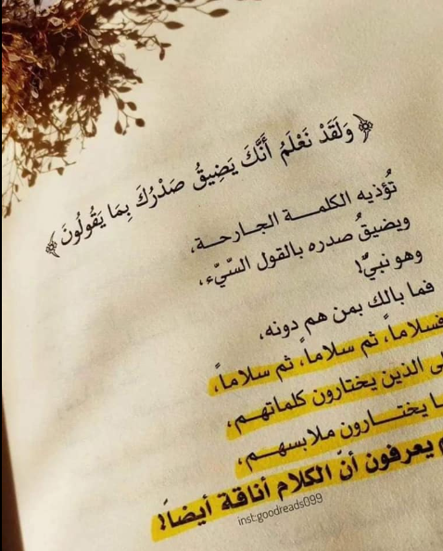
Why I Recommend This Book
Inspirational Messages:
The book is filled with positive messages that encourage in the face of life’s challenges.
Easy to Understand:
Despite addressing deep themes, the book is written in a clear and engaging style.
Suitable for All Ages:
The book isn’t just for adults or religious scholars.

Slide 7
Conclusion
This book is not just a religious text but a life manual that guides readers to become better and more faithful individuals.
"What book has had the greatest impact on your life?"

Slide 8
Thank you…
Feel Free to ask !

