Slide 1
Web Programming Project Hotel Customers Register System link for project
Click right -> open link
Sama Sammar 202110795
Aya Zayed 202111486
Zaid Ardah 202210598

Slide 2
Functional Requirements
Log in and log out securely.
View customer details.
Show the information of customer.
Add new customer.
Edit the information of customer.
Searching for customer.
Delete a costumer.

Slide 3
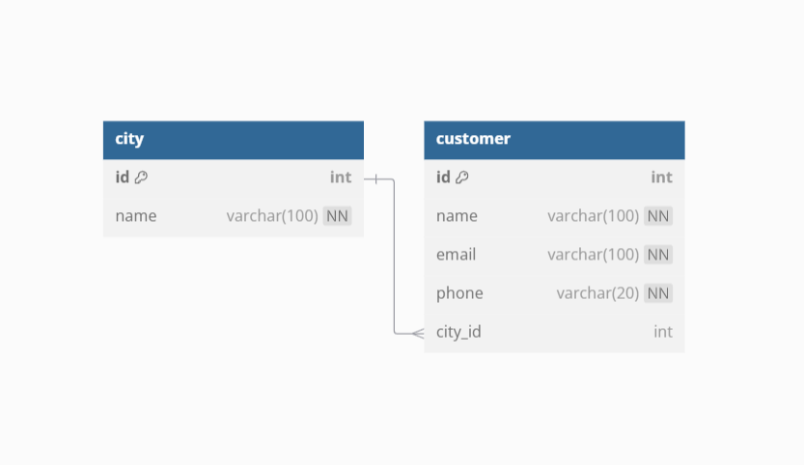
ER diagram & Relational tables

Slide 4
Screenshots of Main Functionalities

Slide 5

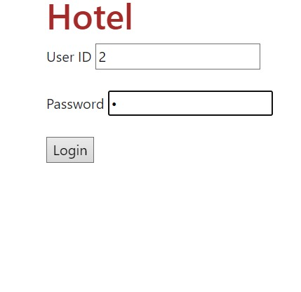
Log in
Controller : CustomerController.cs
View : login.cshtml

Slide 6
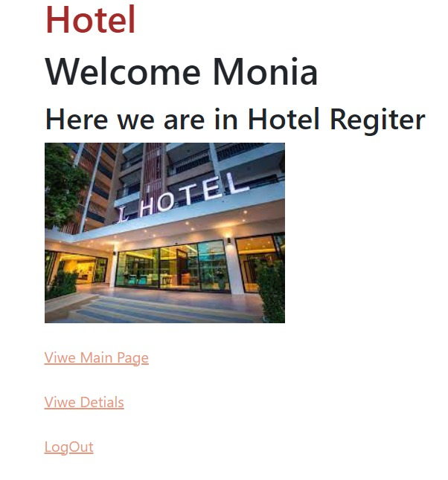
Welcome Page
View: Welcome.cshtml

Slide 7
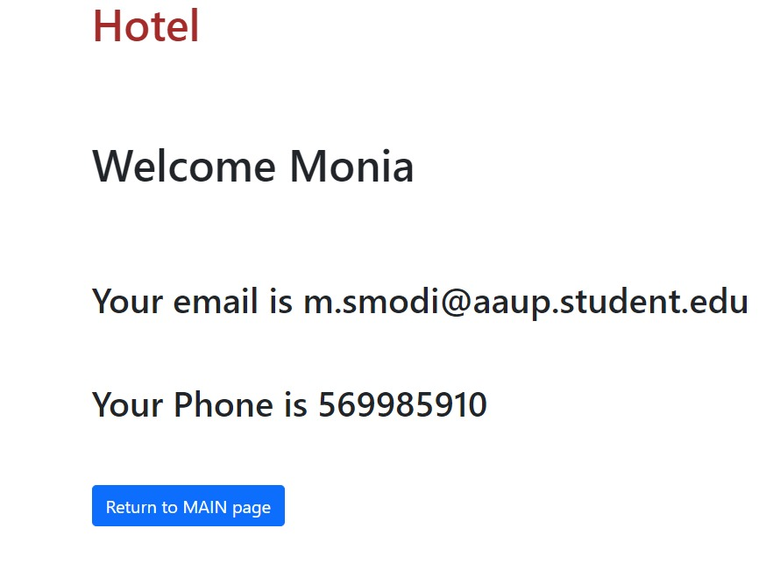
Details
View: Sdetails.cshtml

Slide 8
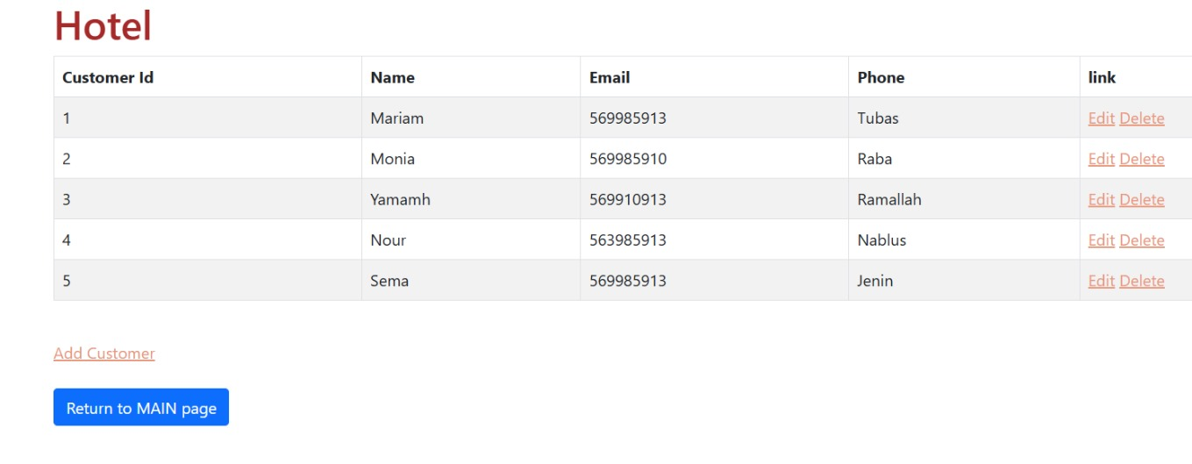
First Page
Delete Button
View: Index.cshtml

Slide 9
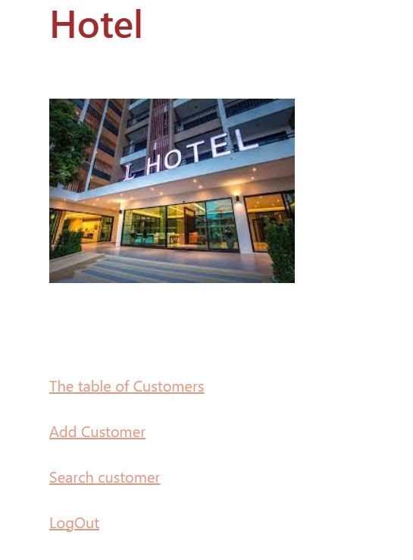
Main Page
Controller:
MainController.cs
View : Index.cshtml

Slide 10
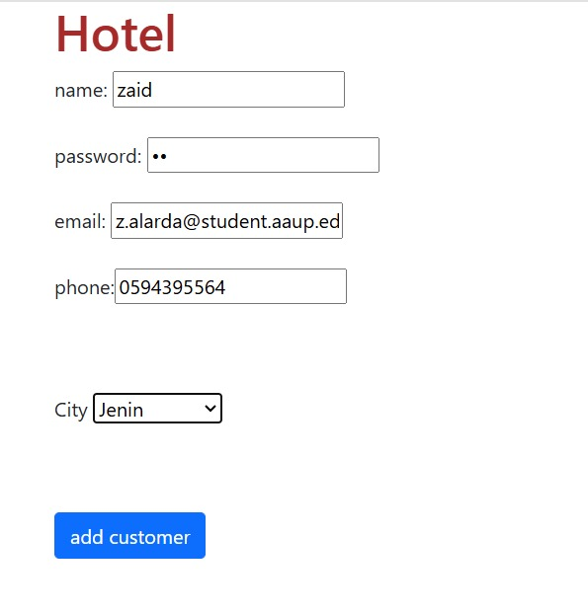
Add a Customer
View: Add.cshtml

Slide 11
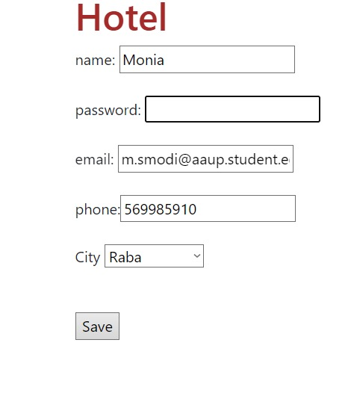
Edit a Customer
View: SDetails.cshtml

Slide 12
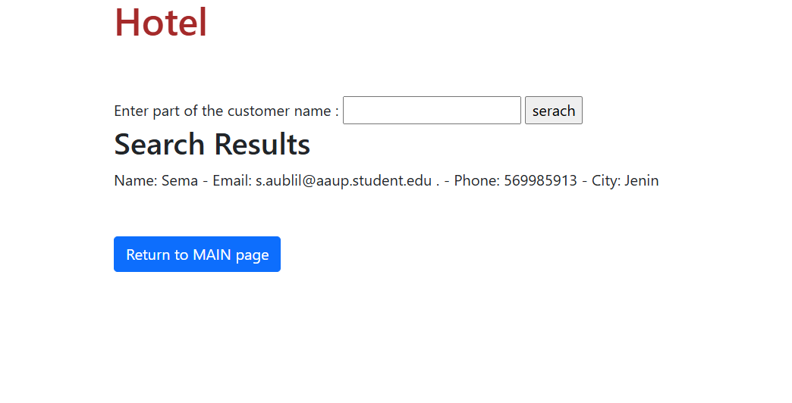
Search Page
View: Search.cshtml

Slide 13
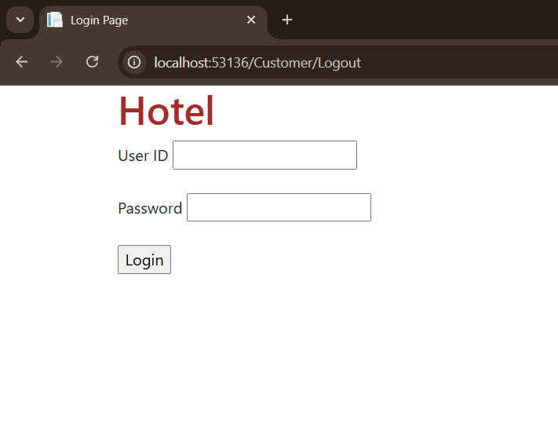
Log out
View: login.cshtml

Slide 14
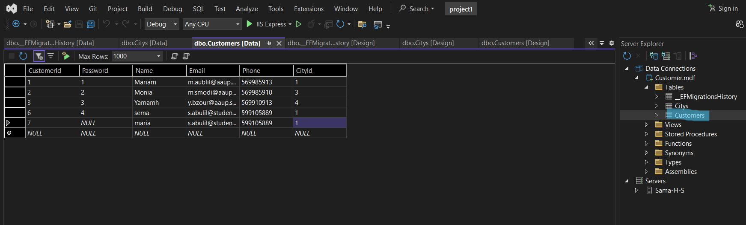
Customer Table

Slide 15
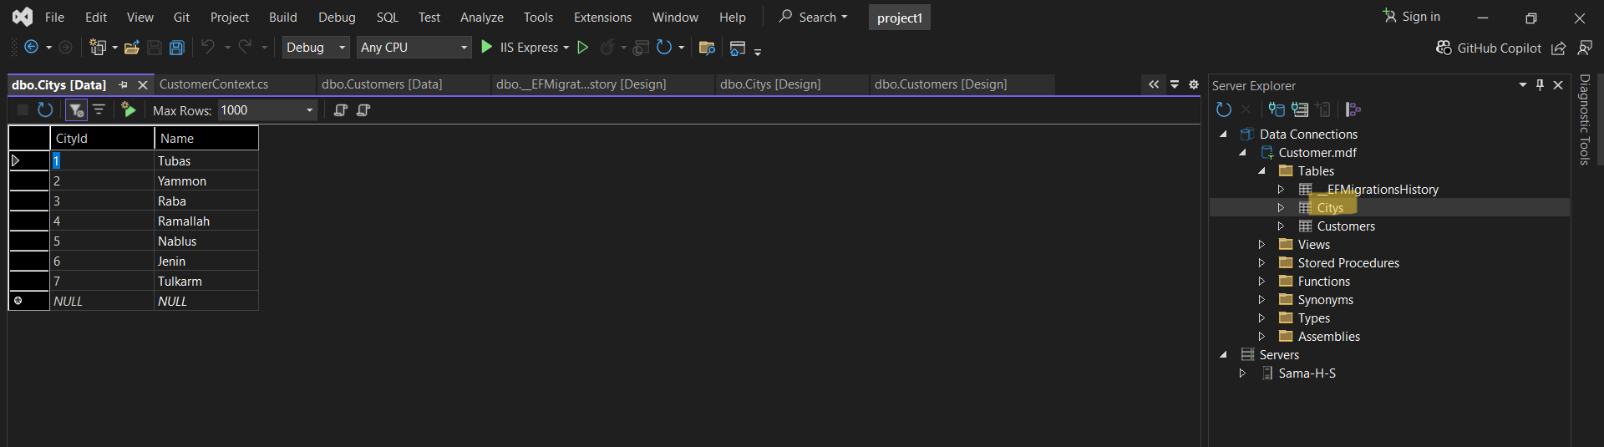
City Table

Slide 16
Thanks!

