Slide 1
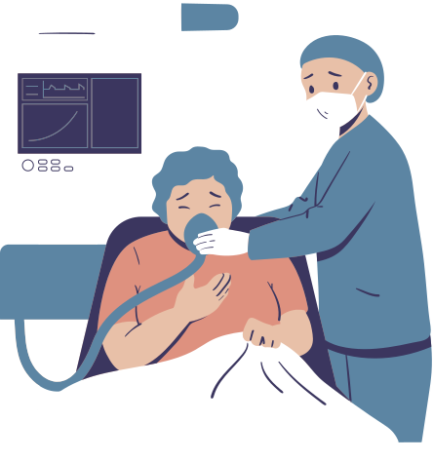
ANALYZING U.S. COVID-19 DATA
FARIDA MOHAMED 202000860
Hagar Alaa eldin 202000000
Nada Tayel 202001944
Sama Yousef 202000819

Slide 2
EXPLORATORY DATA ANALYSIS
This part outlines the analysis performed on two datasets: COVID-19 case data and Pulse Survey data. The analysis aims to address ten specific questions related to hospitalization, death rates, ICU admittance, employment loss, and medical treatment delays due to the COVID-19 pandemic. The following sections provide a detailed breakdown of the methods and findings for each question.

Slide 3
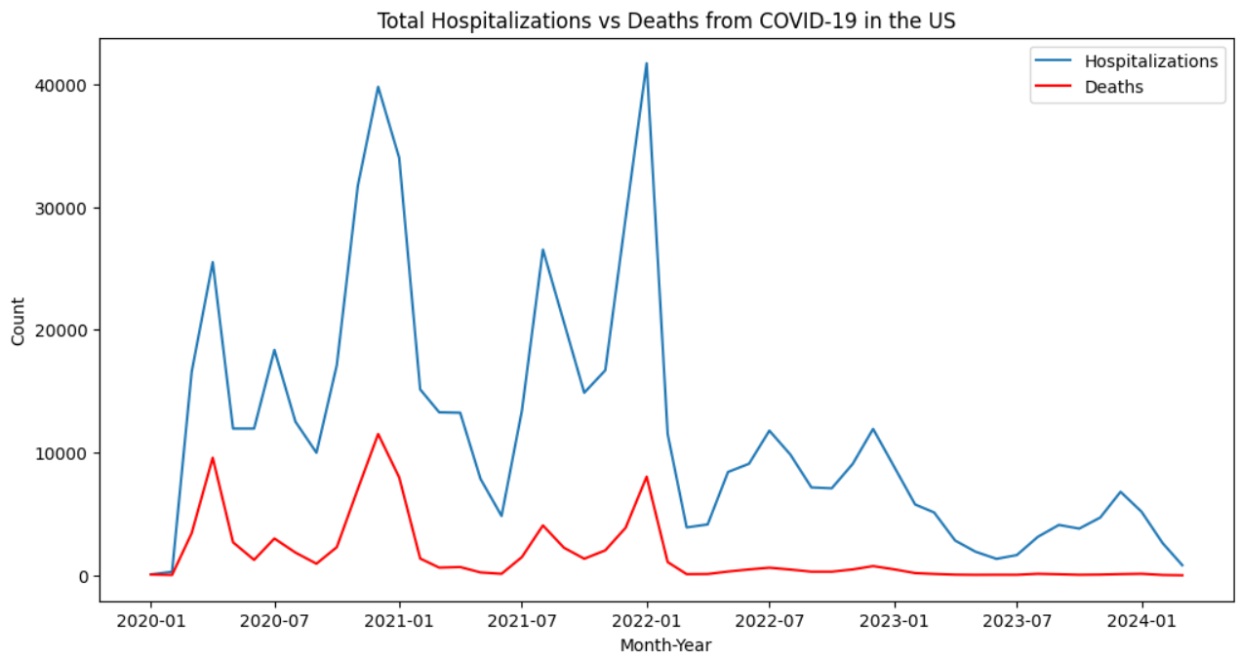
TOTAL NUMBER OF HOSPITALIZATIONS VS. DEATHS FROM COVID-19 OVER TIME
The plot shows the fluctuations in the number of hospitalizations and deaths over time, highlighting peaks and troughs corresponding to different waves of the pandemic.

Slide 4
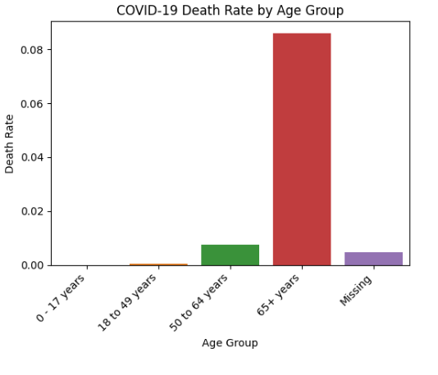
AVERAGE RATES OF COVID-RELATED DEATHS RELATIVE TO PATIENT DEMOGRAPHICS
The plot clearly shows that the death rate increases significantly with age.
The death rate for the "65+ years" age group is the highest, indicating a much higher vulnerability to severe outcomes from COVID-19.

Slide 5
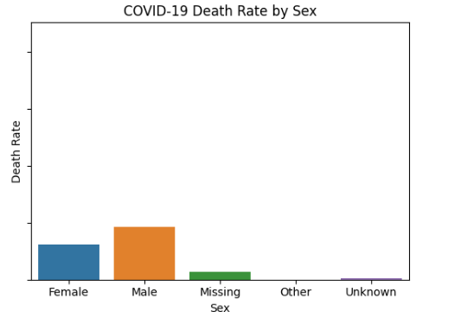
AVERAGE RATES OF COVID-RELATED DEATHS RELATIVE TO PATIENT DEMOGRAPHICS
The death rate for males is higher compared to females, suggesting a gender disparity in COVID-19 outcomes.

Slide 6
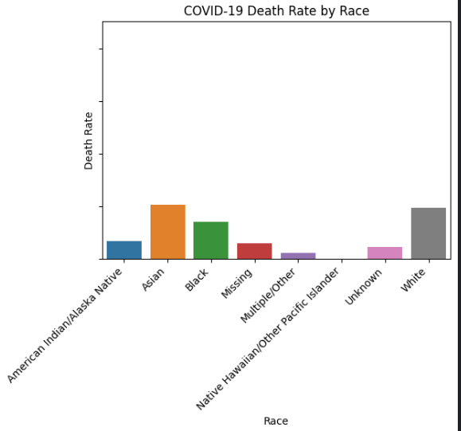
AVERAGE RATES OF COVID-RELATED DEATHS RELATIVE TO PATIENT DEMOGRAPHICS
The death rate varies across different racial groups.
The "White" and "Asian" racial groups show higher death rates compared to other racial groups.
The "Black" racial group also shows a notable death rate.
The "American Indian/Alaska Native" and "Native Hawaiian/Other Pacific Islander" groups show lower death rates, but this could be due to smaller sample sizes in the dataset.

Slide 7
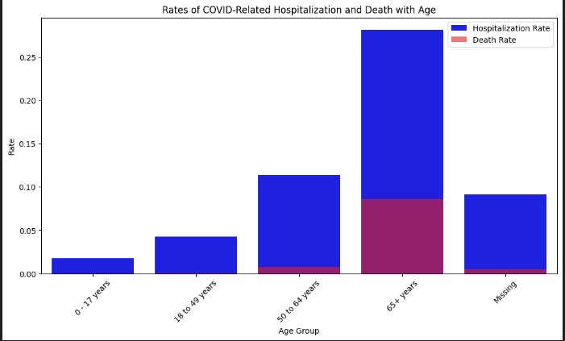
RATES OF COVID-RELATED HOSPITALIZATION AND DEATH WITH AGE
The bar chart shows that both hospitalization and death rates increase with age, with the highest rates observed in the 65+ age group.

Slide 8
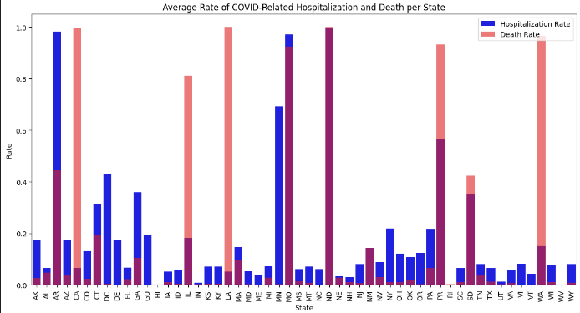
AVERAGE RATE OF COVID-RELATED HOSPITALIZATION AND DEATH PER STATE
1- Varied Hospitalization Rates:
High in states like Arizona (AZ), Georgia (GA), and Mississippi (MS).
Low in many other states, indicating fewer severe cases.
2- Varied Death Rates:
High in Nebraska (NE), Hawaii (HI), and Kansas (KS).
Low in several states, suggesting better case management or other factors.

Slide 9
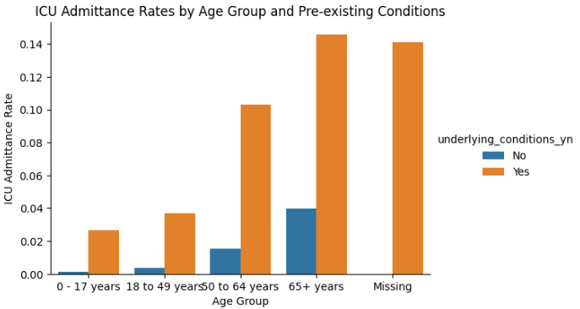
ICU ADMITTANCE RATES BY AGE GROUP AND PRE-EXISTING CONDITIONS
The chart shows that ICU admittance rates are higher for individuals with pre-existing conditions across all age groups, with the highest rates in the 65+ age group.

Slide 10
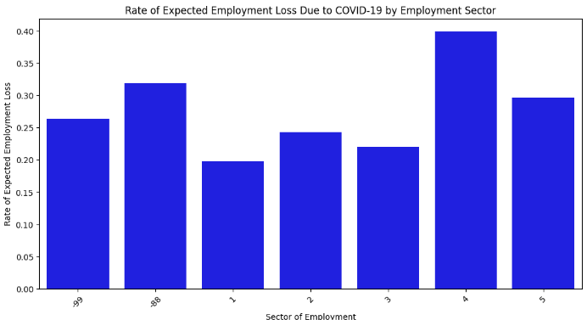
RATE OF EXPECTED EMPLOYMENT LOSS DUE TO COVID-19 BY SECTOR
Sector 4 (self-employed) is the most affected by expected employment loss.
Sector 1 (Government) is the least affected by expected employment loss.
Special categories (-99 and -88) indicate significant employment loss rates but represent missing or unreported data.

Slide 11
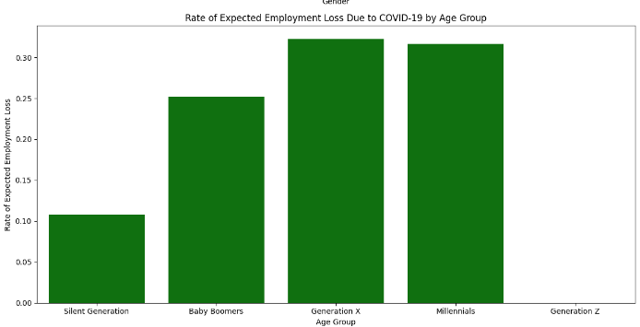
RATE OF EXPECTED EMPLOYMENT LOSS DUE TO COVID-19 RELATIVE TO RESPONDERS' DEMOGRAPHICS
Middle-aged adults (Generation X and Millennials) are more affected by expected employment loss compared to older generations (Silent Generation).

Slide 12
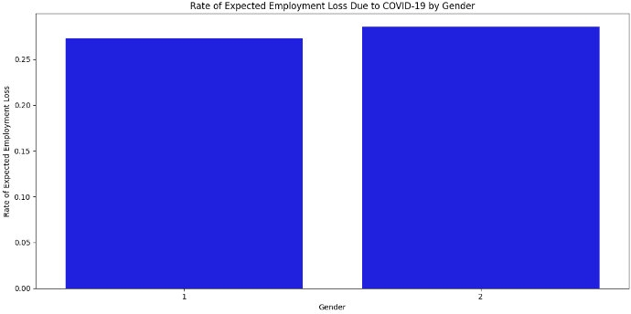
RATE OF EXPECTED EMPLOYMENT LOSS DUE TO COVID-19 RELATIVE TO RESPONDERS' DEMOGRAPHICS
The expected employment loss due to COVID-19 does not significantly differ between the two gender categories in the dataset, but it’s more prominent for females .

Slide 13
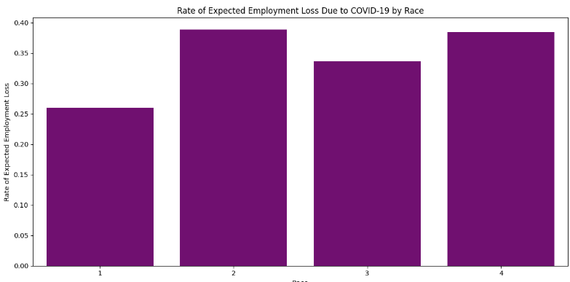
RATE OF EXPECTED EMPLOYMENT LOSS DUE TO COVID-19 RELATIVE TO RESPONDERS’ DEMOGRAPHICS
White(1) has the lowest rate of expected employment loss among the groups.
Black (2) has the highest rate of expected employment loss.
Asian(3) and Any other race alone, or race in combination(4) have similar rates, which are higher than White, Alone but slightly lower than Black, Alone.

Slide 14
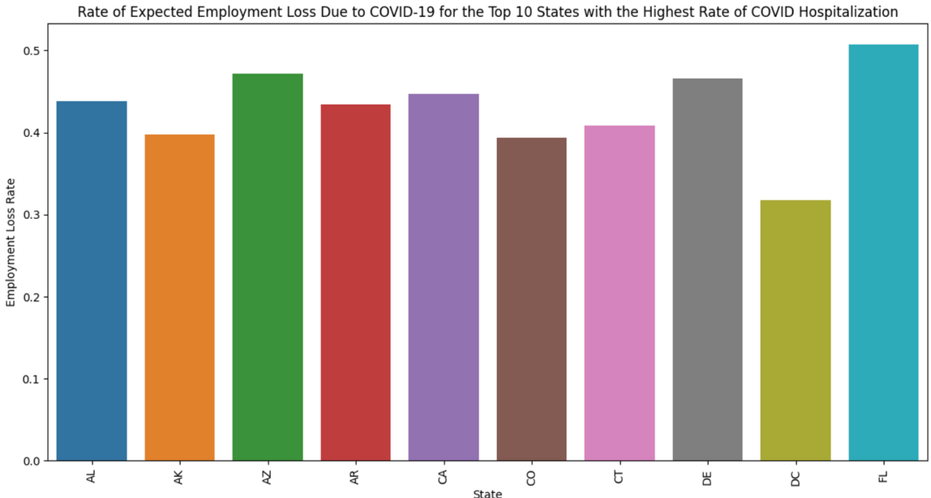
RATE OF EXPECTED EMPLOYMENT LOSS DUE TO COVID-19 FOR THE TOP 10 STATES WITH THE HIGHEST RATE OF COVID HOSPITALIZATION.
Florida (FL) shows the highest rate of expected employment loss (~50%).
Connecticut (CT) and Delaware (DE) also have high rates (~45%).
California (CA), Colorado (CO), and Arizona (AZ) have moderate rates (40%-45%).
Arkansas (AR), Alabama (AL), and Alaska (AK) have slightly lower rates (~35%-40%).
Implications:
The variation suggests differing economic impacts due to COVID-19.

Slide 15
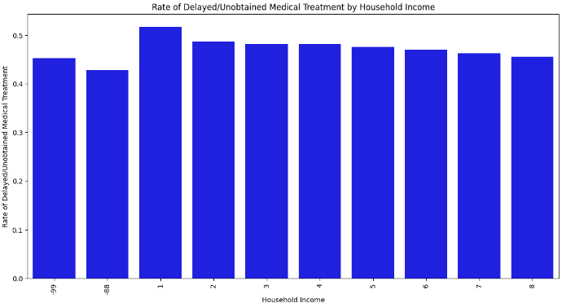
THE RELATIONSHIP BETWEEN HOUSEHOLD INCOME AND THE RATE OF DELAYED/ OR unobtained medical treatment (Due to COVID or otherwise).
The rates of delayed/unobtained medical treatment are relatively high across all household income groups, indicating a widespread issue affecting all segments of the population.
The income group labeled 1 (representing the lowest income bracket) shows the highest rate of delayed/unobtained medical treatment at around 50%.

Slide 16
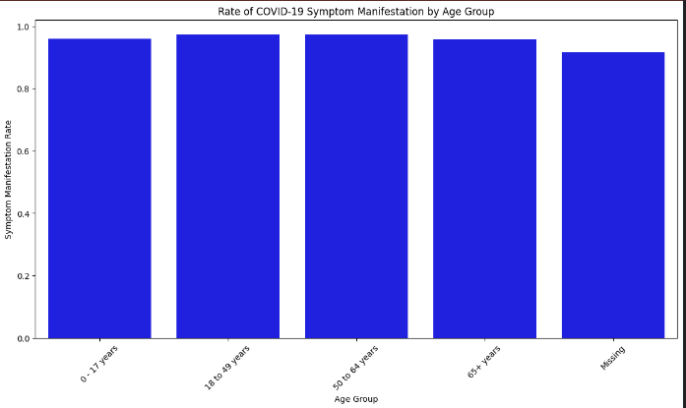
THE RELATIONSHIP BETWEEN COVID-19 SYMPTOM MANIFESTATION AND AGE group.
The rates of symptom manifestation are high across all age groups, indicating that most individuals who were part of the survey reported symptoms if they had COVID-19.

Slide 17
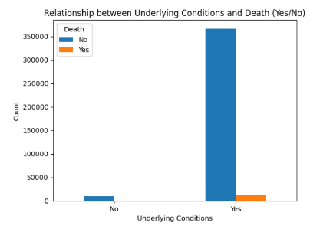
VISUALIZATIONS
The graph illustrates that the number of deceased individuals with underlying medical conditions and/or risk behaviors is greater, whereas the number of deceased individuals without underlying medical conditions and/or risk behaviors is zero

Slide 18
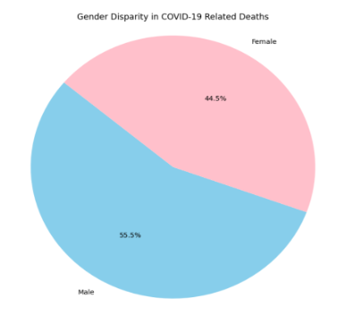
VISUALIZATIONS
The gender that appears to be most at risk of death due to COVID-19 is males, as indicated by the graph where the percentage of deceased males due to COVID-19 is 55.5%

Slide 19
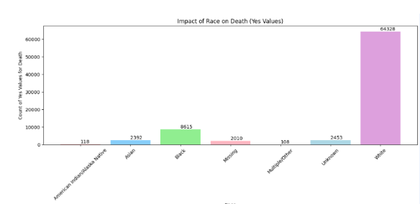
VISUALIZATIONS
The white race appears to be the most at risk of death due to COVID-19, as indicated by the graph showing that the percentage of deceased white individuals due to COVID-19 is 58%, totaling 64,328 cases.

Slide 20
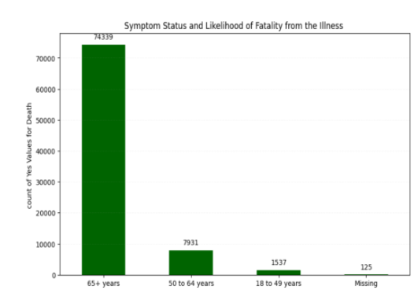
VISUALIZATIONS
In the population under 18 years of age, there were no reported deaths due to the COVID-19 virus. The incidence of mortality increases with advancing age, with individuals above 65 years being the most affected demographic group in terms of COVID-19 related deaths.

Slide 21
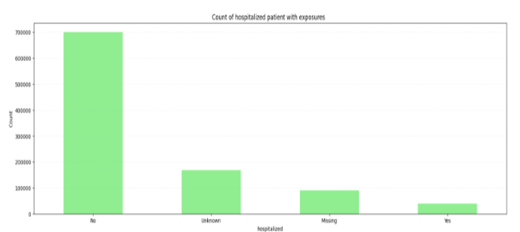
VISUALIZATIONS
From the graph, it is evident that a substantial number of patients who reported exposure to any kind of travel or congregation within the 14 days prior to illness onset were not hospitalized .

Slide 22
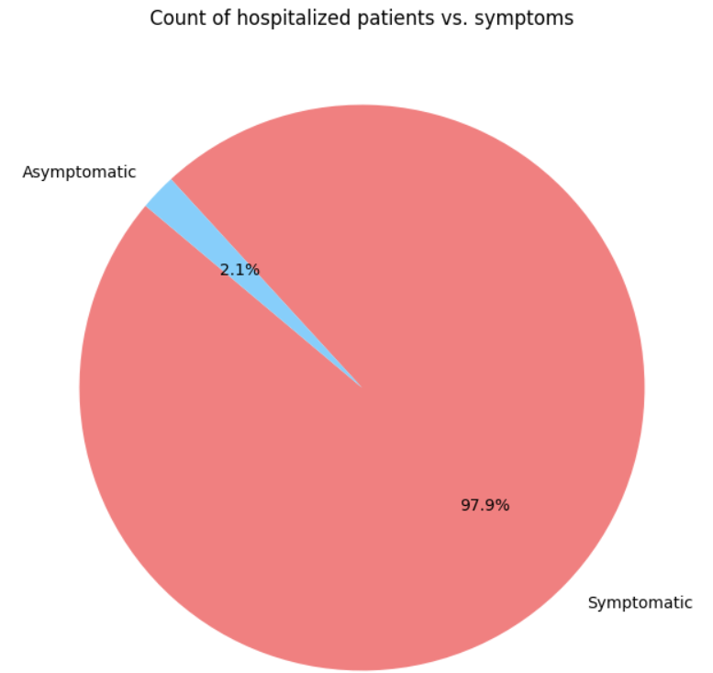
VISUALIZATIONS
Based on the data presented in the graphs, it is evident that most of the hospitalized patients are symptomatic COVID cases, constituting 97.9% of the total number, which amounts to 37,028 individuals. In contrast, asymptomatic patients represent a smaller percentage of hospitalizations at 2.1%, totaling 785 individuals

Slide 23
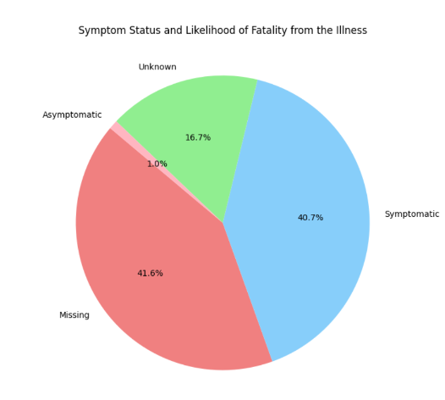
VISUALIZATIONS
COVID patients are less likely to die from their illness. The analysis from the graph reveals that a higher percentage of deceased patients had symptomatic COVID, accounting for 40.7%, while the percentage of deceased patients who were asymptomatic is notably lower at 1%

Slide 24
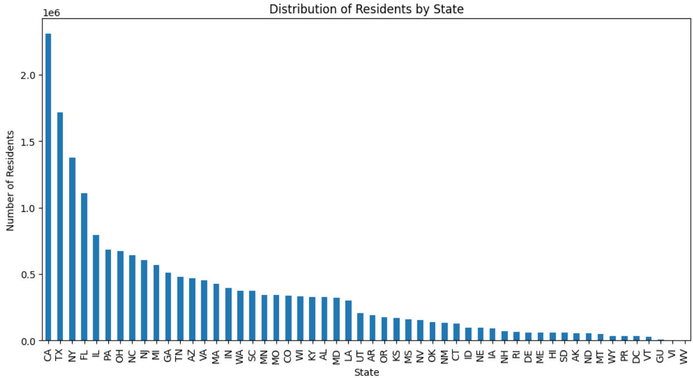
VISUALIZATIONS
California is associated with the highest percentage of Economic Impact Payments among survey respondents. This conclusion is drawn from the significant number of survey participants indicating California as their state of residence, suggesting a strong correlation with Economic Impact Payments

Slide 25
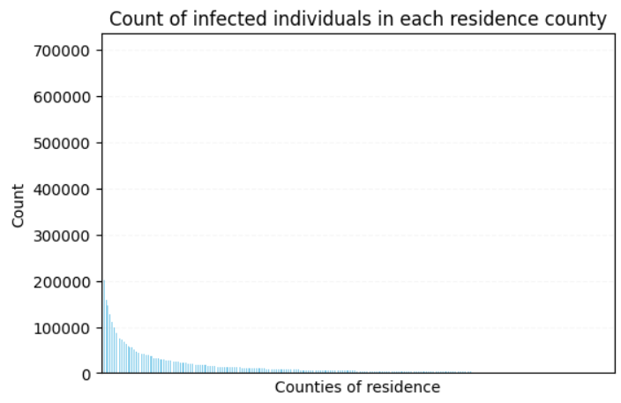
VISUALIZATIONS
The graph illustrating the number of infected individuals in each residence province clearly demonstrates an exponential increase in the number of infected people due to the close spread of the infection.

Slide 26
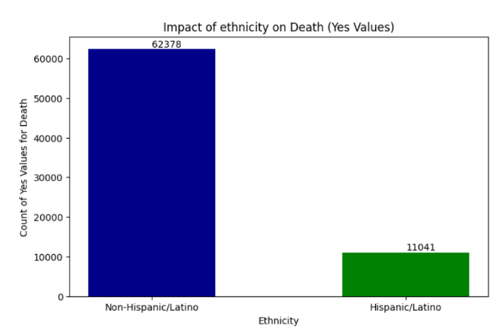
VISUALIZATIONS
The mortality count of non-Hispanic or Latino individuals is 62378 which is greater than Hispanic/Latino mortality count that is 11041

Slide 27
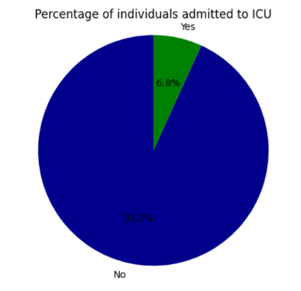
VISUALIZATIONS
The chart suggests that a significant portion of infected individuals did not require intensive care, with only 6.8% of patients admitted. However, it is important to note the substantial presence of missing and unknown data in the initial dataset.

Slide 28
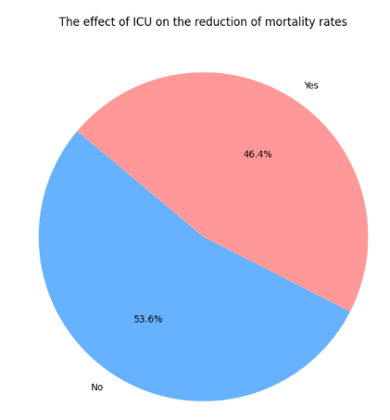
VISUALIZATIONS
The impact of intensive care on the reduction of the mortality rate was not deemed significant, considering the minimal disparity between the percentages of deceased and surviving individuals following admission to the intensive care unit, as illustrated in the chart .

Slide 29
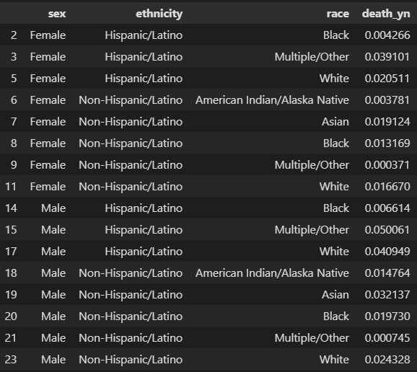
HYPOTHETICAL TESTING
Hypothesis Testing
Null Hypothesis (H0): There is no association between demographics and death probability.
Alternative Hypothesis (Ha): There is an association between demographics and death probability.
Contingency table illustrating demographics with mean of deaths

Slide 30
HYPOTHETICAL TESTING
p-value of 1.0 suggests no evidence against the null hypothesis
indicating a statistically insignificant association between demographics and COVID-19 death probability.
It signifies that the observed distribution of death outcomes across different demographic groups is highly likely to have occurred by chance.

Slide 31
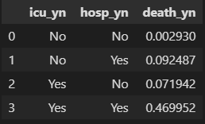
HYPOTHETICAL TESTING
Hypothesis Testing
Null Hypothesis (H0): There is no association between being hospitalized and icu and death probability.
Alternative Hypothesis (Ha): There is an association between being hospitalized and icu and death probability.
Contingency table illustrating hospitality with mean of deaths

Slide 32
HYPOTHETICAL TESTING
Fail to reject H0.
Evidence is inconclusive at the 5% significance level indicating a statistically insignificant association between demographics and COVID-19 death probability.
It signifies that the observed distribution of death outcomes across different demographic groups is highly likely to have occurred by chance.

Slide 33
HYPOTHETICAL TESTING
Fail to reject H0.
Evidence is inconclusive at the 5% significance level indicating a statistically insignificant association between demographics and COVID-19 death probability.
It signifies that the observed distribution of death outcomes across different demographic groups is highly likely to have occurred by chance.

Slide 34
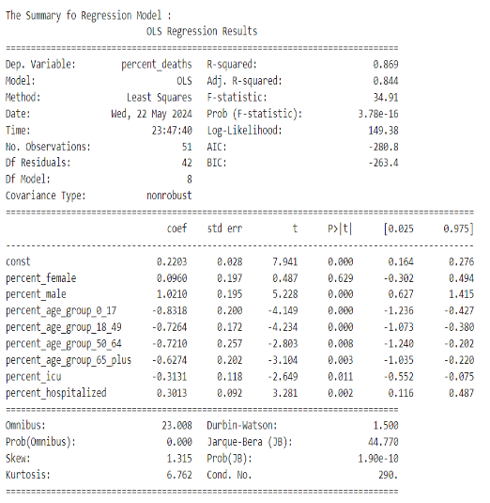
REGRESSION ANALYSIS
The summary of regression model , that represent the total percent (or proportion) of deaths out of all COVID cases

Slide 35
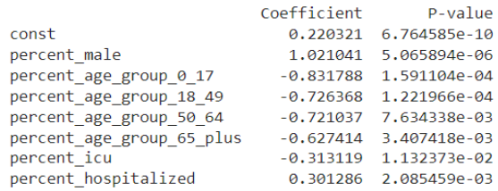
REGRESSION ANALYSIS
Good Predictors are those predictors whose P-value < 0.05 :

Slide 36
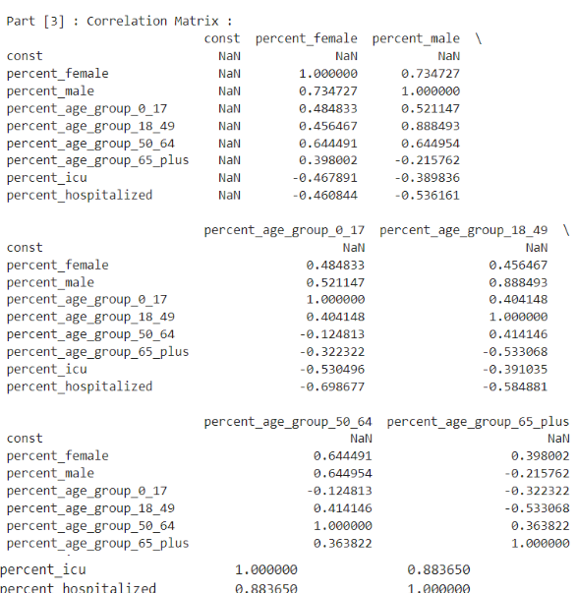
REGRESSION ANALYSIS
Correlation matrix to represent the correlation among Proportions:

Slide 37
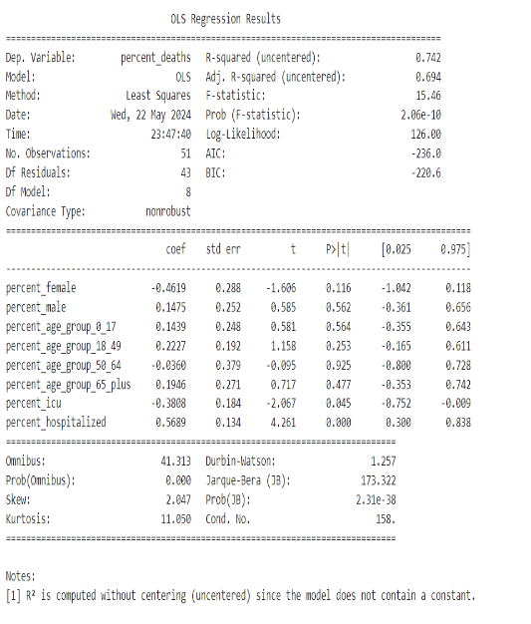
SUMMARY OF THE REGRESSION WITHOUT INTERCEPT :

Slide 38
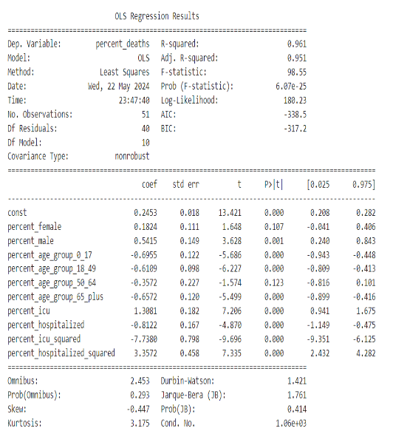
REGRESSION ANALYSIS
SUMMARY OF THE REGRESSION WITH HIGHER ORDER TERMS :

Slide 39
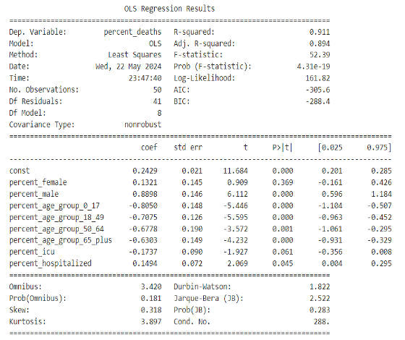
REGRESSION ANALYSIS
SUMMARY OF THE REGRESSION WITHOUT OUTLIERS :

Slide 40
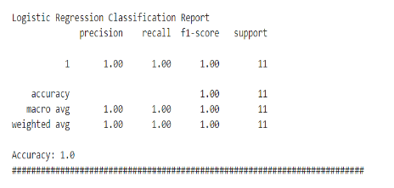
BONUS PART
PREDICT THE LIKELIHOOD OF DEATH DUE TO COVID-19 USING ANY/ALL OF THE RELEVANT ATTRIBUTES IN THE COVID CASE SURVEILLANCE DATASET:

Slide 41
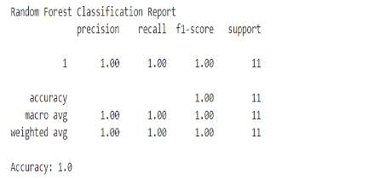
BONUS PART
RANDOM FOREST CLASSIFIER

Slide 42
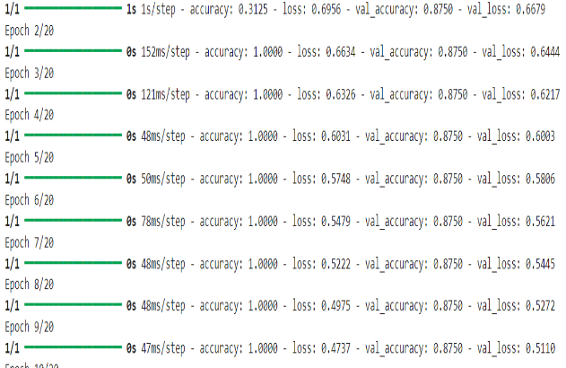
BONUS PART
The network consists of 128 Layers of Relu , 64 of Relu , 1 Sigmoid , then it was modeled using ADAM optimizer , Binary-Crossentropy loss function .

