Slide 1
OS Lab Project 4
Sequential vs Parallel Compute
Deadline: March 23, 11:59 PM
Grade: 14%

Slide 2
01 Team Roles
Member 1: Sama Emad Abu Zahra
Member 2: Yara
Requirements: a, b, c, d + adding parallel and sequential compute to xv6 (Bonus part)
Write sequential_compute
Write parallel_compute (forking n_proc children, distributing ranges via pipes, collecting results via pipes)
Write the correctness test: run both functions on simple known inputs (like case where N is not divisible by n_proc 1,2,3,4,5 with add) and verify they produce identical results, including the edge
Prepare slides for: roles, pseudo-code of both functions, simple correctness examples, and the pipe/process figure
Requirements: a, e, f, g
Write the two test functions (vary N with fixed n_proc, vary n_proc with fixed N), each producing at least 50 readings
Handle curve smoothing (run each point an odd number of times, take the median)
Produce the Excel file: 2 sheets, each with raw data and a graph
Prepare slides for: how the tests are designed and ranges chosen, the smoothing method, and the comparison results with answers to both questions
Bonus: Editing the experiment codes to add them to xv6

Slide 3
02 sequential_compute — Pseudo-code
What it does
Signature
Reads N numbers from a file and applies function f pairwise left-to-right. No forking, no pipes — pure sequential fold.
int sequential_compute(
const char *filepath,
int (*f)(int, int)
);
FUNCTION sequential_compute(filepath, f): nums ← read_numbers(filepath) // parse newline or comma separated result ← nums[0] FOR i = 1 TO len(nums) - 1 : result ← f(result, nums[i]) // fold left RETURN result

Slide 4
02 Parallel Compute - Description
What it does
Takes:
The path of a file containing N numbers separated by new lines (or commas)
Number of processes n_proc.
A pointer to a function f that takes 2 numbers and returns a number.
then does the same as sequential_compute except that it splits the computation over n_proc processes as evenly as possible.

Slide 5
02 parallel_compute — Pseudo-code
FUNCTION parallel_compute(filepath, n_proc, f): nums ← read_numbers(filepath) chunk ← len(nums) / n_proc remainder ← len(nums) % n_proc FOR i = 0 TO n_proc - 1 : create ctrl_pipe[i], res_pipe[i] fork child i IF child : start, end ← read(ctrl_pipe[i]) // receive slice bounds partial ← sequential_compute(nums[start..end], f) write(res_pipe[i], partial) ; exit() ELSE (parent) : write(ctrl_pipe[i], start, end) wait() for all children result ← read(res_pipe[0]) FOR i = 1 TO n_proc-1 : result ← f(result, read(res_pipe[i])) RETURN result

Slide 6
03 Correctness Examples
add [1, 2, 3, 4, 5]
Sequential: add(add(add(add(1,2),3),4),5) = 15
Parallel (n_proc=2): child 0: [1,2] → 3 | child 1: [3,4,5] → 12
f(3, 12) = 15 ✓
multiply [10, 20, 30]
Sequential: multiply(multiply(10,20),30) = 6000
Parallel (n_proc=2): child 0: [10,20] → 200 | child 1: [30]
f(200, 30) = 6000 ✓
add [1, 2, 3, 4, 5, 6, 7] — N not divisible by n_proc
Sequential: n_proc=3, chunk=2, remainder=1 = 28
Parallel (n_proc=3): child 0: [1,2]→3 child 1:[3,4]→7 child 2:[5,6,7]→18
f(f(3,7),18) = 28 ✓

Slide 7
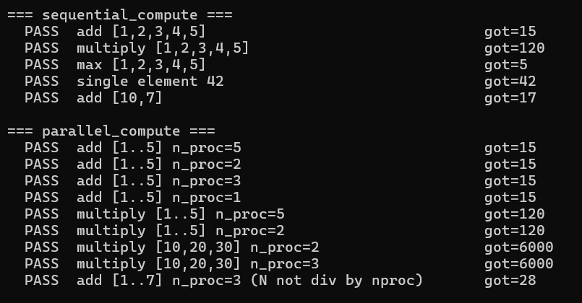
03 Correctness Examples

Slide 8
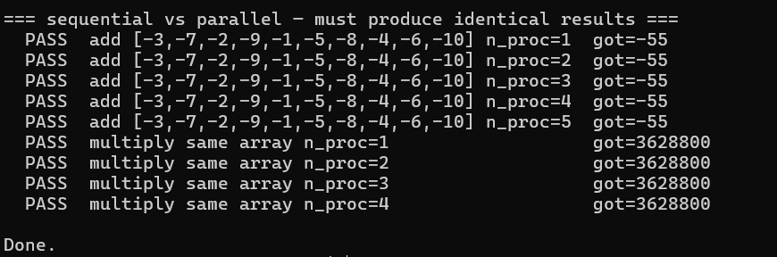
03 Correctness Examples

Slide 9
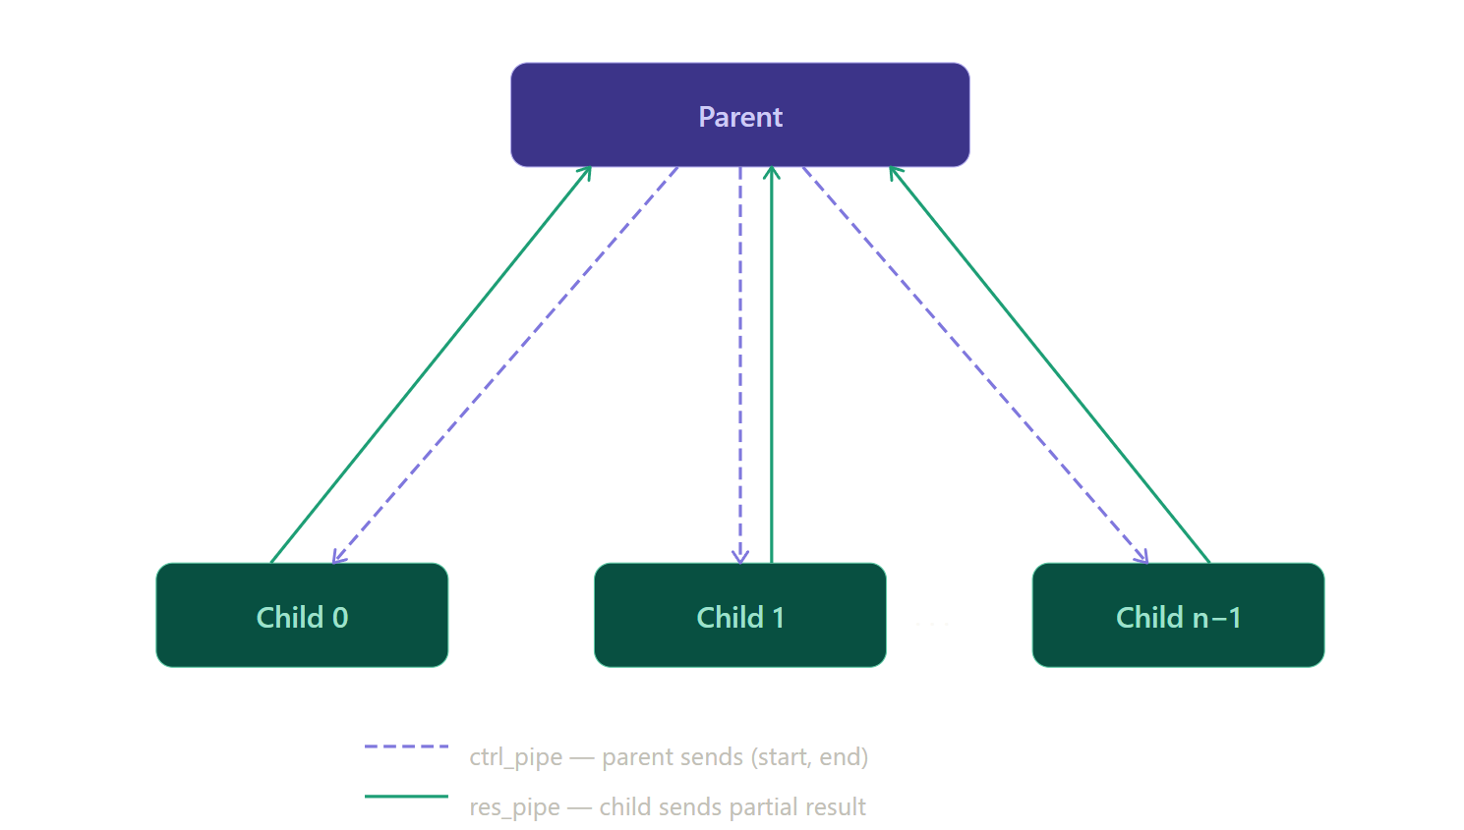
04 Pipe Architecture in parallel_compute

Slide 10
Implementation Notes
2 pipes / child
wait() first
ctrl_pipe sends (start, end) from parent to child. res_pipe returns the partial result from child to parent.
Parent calls wait() for ALL children before reading any result pipe, ensuring partial results are fully written.
Remainder rule
f is generic
If N % n_proc ≠ 0, the extra numbers all go to the last child. Example: 7 numbers, 3 processes → child 2 gets [5,6,7].
Parent aggregates partial results using f, not +. Works correctly for add, multiply, max
Close unused ends
File format
Each process must close the pipe ends it does not use.
Parser handles both newline-separated and comma-separated numbers using strtok with delimiters ",\n\r ".

Slide 11
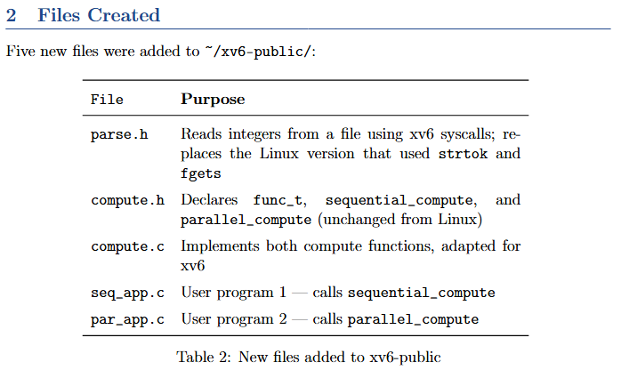
Deploying Sequential & Parallel Compute on xv6

Slide 12
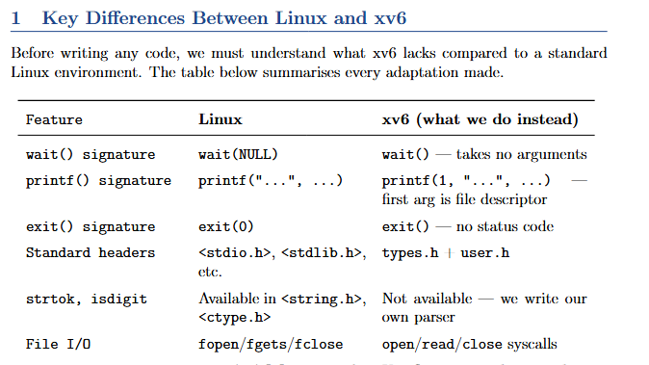
Deploying Sequential & Parallel Compute on xv6

Slide 13
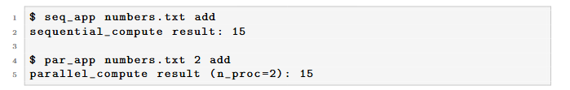
Deploying Sequential & Parallel Compute on xv6
Result:

Slide 14
Comparisons Tests

Slide 15
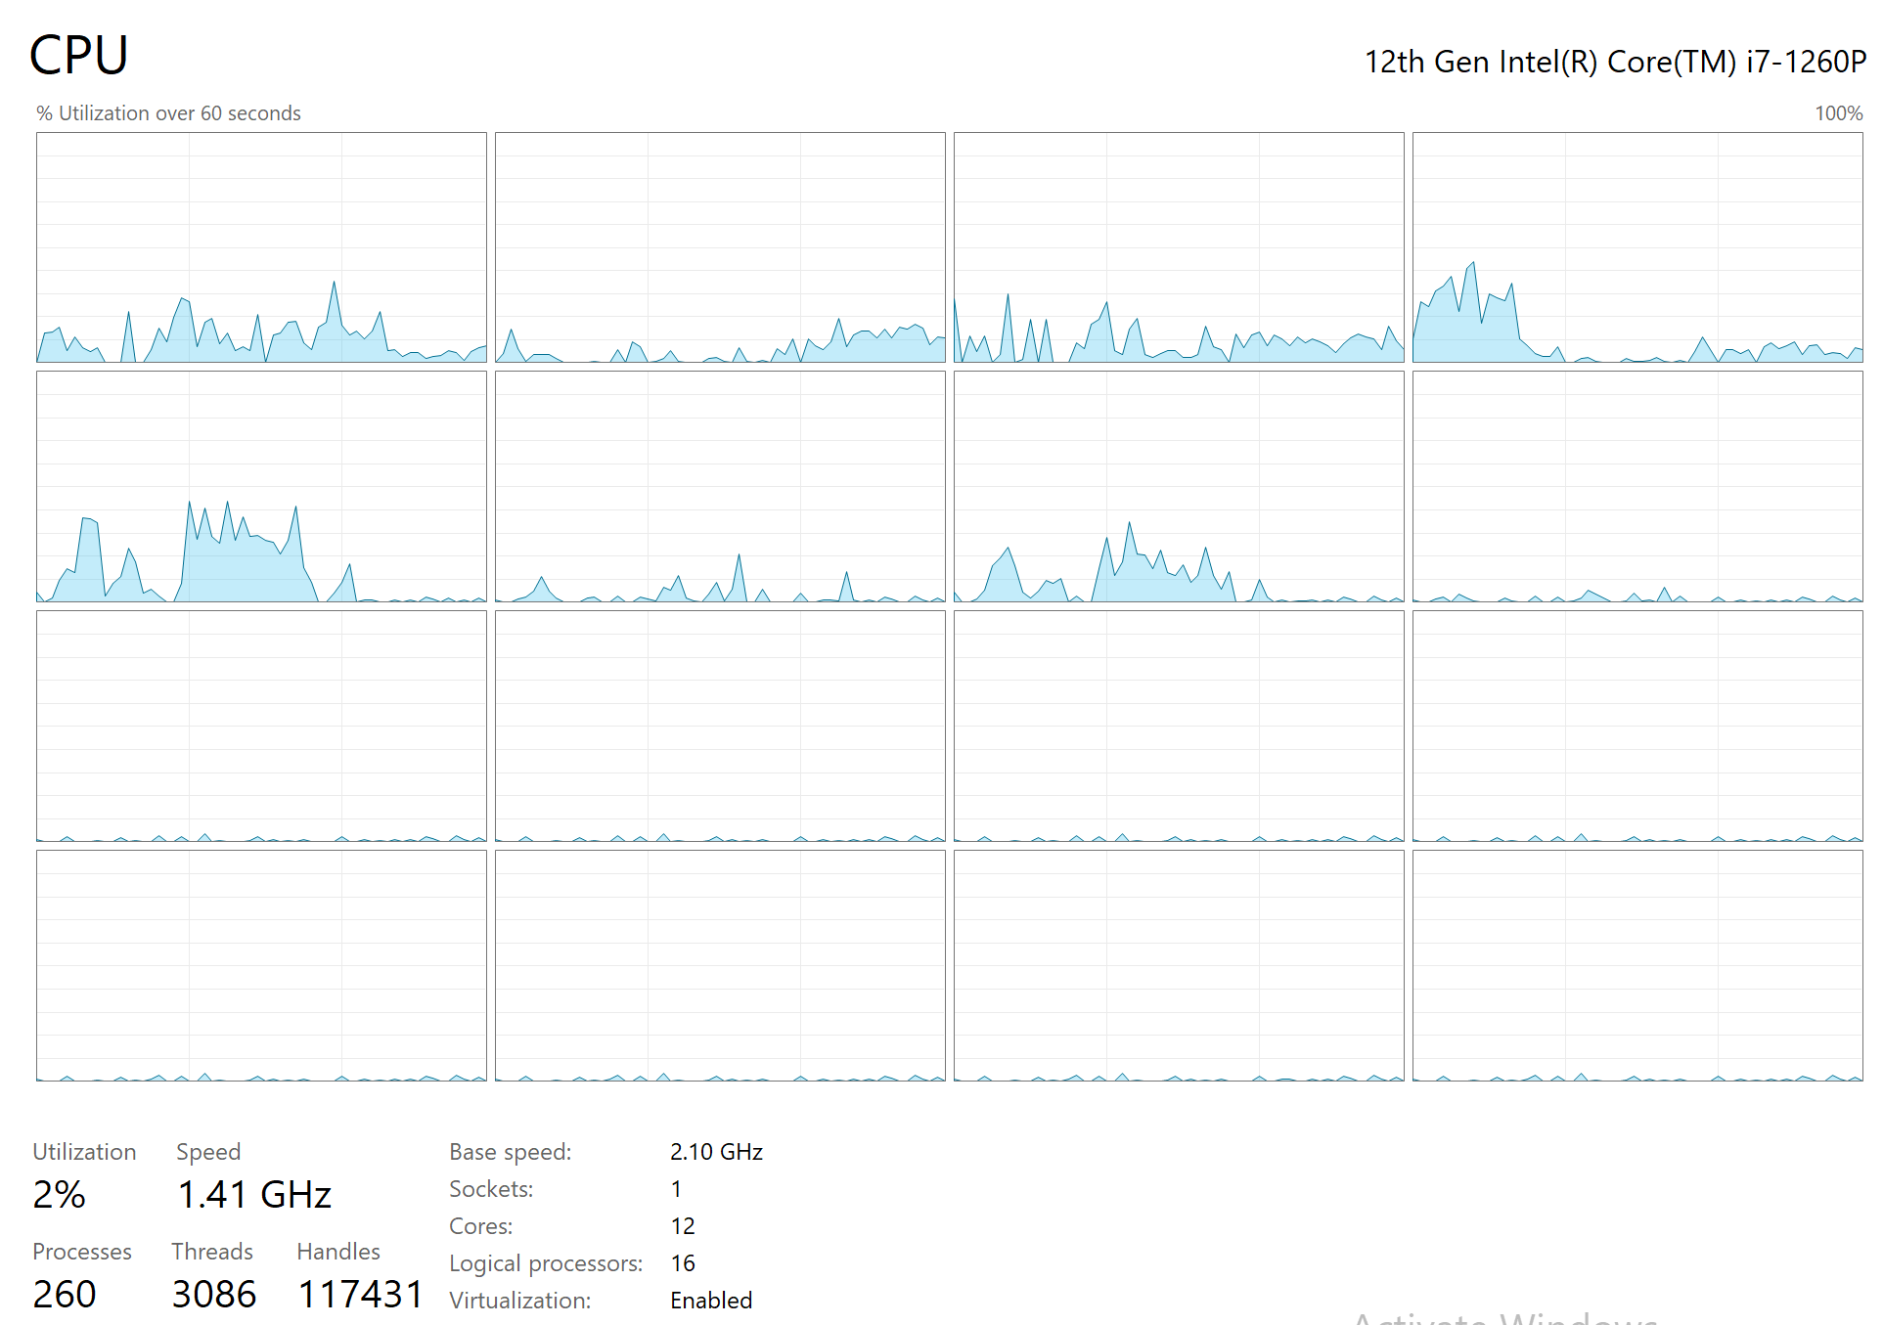
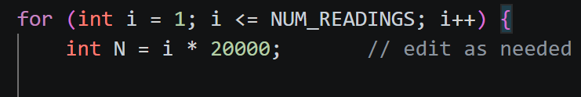
Tests Design and Chosen Ranges
Test 1:
The number of processes fixed for the test was 9 as this was the number of idle processes at the time of testing.
100 Readings were conducted going by increments of 20,000 for N. (Range: 20k to 2M)
Test 2:
The parameter n_proc was iterated from 1 to 24 to significantly exceed the number of logical processors of the machine which is 16. Here, N is fixed to 2,000,000.
Note: For test 1, the range kept adjusting till reaching this range that showed a clear winner between the 2 functions.

Slide 16
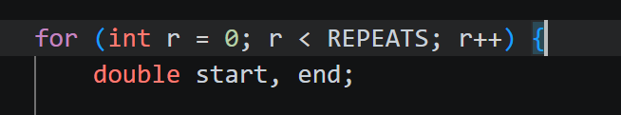
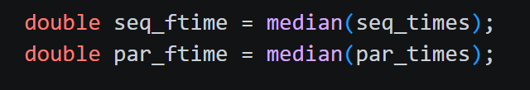
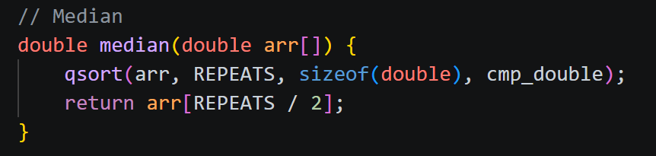

Smoothing Techniques
Smoothing was done by repeating the experiment an odd number of times for each N/n_proc, then taking the median value by sorting.
The experiment was repeated 7 times for each N in test 1 and 23 times for each n_proc in test 2 as it had a relatively small number of iterations.

Slide 17
Results and Answers (Test 1)
Question: If we fix n_proc, then at which value of N does parallel_compute outperform sequential_compute?
Answer: It starts consistently outperforming at N = 1,280,000.
Note: parallel_compute starts outperforming at large values of N

Slide 18
Results and Answers (Test 2)
Results and Answers (Test 2)
Question: If we fix N to a large number, then at which value of n_proc does parallel_compute outperform sequential_compute?
Answer: It starts outperforming at n_proc = 6.
Note: parallel_compute outperforms as long using extra processors compensate the fork and pipe operations overhead, but starts underperforming when n_proc exceeds idle processors

Slide 19
Bonus

Slide 20
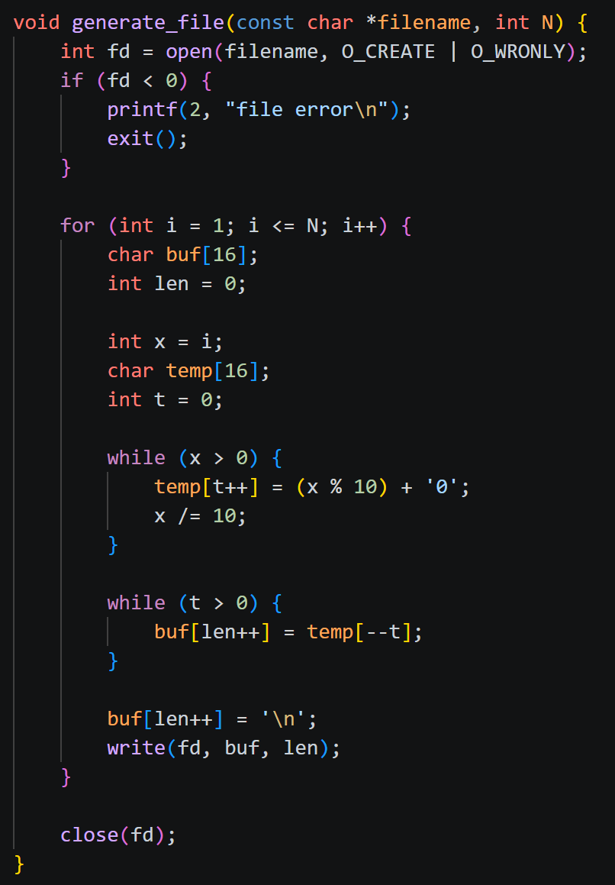
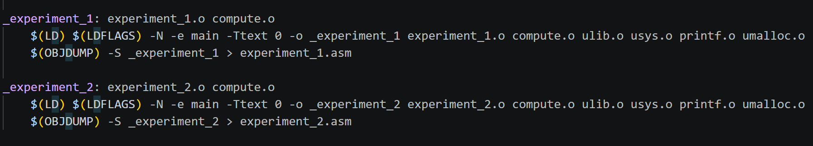
Results and Answers (Test 2)
Adding experiment_1 and experiment_2 to xv6
Edits made:
Implementing manual sort for finding median
Writing integers as strings of characters to the file
Decrease n_proc in test 1 to 6 as maximum CPUs is 8 (we shouldn’t use them all as there are still init and shell)
Decrease the maximum n_proc in test 2
Edit Makefile to relate compute.c to the experiments and add them as user programs
Edit syntax and includes

Slide 21
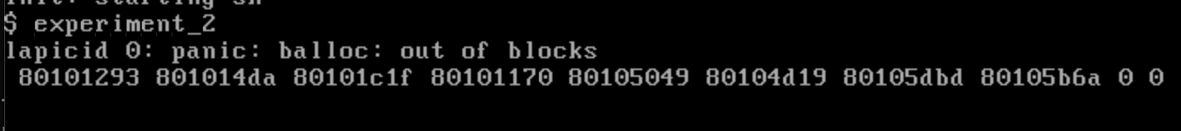
Results and Answers (Test 2)
Results in xv6
When we try to run any of the 2 tests, we get this error:
Why does this happen?
Answer: This is because xv6 has a limited disk spaces for files
This size is so small, so it’s impossible to save N
numbers in the file where N is from 20k to 2M

Slide 22
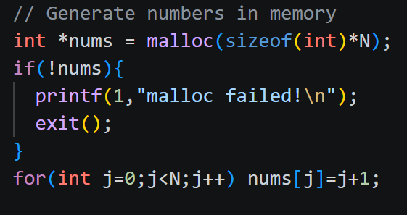

Results and Answers (Test 2)
Alternative Solution for xv6
Don’t use xv6’s disk space, use RAM
Don’t use files, use allocated memory (arrays)
This would require sequential and parallel compute functions to operate on arrays and not files and for the tests to generate these arrays

Slide 23
THANK YOU

