Slide 1
OS Lab Project 5
IPC via Shared Memory
& POSIX Threads
mmap_compute · threads_compute

Slide 2
Team Roles
MEMBER 1
MEMBER 2
Sama Emad Abu Zahra
Yara
Implemented Experiment_1
Implemented Experiment_2
Ran both experiments and extracted results
Updated sequential and parallel compute to match the new input function requirements
Implemented mmap_compute
Implemented threads_compute
Requirements 2, 3, 4, and 5 in the slides.
Updated compute.h (ulfunc_t type)
Wrote test_correctness.c for all 4 functions
Verified correctness

Slide 3
Github Repo Link:
https://github.com/Sama3mad/Project-5---IPC-via-Shared-Memory-POSIX-Threads-.git

Slide 4
mmap() – Inputs & Outputs
void *mmap(void *addr, size_t length, int prot, int flags, int fd, off_t offset);
Parameter | Type | Description
addr | void * | Hint address for the mapping (NULL = kernel decides)
length | size_t | Number of bytes to map
prot | int | PROT_READ | PROT_WRITE — read/write access
flags | int | MAP_SHARED | MAP_ANONYMOUS — shared, no file backing
fd | int | -1 when MAP_ANONYMOUS is used
offset | off_t | 0 when MAP_ANONYMOUS is used
Returns: Pointer to the mapped memory region, or MAP_FAILED on error. Release with munmap(ptr, length).

Slide 5
mmap_compute – Description & Pseudo-code
Description
Pseudo-code
Signature
unsigned long mmap_compute( const char *filepath, int n_proc, ulfunc_t f )
Returns: unsigned long
Key idea:
Children write partial results into a MAP_SHARED region — no pipes needed.
1. Read nums[] from file
2. Clamp n_proc ≤ count
3. mmap partials[n_proc] ← shared
4. FOR i = 0 to n_proc-1:
start = i * chunk
end = start + chunk - 1
if last: end += remainder
FORK child i:
partial = f(nums[start..end])
partials[i] = partial
EXIT
5. WAIT for all children
6. result = partials[0]
FOR i = 1 to n_proc-1:
result = f((int)result, (int)partials[i])
7. munmap → return result

Slide 6
mmap_compute – side note
In this implementation, the partials array is declared as:
unsigned long *partials
However, when combining results, we cast values to int:
result = f((int)result, (int)partials[i]);
⚠️ Why this casting was used?
The function f according to the project requirements is defined to accept:
int, int → unsigned long
But intermediate results are stored as unsigned long
Therefore, casting is required to match the required function signature
To avoid casting, we should define a consistent function type:
unsigned long f(unsigned long a, unsigned long b);

Slide 7
threads_compute – Description & Pseudo-code
Description
Pseudo-code
Signature
unsigned long threads_compute( const char *filepath, int n_threads, ulfunc_t f )
Returns: unsigned long
All threads share nums[] (read-only). Each thread writes only to its own partials[i] — no mutex needed.
Key idea:
No forking, no pipes, no mmap. Threads communicate via regular array slots.
1. Read nums[] from file
2. Clamp n_threads ≤ count
3. Allocate partials[n_threads]
4. FOR i = 0 to n_threads-1:
start = i * chunk
end = start + chunk - 1
if last: end += remainder
args[i] = { nums, start, end, f, &partials[i] }
pthread_create(worker, args[i])
5. pthread_join all threads
6. result = thread_worker(arg):
partial = nums[start]
FOR k = start+1 to end:
partial = f((int)partial, nums[k])
*result = partial
7. free all → return result
thread_worker(arg):
partial = f(nums[start..end])
*result = partial

Slide 8
From the pervious project

Slide 9
02 sequential_compute — Pseudo-code
What it does
Signature
Reads N numbers from a file and applies function f pairwise left-to-right. No forking, no pipes — pure sequential fold.
int sequential_compute(
const char *filepath,
int (*f)(int, int)
);
FUNCTION sequential_compute(filepath, f): nums ← read_numbers(filepath) // parse newline or comma separated result ← nums[0] FOR i = 1 TO len(nums) - 1 : result ← f(result, nums[i]) // fold left RETURN result

Slide 10
02 Parallel Compute - Description
What it does
Takes:
The path of a file containing N numbers separated by new lines (or commas)
Number of processes n_proc.
A pointer to a function f that takes 2 numbers and returns a number.
then does the same as sequential_compute except that it splits the computation over n_proc processes as evenly as possible.

Slide 11
02 parallel_compute — Pseudo-code
FUNCTION parallel_compute(filepath, n_proc, f): nums ← read_numbers(filepath) chunk ← len(nums) / n_proc remainder ← len(nums) % n_proc FOR i = 0 TO n_proc - 1 : create ctrl_pipe[i], res_pipe[i] fork child i IF child : start, end ← read(ctrl_pipe[i]) // receive slice bounds partial ← sequential_compute(nums[start..end], f) write(res_pipe[i], partial) ; exit() ELSE (parent) : write(ctrl_pipe[i], start, end) wait() for all children result ← read(res_pipe[0]) FOR i = 1 TO n_proc-1 : result ← f(result, read(res_pipe[i])) RETURN result

Slide 12
Correctness Examples – All 4 Functions
Input file: [ 1, 2, 3, 4, 5 ] f = add Expected result = 15
sequential_compute
fold left: ((((1+2)+3)+4)+5) = 15
= 15
sequential_compute("file.txt", add)
parallel_compute
proc0=[1,2]→3 proc1=[3,4,5]→12 f(3,12)=15
= 15
parallel_compute("file.txt", 2, add)
mmap_compute
same split via shared memory, result=15UL
= 15UL
mmap_compute("file.txt", 2, ul_add)
threads_compute
t0=[1,2]→3 t1=[3,4,5]→12 f(3,12)=15UL
= 15UL
threads_compute("file.txt", 2, ul_add)

Slide 13
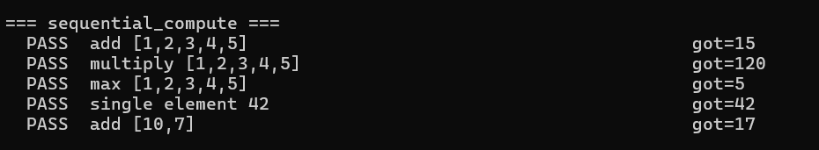
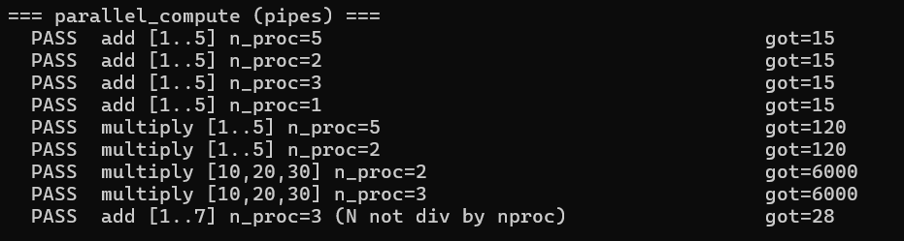
Correctness Examples – All 4 Functions

Slide 14
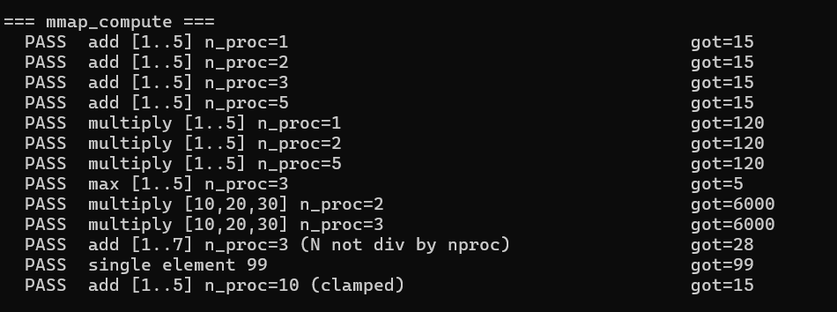
Correctness Examples – All 4 Functions

Slide 15
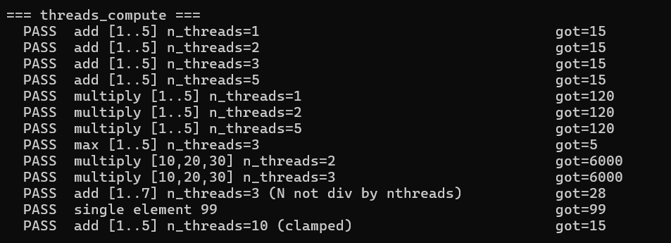
Correctness Examples – All 4 Functions

Slide 16
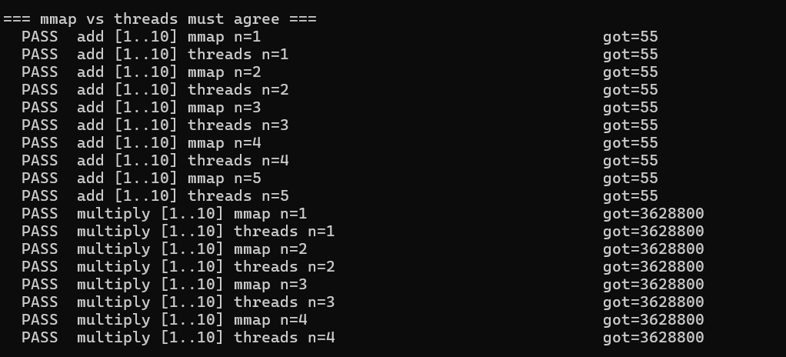
Correctness Examples – All 4 Functions

Slide 17
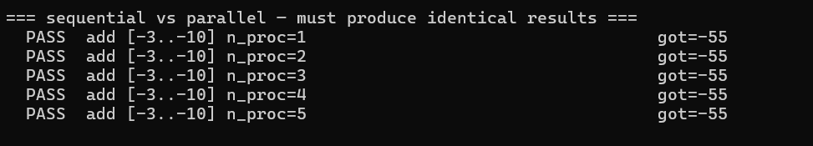
Correctness Examples – All 4 Functions

Slide 18
threads_compute – Data Flow Diagram
Example: nums=[1,2,3,4,5,6,7] n_threads=3 f=add
Main Thread
Read file → nums[] | Allocate partials[3]
pthread_create ×3
Thread 0
Thread 1
Thread 2
slice: nums[0..1]
f(slice)
→ partials[0] = 3
slice: nums[2..3]
f(slice)
→ partials[1] = 7
slice: nums[4..6]
f(slice)
→ partials[2] = 18
pthread_join (wait for all threads)
result = f(3, 7, 18) = 28 → return 28UL

Slide 19
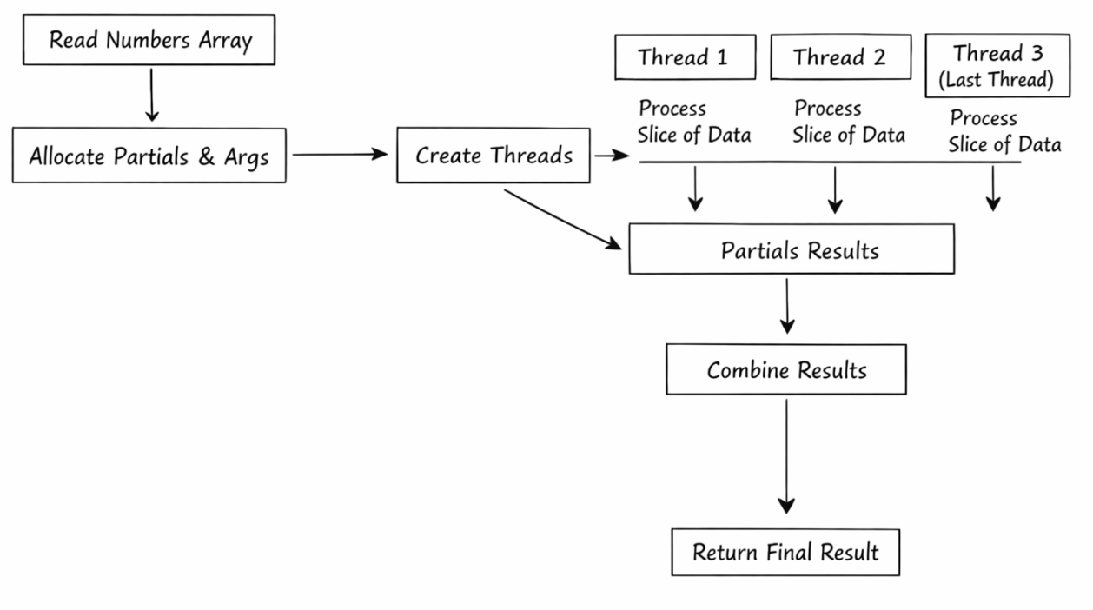
threads_compute – Data Flow Diagram

Slide 20
From the pervious project

Slide 21
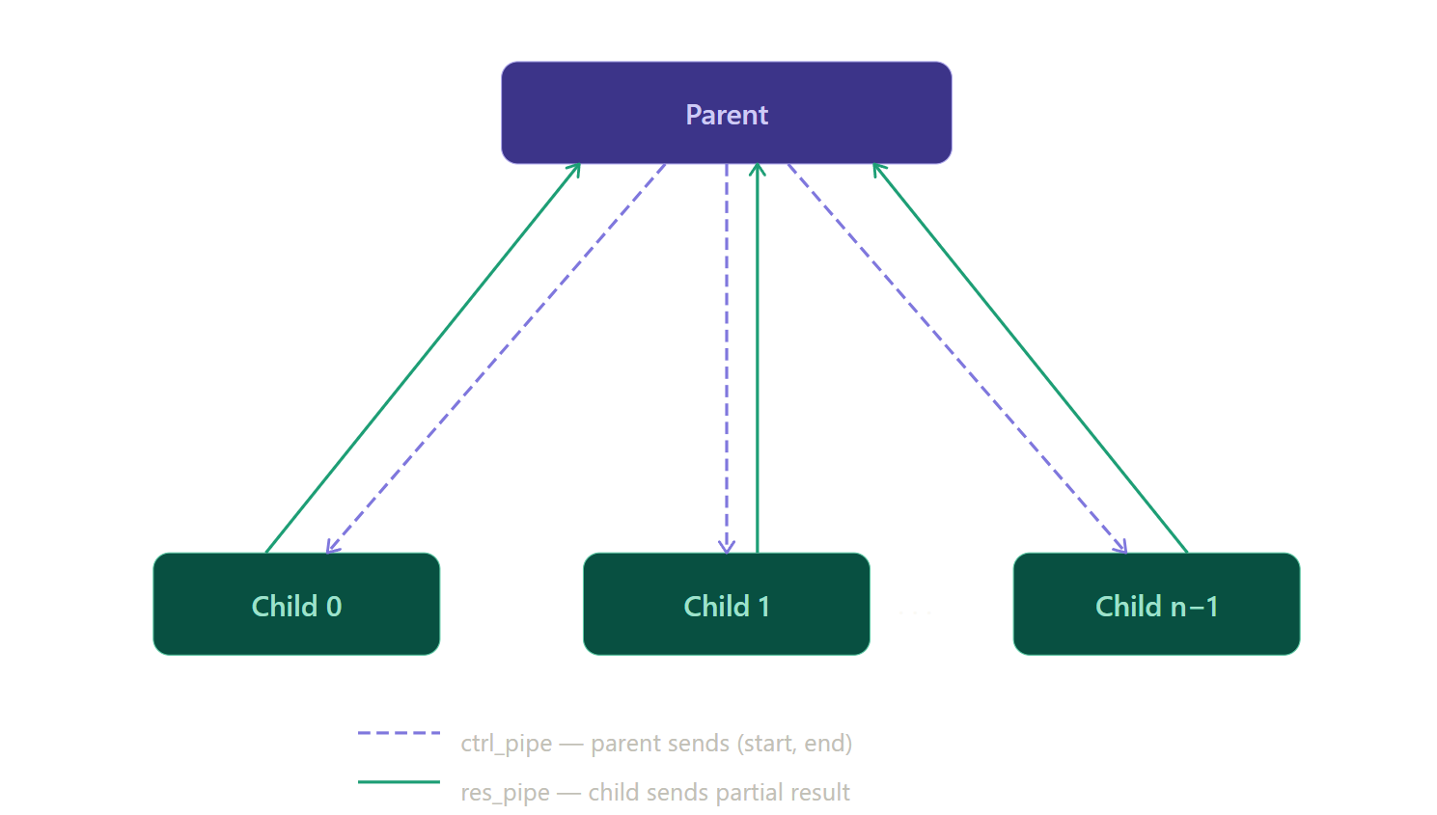
04 Pipe Architecture in parallel_compute

Slide 22
Comparisons Tests

Slide 23
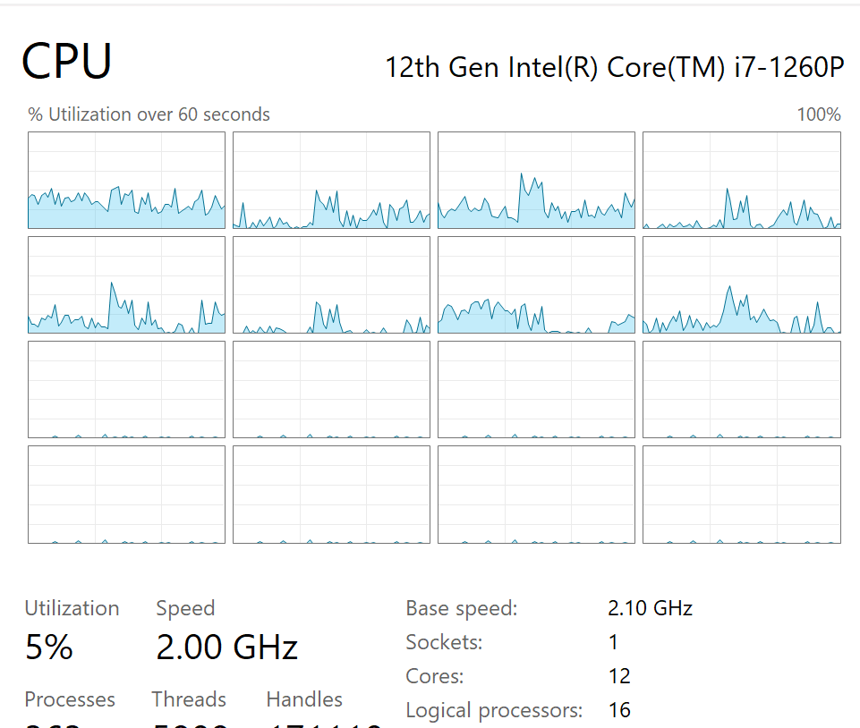
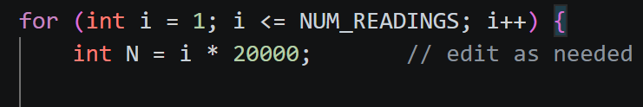
Tests Design and Chosen Ranges
Test 1:
The number of processes fixed for the test was 8 as this was the number of idle processes at the time of testing.
100 Readings were conducted going by increments of 50,000 for N. (Range: 50k to 5M)
Test 2:
The parameter n_proc was iterated from 1 to 24 to significantly exceed the number of logical processors of the machine which is 16.
Note: For test 1, the range kept adjusting till reaching this range that showed a clear winner between the 4 functions.

Slide 24
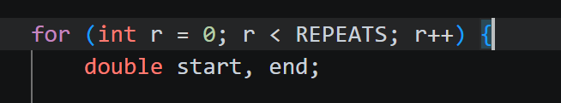
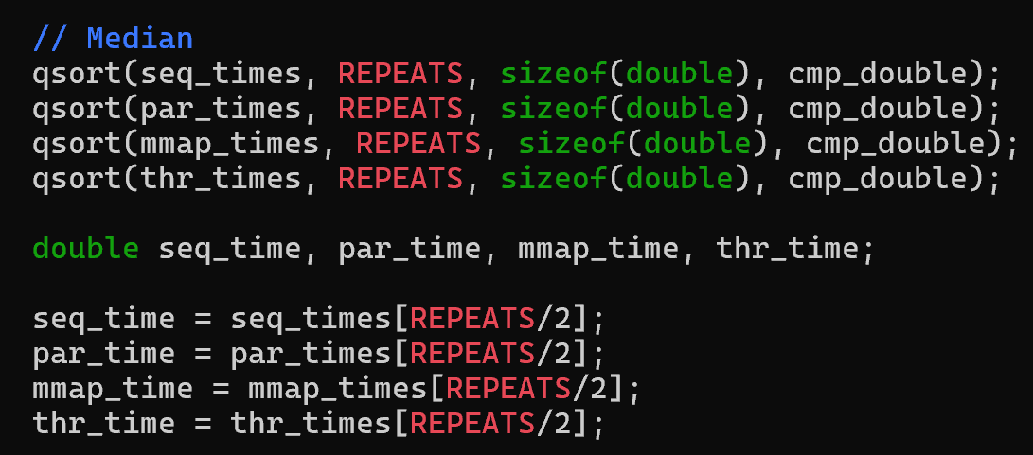

Smoothing Techniques
Smoothing was done by repeating the experiment an odd number of times for each N/n_proc, then taking the median value by sorting.
The experiment was repeated 7 times for each N in test 1 and 23 times for each n_proc in test 2 as it had a relatively small number of iterations.

Slide 25
Results and Answers (Test 1)
Question: If we fix n_proc and n_thread to the same value, then which of the 4 functions take the least time? At which value of N does this behavior persist?
Answer: The threads_compute function gives the best performance. It starts consistently outperforming at N = 3,700,000.
Note: We can see that sequential_compute is outperformed at large values of N, followed by mmap and pipes. The reason why there wasn’t much of a difference between mmap and pipes is that the cost of communication is trivial compared to the N calculations

Slide 26
Results and Answers (Test 2)
Results and Answers (Test 2)
Question: If we fix N to a large number, then which of the 4 functions take the least time? At which value of n_proc (n_thread) does this behavior persist?
Answer: The fuction threads_compute gives the best performance. It starts outperforming at n_proc = n_thread = 2.
Note: parallel_compute outperforms as long using extra processors compensate the fork and pipe operations overhead, but starts underperforming when n_proc exceeds idle processors

