Slide 1
Operating System Lab
Project 6: scheduling in xv6
Operating Systems Lab • Sama | Yara

Slide 2
Team Members & Roles
Sama Abu Zahra
Yara
Responsibilities:
Added a numeric priority attribute to processes.
Added the two system calls.
For each of the 2 system calls, I created a user program.
Provide tests for the 2 user programs.
Finished part 1 slides in the presentation
Responsibilities:
Implemented the 2 schedulers
Tested the 2 schedulers
Did part 2 slides in the presentation

Slide 3
Part 1

Slide 4
xv6 Files Modified & Added
File | Action | Why
proc.h | Modified | Added int priority field to struct proc
proc.c | Modified | Set default priority in allocproc(); added setpriority() & printptable()
sysproc.c | Modified | Added sys_setpriority() & sys_printptable() wrappers
syscall.h | Modified | Assigned unique numbers to the 2 new syscalls
syscall.c | Modified | Registered the new syscall functions in the dispatch table
user.h | Modified | Declared new syscalls so user programs can call them
usys.S | Modified | Generated assembly stubs for the 2 new syscalls
Makefile | Modified | Added 4 new programs to the UPROGS build list
setpriority.c | New File | User program: change a process's priority from the shell
printptable.c | New File | User program: print the process table from the shell
test_setpriority.c | New File | Test program for setpriority syscall
test_printptable.c | New File | Test program for printptable syscall

Slide 5
Priority Semantics
Minimum Priority
Default Priority
Maximum Priority
0
5
10
Highest priority
(runs first)
Assigned to every
new process
Lowest priority
(runs last)
Higher priority ←————————————→ Lower priority
Validation rule: setpriority() rejects any value outside 0–10 and returns -1. Valid input returns the old priority.

Slide 6
How Priorities Are Initialized
xv6 Boots
allocproc()
p->priority = 5
fork() called
Child gets priority 5
init is the first process
created after boot
Called every time a new
process is being created
Default priority assigned
inside allocproc()
Child process created
via allocproc()
Every child starts with
the same default
// Inside allocproc() in proc.c
p->context->eip = (uint)forkret;
p->priority = 5; // every new process starts at priority 5
return p;

Slide 7
Pseudo-code: setpriority(pid, new_priority)
function setpriority(pid, new_priority):
if new_priority < 0 OR new_priority > 10:
return -1 // invalid range
if pid <= 0:
return -1 // invalid pid
lock(ptable) // protect the process table
for each process p in ptable:
if p.pid == pid:
old_priority = p.priority
p.priority = new_priority
unlock(ptable)
return old_priority // success
unlock(ptable)
return -1 // pid not found

Slide 8
Pseudo-code: printptable()
function printptable():
print "name pid state priority"
print "-------------------------------"
lock(ptable)
for each process p in ptable:
if p.state == UNUSED:
continue // skip empty slots
print(p.name, p.pid, p.state, p.priority)
unlock(ptable)

Slide 9
How We Tested
test_setpriority
test_printptable
Test 1:
Change our own priority to 3 → PASSED
Test 2:
Change to 7 (verify old value returned) → PASSED
Test 3:
Priority 99 (out of range) → Rejected ✓
Test 4:
Priority -5 (negative) → Rejected ✓
Test 5:
PID 9999 (doesn't exist) → Rejected ✓
Test 6:
Fork child, set child priority → PASSED
Step 1:
Fork 3 child processes
Step 2:
Set children to priorities 1, 5, 9
Step 3:
Call printptable()
Expected output:
→ 4 entries: parent + 3 children
→ Different pids, same name
→ Priorities shown as 5, 1, 5, 9

Slide 10
Sample Output
$ printptable
$ test_setpriority
name pid state priority
----------------------------------
init 1 SLEEPING 5
sh 2 SLEEPING 5
printptable 3 RUNNING 5
Test 1: priority 5 → 3 PASSED
Test 2: priority 3 → 7 PASSED
Test 3: pr=99 rejected PASSED
Test 4: pr=-5 rejected PASSED
Test 5: pid=9999 miss PASSED
Test 6: child pr → 1 PASSED
=== All tests done ===
Note: All tests pass. The process table correctly shows all active processes with their priorities. UNUSED slots are skipped.

Slide 11
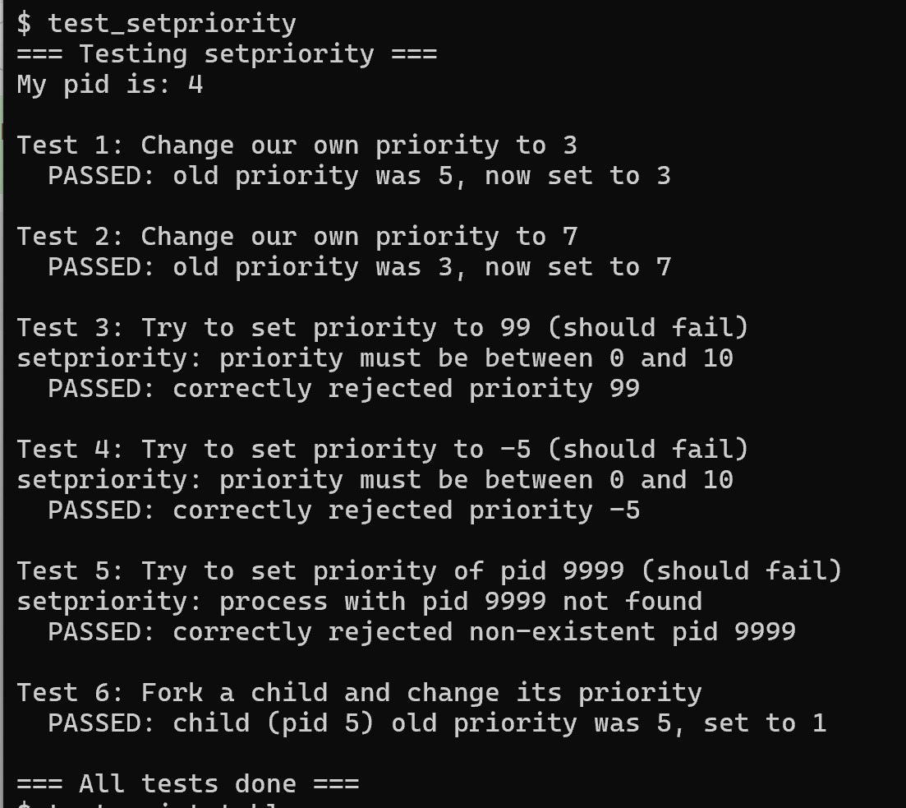
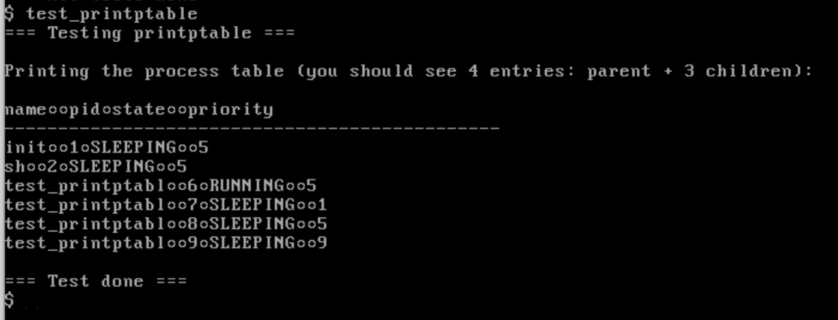
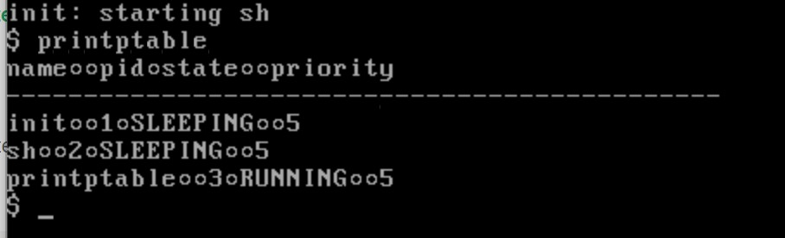

Slide 12
Part 2

Slide 13
xv6 Files Modified & Added
Implementation | Testing
For priority based: Edited the scheduler() function in proc.c | Ran the user programs test_setpriority.c & test_printptable.c with the two schedulers Compared total wait time for the two schedulers
For priority based: Edited the scheduler() function in proc.c Added max_priority attribute for struct proc in proc.h Initialized max_priority with 10 in allocproc() in proc.c Updated max_priority’s value in setpriority() in proc.c

Slide 14
Priority Based Scheduling - Pseudocode
Initialize highprproc with 0 and highestpr with 11 (lowest than the lowest value)
Iterate through the ptable circularly from last
If you find a runnable process with higher priority
Update highespr and highprproc
If highprproc was updated
Update last to point to the next pcb
Update current process to highprproc and change context to it
Note
Role of last:
If we start iterating from the beginning of the ptable each time, we won’t iterate iterate through different processes with the same priority, however this way we implement a Round Robin technique within processes of the same priority

Slide 15
Priority Based Scheduling with Decay - Pseudocode
Initialize highprproc with 0 and highestpr with 11 (lowest than the lowest value)
Iterate through the ptable circularly from last
If you find a runnable process with higher priority
Update highespr and highprproc
If highprproc was updated
Update last to point to the next pcb
Update current process to highprproc and change context to it
Update the priority of highprproc according to max_priority and its current priority
How was the new priority set?
If priority is less than 5 (high):
It’s only incremented if ticks%2 = 0 (occasionally)
Otherwise (low priority) the priority is incremented regardless of ticks
In both cases, we won’t increment the priority if it already reached max_priority
How was max_priority set?
The default value is 10 (so priority would go from 5 to 10)
When setpriority is called, it is set to the new priority + 6

Slide 16
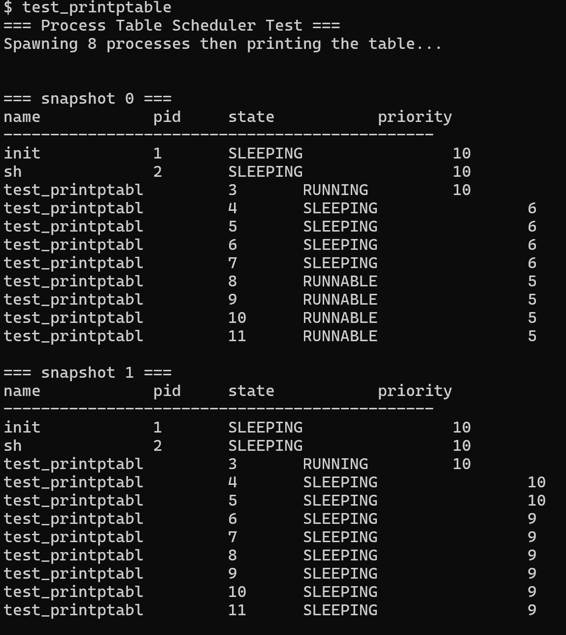
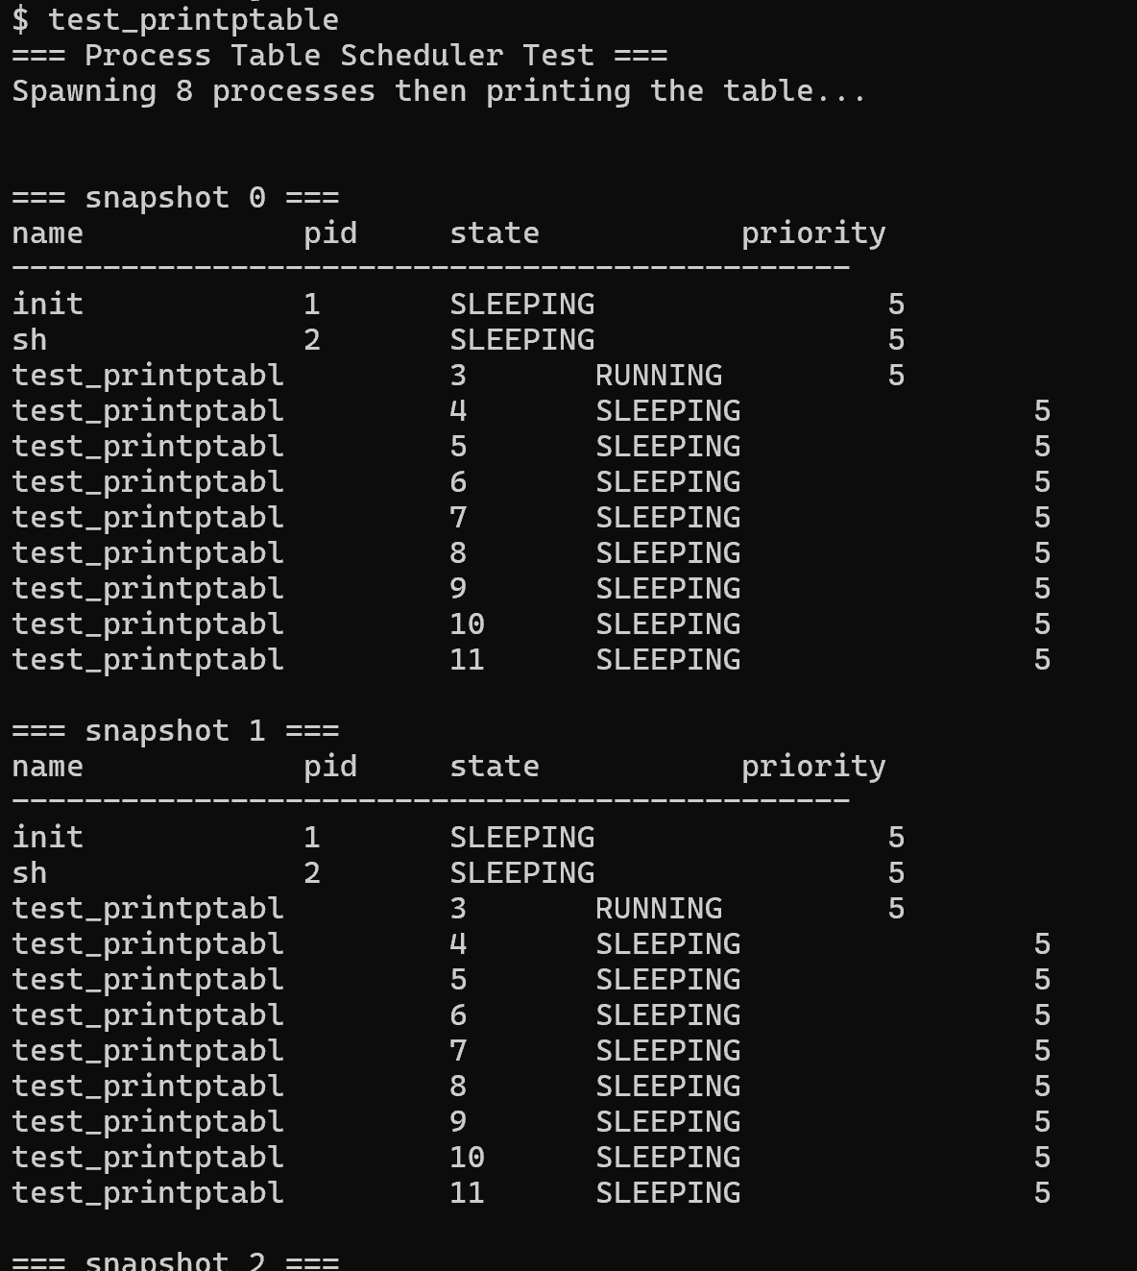
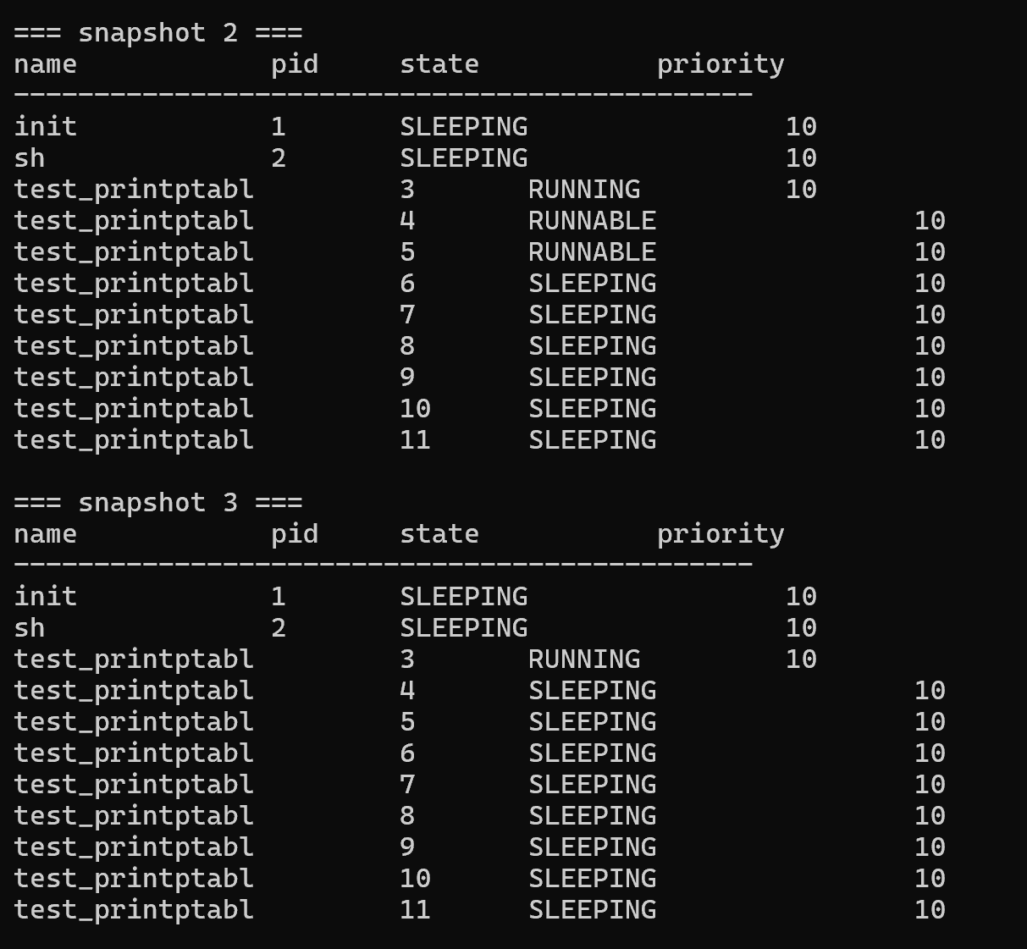
Tests using test_printptable
No Decay
With Decay

Slide 17
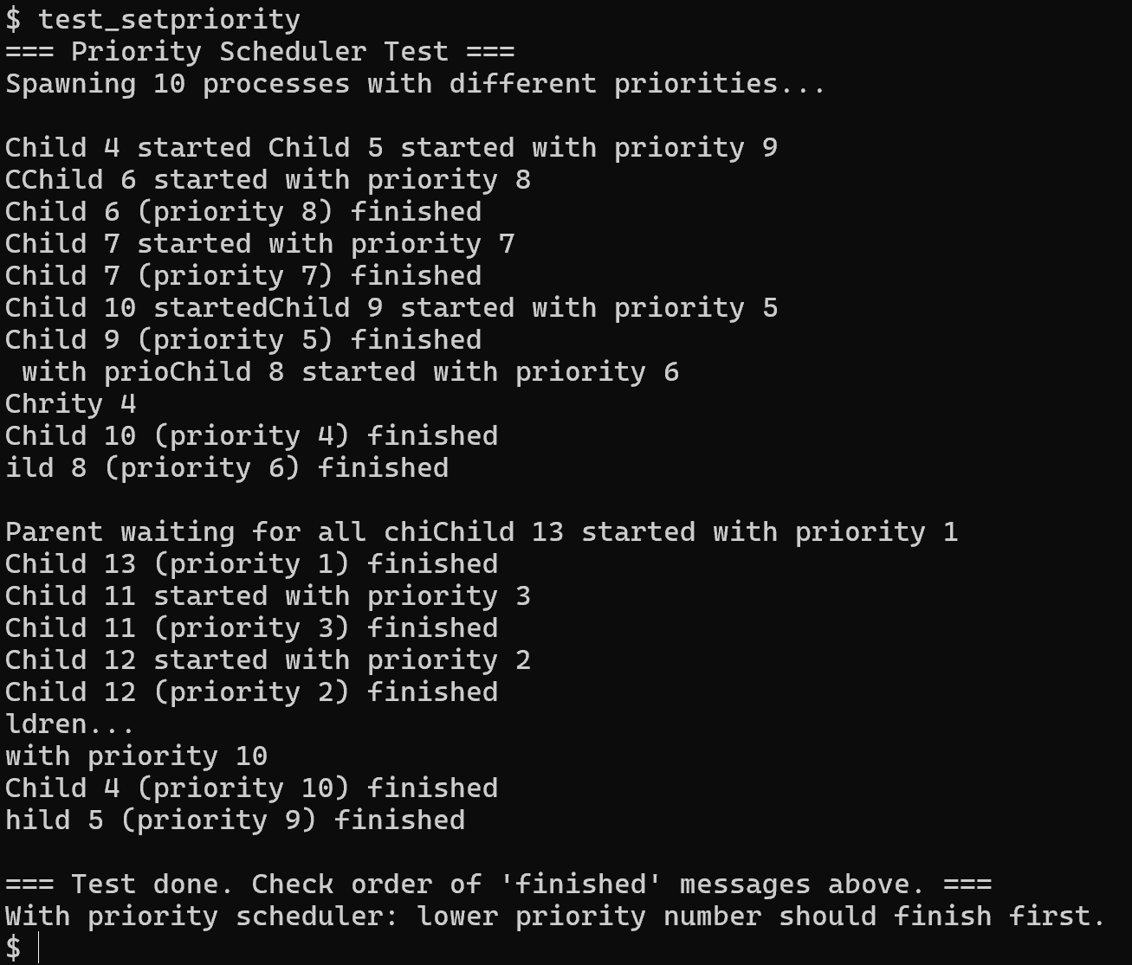
Tests using test_setpriority

Slide 18
Thank You!

