Slide 1

BVRIT HYDERABAD College of Engineering for Women Department of CSE
BIKE SHARING PREDICTION
Dated: 23 February 2021
S.NISCHALA: 18WH5A0506
D.TRIPURA : 17WH1A0521
K.JAGADISHWARI : 18WH5A0510 Guide: U. CHANDRASHEKAR
Assistant Professor,CSE

Slide 2
AGENDA
Abstract
Dataset description
System Requirements
Libraries used
Blot Graphs
Violin Graphs
Correlation Analysis
References
Conclusion

Slide 3
ABSTRACT:
Bike sharing systems are new generation of traditional bike rentals where whole process from membership, rental and return back has become automatic.
Through these systems, user is able to easily rent a bike from a particular position and return back at another position.
Currently, there are about over 500 bike-sharing programs around the world which is composed of over 500 thousands bicycles.
Today, there exists great interest in these systems due to their important role in traffic, environmental, social, public, eco and health issues.

Slide 4
DATA-SET DESCRIPTION:
HOUR CSV:
This bike sharing dataset contains the hourly and daily count of rental bikes between years 2011 and 2012 in Capital bike share system with the corresponding weather and seasonal information.
Attribute Information::
Instant
hr
Season
Weathersit
Temp
Hum
Windspeed
Casual
Atemp
Count
Registered

Slide 5
System Requirements:
Software Requirements:
Operating system : windows 10
Cloud service : Google Collaborator or jupyter Notebook.
Coding Language : Python 3
Hardware Requirements:
Processor : Intel Core i5
Physical Memory : 4GB RAM
Hard Disk Drive : 1TB

Slide 6
LIBRARIES USED:
Numpy : Is a Python library used for working with arrays.
Pandas : It is used to analyze data.
Matplotlib : matplotlib.pyplot is a plotting library used for 2D graphics

Slide 7
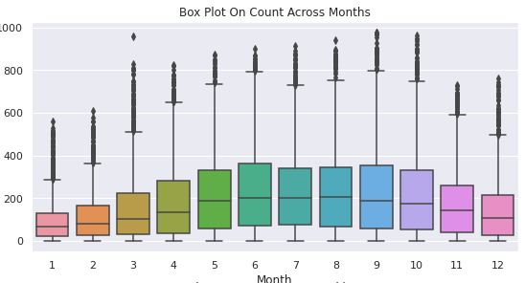
Fig: Box Plot On Count Across Month.

Slide 8
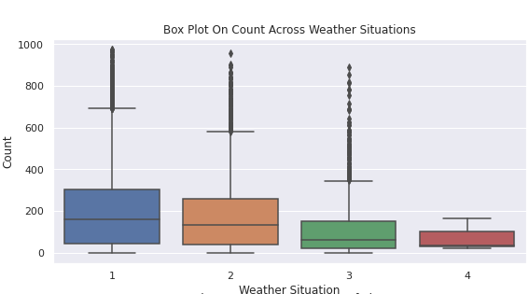
Fig: Box Plot On Count Across Weather

Slide 9
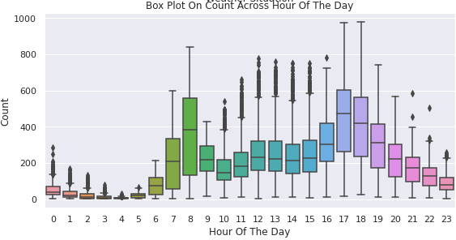
Fig: Box Plot On Count Across Hour Of Day.

Slide 10
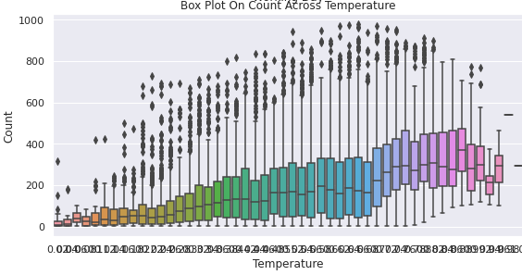
Fig: Box Plot On Count Across Temperature.

Slide 11
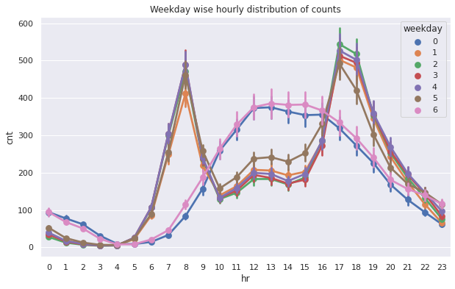
Fig: Weekday wise hourly distribution of counts

Slide 12
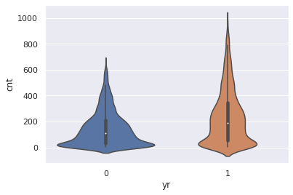
Fig: ViolinPlot

Slide 13
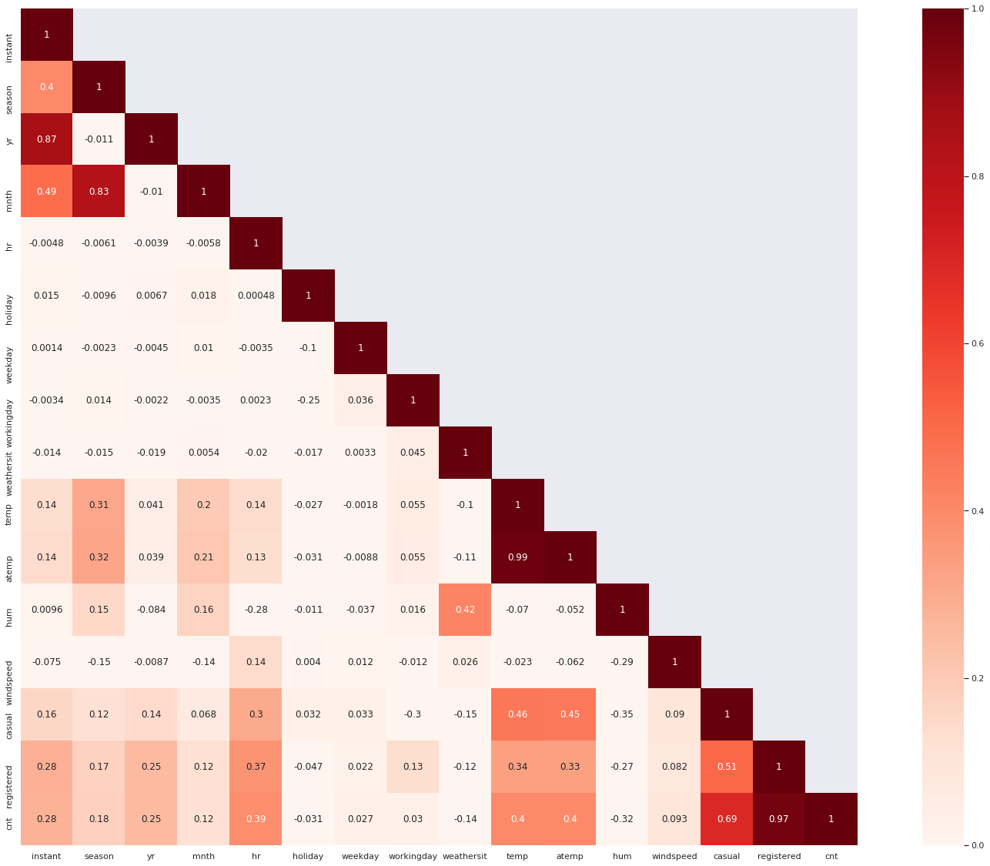
Fig: Correlation Analysis.

Slide 14
REFERENCE:
Bike-Sharing-Demand: https://www.kaggle.com/c/bike-sharing-demand/notebooks
https://medium.com/@limavallantin/analysing-bike-sharing-trends-with-python a9f574c596b9
Research-papers: https://www.researchgate.net/publication/337062461_Regression_Model_for_Bike Sharing_Service_by_Using_Machine_Learning
Data set link: http://archive.ics.uci.edu/ml/datasets/Bike+Sharing+Dataset

Slide 15
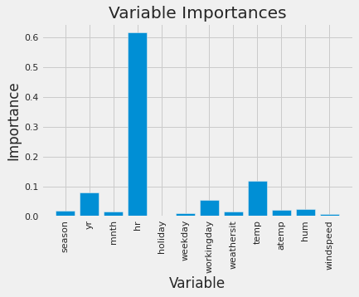
CONCLUSION:
The result corresponds to the high correlation of the hour and temperature variable with the bicycle sharing count in the feature correlation matrix.
Hence, here hr and temp have highest correlation with hr having a impotance of 0.62 and temp having a importance 0.12 respectively.

Slide 16
Any Questions??

Slide 17
Thank you!

