Slide 1
How to deal with social media addiction in children
University of Bolton
Solution Driven Design and Practice(CDM 7002)
2022
ID : 2110047

Slide 2
Introduction
Problems
Solutions

Slide 3
Introduction
What is social media?
Social media is a web-based platform
What is social media
addiction?
Social media addiction is a type of behavioral addiction

Slide 4
Problems
Struggling putting down any device
Sleep will eventually give place to being online.
Even if children’s are not online
Everyday duties and activities are hurried

Slide 5
Problems(cont.)
Personal cleanliness and care decrease
They become annoyed
They can't use social media less
They have a sense of isolation.

Slide 6
Problems(cont.)
Refusing to participate in any family activities.
Poor academic performance
They don't even have any friends outside of the internet.
Distant relations with family.

Slide 7
Solutions
Parents and teachers can play the biggest role
Parents should avoid using social media
Avoid giving Smartphone
Parents can share their phones with their children

Slide 8
Solution(cont.)
Parents should keep a close eye on their children
It is important to establish a pleasant relationship
Parents should explain the pros and cons of social media.
Teacher should encourage children to participate in creative works.

Slide 9
Solution(cont.)
Addiction's best therapy is distraction.
keep children's phone at a safe distance
The school should provide workshops or training to parents
Parents and teachers can demonstrate to children how they are wasting precious time

Slide 10
Solution(cont.)
Children should be given certain guidelines
Disable notifications
Set the time for them how to use it and stick to it
Make a rule for children like "no social media during eating time or study time."

Slide 11
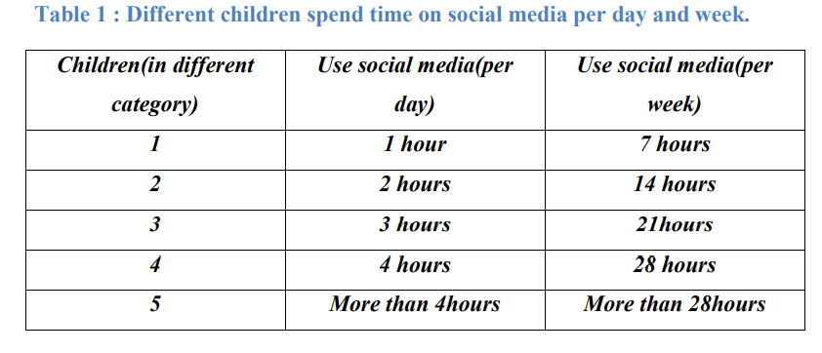
Solution(cont.)

Slide 12
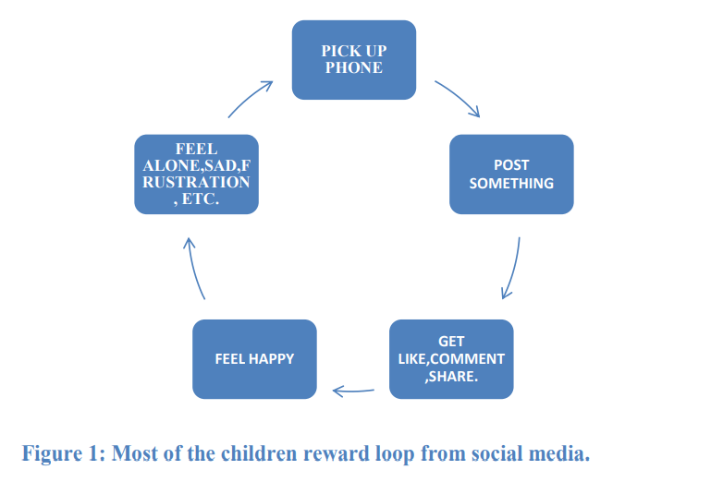
Solution(cont.)

Slide 13
Finally , Allowing these online social networks to take up your valuable time or control your life is never a good idea; instead, you should utilize them as a tool to manage your life.

Slide 14

Any Question?

