Slide 1
Stringent response modeling

Slide 2
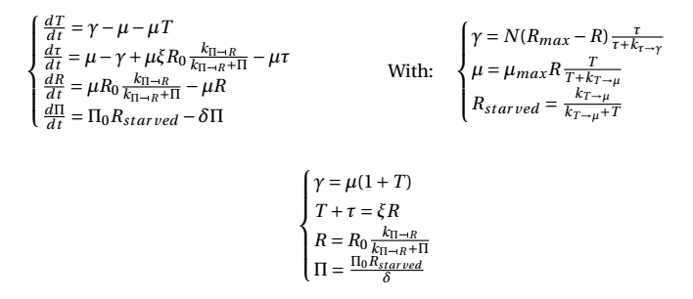


Dynamic equations
Steady state equation

Slide 3
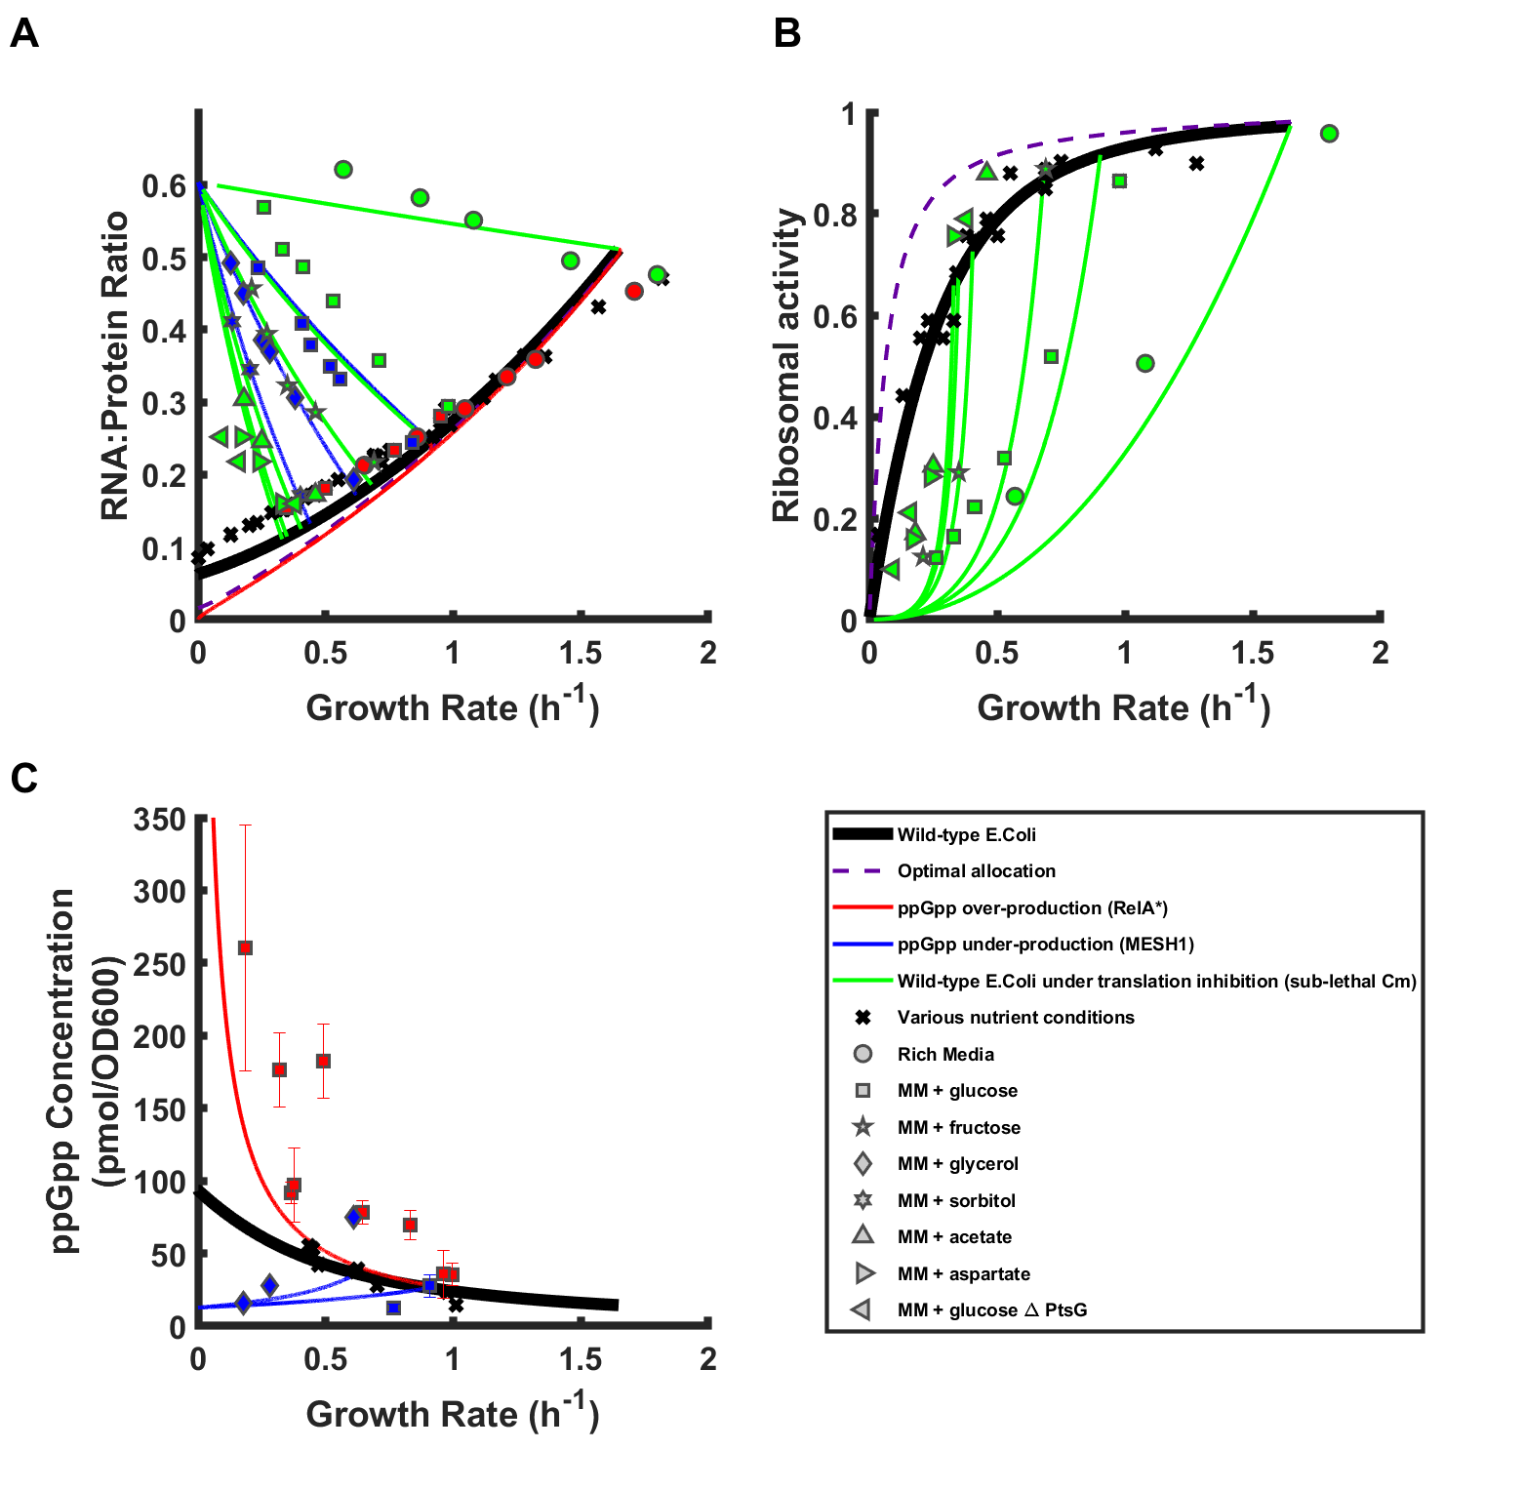
Added Zhu et al. 2019 data

Slide 4
