Slide 1
Stringent response modeling

Slide 2
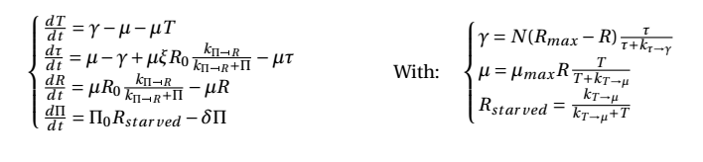




Dynamic equations
Inputs: N,O,M,I
Variables: T,tau,R,Pi
Deducted values: Rstarved, RNA_protein ratio, ribosomal activity
Rates: mu, gamma
Parameter: xi, R0, kPi_inhibits_R, Pi0, delta, Rmax, muMax, Rstarved

Slide 3
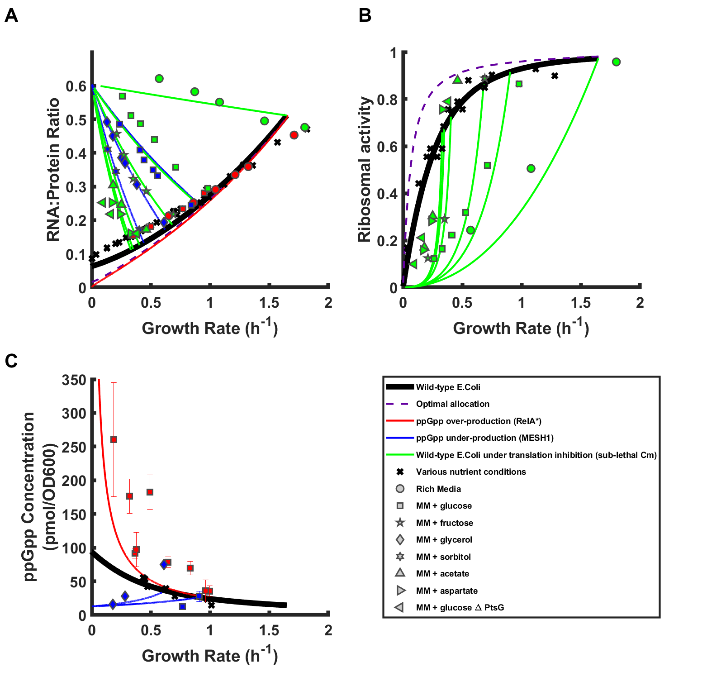

Slide 4
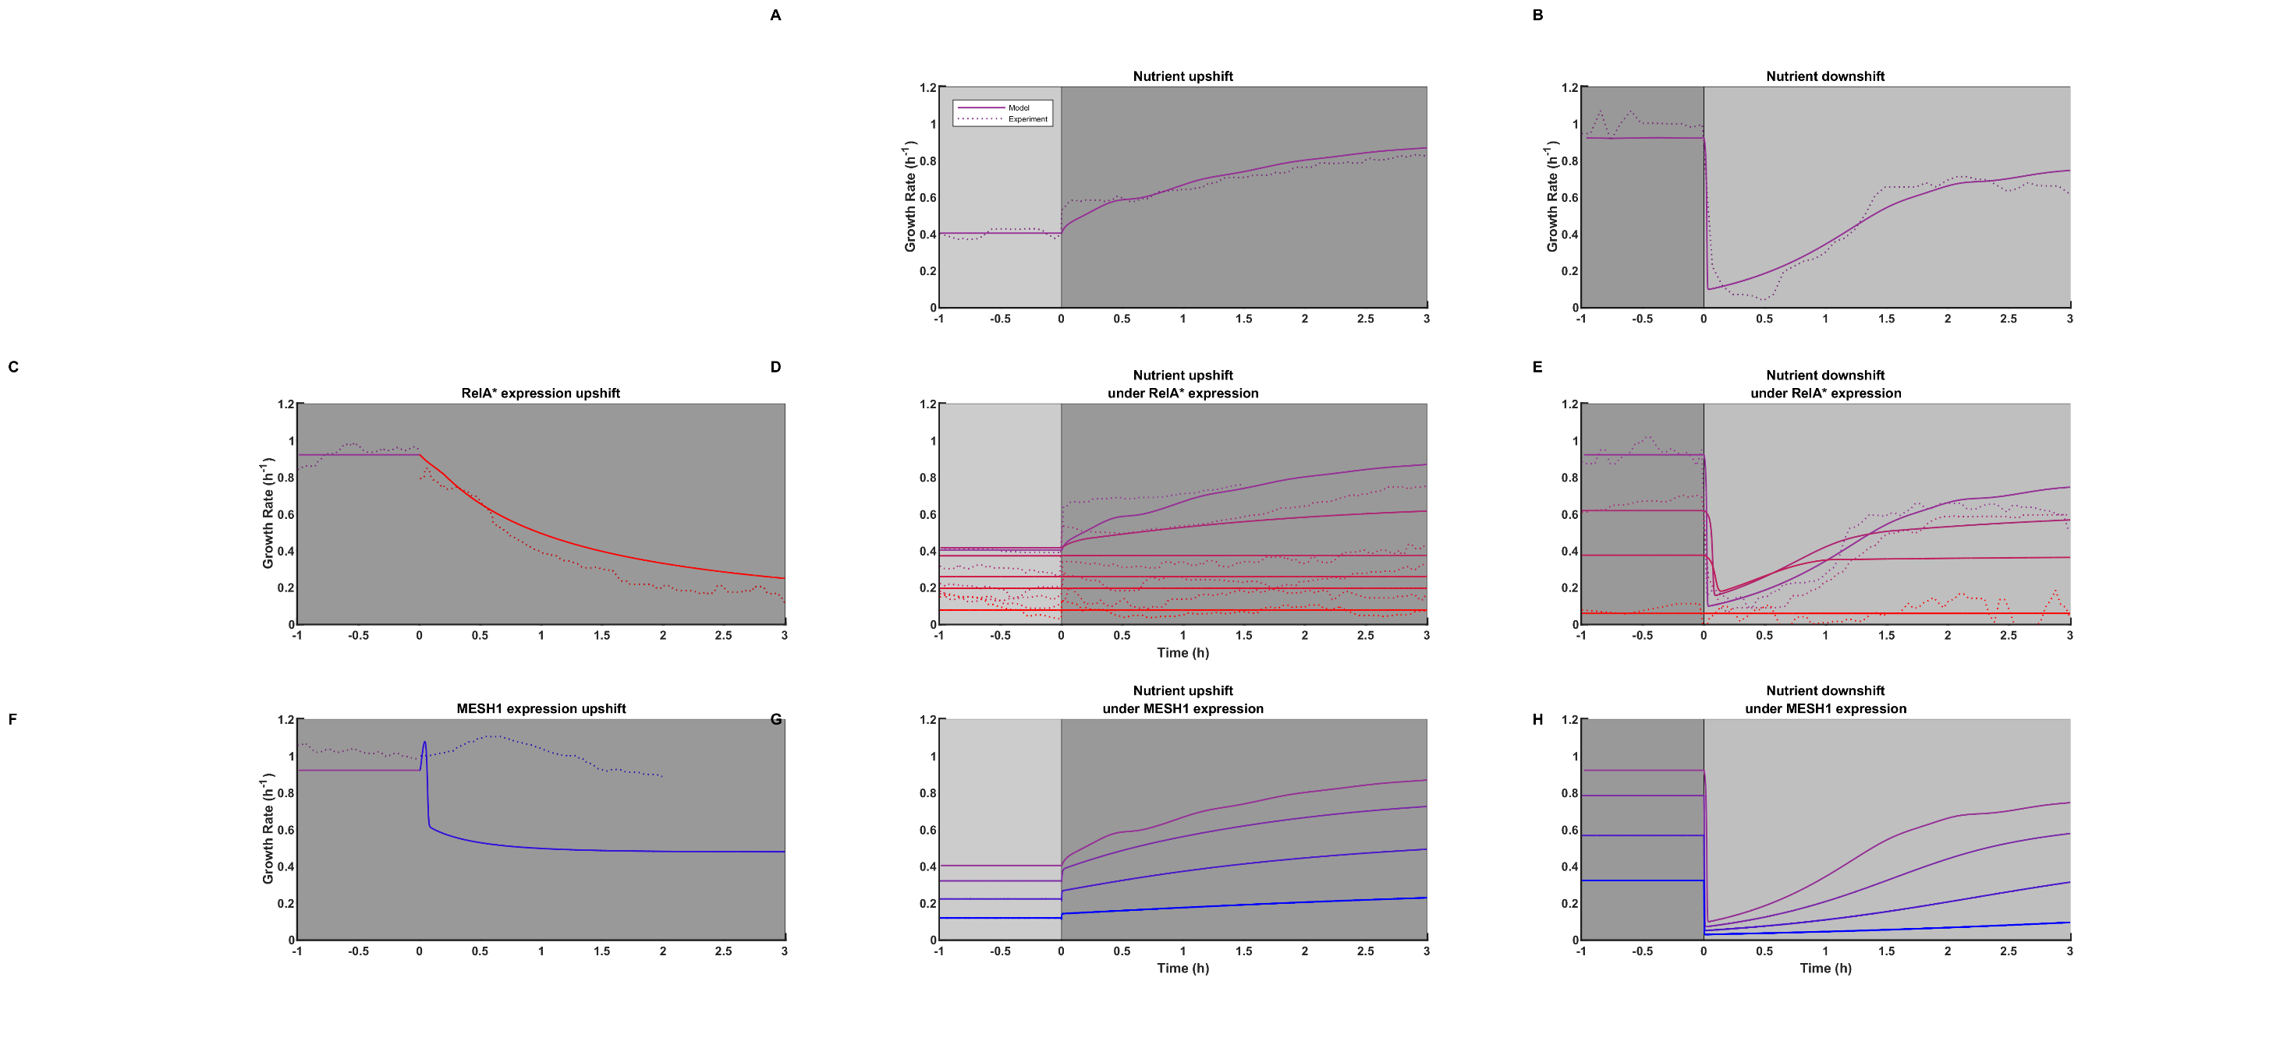
t
t
t

