Slide 1
Stringent response modeling

Slide 2
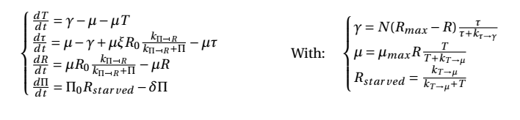





Dynamic equations
Inputs: N,O,M,I
Variables: T,tau,R,Pi
Deducted values: Rstarved, RNA_protein ratio, ribosomal activity
Rates: mu, gamma
Parameter: xi, R0, kPi_inhibits_R, Pi0, delta, Rmax, muMax

Slide 3
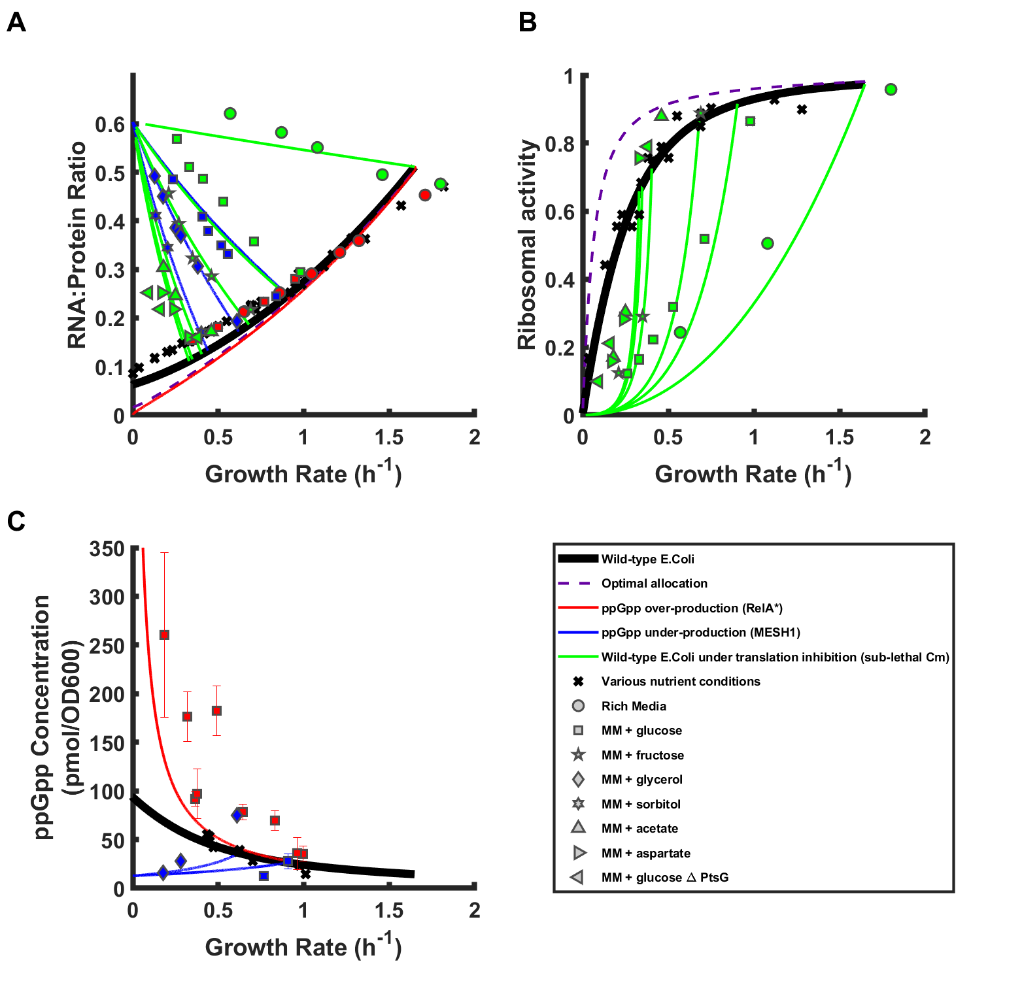
M,O,I=0 N=[0,1]
M,I=0 O=[0,infinity] N=discrete values
M,O=0 I=[0,1] N=discrete values
I,O=0 M=[0,infinity] N=discrete values

Slide 4
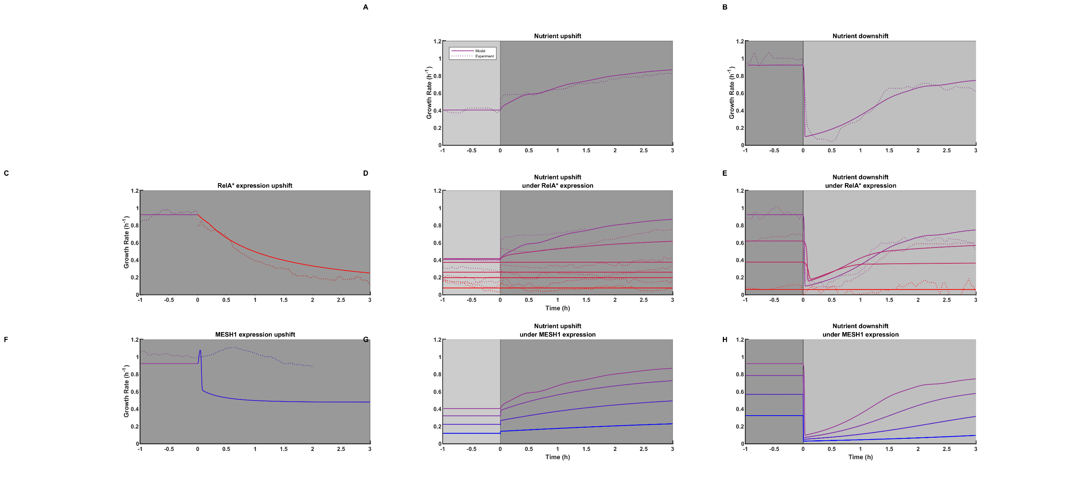
Step down in N with I,O,M=0
Step up in N with I,O,M=0
t
t
Step up in O
N=constant with I,M=0
Step up in N with I,M=0
and O=discrete values
Step down in N with I,M=0
and O=discrete values
t
Step up in M
N=constant with I,O=0
Step down in N with I,O=0 and M= discrete values
Step down in N with I,O=0 and M= discrete values

Slide 5

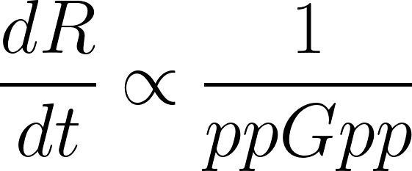
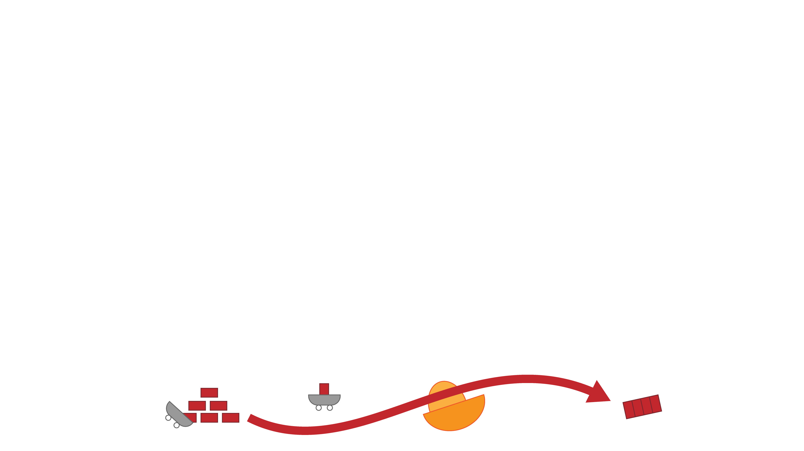
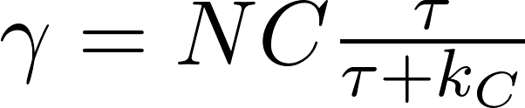
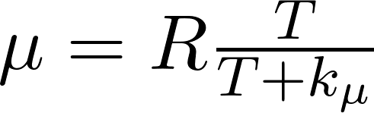


C
R
C
R
Nutrients
T
Biomass
Inactive ribosomes

