Slide 1
Bluestock Fintech
Mutual Fund Analytics Platform
Capstone Project Presentation
Bluestock Fintech | 1/12

Slide 2
Problem & Objective
• India's mutual fund industry manages Rs.81 lakh crore across 1,908 schemes and 26.12 crore investor folios, but data is fragmented across AMFI, NSE/BSE and third-party APIs.
• Investors struggle to compare funds on a risk-adjusted basis - raw NAV data requires significant transformation to compute Sharpe, Alpha, Beta, etc.
• Most retail investors don't know if their fund is beating its benchmark.
• Objective: Build an end-to-end analytics platform - ETL pipeline, SQLite database, EDA, performance/risk metrics, interactive dashboard, and investor behaviour analytics.
Bluestock Fintech | 2/12

Slide 3
Data Sources & Datasets
• 10 provided CSV datasets: fund master (40 schemes), NAV history (46,000 rows), AUM by fund house, monthly SIP inflows, category inflows, folio counts, scheme performance, investor transactions (32,778 rows), portfolio holdings, benchmark indices (8,050 rows).
• Live data: mfapi.in REST API used to fetch real-time NAV for 6 large-cap schemes (HDFC Top 100, SBI/ICICI/Axis/Kotak Bluechip, Nippon Large Cap).
• All AMFI codes, fund names, expense ratios and AUM figures sourced from real AMFI India / mfapi.in data. Investor transactions are simulated using real demographic and geographic distributions.
Bluestock Fintech | 3/12

Slide 4
System Architecture
• Layer 1 - Extract: 10 CSV files + mfapi.in REST API
• Layer 2 - Transform: Python/Pandas - date parsing, forward-fill, deduplication, validation, daily return calculation
• Layer 3 - Load: SQLite star schema - 1 dimension table (dim_fund) + 6 fact tables (nav, transactions, performance, portfolio, AUM, SIP), 79,318 total rows
• Layer 4 - Analyse: Jupyter notebooks - EDA, Sharpe/Sortino/Alpha/Beta/VaR/HHI
• Layer 5 - Visualise: Power BI dashboard - 4 interactive pages with slicers
Bluestock Fintech | 4/12

Slide 5
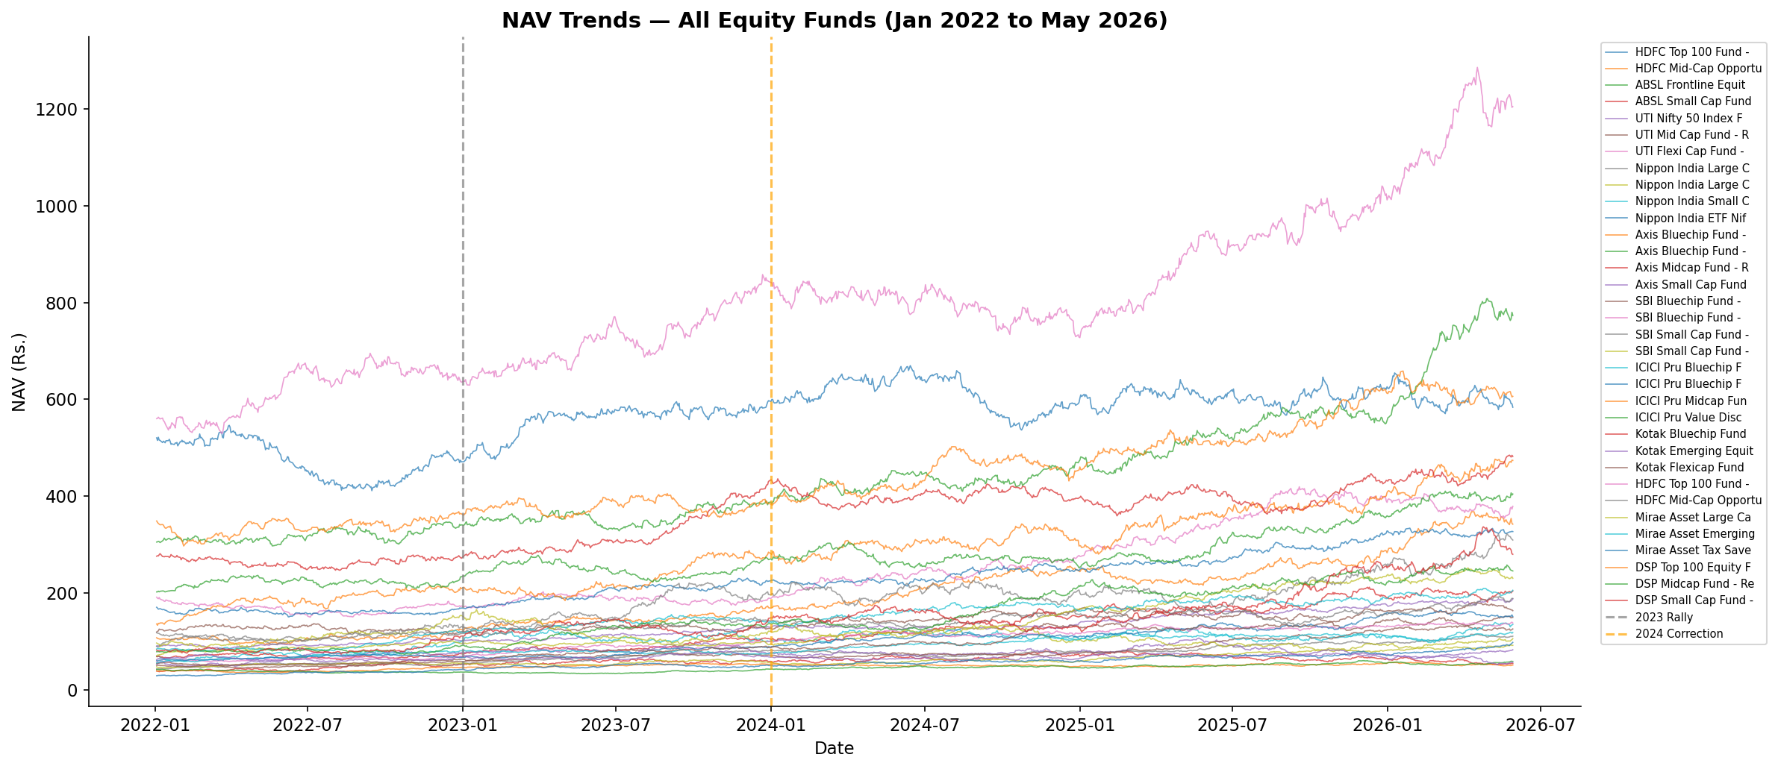
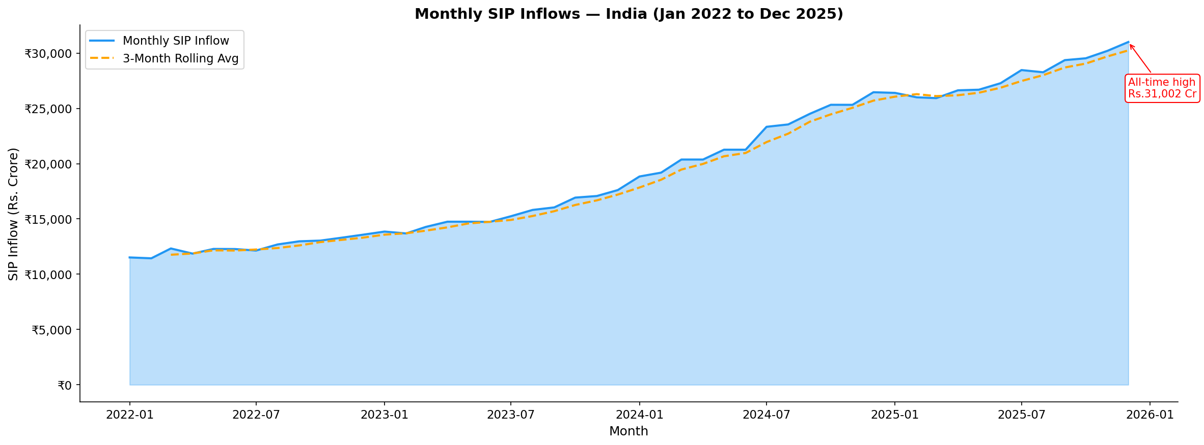
EDA Highlights (1/2)
• All 40 equity funds show consistent NAV growth 2022-2026
• Monthly SIP inflows grew 169% - Rs.11,517 Cr to Rs.31,002 Cr (Dec 2025 ATH)
Bluestock Fintech | 5/12

Slide 6
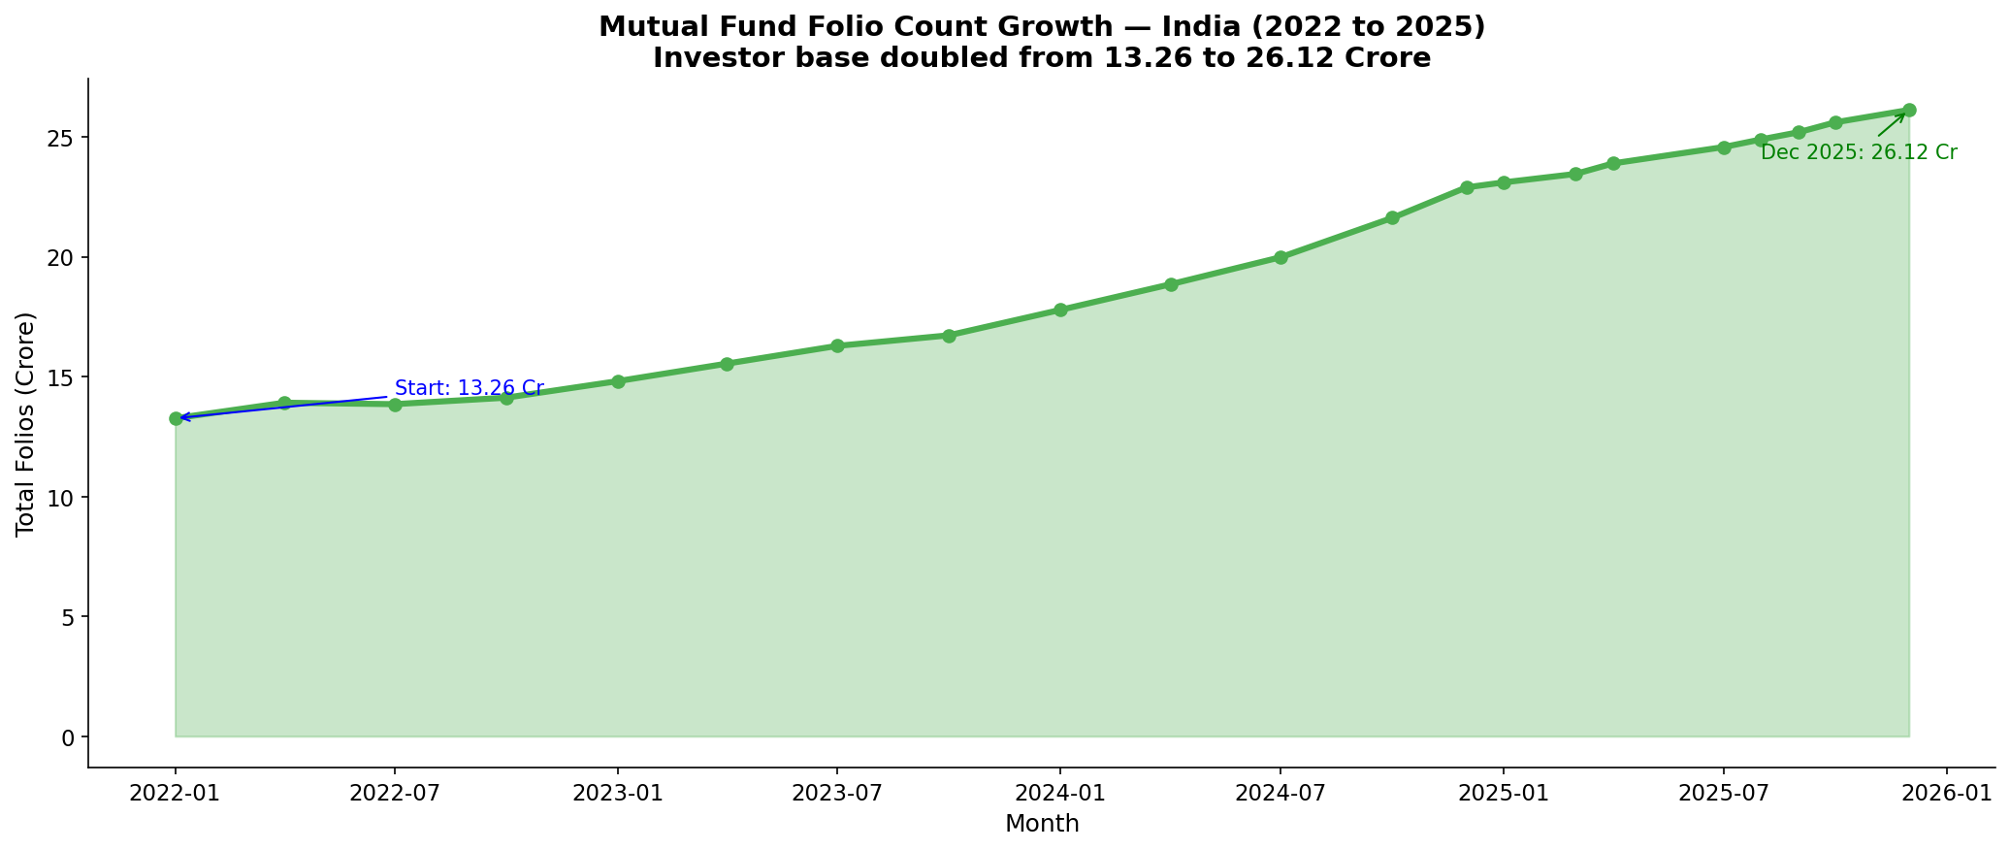
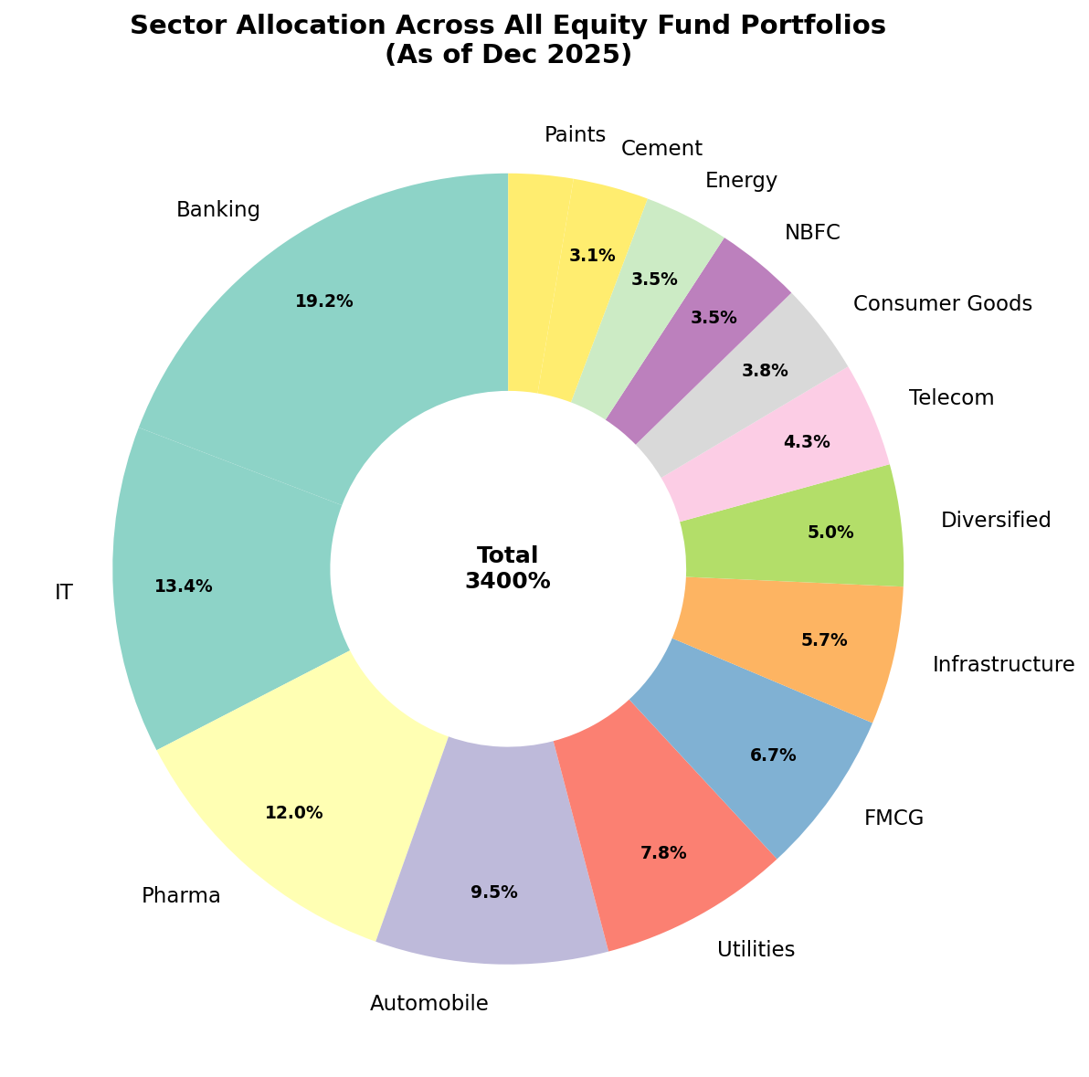
EDA Highlights (2/2)
• Folio count nearly doubled - 13.26 Cr to 26.12 Cr (97% growth in 4 years)
• Banking & Financial Services dominates sector allocation (25-30%)
Bluestock Fintech | 6/12

Slide 7
Performance Metrics (1/2)
• Annualised returns computed for all 40 funds using 252 trading days
• CAGR (1yr, 3yr, 4yr) - Best 3yr: Axis Midcap at 36.07%
• Sharpe Ratio (Rf=6.5%) - Best: Mirae Asset Large Cap at 1.45
• Sortino Ratio - Best: Mirae Asset Large Cap at 2.39
• Alpha & Beta vs Nifty 100 computed via OLS regression
• Max Drawdown - Worst: SBI Small Cap Direct at -52.57% (needed 110.86% to recover)
Bluestock Fintech | 7/12

Slide 8
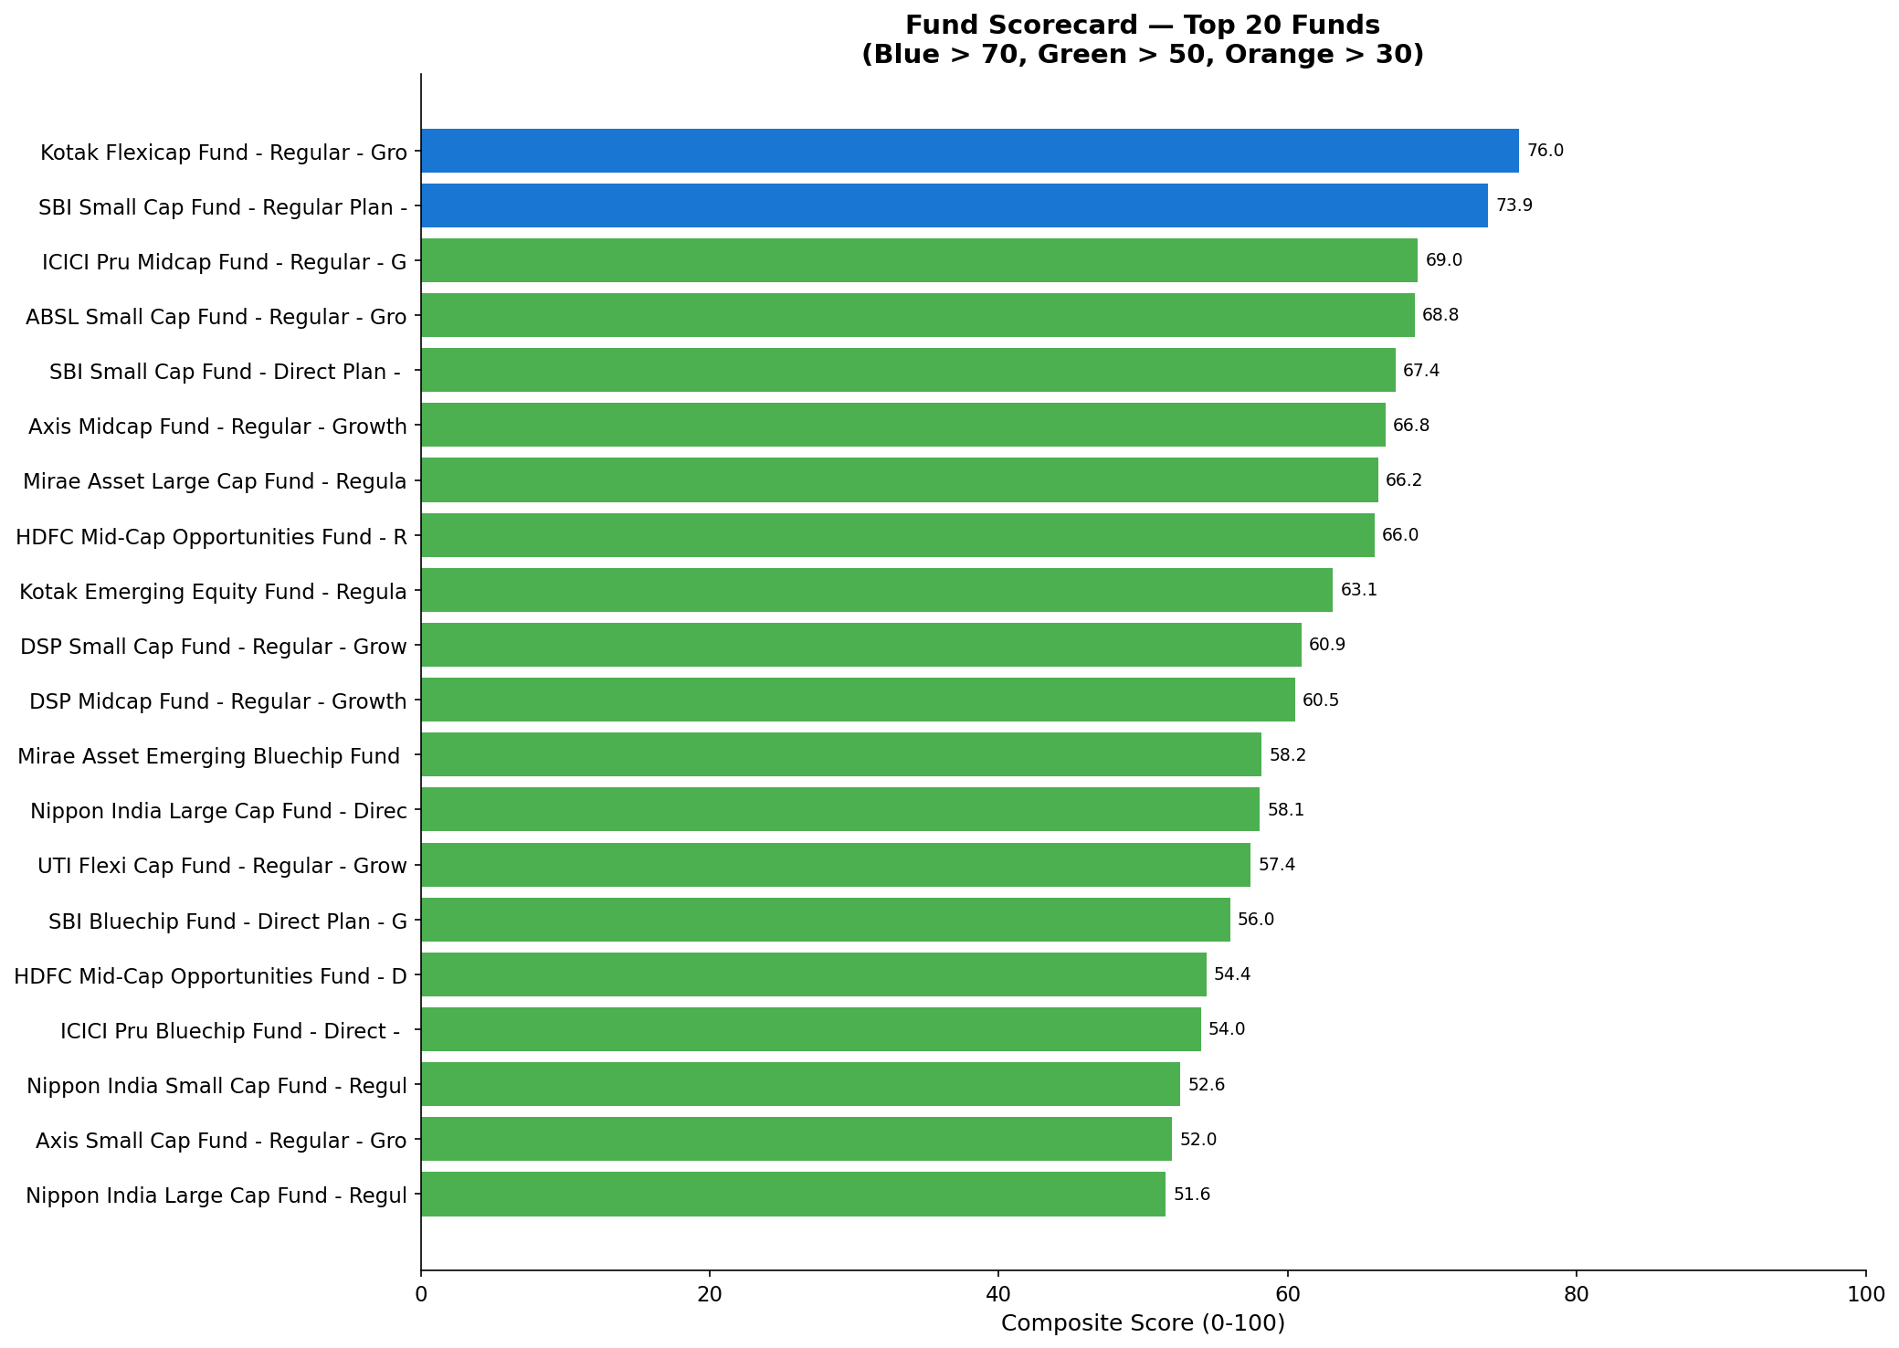
Performance Metrics (2/2) - Fund Scorecard
Bluestock Fintech | 8/12

Slide 9
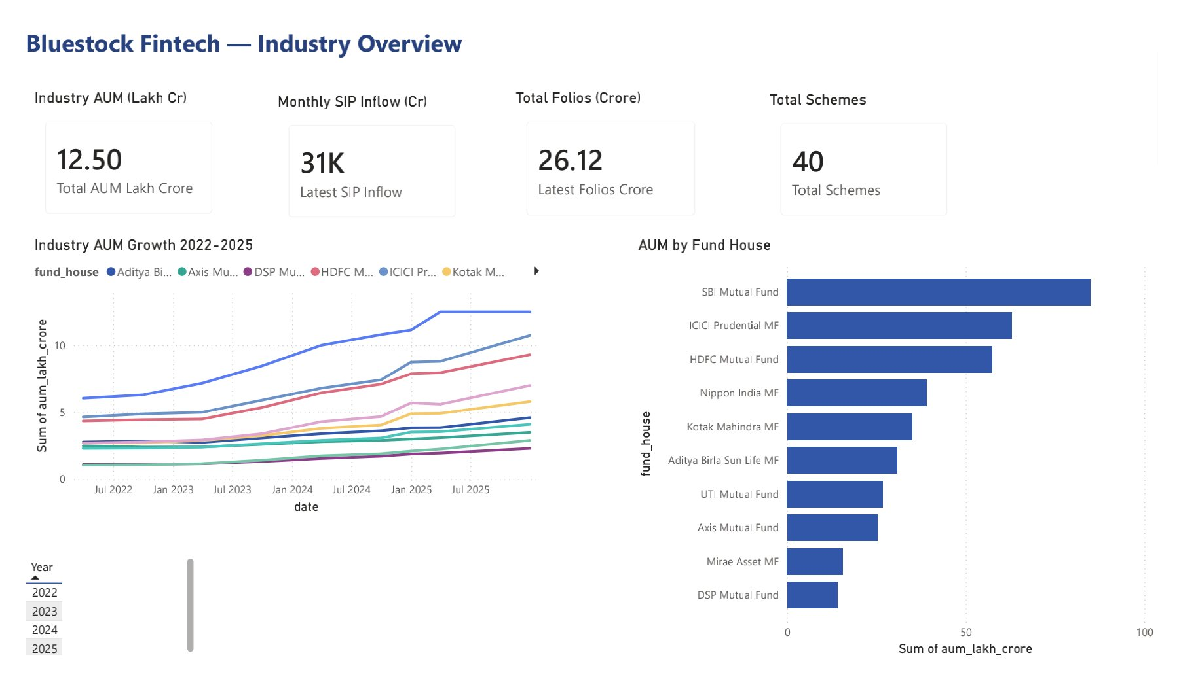
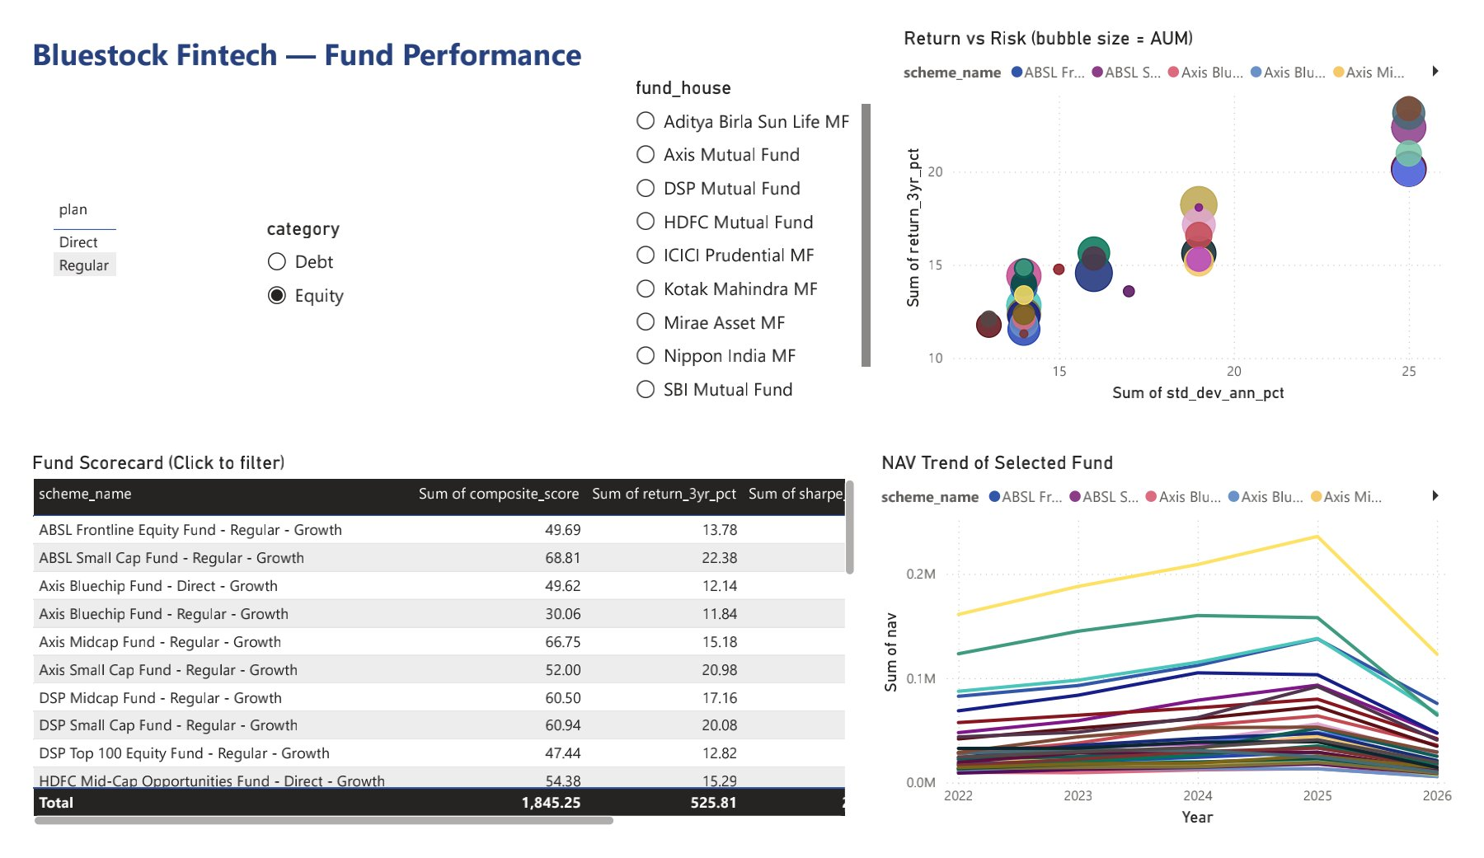
Interactive Dashboard (1/2)
• Page 1: Industry Overview - KPI cards for AUM, SIP, Folios, Schemes
• Page 2: Fund Performance - Return vs Risk scatter, scorecard table
Bluestock Fintech | 9/12

Slide 10
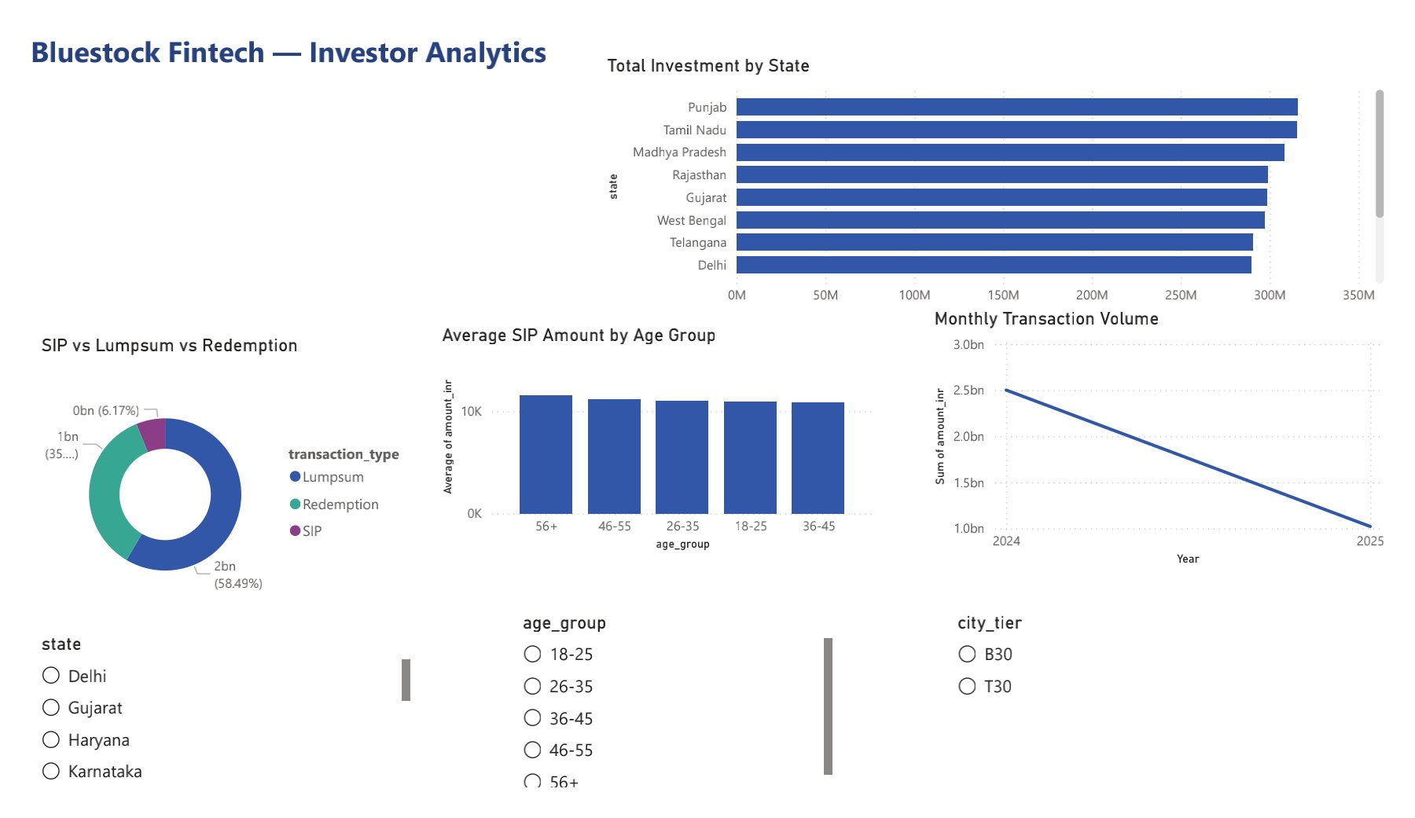
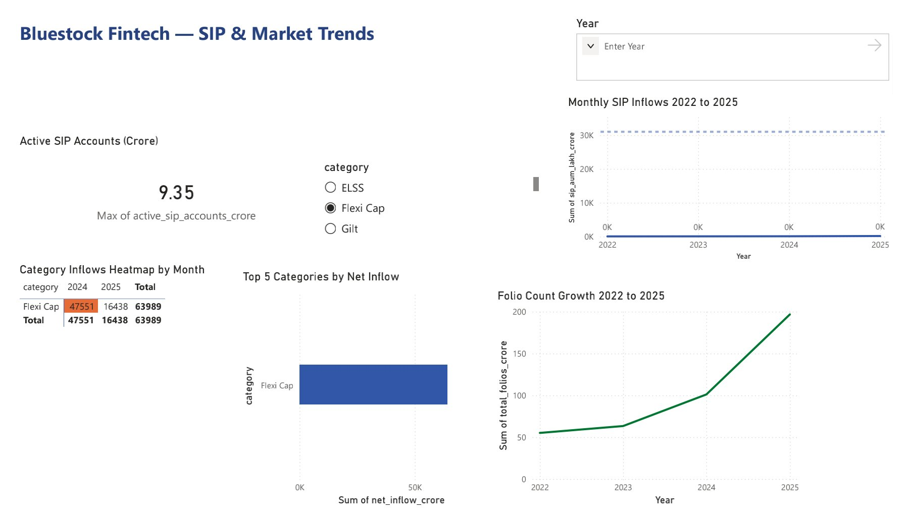
Interactive Dashboard (2/2)
• Page 3: Investor Analytics - State/age/city-tier breakdowns
• Page 4: SIP & Market Trends - Inflow trends, category heatmap
Bluestock Fintech | 10/12

Slide 11
Key Findings
• SBI Mutual Fund leads with Rs.12.5 lakh crore AUM (largest AMC)
• All 40 funds beat their 3-year benchmark - positive alpha across the board
• Small Cap funds carry highest risk (VaR/CVaR) - up to -5.8% worst-day loss
• Liquid funds are near risk-free - worst-day loss under 0.1%
• 97.8% of frequent SIP investors show gaps >35 days - SIP discipline gap
• 2025 cohort invests 23% more per SIP (Rs.13,505) vs 2024 cohort (Rs.10,997)
• All equity portfolios have HHI < 2500 - reasonable sector diversification
• 26-35 age group has the most SIP investors; 56+ invests highest average amount
Bluestock Fintech | 11/12

Slide 12
Thank You
Bluestock Fintech | Mutual Fund Analytics Capstone
GitHub: github.com/Samadhan1904/bluestock-fintech-capstone
Bluestock Fintech | 12/12

