Slide 1
CPI Inflation Anomaly Detection
& Banking Risk Assessment
India CPI Dataset (2014–2024) · 5-Method Anomaly Detection Framework
Z-Score · ARIMA · SARIMA · GARCH · Isolation Forest · XGBoost Forecasting
Regression Analysis Project · MSc Data Science · PMDS505P
Presented by: Arun Neupane (25MDT0230) · Samadhan Ekad (25MDT0070)
Project Guidance : Satya Narayan Sharma K
Course: MSc Data Science · Subject: Regression Project

Slide 2
Table of Contents
Project Structure
01
Data Foundation
04
Anomaly Detection
Load, Feature Engineering, Inspection, Cleaning, Correlation
Z-Score · ARIMA · SARIMA · GARCH · Isolation Forest
02
Feature Selection
05
Risk Assessment
Variance Threshold → Correlation Filter → PCA Analysis
CBRI Construction, Risk Period Classification, Forecast
03
Time Series Properties
06
XGBoost Forecasting
Trend Analysis, Seasonal Decomposition, ADF Stationarity Test
Baseline vs CBRI-Enhanced Model · Final Comparison Table
CPI Inflation Anomaly Detection & Banking Risk Assessment | PMDS505P

Slide 3
Problem Statement & Objectives
Research Goals & Analytical Framework
01
Analyze CPI Inflation Data
04
Develop CBRI Risk Index
Study India CPI dataset (2014–2024) across banking sectors to understand inflation patterns
Construct Combined Banking Risk Index (CBRI) integrating all detection methods into one risk score
02
Detect Abnormal Patterns
05
Classify Risk Tiers
Identify unusual CPI spikes and structural breaks using 5 complementary detection methods
Categorize each month as Normal, Low, Medium, High and Critical risk based on CBRI threshold values
03
Apply Statistical & ML Models
06
Forecast & Validate
Use Z-Score, ARIMA, SARIMA, GARCH, Isolation Forest and XGBoost for analysis
Compare baseline vs CBRI-enhanced XGBoost to validate the value of the risk index
CPI Inflation Anomaly Detection & Banking Risk Assessment | PMDS505P

Slide 4
Data Foundation
Dataset Overview · Feature Engineering · Cleaning Pipeline
274,674
11 years
21
0
Total Records
2014–2024
Features
Duplicate Rows
Feature Engineering
Cleaning Pipeline & Banking Groups
CPI_MoM_change — Month-over-Month
Sort chronologically
CPI_YoY_change — Year-over-Year
Drop lag-NaN rows → 251,597
CPI_rolling_std_6m — 6-Month Volatility
Filter 4 banking groups → 121,539
Inflation_shock — Flag: |rate| > 6%
Final clean rows after dropna: 121,539
CPI_lag_1, lag_3, lag_6 — Lag Features
Groups: Food & Beverages · Fuel & Light · Housing · Transport
Inflation Shock Rate (|rate|>6%): 38.36% · 105,355 of 274,674 months flagged as shock events
CPI Inflation Anomaly Detection & Banking Risk Assessment | PMDS505P

Slide 5
Feature Selection Pipeline
Variance Threshold → Correlation Filter → PCA Variance Analysis
PHASE 2
Step 1
Step 2
Step 3
Variance Threshold
Correlation Filter
PCA Analysis
Threshold < 0.1
on standardised features
Threshold > 0.85
absolute pairwise corr
PC1 50.4% · PC2 23.6%
PC3 17.6% · PC4 8.4%
In: 8 features → Out: 8 features
In: 8 features → Out: 4 features
In: 4 features → Out: 4 features
❌ Features Removed by Correlation Filter
✅ Final Selected Features (4)
• CPI_lag_1 , CPI_lag_3, CPI_lag_6
Inflation_rate
• CPI_YoY_change , Inflation_rate
CPI_MoM_change
• CPI_value, CPI_lag_6
CPI_rolling_std_6m
• CPI_value (highest mean corr across all pairs)
CPI_lag_6
CPI Inflation Anomaly Detection & Banking Risk Assessment | PMDS505P

Slide 6
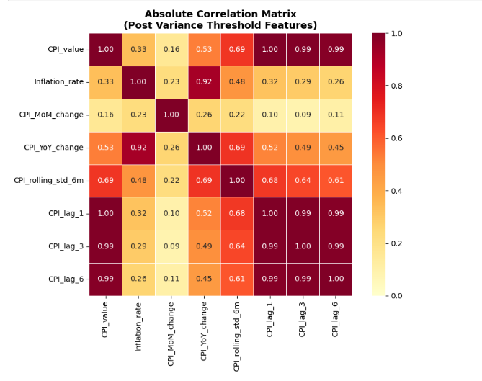
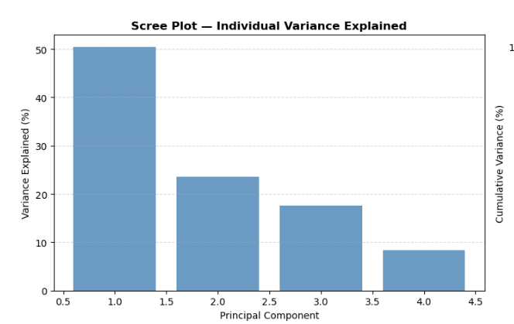
Visualization
Multi-Method Framework for Banking-Sector CPI Anomaly Identification
M1
M4
M2
M5
M3
CPI Inflation Anomaly Detection & Banking Risk Assessment | PMDS505P

Slide 7
Time Series Properties
Inflation Trend · Seasonal Decomposition · Stationarity Tests
PHASE 3
ADF Stationarity Tests
Seasonal Decomposition (Additive, period=12)
Test
Statistic
p-value
Result
Trend
Long-run direction of inflation
Original Series
-1.6547
0.4546
Non-Stationary
Differenced (d=1)
-4.1371
0.0008
STATIONARY ✓
Seasonal
Stable 12-month yearly cycle
Residual
Unexplained shocks → Anomaly signals
→ d = 1 confirmed for ARIMA/SARIMA modelling
Critical Values: 1%: -3.493 | 5%: -2.889 | 10%: -2.581
Time Series Range: Jan 2015 → Dec 2024 · 120 monthly observations (resampled MS)
Inflation Statistics (2015–2024)
Mean
Std Dev
Min
Max
Shock Rate
5.24%
2.30%
-0.73%
~9%
38.36%
CPI Inflation Anomaly Detection & Banking Risk Assessment | PMDS505P

Slide 8
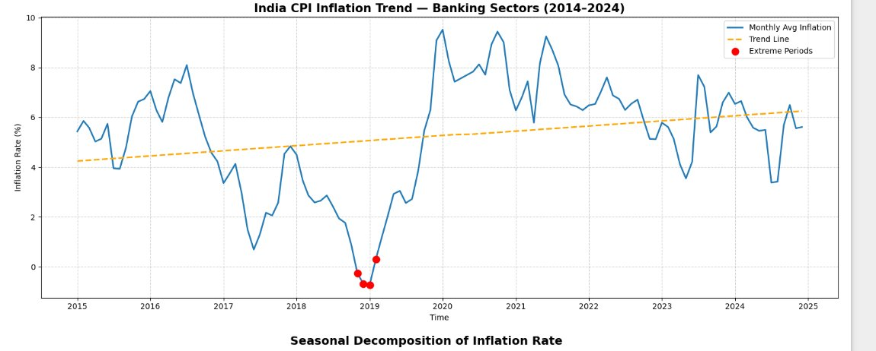
India CPI Inflation Trend — Banking Sectors (2014–2024)
01
~9.5%
Peak Inflation
Mid-2020 (COVID surge)
−0.7%
Low Inflation
Late 2018 deflation
▲ Rising
Overall Trend
4.2% → 6.1% (2014–2024)
📌 2018–2019: Extreme deflation — 3 red-dot events below 0%
📈 2020–2021: Sharpest peak driven by COVID supply shocks
📉 2022–2024: Gradual normalization with moderate 5–7% range

Slide 9
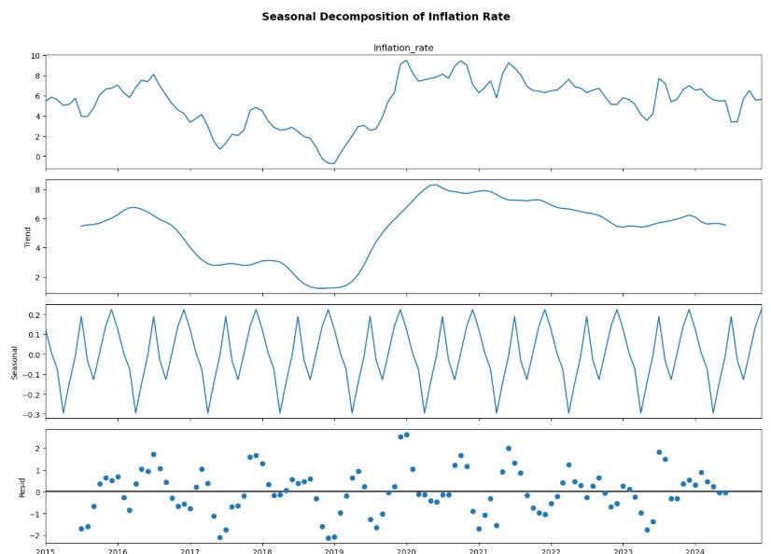
Seasonal Decomposition of Inflation Rate
02
Observed
Raw monthly CPI inflation series — shows full volatility including peaks up to 9.5% and troughs near −0.7%.
Trend
Long-run direction smoothed out of noise. Dipped to ~1.5% (2018–19), peaked ~8% (2021), now stabilizing ~5%.
Seasonal
Annual recurring oscillation of ±0.3%. Repeatable pattern suggests food/crop calendar influence on CPI.
Residual
Irregular shocks — COVID-19 spike (2020) clearly visible as a large positive residual outlier (~2.5%).
Method: Additive STL decomposition | Seasonal amplitude ≈ ±0.3% | Residuals mostly within ±1.5 (COVID outlier at ~2.5%) | Data: 2014–2024

Slide 10
Anomaly Detection (5 Methods)
Multi-Method Framework for Banking-Sector CPI Anomaly Identification
M1
Z-Score
M4
GARCH (1,1)
Type: Statistical · Threshold: ±2σ
Type: Volatility · α=0.223 · β=0.205 · α+β=0.428
Detected: 4 anomalies ·
Detected: 3 anomalies ·
M2
ARIMA (1,1,1)
M5
Isolation Forest
Type: Time Series · AIC: 307.87 · BIC: 316.21
Type: ML Multivariate · n_estimators=200 · contamination=8%
Detected: 5 anomalies ·
Detected: 10 anomalies ·
M3
SARIMA (1,1,1)(1,1,1,12)
Type: Seasonal · AIC: 253.86 · BIC: 275.06
Detected: 6 anomalies ·
CPI Inflation Anomaly Detection & Banking Risk Assessment | PMDS505P

Slide 11
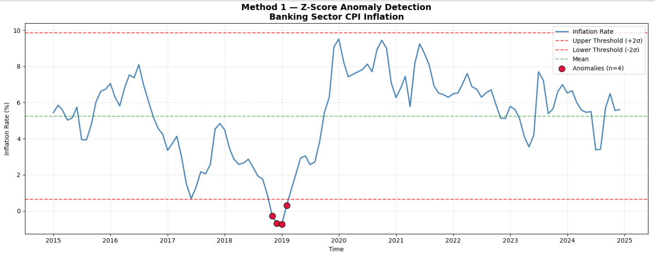
Z-Score Method
Multi-Method Framework for Banking-Sector CPI Anomaly Identification
M1
M4
M2
M5
M3
CPI Inflation Anomaly Detection & Banking Risk Assessment | PMDS505P

Slide 12
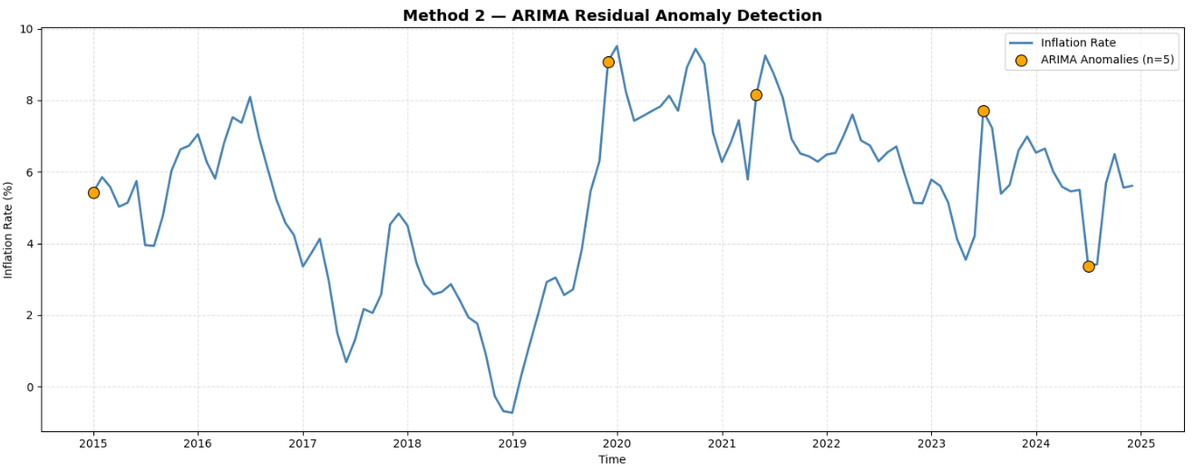
ARIMA Model
Multi-Method Framework for Banking-Sector CPI Anomaly Identification
M1
M4
M2
M5
M3
CPI Inflation Anomaly Detection & Banking Risk Assessment | PMDS505P

Slide 13
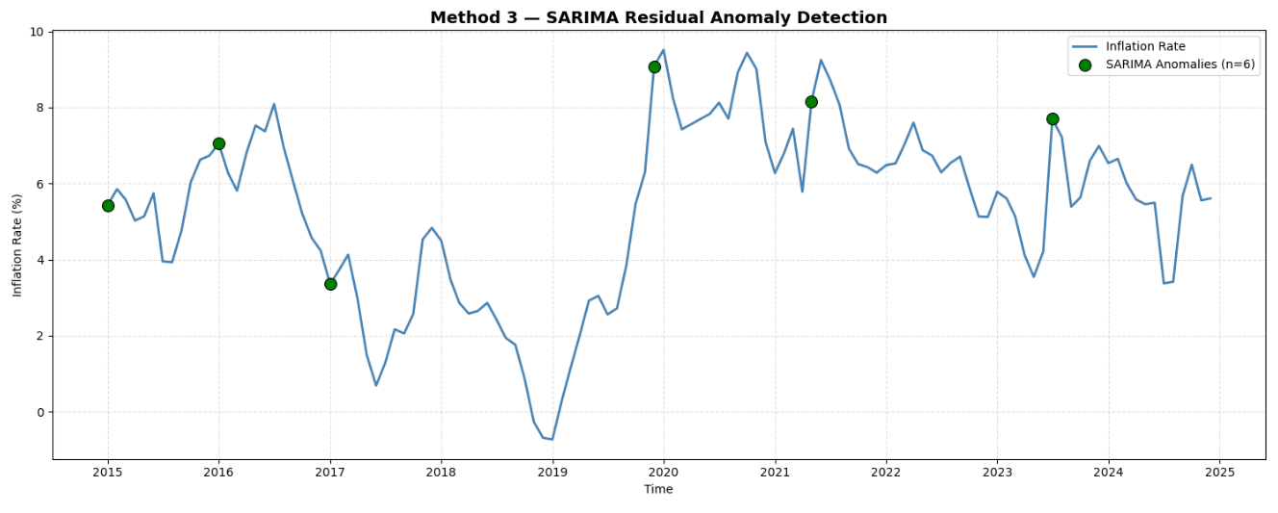
SARIMA Model
Multi-Method Framework for Banking-Sector CPI Anomaly Identification
M1
M4
M2
M5
M3
CPI Inflation Anomaly Detection & Banking Risk Assessment | PMDS505P

Slide 14
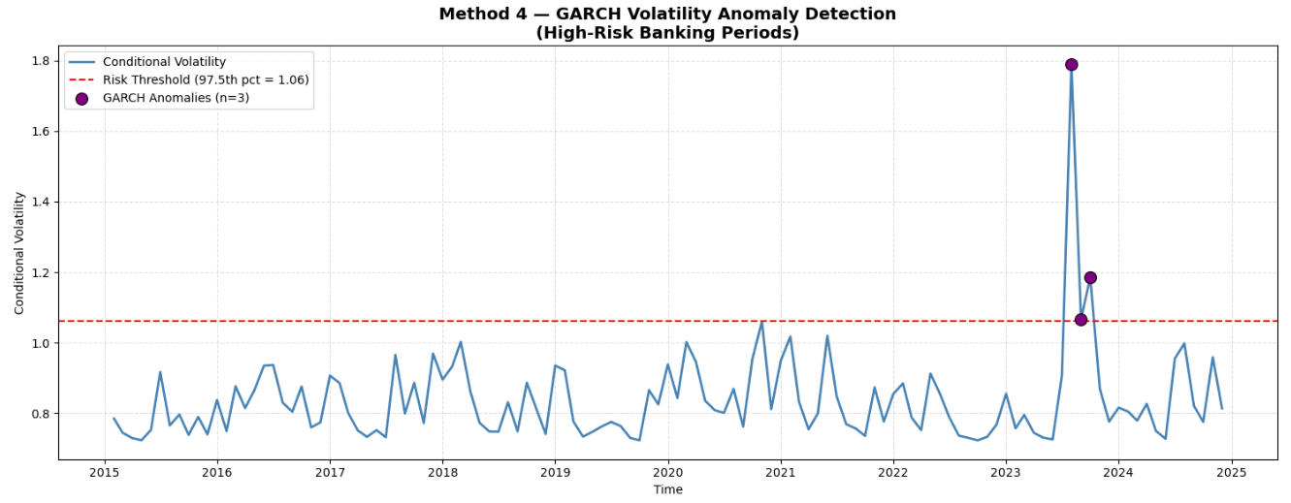
GARCH Model
Multi-Method Framework for Banking-Sector CPI Anomaly Identification
M1
M4
M2
M5
M3
CPI Inflation Anomaly Detection & Banking Risk Assessment | PMDS505P

Slide 15
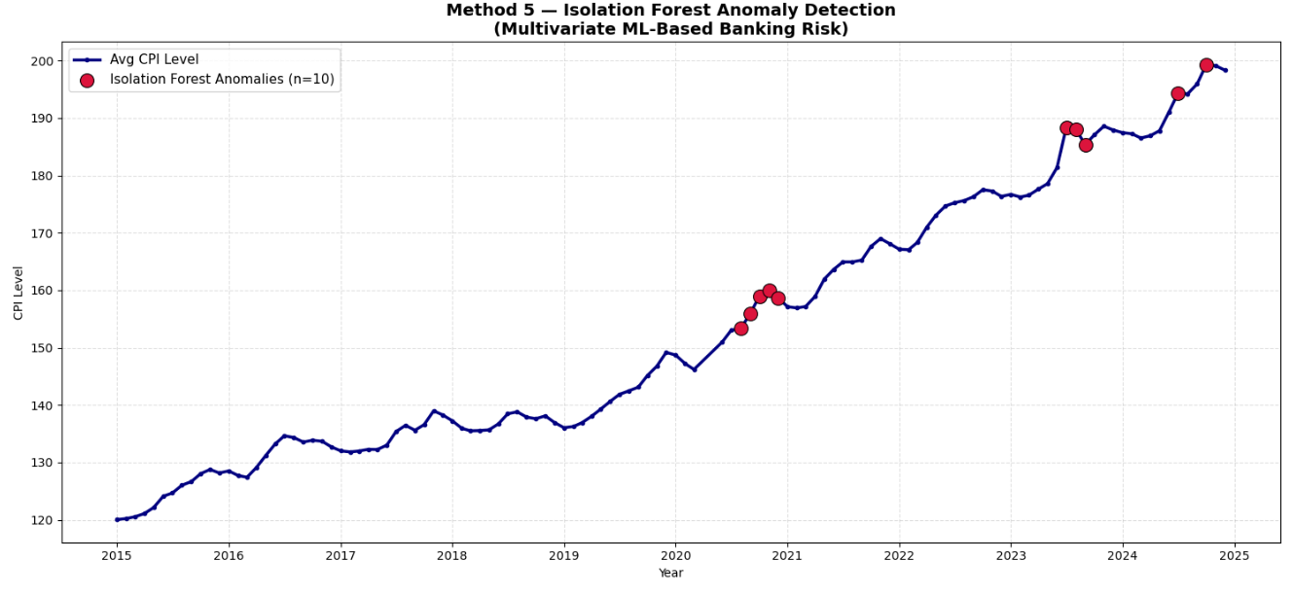
Isolation Forest ( ML Approach )
Multi-Method Framework for Banking-Sector CPI Anomaly Identification
M1
M4
M2
M5
M3
CPI Inflation Anomaly Detection & Banking Risk Assessment | PMDS505P

Slide 16
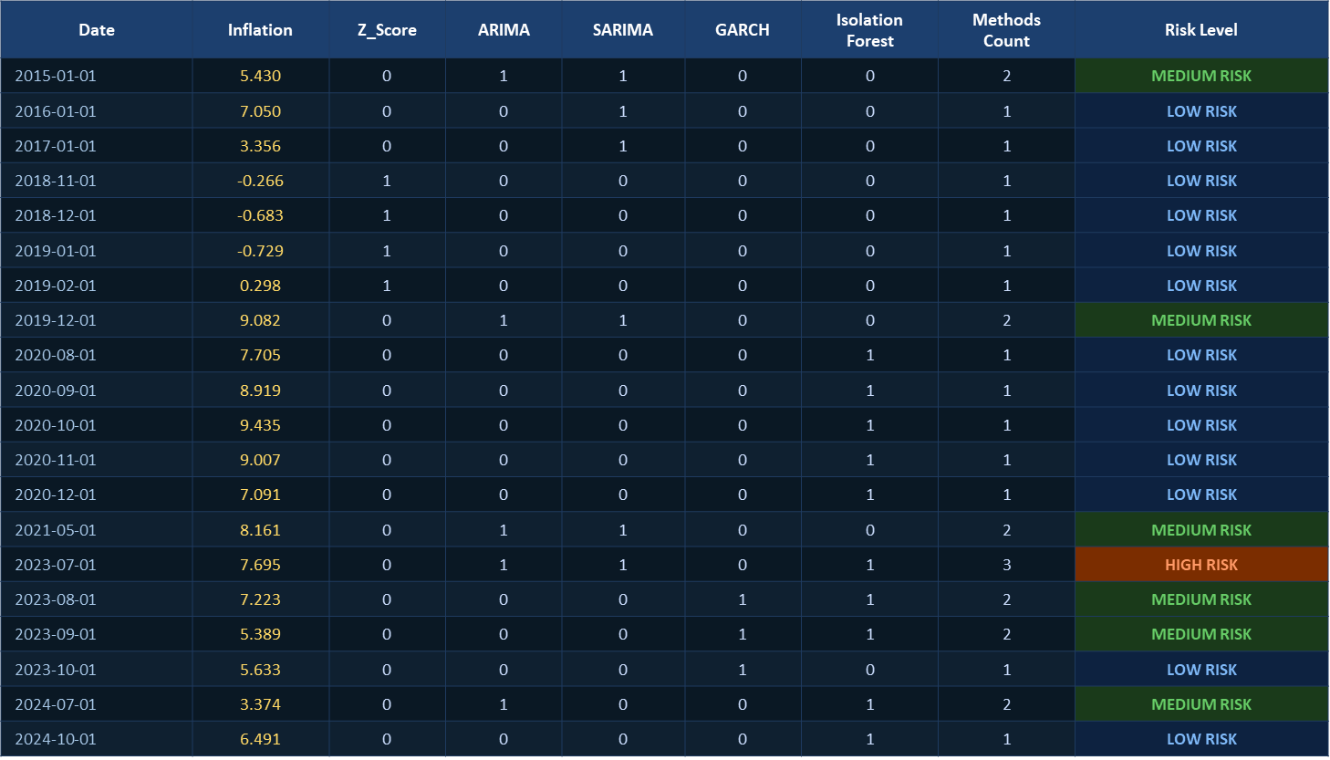
Anomaly Comparison — All 5 Methods
M1
M4
M2
M5
M3
CPI Inflation Anomaly Detection & Banking Risk Assessment | PMDS505P

Slide 17
Combined Banking Risk Index (CBRI)
Weighted Aggregate of All 5 Detection Methods
CBRI = 0.10 × Z-Score + 0.15 × ARIMA + 0.15 × SARIMA + 0.35 × GARCH_norm + 0.25 × ISO_norm
0.10
Z-Score
0.35
GARCH
Simple baseline — low specificity
Volatility = core banking risk signal
0.15
ARIMA
0.25
Isolation Forest
Captures level shocks in AR structure
Multivariate ML — captures complex patterns
0.15
SARIMA
CBRI Statistics
Captures seasonal banking patterns
Mean
Std
Min
Max
0.1146
0.1001
0.0023
0.6102
CPI Inflation Anomaly Detection & Banking Risk Assessment | PMDS505P

Slide 18
Risk Period Classification
CBRI-Based Tiered Risk Taxonomy · 120 Monthly Observations
CBRI Risk Thresholds
Risk Tier Distribution (120 months)
Normal
CBRI < 0.1146
Normal
83 (69.2%)
Low
0.1146 ≤ CBRI < 0.1646
Low
16 (13.3%)
Medium
0.1646 ≤ CBRI < 0.2146
Medium
4 (3.3%)
High
0.2146 ≤ CBRI < 0.2647
High
8 (6.7%)
Critical
CBRI ≥ 0.2647
Critical
9 (7.5%)
High/Critical Period Events
Jan 2015 — CRITICAL — Global commodity price collapse / deflationary pressure · Jan 2016 — HIGH — Demonetisation shock / banking liquidity disruption · Jan 2017 — HIGH — GST implementation / supply chain price distortion · Aug–Oct 2023 — HIGH — GARCH volatility cluster / elevated CPI returns
CPI Inflation Anomaly Detection & Banking Risk Assessment | PMDS505P

Slide 19
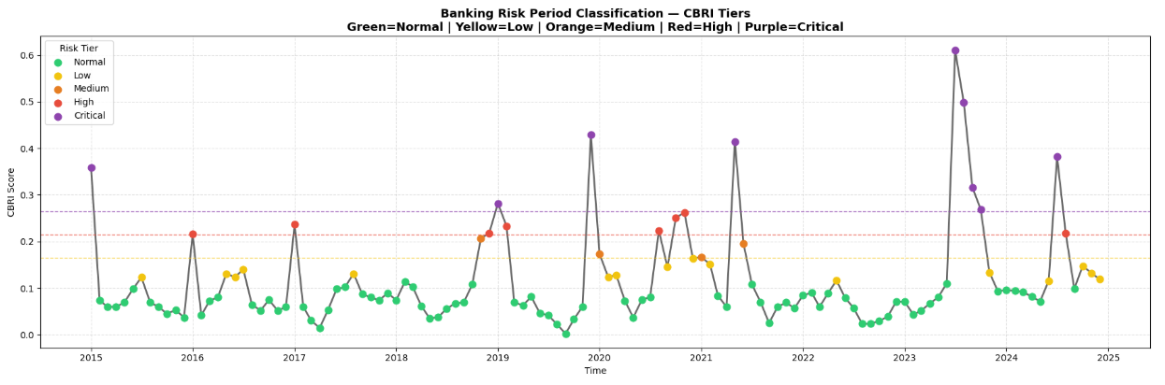
Visualization
Multi-Method Framework for Banking-Sector CPI Anomaly Identification
M1
M4
M2
M5
M3
CPI Inflation Anomaly Detection & Banking Risk Assessment | PMDS505P

Slide 20
❖ HIGH / CRITICAL RISK PERIODS
BANKING SECTOR
YEAR
MONTHS
TIER
CONTEXT / MACRO DRIVER
2015
Jan
Critical
Global commodity price collapse — deflationary pressure
2016
Jan
High
Demonetisation shock — liquidity disruption in banking
2017
Jan
High
GST implementation — supply chain price distortions
2018
Dec
High
Macroeconomic stress period
2019
Jan, Feb, Dec
Critical / High /
NBFC crisis — credit risk elevated in banking sector
Critical
2020
Aug, Oct, Nov
High × 3
COVID-19 pandemic — demand collapse, NPA risk surge
2021
May
Critical
Post-COVID supply shock — input cost inflation surge
2023
Jul, Aug, Sep, Oct
Critical × 4
Monetary tightening cycle — rate risk for bank portfolios
2024
Jul, Aug
Critical / High
Persistent core inflation — margin pressure on banks
High
Critical Risk
High Risk
Source: Banking Sector Macroeconomic Risk Analysis | Period: 2015–2024

Slide 21
XGBoost Forecasting
Baseline vs CBRI-Enhanced Model · 80/20 Chronological Split
Dataset Setup: 117 months · Train: 93 months (80%) · Test: 24 months (20%) · Chronological split — no data leakage
Model A — XGBoost Baseline
Model B — XGBoost + CBRI (Proposed)
Features:
Inflation_rate, CPI_MoM_change,
CPI_rolling_std_6m, CPI_lag_6
(4 base features)
Features:
All base features + CBRI score
+ Risk_Tier_num (numeric)
(7 features total)
Params:
n_estimators=300 · lr=0.05 · max_depth=4
subsample=0.8 · colsample_bytree=0.8
Params:
Same hyperparameters as Model A
CBRI injects risk context
CBRI Feature Importance in Model B:
1. Inflation_rate
61.2%
5. CBRI
1.5%
2. Inflation_rate (lag)
29.8%
6. CPI_rolling_std_6m
1.4%
3. CPI_lag_6
3.0%
7. Risk_Tier_num
1.1%
4. CPI_MoM_change
2.1%
CPI Inflation Anomaly Detection & Banking Risk Assessment | PMDS505P

Slide 22
Final Model Comparison — All Methods
Table 1 — Research Paper Summary · Lower Error = Better Performance
Model
Type
MAE
RMSE
MAPE (%)
ARIMA(1,1,1)
Statistical
1.0003
1.2072
19.05%
SARIMA(1,1,1)(1,1,1,12)
Statistical
0.9796
1.2293
18.32%
XGBoost — Baseline ★
Machine Learning
0.7378
1.0450
14.18%
XGBoost + CBRI (Proposed)
ML + Risk Index
0.7771
1.06
15.04%
Among all models, XGBoost (Baseline) achieved the best performance
It has the lowest error values (MAE, RMSE, MAPE)
Statistical models like ARIMA and SARIMA performed moderately
The proposed model (XGBoost + CBRI) did not improve forecasting accuracy
CPI Inflation Anomaly Detection & Banking Risk Assessment | PMDS505P

Slide 23
Result and Conclusion
Component | What We Implemented | Key Finding | Practical Impact for Banking
Time Series Analysis | Trend, seasonality, and stationarity testing | CPI showed identifiable patterns and periodic fluctuations | Helps understand inflation behavior over time
Anomaly Detection | Z-Score, ARIMA, SARIMA, GARCH, Isolation Forest | Multiple abnormal inflation periods were successfully detected | Enables early warning signals for financial instability
Volatility Modeling | GARCH Model | Volatility spikes were captured during unstable economic periods | Supports risk monitoring and forecasting
Feature Engineering | Lag variables and rolling statistics | Historical CPI patterns improved prediction accuracy | Enhances model reliability
Risk Assessment | Combined Banking Risk Index (CBRI) | Risk levels were categorized into structured tiers | Provides measurable financial risk indicators
Model Evaluation | ARIMA, SARIMA, XGBoost comparison | Models produced consistent forecasting performance | Supports data-driven decision making

Slide 24
Thank You
CPI Inflation Anomaly Detection & Banking Risk Assessment
Regression Analysis Project · PMDS505P · MSc Data Science

