Slide 1
Title: Personal Financial Advisor Team: Project Team 3
Members:
Sham Solanki- ML Engineer Muskan Chauhan – Cloud Engineer

Slide 2
Project Overview
Problem:
Users struggle to track savings and detect overspending from raw expense data.
Objective: Build an intelligent, interactive platform to:
Predict actual savings rate
Flag overspending patterns
Provide visual and chatbot-based guidance
Business Value & Impact :
Helps users understand financial health in real-time
Recommends actionable insights to meet savings goals
Prevents over-budgeting and supports better planning
Deployed on the cloud: accessible anywhere

Slide 3
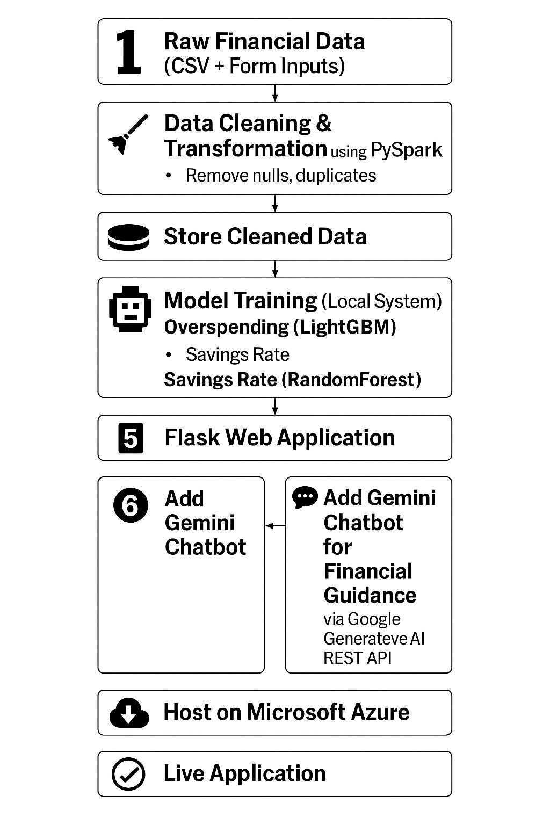
Architecture Flow

Slide 4
Data Preprocessing(ETL)
▶ Dataset :
▶ Total Records are 275000
▶ Null values in Income [5454] , Age [5420] , random_note [137319] ,
temp_value [137366]
▶ So in this case we drop null records , we cannot impute that if we impute that it is meaning less
▶ For random_note and temp_value there is more than 50 % null records .
▶ So we drop these 2 columns & these two columns are meaning less for our needs
▶ And save cleaned file in csv mode
▶ Cleand data size now 255381

Slide 5
Exploratory Data Analysis & Insights
Loaded dataset and checked shape, info, and summary stats
Removed nulls and verified missing values
Engineered new features like:
Spending_Rate, Actual_Savings_Rate, Savings_Gap
Created Overspend_Flag for classification
Encoded categorical columns: Occupation, City_Tier
Visualized distributions: Income, Savings Rate, Spending Rate
Analyzed overspending by Occupation and City Tier
Plotted boxplot: Income vs Overspend
Correlation heatmap for feature relationships
Checked multicollinearity using VIF

Slide 6
ML Implementation
▶ * Overspending Detection (Classification)
▶ Models Tried: Logistic Regression, Random Forest, LightGBM
▶ Best Model: LightGBM (F1 = 0.59, Recall = 0.99 , accuracy = 0.90)
▶ Why: Best trade-off between accuracy and recall for minority class
▶ Metrics Used: F1-Score, Recall, Confusion Matrix
▶ * Savings Rate Prediction (Regression)
▶ Models Tried: Random Forest, Gradient Boosting, LightGBM
▶ Best Model: Random Forest (R² = 0.91, MAE = 0.0218)
▶ Why: Highest prediction accuracy with minimal error
▶ Metrics Used: RMSE, MAE, R² Score

Slide 7
Application Development
▶ Frontend (HTML + CSS) :
▶ Collects user inputs via interactive forms
▶ Displays savings insights, pie charts & feedback
▶ Integrated Gemini Chatbot for financial guidance
▶ Flask Backend :
▶ Handles input preprocessing & model loading
▶ Serves real-time predictions via Flask routes
▶ Integration :
▶ HTML Form → Flask Route → ML Model → HTML Response
▶ Bidirectional flow between chatbot and backend
▶ User Experience :
▶ Instant predictions with clear visual insights
▶ Natural interaction via chatbot for suggestions

Slide 8
Deployments on Azure
create resources => web app service => Runtime stack = python use free tier version
Deployement Center => Authenticated with Github => select User =>
Repository => branch => main
From overview we can able to access the hosted URL
With the help of hosted URL we are able to access the project

Slide 9
Results & Business Value
▶ 1. Key Findings
▶ Top overspending drivers: Eating Out, Entertainment, Miscellaneous.
▶ Users with loans + high rent% show consistently lower savings.
▶ 2. Model Performance
▶ Overspending Detection
▶ Savings Rate Prediction
▶ 3. Business Recommendations
▶ Push personalized nudges to cut top 2 overspend categories.
▶ Partner features: insurance/loan refinance suggestions for high-loan users.

Slide 10
Results & Business Value
▶ 4. Future Enhancements (Easy & Practical)
▶ Auto email/SMS reminders when user crosses a spend limit
▶ One-click Excel/PDF export of monthly report
▶ Category-wise tips (e.g., “Cut eating-out by 10% to hit your goal”)
▶ User login + history tracking (see past months’ trends)
▶ Mobile-friendly UI / Android app later

