Slide 1
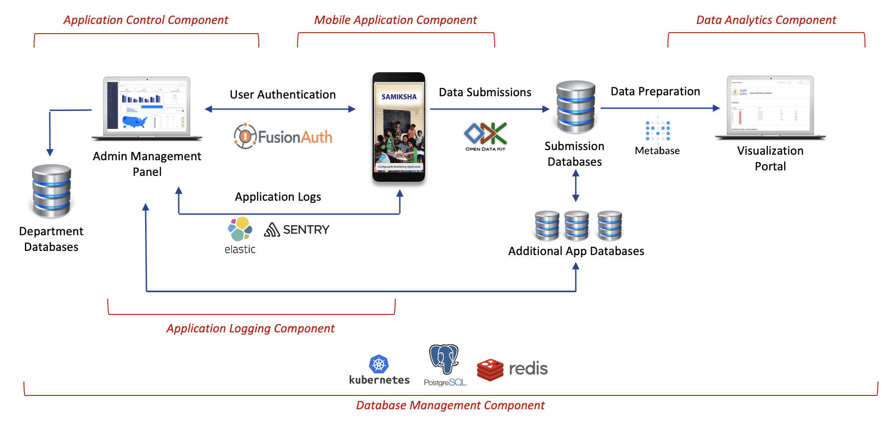

Open Source components can also be reused to create other products
Type 1 – With existing Open Source components and existing wiring
Unit of measure

Slide 2


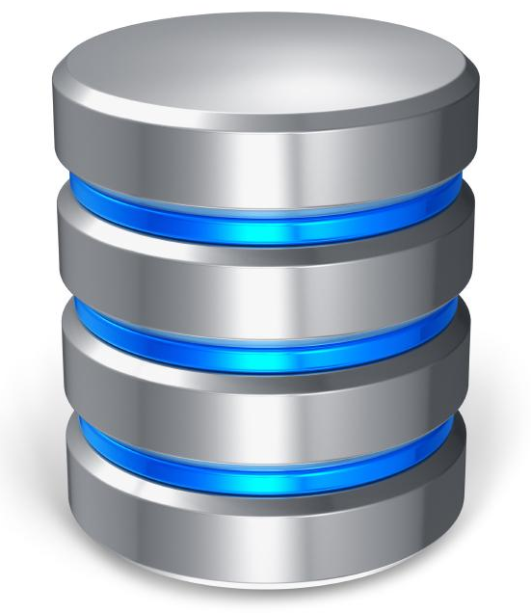
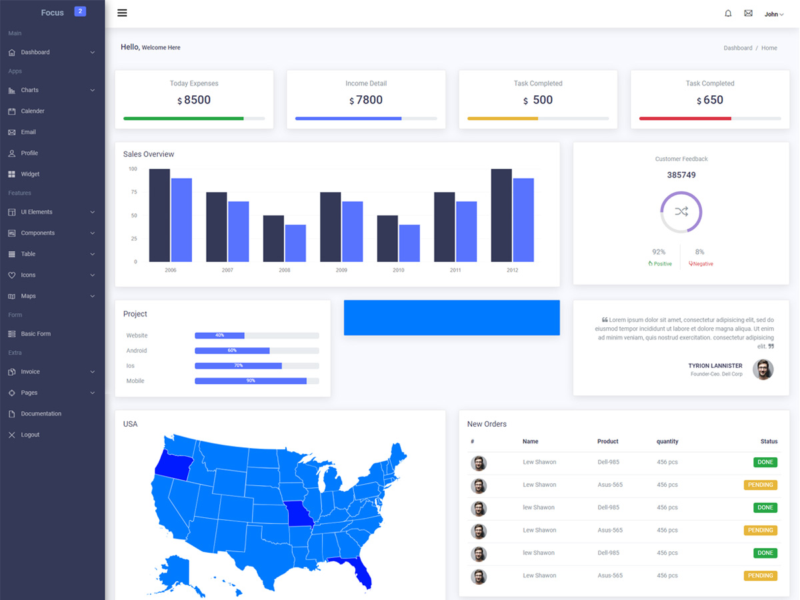

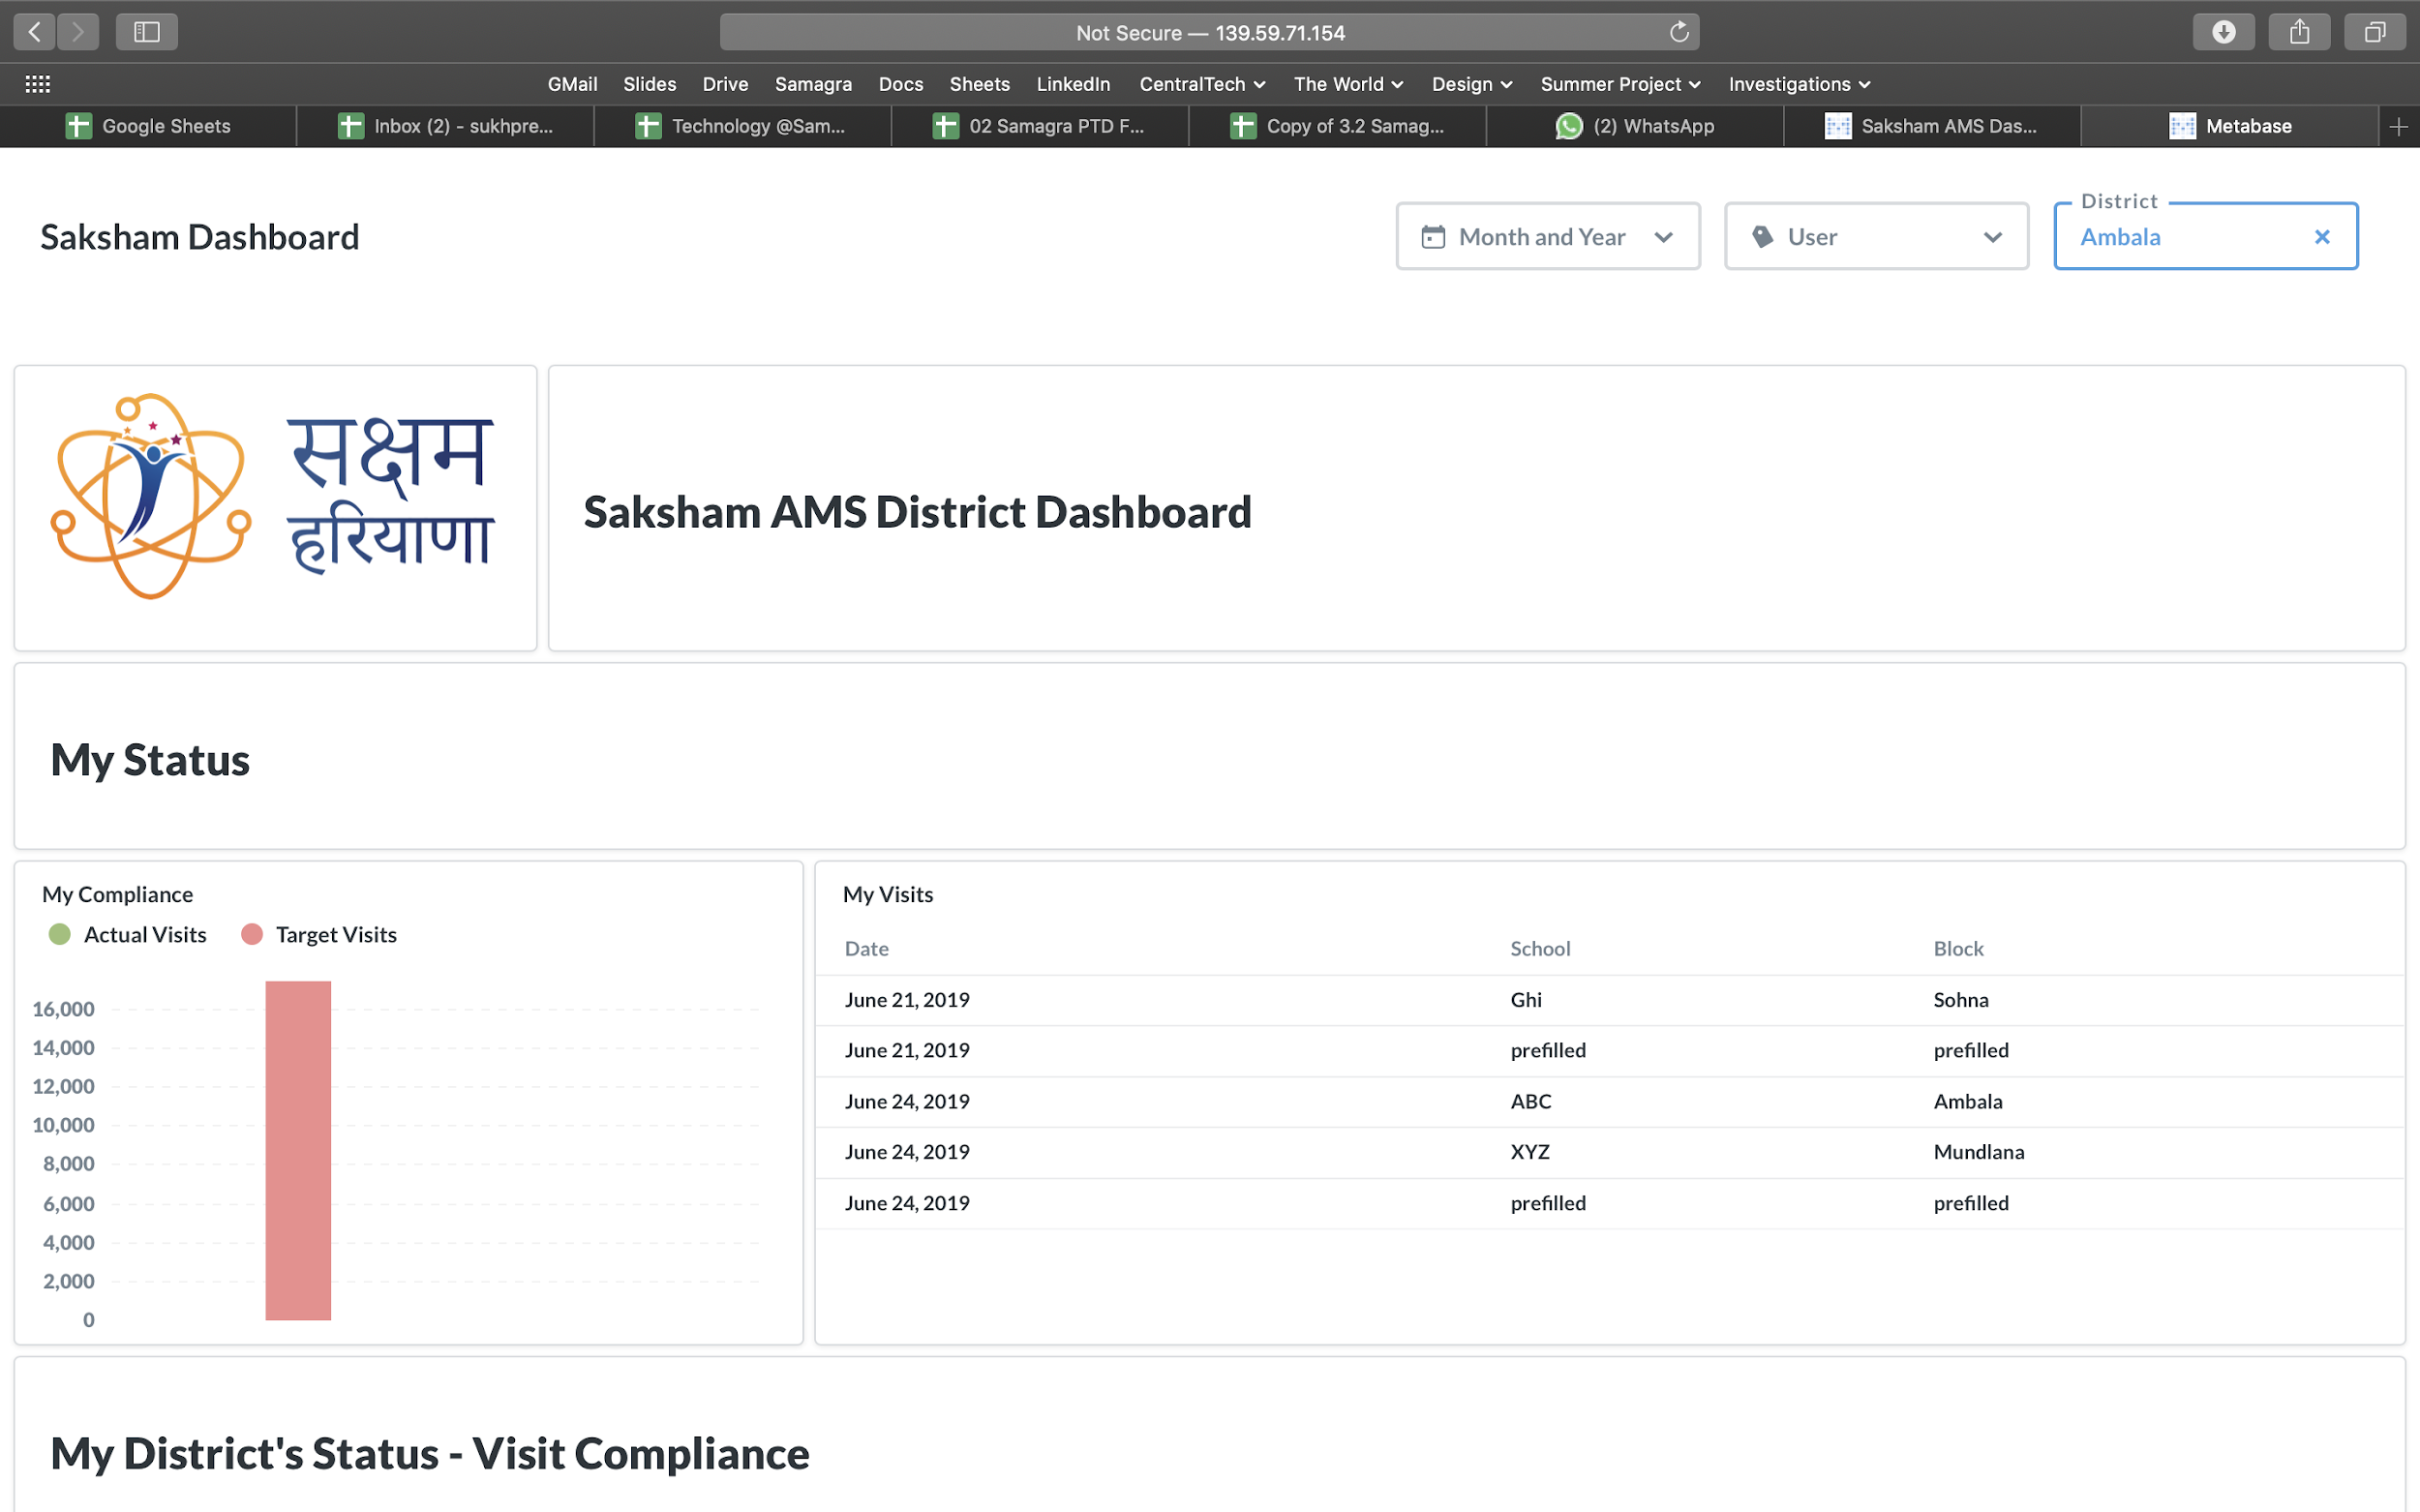









Open Source components can also be reused to create other products
Type 2 – With existing Open Source components and updated wiring
Unit of measure
Application Control Component
Mobile Application Component
Data Analytics Component
Students & Assessments update
User Authentication
Data Preparation
Admin Management
Panel
Submission Databases
Visualization
Portal
Application Logs
Department Databases
Additional App Databases
Application Logging Component

Slide 3




Open Source components can also be reused to create other products
Type 3 – With existing and new Open Source components and updated wiring
Unit of measure
Application Control Component
Mobile Application Component
Data Analytics Component
User Authentication
Data Submissions
Data Preparation
Admin Management
Panel
Submission Databases
Visualization
Portal
Application Logs
Student & SMS Status Update
Department Databases
Additional App Databases
SMS Gateway
SMS to Parent
Application Logging Component
Communication & Alerts Component

