Slide 1
Comprehensive Data Science Capstone Project
End-to-End Business Problem Solving using Machine Learning

Slide 2
Project Overview
End-to-end data science project
Multiple real-world business problems
EDA, modeling, evaluation, deployment readiness
Designed for academic & industry evaluation

Slide 3
Datasets Used
Sales Dataset – Revenue forecasting
House Prices Dataset – Price prediction
Customer Churn Dataset – Retention analysis
Combination of regression and classification tasks

Slide 4
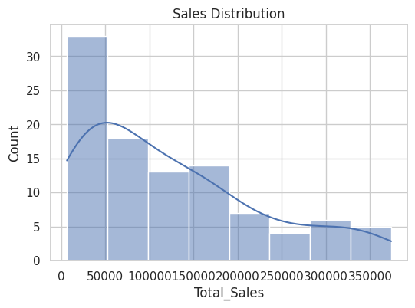
Sales Data Analysis
Sales distribution shows right skewness.
High-value sales contribute significantly to total revenue.

Slide 5
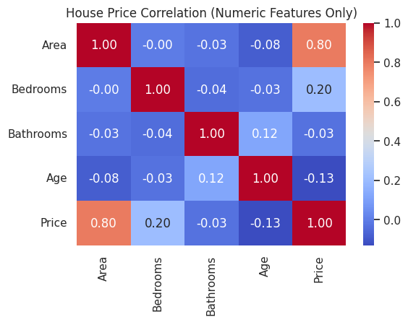
House Price Correlation Analysis
Area has the strongest positive correlation with price.
Age shows a slight negative impact.

Slide 6
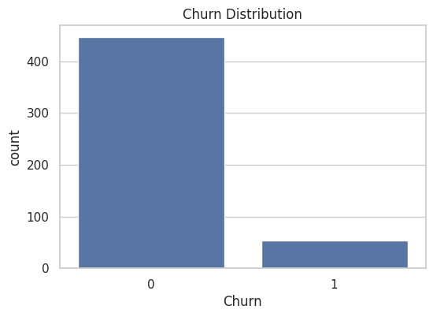
Customer Churn Distribution
Churn data is highly imbalanced.
Requires careful model evaluation and interpretation.

Slide 7
Modeling Approach
Random Forest Classifier for churn prediction
Random Forest Regressor for house price prediction
Linear Regression for sales forecasting
Feature engineering and tuning applied

Slide 8
Model Evaluation
Classification: Accuracy, Precision, Recall, F1-score
Regression: RMSE and R² score
Models show strong predictive performance

Slide 9
Business Insights
Identify high-risk churn customers early
Data-driven pricing for real estate
Improved sales planning and inventory management

Slide 10
Conclusion
Demonstrates practical data science skills
End-to-end workflow implementation
Portfolio-ready and industry-aligned project

