Slide 1
Complete Business Analysis Project
Objective:
• Perform end-to-end business analysis
• Extract insights from real-world datasets
• Provide actionable business recommendations

Slide 2
Business Problem
• Identify factors influencing house prices
• Understand customer churn behavior
• Analyze regional and temporal sales performance

Slide 3
Dataset Overview
• House Prices Dataset
• Customer Churn Dataset
• Sales Dataset
Total Records Analyzed: 900+

Slide 4
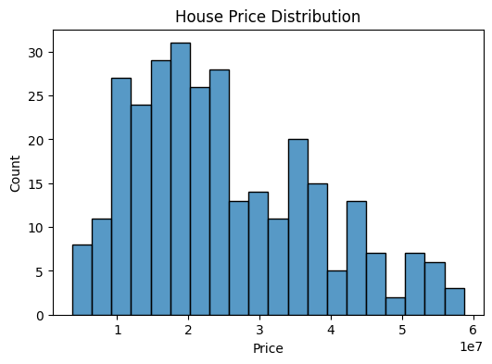
House Price Distribution
House prices are right-skewed, indicating a higher concentration of mid-range properties.

Slide 5
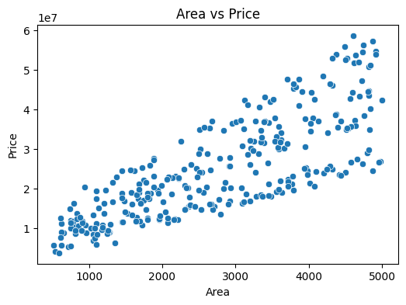
Area vs Price Relationship
A strong positive relationship exists between property area and price.

Slide 6
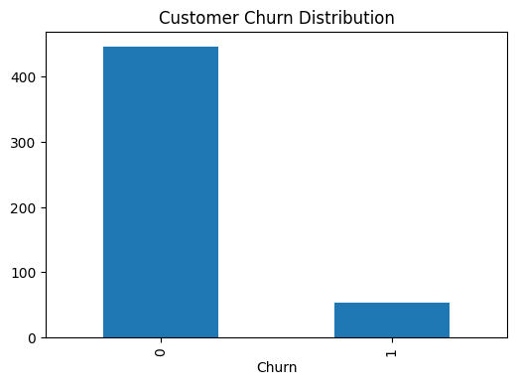
Customer Churn Distribution
A smaller proportion of customers churn, but they represent significant revenue risk.

Slide 7
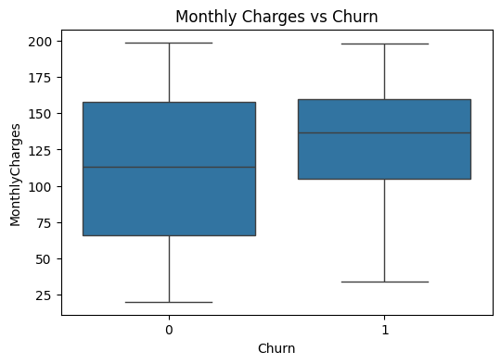
Monthly Charges vs Churn
Higher monthly charges are associated with increased churn probability.

Slide 8
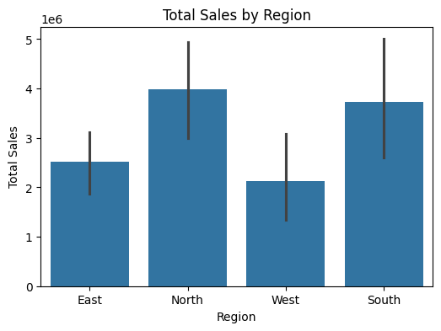
Total Sales by Region
Sales performance varies significantly across regions.

Slide 9
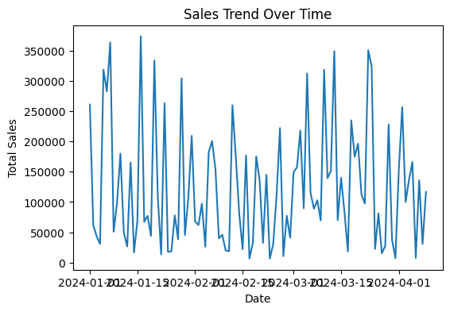
Sales Trend Over Time
Sales show fluctuations and periodic spikes, indicating seasonality.

Slide 10
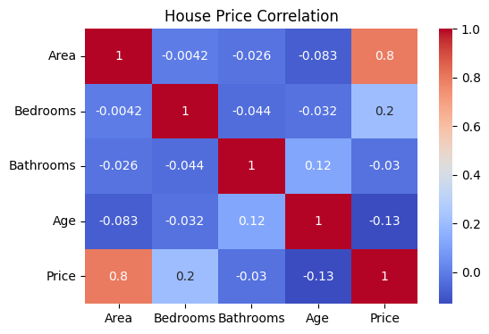
Key Findings & Recommendations
• Area strongly influences house prices
• Target high-risk churn customers
• Replicate best regional sales strategies

