Slide 1
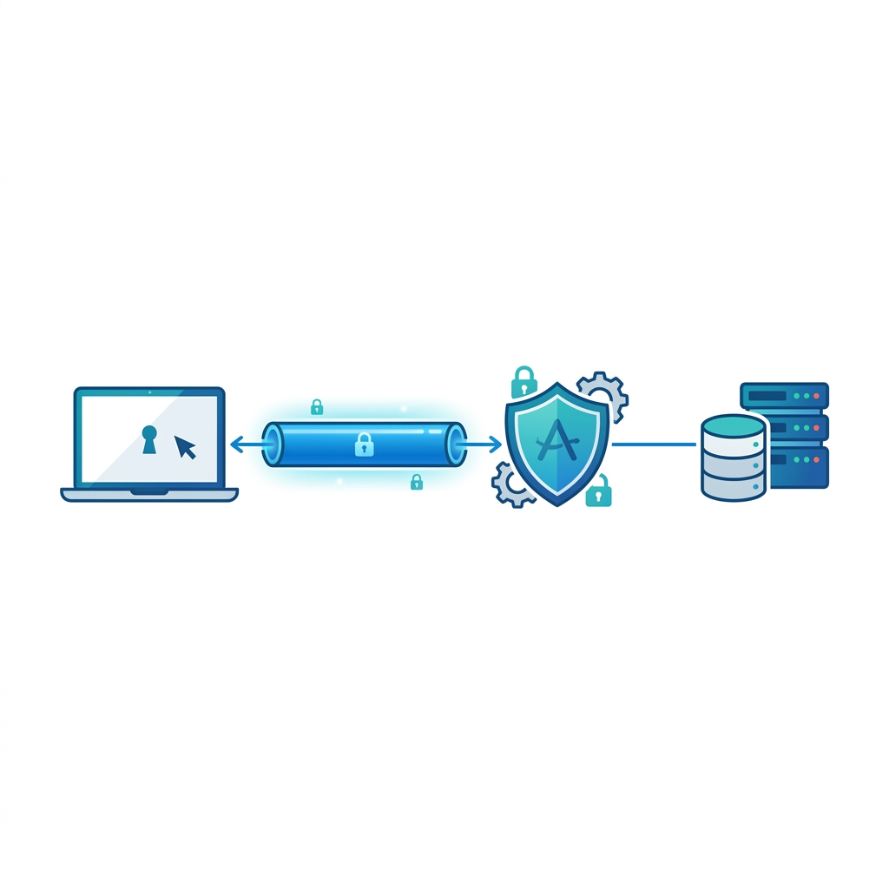
Post-Quantum OpenID Connect over KEMTLS and QUIC
Session-Bound Tokens, KEMTLS-PDK, and Research-Grade Benchmarking
Team Name | Submission / Challenge Name
1

Slide 2
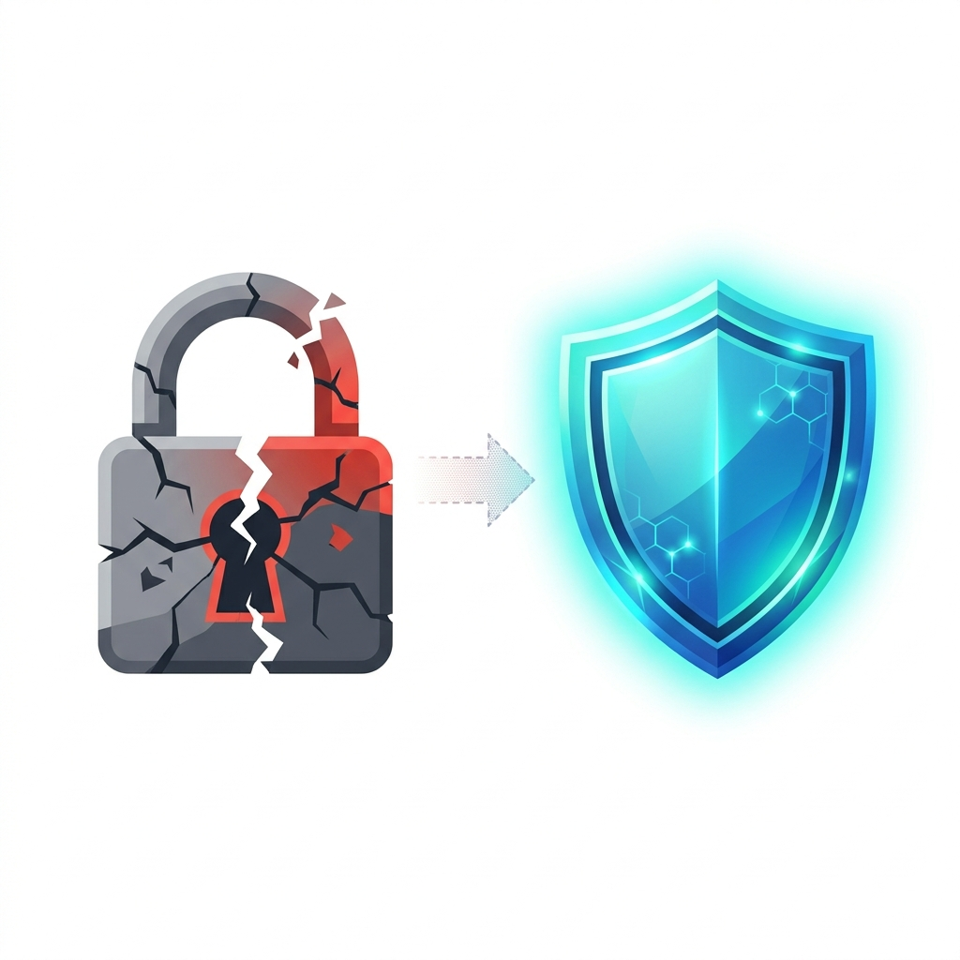
Problem and Opportunity
Why current identity systems need a post-quantum transport redesign
• Modern identity systems still rely on classical public-key cryptography.
• Post-quantum migration often keeps the traditional secure transport model unchanged.
• KEMTLS is a strong post-quantum transport candidate, but is underexplored in OIDC.
• Opportunity: preserve OpenID Connect while improving transport security and token protection.
2

Slide 3

Proposed Solution
Standard OIDC flow, redesigned transport and cryptographic foundation
• Preserve the standard OIDC Authorization Code Flow with PKCE.
• Secure communication using KEMTLS, with QUIC integrated into the transport path.
• ML-KEM-768 for key establishment and ML-DSA-65 for token signatures.
• Python for OIDC orchestration + Rust for high-performance transport.
• Strengthen token security without changing the visible OpenID Connect flow.
3

Slide 4
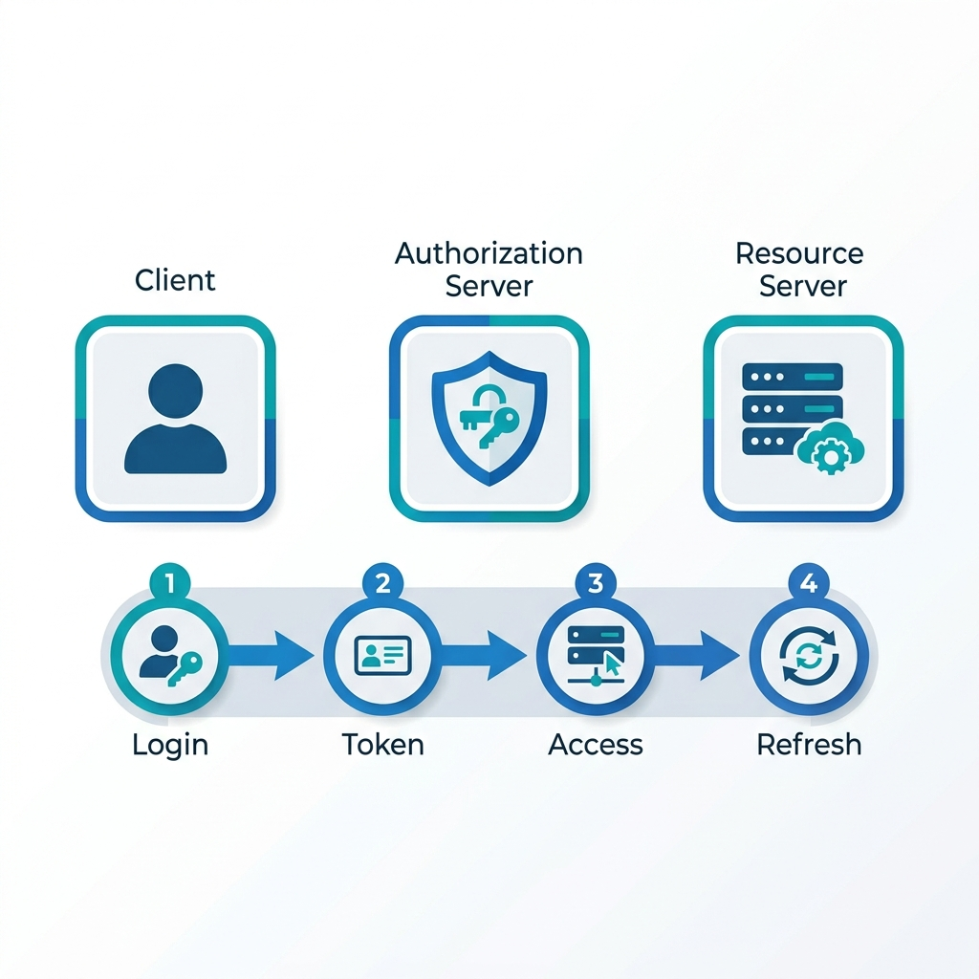
End-to-End System Flow
From login to protected resource access and token refresh
• Client establishes a secure session with the authorization server.
• Authorization and token exchange run through the protected transport channel.
• Auth server issues post-quantum-signed identity and access tokens.
• Client accesses the resource server through the same secure model.
• Resource server verifies both token validity and live session binding.
• Refresh-token rotation rebinds newly issued tokens to the active session.
4

Slide 5
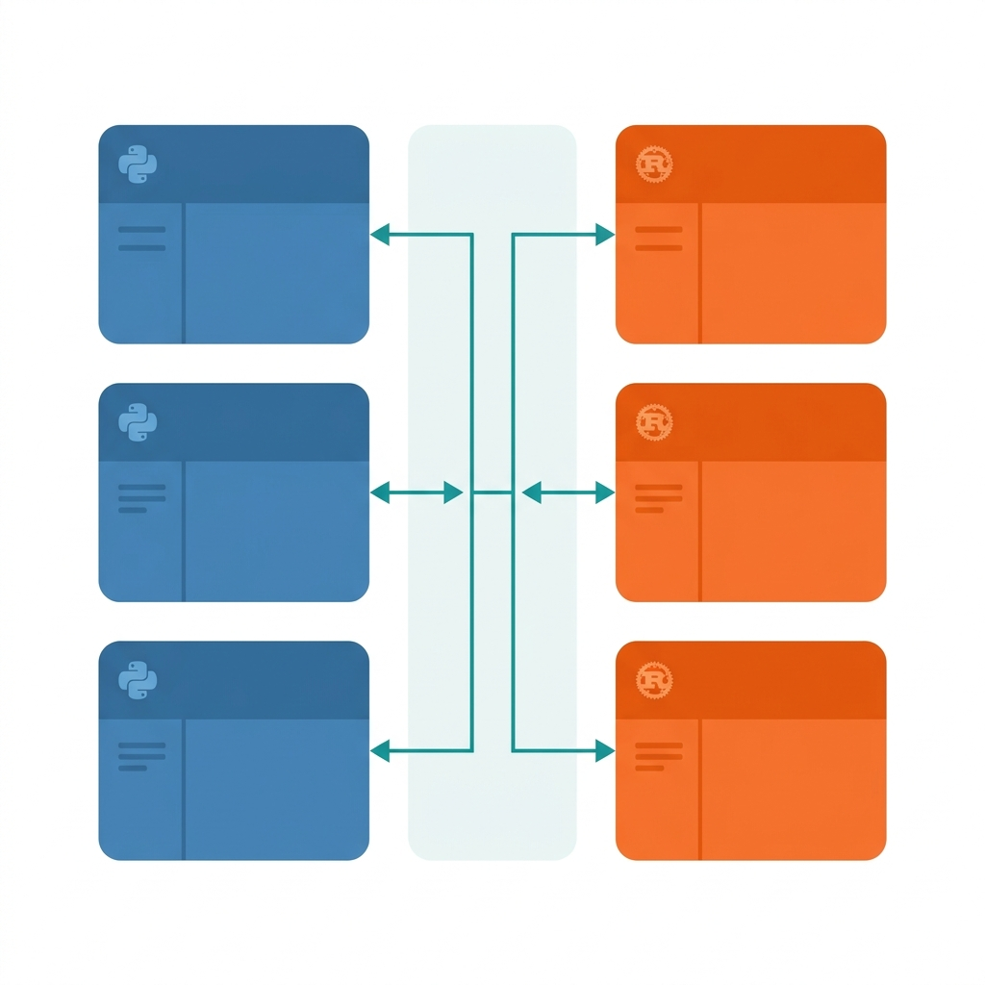
Technical Architecture
Modular Python + Rust implementation stack
• Python handles OIDC orchestration, endpoint logic, demo flow, and benchmark control.
• Rust handles performance-critical transport and secure communication components.
• Modular architecture across cryptography, transport, OIDC, servers, client, and benchmarking.
• Supports baseline trust, KEMTLS-PDK, and QUIC-integrated deployment modes.
5

Slide 6

Core Novelties
Five key innovations in this system
• KEMTLS-PDK: reduces certificate-related trust-establishment overhead in managed environments.
• QUIC-Integrated Transport: improves communication efficiency and responsiveness.
• Session-Bound Access Tokens: valid tokens fail when replayed on a different session.
• KEMTLS-Bound Refresh Rotation: refresh tokens rotate and rebind to the active session.
• Research-Grade Benchmarking: evaluates crypto, transport, and full identity-flow behavior.
6

Slide 7
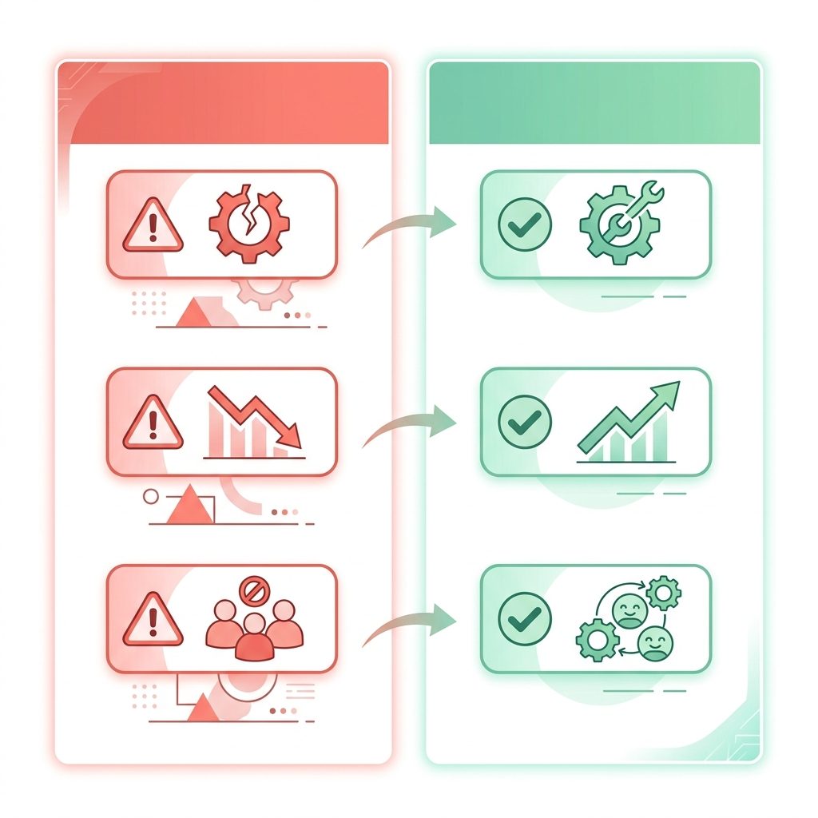
Feasibility and Productization
Deployment paths, challenges, and mitigations
• Suitable for enterprise identity, regulated environments, and controlled PQ migration.
• Supports certificate-oriented trust and tightly managed KEMTLS-PDK deployments.
• QUIC integration provides a practical path for performance-oriented secure systems.
• Challenges: browser compatibility, interoperability, deployment complexity.
• Mitigations: controlled pilots, modular integration, standards-aligned flow, phased adoption.
7

Slide 8

Benchmarking and Research Methodology
A layered, reproducible evaluation framework
• Multi-Layer Evaluation: crypto primitives → transport → full OIDC flow.
• Comparison Model: local results vs. classical and PQ literature baselines.
• Measurement Discipline: warm-up exclusion, repeated trials, per-phase timing, size analysis.
• Reproducibility: Python+Rust modular stack, fixed config, raw and processed outputs preserved.
8

Slide 9
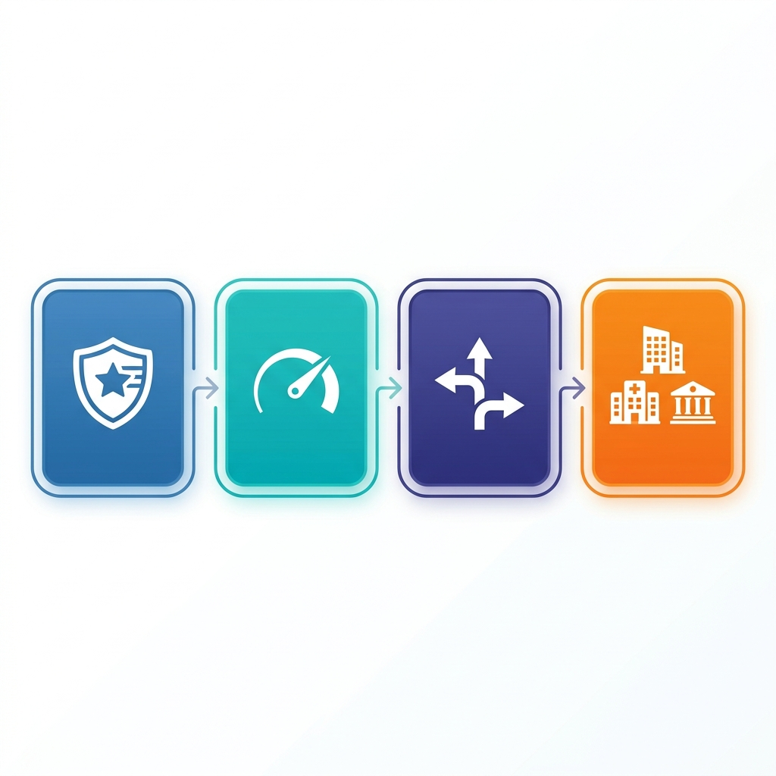
Performance, Impact, and Beneficiaries
Measurable improvements and target sectors
• KEMTLS-PDK reduces trust-establishment overhead in managed deployments.
• QUIC-integrated transport improves efficiency and responsiveness.
• Session-bound tokens reduce replay risk and strengthen resource access.
• Practical migration path toward post-quantum-secure identity infrastructure.
• Key sectors: banking, government, healthcare, and enterprise identity.
9

Slide 10

Research References and Closing
Building on KEMTLS research, NIST standards, and post-quantum OIDC studies
• Builds on KEMTLS research, PQ-OIDC studies, and NIST standards for ML-KEM / ML-DSA.
• Preserves OIDC semantics while redesigning transport and token security for the PQ era.
• Main contribution: KEMTLS + KEMTLS-PDK + QUIC + session-bound tokens + benchmarking.
• [Insert Repository / Demo Link / QR Code Here]
Thank you.
10

