Slide 1

Deep learning
Week 2, Lecture 2
Muhammad Saqib Sohail
Fall 2025

Slide 2
Marks distribution
Assignment 1
Assignment due date: 13 Sep 2025
No extension
Quiz 1
September 16 – Everything covered in the first 2 weeks

Slide 3

What is $R^{2}$?

Slide 4
Correlation
Relationship between variables
Calories burned – exercise duration
Examples of different correlations…
Positive/negative and Weak/strong
Correlation coefficient (r)
Calories burned
-1 0 1
Exercise duration

Slide 5

Understanding $R^{2}$
Linear regression
Strong, weak, and no correlation
Calories burned
Calories burned
Calories burned
Exercise duration
Exercise duration
Exercise duration

Slide 6
Understanding $R^{2}$
Linear regression
Strong, weak, and no correlation
Strong correlation
Medium/weak correlation
No correlation
Calories burned
Calories burned
Calories burned
Exercise duration
Exercise duration
Exercise duration

Slide 7

Understanding $R^{2}$
How good is your prediction based on your linear model?
I.e., How well is “calories burned” explained by “Exercise duration”?
Metric: $R^{2}$ (goodness of fit)
Calories burned
Calories burned
Calories burned
Exercise duration
Exercise duration
Exercise duration

Slide 8
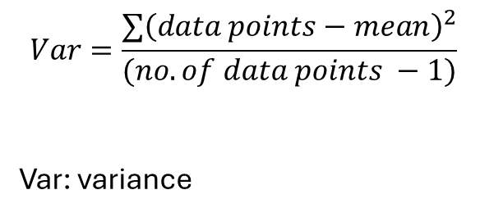
Understanding $R^{2}$
How well is “calories burned” explained by “Exercise duration”?
= How much variation in “calories burned” explained by “Exercise duration”?
$$Var=\frac{{∑\left(data points−mean\right)}^{2}}{(no. of data points −1)}$$
Var: variance
Calories burned
Calories burned
Exercise duration
Exercise duration

Slide 9

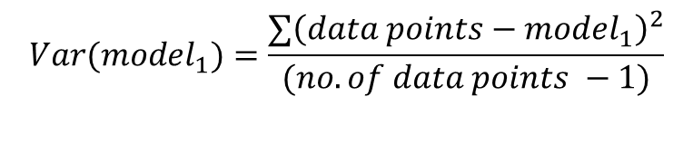
Under standing $R^{2}$
How well is “calories burned” explained by “Exercise duration”?
= How much variation in “calories burned” explained by “Exercise duration”?
Calories burned
Exercise duration
$$Var(model_{1})=\frac{{∑\left(data points−model_{1}\right)}^{2}}{(no. of data points −1)}$$
Distance between each data point from the dashed line

Slide 10
Under standing $R^{2}$
Exaggerated view to explain
Calories burned
Exercise duration
$$Var(model_{1})=\frac{{∑\left(data points−model_{1}\right)}^{2}}{(no. of data points −1)}$$
Distance between each data point from the dashed line

Slide 11

Under standing $R^{2}$
How well is “calories burned” explained by “Exercise duration”?
= How much variation in “calories burned” explained by “Exercise duration”?
$$Var(mean)=\frac{{∑\left(data points−mean\right)}^{2}}{(no. of data points −1)}$$
Var: variance
Calories burned
Calories burned
Exercise duration
Exercise duration
$$Var(model_{1})=\frac{{∑\left(data points−model_{1}\right)}^{2}}{(no. of data points −1)}$$
Distance between each data point from the dashed line

Slide 12
Under standing $R^{2}$
This means: A lot of variation in “Calories burned” can be explained by “Exercise duration”
Because the sum of “errors” (residuals) of the dots from the blue dashed line is smaller than that of the solid line on the right
Calories burned
Calories burned
Exercise duration
Exercise duration

Slide 13


Under standing $R^{2}$
$R^{2}$ is a metric that quantifies how much of variation in variable on y axis (“Calories burned”) is explained by the variable on the x axis (“Exercise duration”)
$$R^{2}=\frac{Var\left(mean\right)−Var(model_{1})}{Var(mean)}$$
$R^{2}=1$ : all of the variation of y-axis
variable is explained by x-axis variable
$R^{2}=0$ : none of the variation of y-axis
variable is explained by x-axis variable
Calories burned
Calories burned
Exercise duration
Exercise duration

Slide 14
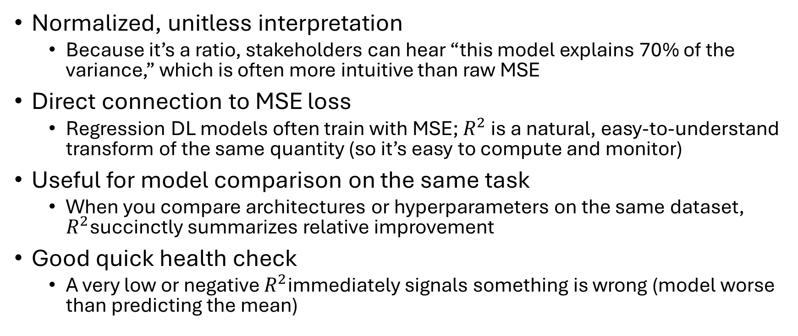

Why use $R^{2}$
Normalized, unitless interpretation
Because it’s a ratio, stakeholders can hear “this model explains 70% of the variance,” which is often more intuitive than raw MSE
Direct connection to MSE loss
Regression DL models often train with MSE; $R^{2}$ is a natural, easy-to-understand transform of the same quantity (so it’s easy to compute and monitor)
Useful for model comparison on the same task
When you compare architectures or hyperparameters on the same dataset, $R^{2}$succinctly summarizes relative improvement
Good quick health check
A very low or negative $R^{2}$immediately signals something is wrong (model worse than predicting the mean)

Slide 15
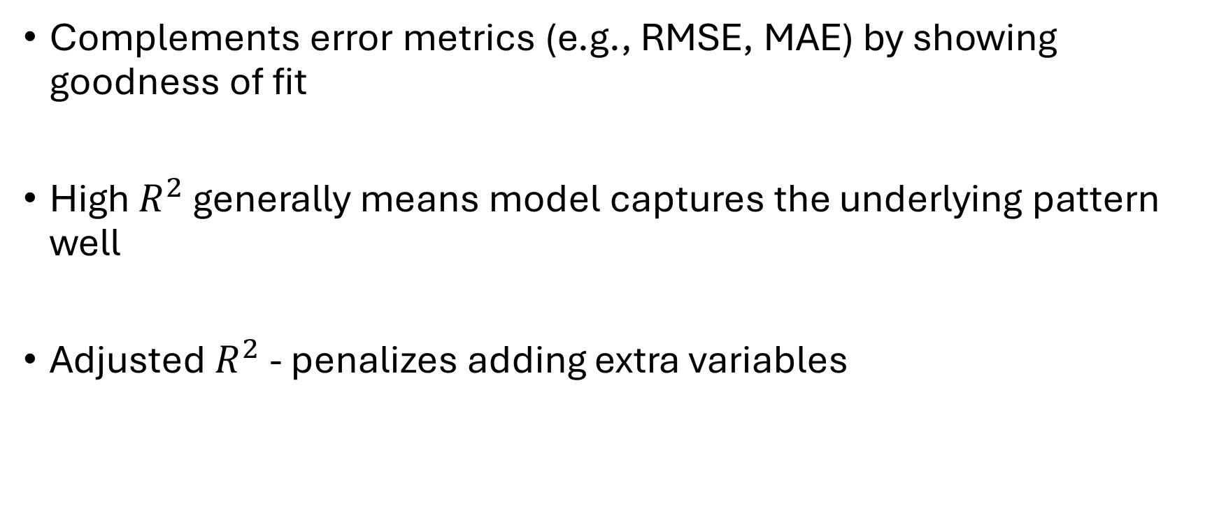
Why use $R^{2}$
Complements error metrics (e.g., RMSE, MAE) by showing goodness of fit
High $R^{2}$ generally means model captures the underlying pattern well
Adjusted $R^{2}$ - penalizes adding extra variables

Slide 16
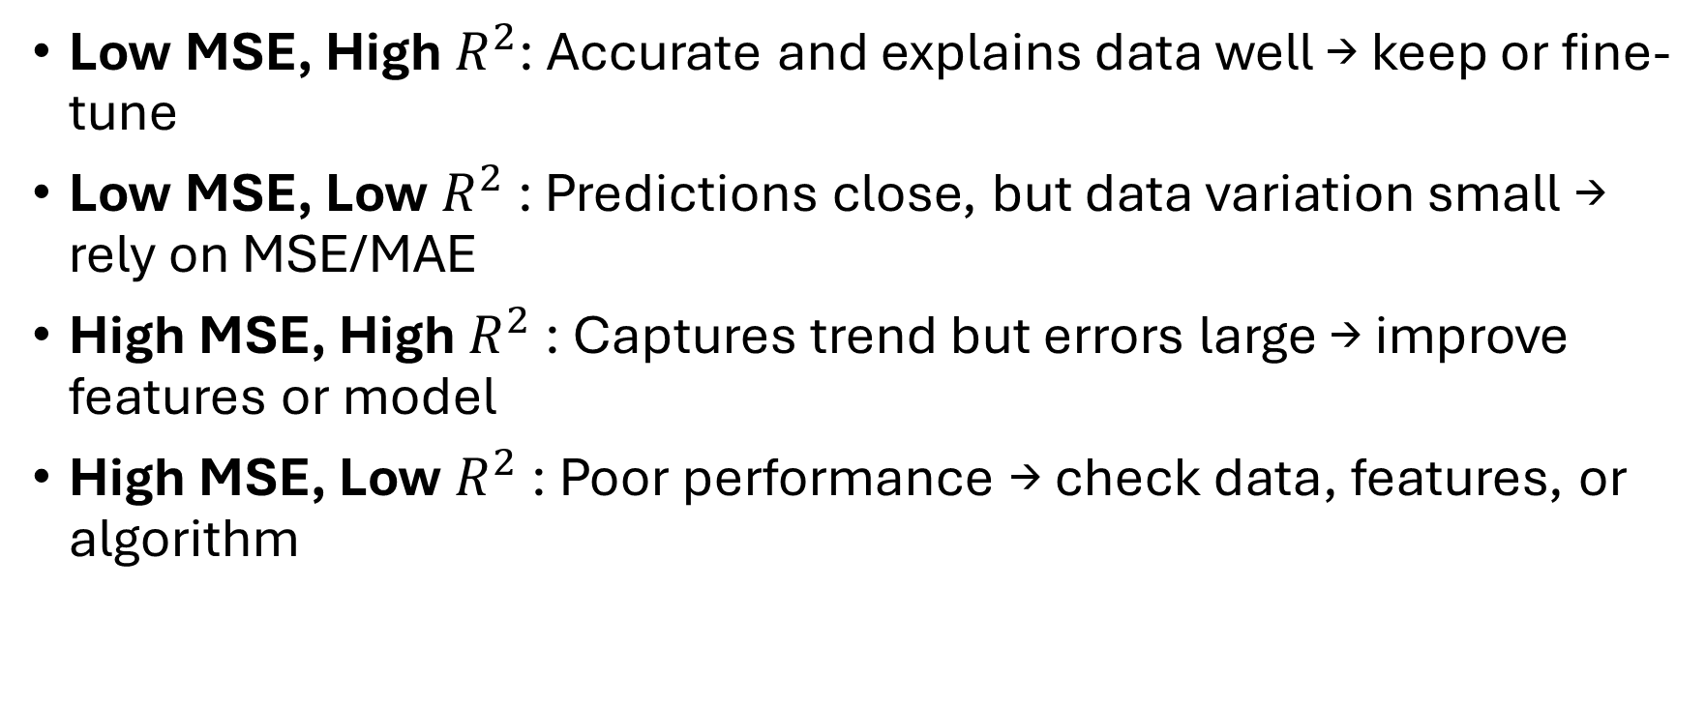
How to know if your model is good
Low MSE, High $R^{2}$: Accurate and explains data well → keep or fine-tune
Low MSE, Low $R^{2}$: Predictions close, but data variation small → rely on MSE/MAE
High MSE, High $R^{2}$: Captures trend but errors large → improve features or model
High MSE, Low $R^{2}$: Poor performance → check data, features, or algorithm

Slide 17

Reference material
Goodfellow (Chapter 1)
D2L (Chapter 1)
Search $R^{2}$explanation on StatQuest YouTube channel

Slide 18
Artificial Neural Networks (ANNs or simply NNs)

Slide 19
What Problem Do ANNs Solve?
Learning Complex Patterns: ANNs capture nonlinear relationships where traditional models struggle
Generalization: From examples → can make predictions on unseen data
High-Dimensional Data of Different Modalities: Handle images, text, audio, signals, and structured data
Automatic Feature Extraction: Learn useful features directly from raw input, reducing manual engineering
Versatility: Used for classification, regression, detection, generation, and control tasks

Slide 20








Neuron: Bias and Weights
$$x_{1}$$
$$w_{1}$$
$$z=∑w_{i}x_{i}+b$$
Activation function
Inputs from previous layer
$$w_{2}$$
$$x_{2}$$
$$w_{3}$$
$$x_{3}$$
$$a=f(z)$$
Bias

Slide 21
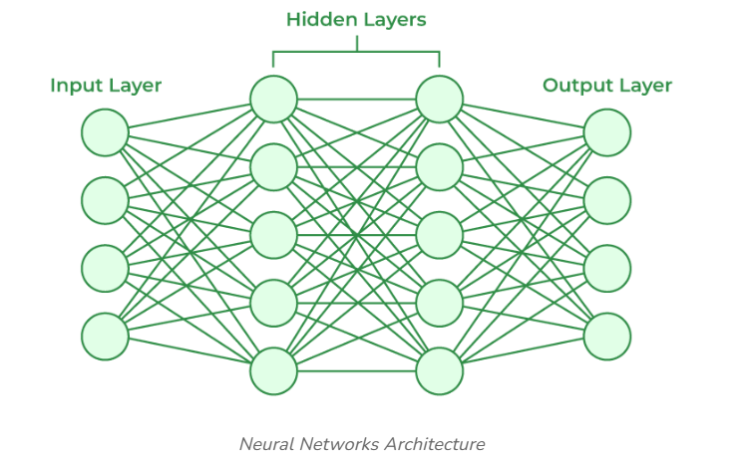
Artificial neural network
A simple feed forward network

Slide 22
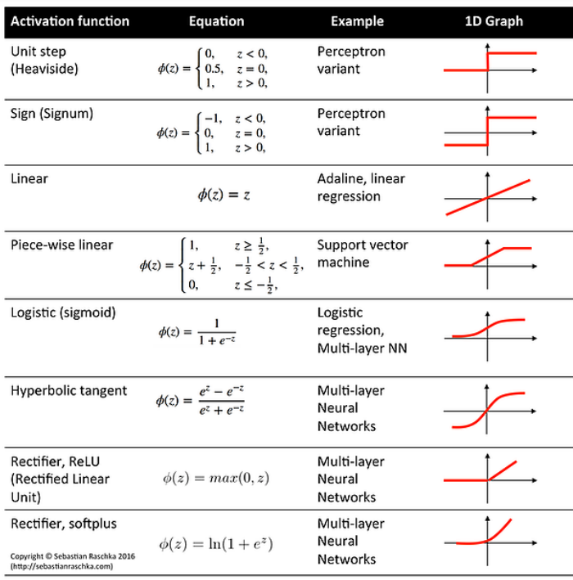
Activation function
Activation function of final layer in Regression NN

Slide 23
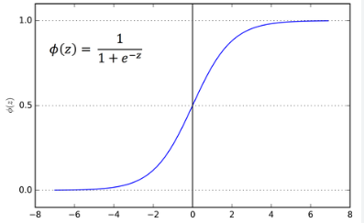
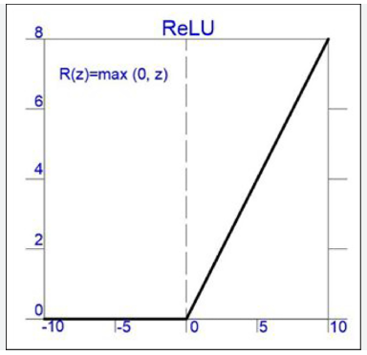


Activation functions
Sigmoid
$φ\left(z\right)=\frac{1}{1+e^{−z}}$
ReLU
$R\left(z\right)=max⁡(0,z)$
$φ$(z)
z
R(z)
z

Slide 24
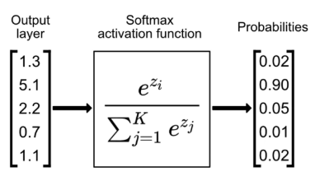
Softmax

Slide 25
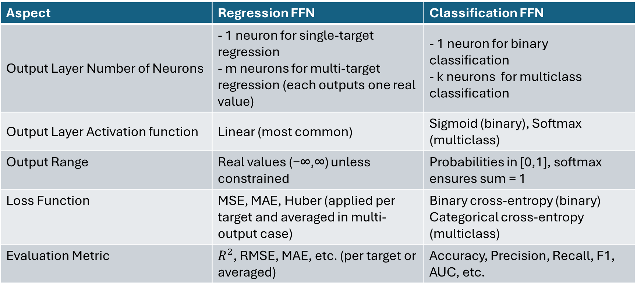
Regression and Classification Feed Forward Networks
Aspect | Regression FFN | Classification FFN
Output Layer Number of Neurons | - 1 neuron for single-target regression - m neurons for multi-target regression (each outputs one real value) | - 1 neuron for binary classification - k neurons for multiclass classification
Output Layer Activation function | Linear (most common) | Sigmoid (binary), Softmax (multiclass)
Output Range | Real values (−∞,∞) unless constrained | Probabilities in [0,1], softmax ensures sum = 1
Loss Function | MSE, MAE, Huber (applied per target and averaged in multi-output case) | Binary cross-entropy (binary) Categorical cross-entropy (multiclass)
Evaluation Metric | $R^{2}$, RMSE, MAE, etc. (per target or averaged) | Accuracy, Precision, Recall, F1, AUC, etc.

Slide 26
Backpropagation algorithm for NN weight update

Slide 27
Gradient descent
2-D example
Find the slope of the loss function
Slope = derivative of the loss function
Positive slope: Take step to decrease the weights to find minima
Negative slope: Take step to increase the weights to find minima

Slide 28
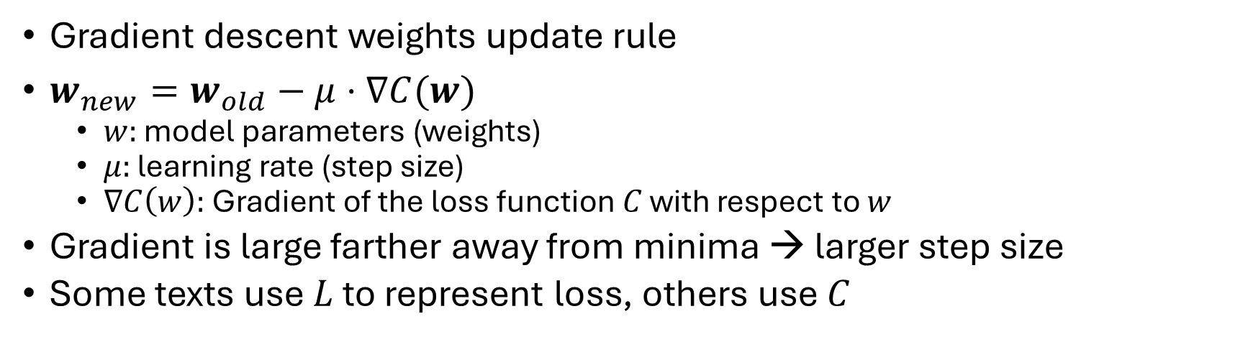
Gradient descent
Gradient descent weights update rule
$w_{new}=w_{old}−μ⋅∇C(w)$
$w:$ model parameters (weights)
$μ:$ learning rate (step size)
$∇C\left(w\right):$ Gradient of the loss function $C$ with respect to $w$
Gradient is large farther away from minima → larger step size
Some texts use $L$ to represent loss, others use $C$

Slide 29

Gradient descent
$∇C\left(w\right)=\left[\begin{matrix}∇C(w_{11}) \\ ∇C(w_{12}) \\ ⋮ \\ ∇C(w_{jk})\end{matrix}\right]$
$w_{jk}$ is the weight connecting $k$th neuron in layer $m$ to the $j$th neuron in layer $n$

Slide 30

Backpropagation
$w=\left[\begin{matrix}w_{11} \\ w_{12} \\ ⋮ \\ w_{jk}\end{matrix}\right]$ → $∇C\left(w\right)=\left[\begin{matrix}∇C(w_{11}) \\ ∇C(w_{12}) \\ ⋮ \\ ∇C(w_{jk})\end{matrix}\right]$

Slide 31
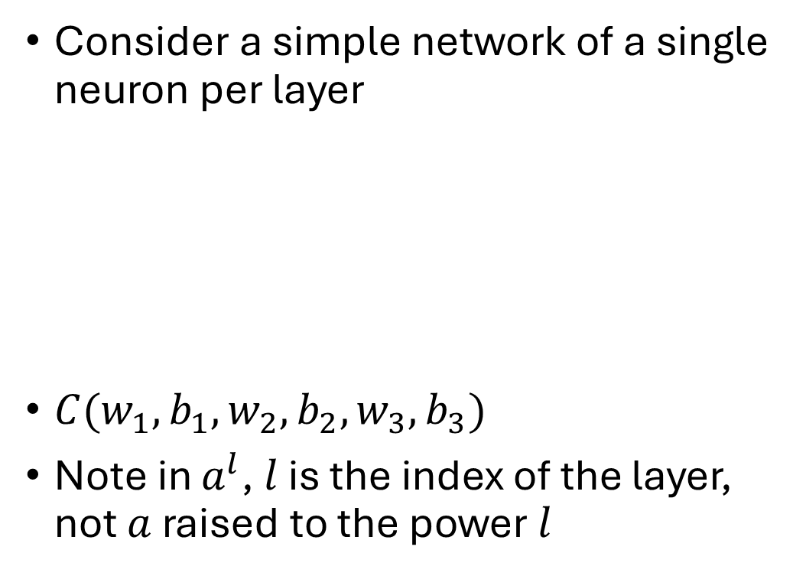
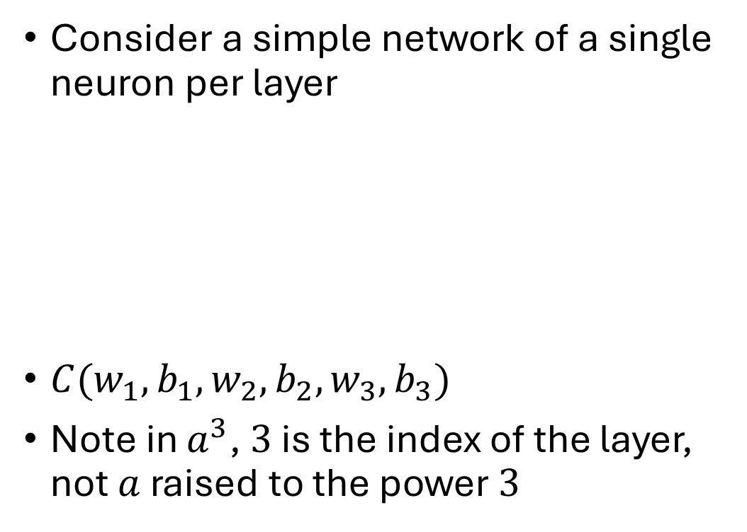



Backpropagation
Consider a simple network of a single neuron per layer
$C(w_{1}, b_{1}, w_{2}, b_{2},w_{3},b_{3})$
Note in $a^{3}$, $3$ is the index of the layer, not $a$ raised to the power $3$
$$a^{l−2}$$
$$a^{l−1}$$
$$a^{l}$$

Slide 32
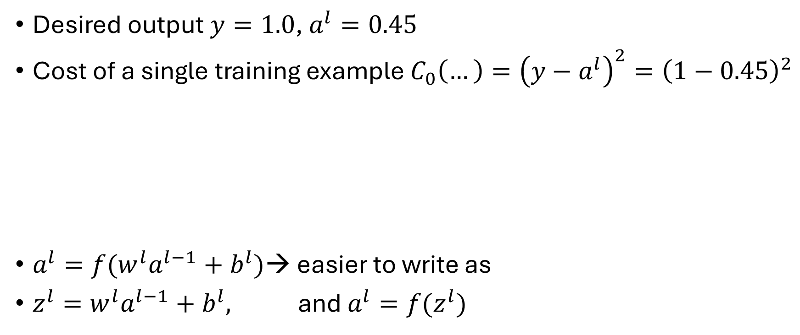
Backpropagation
Desired output $y=1.0$, $a^{l}=0.45$
Cost of a single training example $C_{0}\left(…\right)={\left(y−a^{l}\right)}^{2}={\left(1−0.45\right)}^{2}$
$a^{l}=f(w^{l}a^{l−1}+b^{l})$→ easier to write as
$z^{l}=w^{l}a^{l−1}+b^{l},$ and $a^{l}=f(z^{l})$
$$a^{l−2}$$
$$a^{l−1}$$
$$a^{l}$$

Slide 33



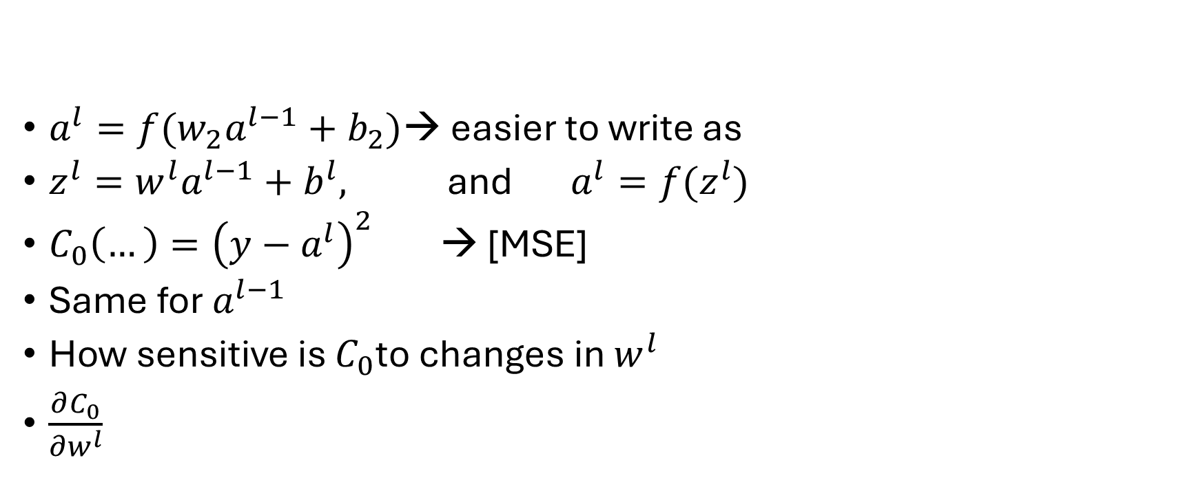





Backpropagation
$a^{l}=f(w_{2}a^{l−1}+b_{2})$→ easier to write as
$z^{l}=w^{l}a^{l−1}+b^{l},$ and $a^{l}=f(z^{l})$
$C_{0}\left(…\right)={\left(y−a^{l}\right)}^{2}$ → [MSE]
Same for $a^{l−1}$
How sensitive is $C_{0}$to changes in $w^{l}$
$\frac{∂C_{0}}{∂w^{l}}$
$$a^{l−2}$$
$$a^{l−1}$$
$$a^{l}$$
$$w^{l} a^{l−1} b^{l}$$
$$z^{l}$$
$$a^{l}$$
$$y$$
$$C_{0}$$

Slide 34
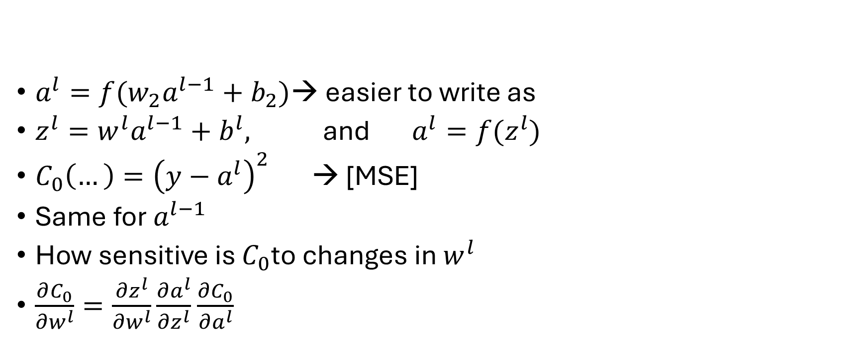
Backpropagation
$a^{l}=f(w_{2}a^{l−1}+b_{2})$→ easier to write as
$z^{l}=w^{l}a^{l−1}+b^{l},$ and $a^{l}=f(z^{l})$
$C_{0}\left(…\right)={\left(y−a^{l}\right)}^{2}$ → [MSE]
Same for $a^{l−1}$
How sensitive is $C_{0}$to changes in $w^{l}$
$\frac{∂C_{0}}{∂w^{l}}=\frac{∂z^{l}}{∂w^{l}}\frac{∂a^{l}}{∂z^{l}}$ $\frac{∂C_{0}}{∂a^{l}}$
$$a^{l−2}$$
$$a^{l−1}$$
$$a^{l}$$
$$w^{l} a^{l−1} b^{l}$$
$$z^{l}$$
$$a^{l}$$
$$y$$
$$C_{0}$$

Slide 35


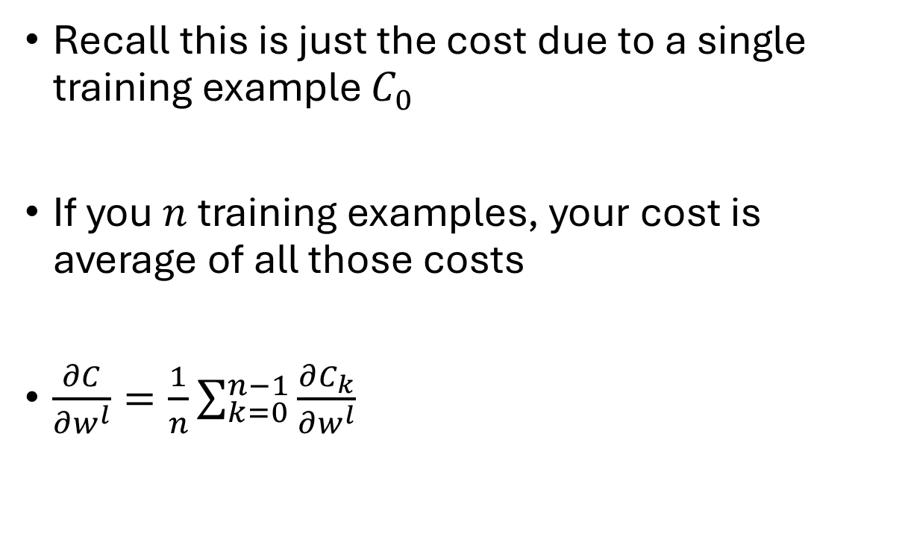
Backpropagation
Recall this is just the cost due to a single training example $C_{0}$
If you $n$ training examples, your cost is average of all those costs
$\frac{∂C}{∂w^{l}}=\frac{1}{n}\sum_{k=0}^{n−1}{\frac{∂C_{k}}{∂w^{l}}}$
$$w^{l} a^{l−1} b^{l}$$
$$z^{l}$$
$$∇C\left(w\right)=\left[\begin{matrix}\frac{∂C}{∂w_{11}^{l}} \\ \frac{∂C}{∂w_{12}^{l}} \\ ⋮ \\ \end{matrix}\right]$$
$$a^{l}$$
$$y$$
$$C_{0}$$

Slide 36
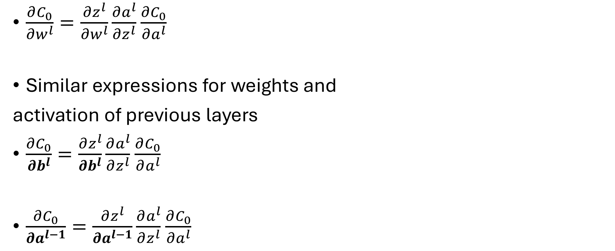
Backpropagation
$\frac{∂C_{0}}{∂w^{l}}=\frac{∂z^{l}}{∂w^{l}}\frac{∂a^{l}}{∂z^{l}}$ $\frac{∂C_{0}}{∂a^{l}}$
Similar expressions for weights and
activation of previous layers
$\frac{∂C_{0}}{∂b^{l}}=\frac{∂z^{l}}{∂b^{l}}\frac{∂a^{l}}{∂z^{l}}$ $\frac{∂C_{0}}{∂a^{l}}$
$\frac{∂C_{0}}{∂a^{l−1}}=\frac{∂z^{l}}{∂a^{l−1}}\frac{∂a^{l}}{∂z^{l}}$ $\frac{∂C_{0}}{∂a^{l}}$
$$w^{l} a^{l−1} b^{l}$$
$$z^{l}$$
$$a^{l}$$
$$y$$
$$C_{0}$$

Slide 37

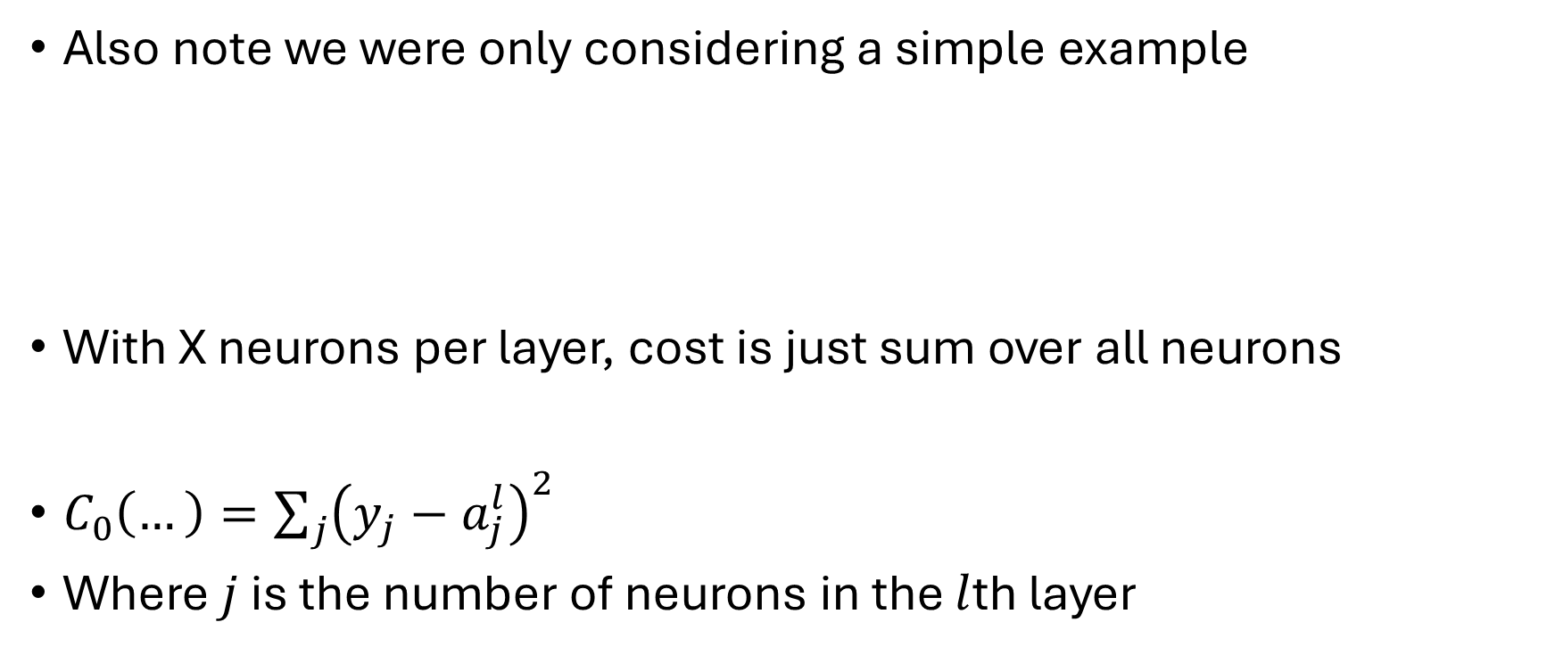


Backpropagation
Also note we were only considering a simple example
With X neurons per layer, cost is just sum over all neurons
$C_{0}\left(…\right)={\sum_{j}{\left(y_{j}−a_{j}^{l}\right)}}^{2}$
Where $j$ is the number of neurons in the $l$th layer
$$a^{l−2}$$
$$a^{l−1}$$
$$a^{l}$$

Slide 38

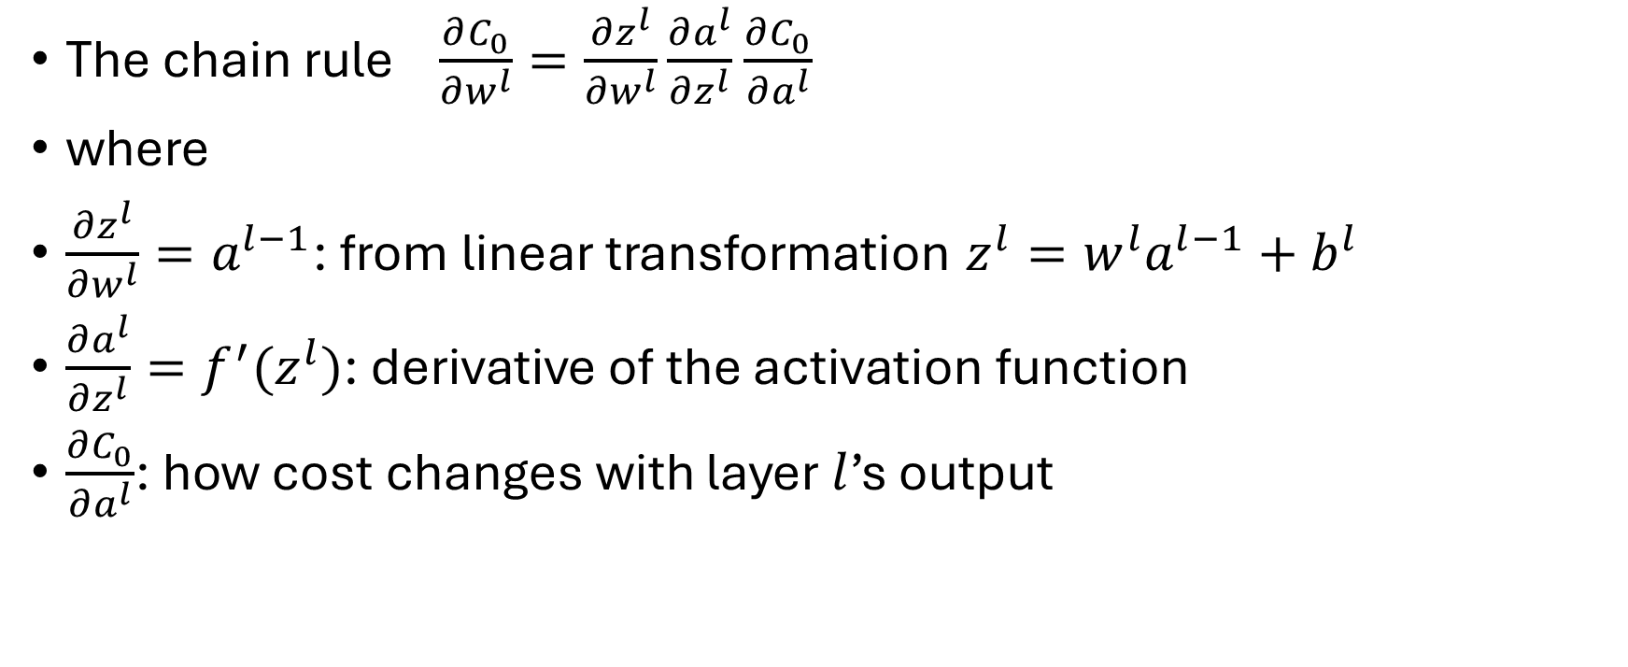

The chain rule
$$w^{l} a^{l−1} b^{l}$$
The chain rule $\frac{∂C_{0}}{∂w^{l}}=\frac{∂z^{l}}{∂w^{l}}\frac{∂a^{l}}{∂z^{l}}$ $\frac{∂C_{0}}{∂a^{l}}$
where
$\frac{∂z^{l}}{∂w^{l}}=a^{l−1}$: from linear transformation $z^{l}=w^{l}a^{l−1}+b^{l}$
$\frac{∂a^{l}}{∂z^{l}}=f^{′}(z^{l})$: derivative of the activation function
$\frac{∂C_{0}}{∂a^{l}}$: how cost changes with layer $l$’s output
$$z^{l}$$
$$y$$
$$a^{l}$$
$$C_{0}$$

Slide 39
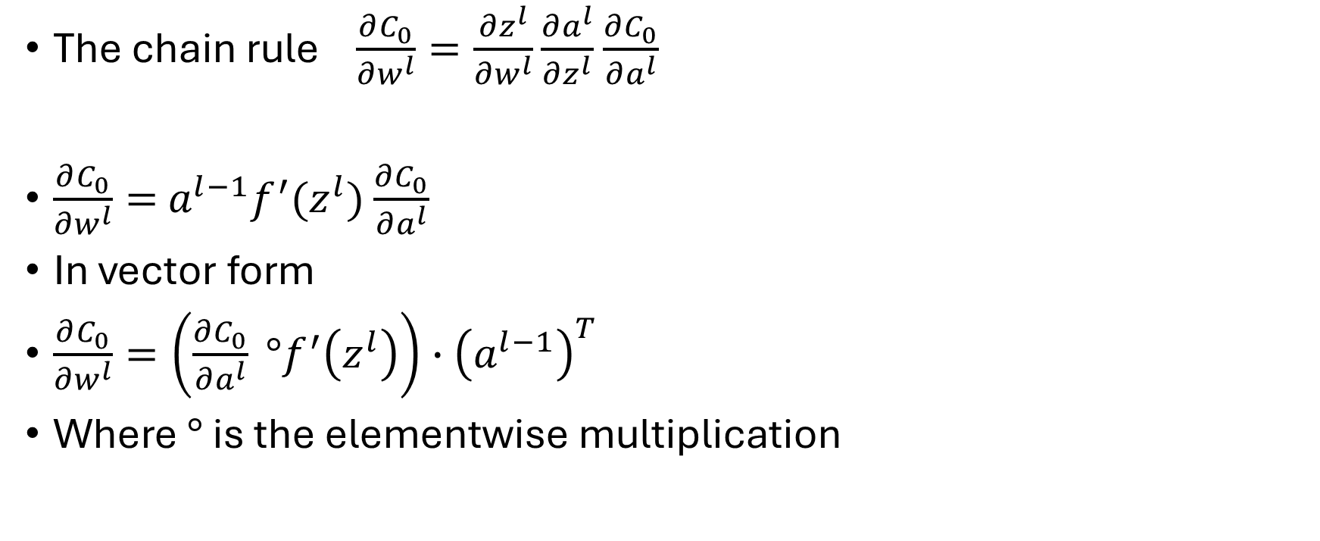
The chain rule
The chain rule $\frac{∂C_{0}}{∂w^{l}}=\frac{∂z^{l}}{∂w^{l}}\frac{∂a^{l}}{∂z^{l}}$ $\frac{∂C_{0}}{∂a^{l}}$
$\frac{∂C_{0}}{∂w^{l}}=$ $a^{l−1}f^{′}(z^{l})$ $\frac{∂C_{0}}{∂a^{l}}$
In vector form
$\frac{∂C_{0}}{∂w^{l}}=\left(\frac{∂C_{0}}{∂a^{l}} °f^{′}\left(z^{l}\right)\right)∙{\left(a^{l−1}\right)}^{T}$
Where $°$ is the elementwise multiplication

Slide 40


Backpropagation
$\frac{∂C_{0}}{∂w^{l}}=\frac{∂z^{l}}{∂w^{l}}\frac{∂a^{l}}{∂z^{l}}$ $\frac{∂C_{0}}{∂a^{l}}$
Similar expressions for $b^{l}$ and $a^{l−1}$
$\frac{∂C_{0}}{∂b^{l}}=\frac{∂z^{l}}{∂b^{l}}\frac{∂a^{l}}{∂z^{l}}$ $\frac{∂C_{0}}{∂a^{l}}$
$\frac{∂C_{0}}{∂a^{l−1}}=\frac{∂z^{l}}{∂a^{l−1}}\frac{∂a^{l}}{∂z^{l}}$ $\frac{∂C_{0}}{∂a^{l}}$
$$w^{l} a^{l−1} b^{l}$$
$$z^{l}$$
$$a^{l}$$
$$y$$
$$C_{0}$$

Slide 41


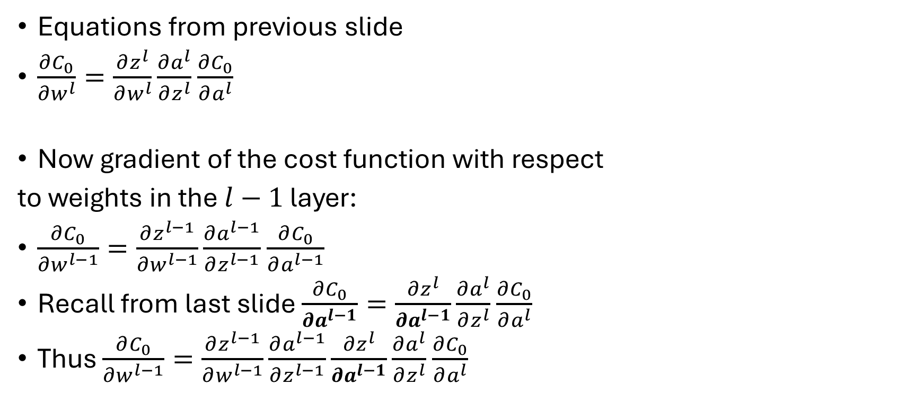
Backpropagation
$$w^{l−1} a^{l−2} b^{l−1}$$
$$z^{l−1}$$
Equations from previous slide
$\frac{∂C_{0}}{∂w^{l}}=\frac{∂z^{l}}{∂w^{l}}\frac{∂a^{l}}{∂z^{l}}$ $\frac{∂C_{0}}{∂a^{l}}$
Now gradient of the cost function with respect
to weights in the $l−1$ layer:
$\frac{∂C_{0}}{∂w^{l−1}}=\frac{∂z^{l−1}}{∂w^{l−1}}\frac{∂a^{l−1}}{∂z^{l−1}}$ $\frac{∂C_{0}}{∂a^{l−1}}$
Recall from last slide $\frac{∂C_{0}}{∂a^{l−1}}=\frac{∂z^{l}}{∂a^{l−1}}\frac{∂a^{l}}{∂z^{l}}$ $\frac{∂C_{0}}{∂a^{l}}$
Thus $\frac{∂C_{0}}{∂w^{l−1}}=\frac{∂z^{l−1}}{∂w^{l−1}}\frac{∂a^{l−1}}{∂z^{l−1}}\frac{∂z^{l}}{∂a^{l−1}}\frac{∂a^{l}}{∂z^{l}}$ $\frac{∂C_{0}}{∂a^{l}}$
$$w^{l} a^{l−1} b^{l}$$
$$z^{l}$$
$$a^{l}$$
$$y$$
$$C_{0}$$

Slide 42
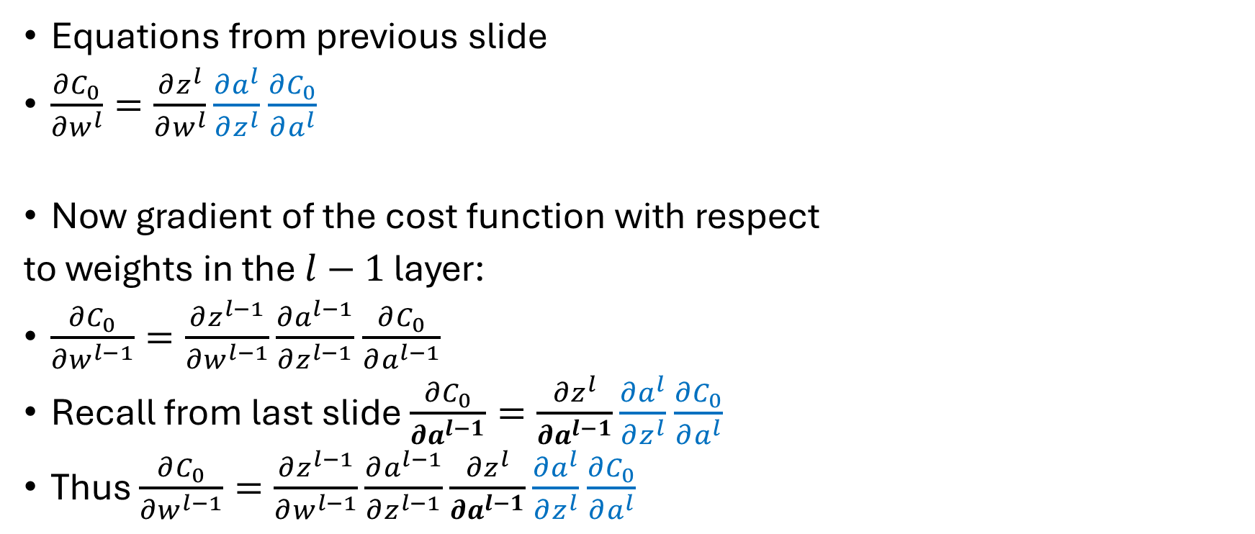

Backpropagation
$$w^{l−1} a^{l−2} b^{l−1}$$
$$z^{l−1}$$
Equations from previous slide
$\frac{∂C_{0}}{∂w^{l}}=\frac{∂z^{l}}{∂w^{l}}\frac{∂a^{l}}{∂z^{l}}$ $\frac{∂C_{0}}{∂a^{l}}$
Now gradient of the cost function with respect
to weights in the $l−1$ layer:
$\frac{∂C_{0}}{∂w^{l−1}}=\frac{∂z^{l−1}}{∂w^{l−1}}\frac{∂a^{l−1}}{∂z^{l−1}}$ $\frac{∂C_{0}}{∂a^{l−1}}$
Recall from last slide $\frac{∂C_{0}}{∂a^{l−1}}=\frac{∂z^{l}}{∂a^{l−1}}\frac{∂a^{l}}{∂z^{l}}$ $\frac{∂C_{0}}{∂a^{l}}$
Thus $\frac{∂C_{0}}{∂w^{l−1}}=\frac{∂z^{l−1}}{∂w^{l−1}}\frac{∂a^{l−1}}{∂z^{l−1}}\frac{∂z^{l}}{∂a^{l−1}}\frac{∂a^{l}}{∂z^{l}}$ $\frac{∂C_{0}}{∂a^{l}}$
$$w^{l} a^{l−1} b^{l}$$
$$z^{l}$$
$$a^{l}$$
$$y$$
$$C_{0}$$
$$δ^{l}$$

Slide 43
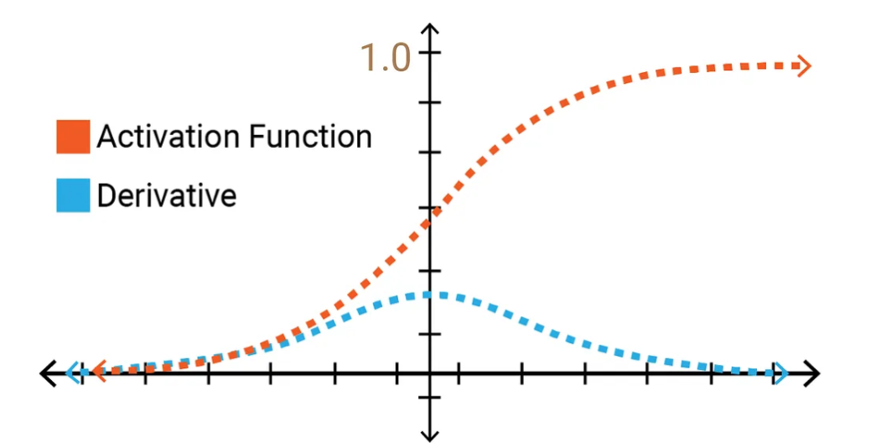



Vanishing gradient
Sigmoid activation function and its derivative
$φ\left(z\right)=\frac{1}{1+e^{−z}}$
$$φ(z)$$
$$z$$

Slide 44
Backpropagation
Useful links
Basic idea of back propagation
The math behind back propagation

