Slide 1

Deep learning
Week 3, Lecture 3
Muhammad Saqib Sohail
Fall 2025

Slide 2
Can Neural Networks Approximate Any Function?

Slide 3
Function approximation
Think of different patterns we might want to model:
A straight line
A curve
A wiggly shape
Question: Are neural networks flexible enough to represent all these?

Slide 4
The Universal Approximation Theorem
A neural network with:
One hidden layer
Enough neurons
Non-linear activations (like sigmoid, ReLU)
… can approximate any continuous function on a bounded input range
Proved by Cybenko (1989)

Slide 5
Why It Matters (and Limits)
Why powerful? → NNs are universal function approximators
Why not trivial?
The theorem doesn’t tell us how many neurons
It doesn’t tell us how to train effectively
Depth and optimization are crucial in practice
Takeaway: NNs can, in theory, approximate almost anything but good design and training are key

Slide 6
Visualizing how a NN performs classification?

Slide 7
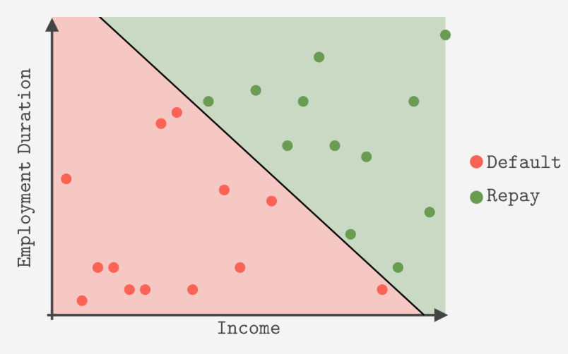

Decision boundary
Decision boundary in 1D
Decision boundary in 2D
Decision boundary in $N$D

Slide 8

1-D Data Binary Classification
1D Data – 2 Classes
Sigmoid (Logisitic)$σ\left(z\right)=\frac{1}{1+e^{−z}}$

Slide 9
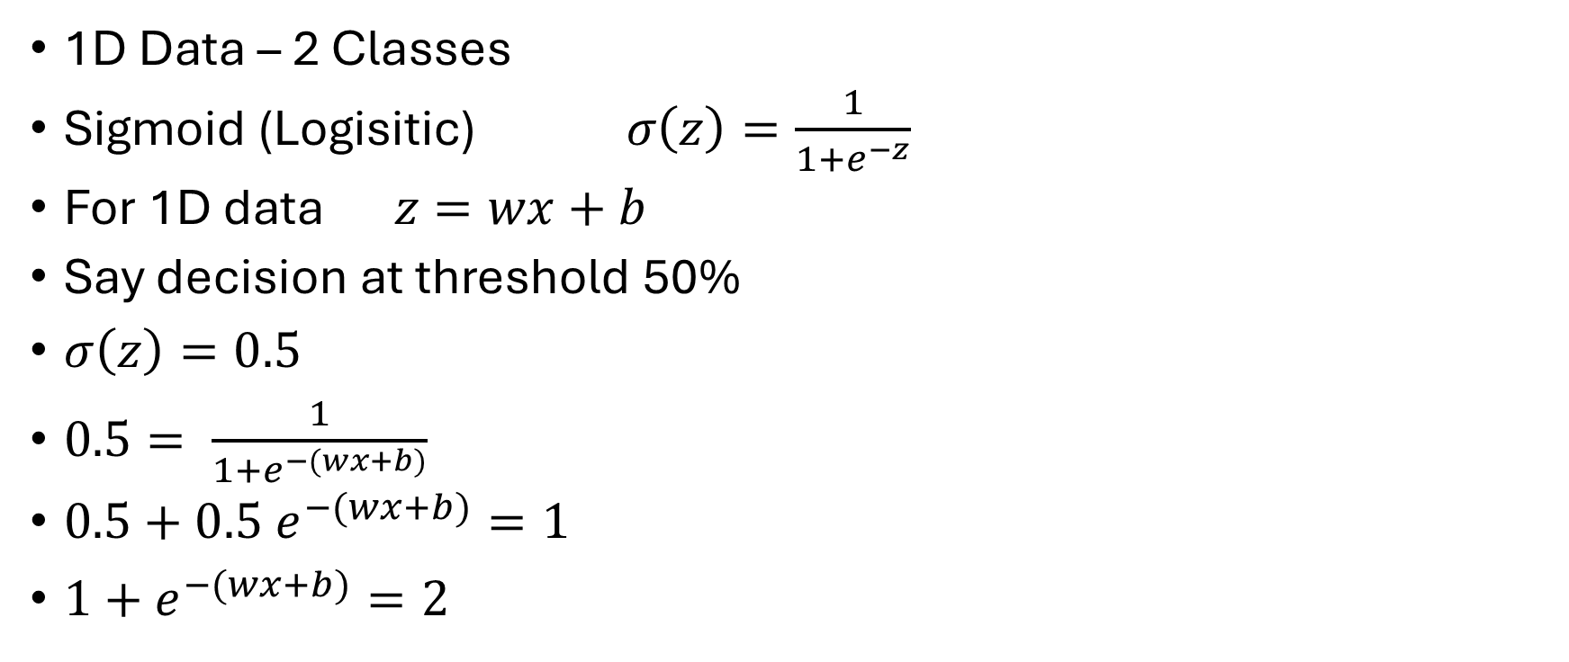

1-D Data Binary Classification
1D Data – 2 Classes
Sigmoid (Logisitic)$σ\left(z\right)=\frac{1}{1+e^{−z}}$
For 1D data $z=wx+b$
Say decision at threshold 50%
$σ\left(z\right)=0.5$
$0.5= \frac{1}{1+e^{−(wx+b)}}$
$0.5+0.5$ $e^{−(wx+b)}=1$
$1+e^{−(wx+b)}=2$
$e^{−(wx+b)}=1$
$−\left(wx+b\right)=0$ (log on both sides)
$x=−\frac{w}{b}$
This is the point decision boundary

Slide 10
1-D Data Binary Classification
Visual Example (on white board)

Slide 11

2-D Data Binary Classification
2-D Data – 2 Classes
Sigmoid (Logisitic)$σ\left(z\right)=\frac{1}{1+e^{−z}}$

Slide 12

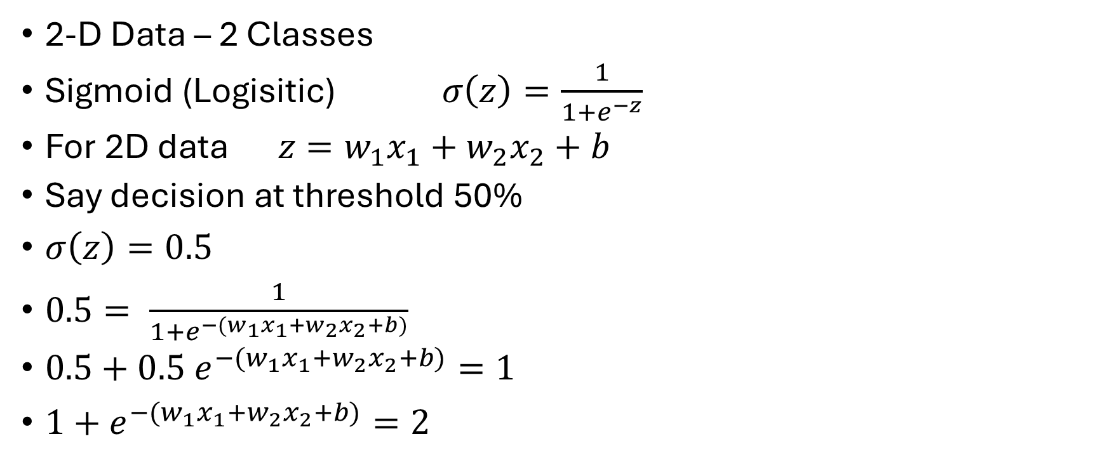
2-D Data Binary Classification
2-D Data – 2 Classes
Sigmoid (Logisitic)$σ\left(z\right)=\frac{1}{1+e^{−z}}$
For 2D data $z=w_{1}x_{1}+w_{2}x_{2}+b$
Say decision at threshold 50%
$σ\left(z\right)=0.5$
$0.5= \frac{1}{1+e^{−(w_{1}x_{1}+w_{2}x_{2}+b)}}$
$0.5+0.5$ $e^{−(w_{1}x_{1}+w_{2}x_{2}+b)}=1$
$1+e^{−(w_{1}x_{1}+w_{2}x_{2}+b)}=2$
$e^{−(w_{1}x_{1}+w_{2}x_{2}+b)}=1$
$−\left(w_{1}x_{1}+w_{2}x_{2}+b\right)=0$
$\left(w_{1}x_{1}+w_{2}x_{2}+b\right)=0$
This is the line decision boundary

Slide 13
2-D Data Binary Classification
Visual example (on white board)

Slide 14
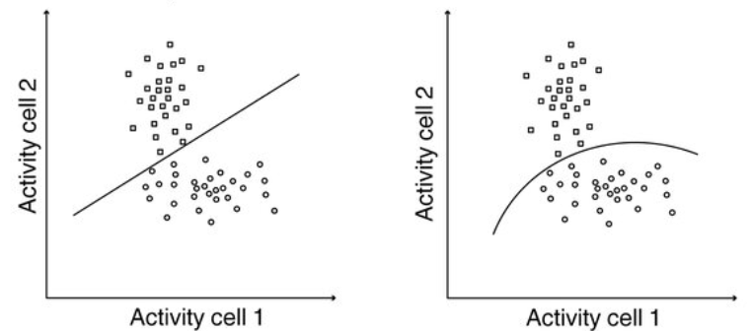
Decision boundaries
Examples

Slide 15
Decision boundaries
Sigmoid: decision boundary is smooth
ReLU: decision boundary is sharp

Slide 16
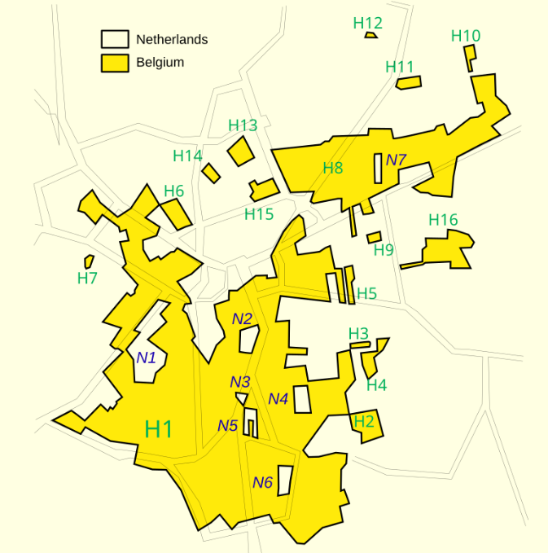
Complex decision boundaries
Examples
Make sharp decision boundaries
Town border of Baarle Hertog, Enclave of Belgium In Netherlands

Slide 17
Complex decision boundaries
UAT says we can fit these complex decision boundaries by a 2-Layer NN as precisely as we want (1 hidden layer, 1 output layer)

Slide 18
How Many Decision Regions Can a Neural Network Create?
Neural networks with ReLU (or similar) activations split the input space into linear regions
More neurons and more layers → more regions → more expressive power
Montúfar, G., Pascanu, R., Cho, K., & Bengio, Y. (2014). On the number of linear regions of deep neural networks. Advances in Neural Information Processing Systems, 27
Serra, T., Tjandraatmadja, C., & Ramalingam, S. (2018). Bounding and Counting Linear Regions of Deep Neural Networks. In Proceedings of the 35th International Conference on Machine Learning (PMLR Vol. 80, pp. 4558–4566).

Slide 19
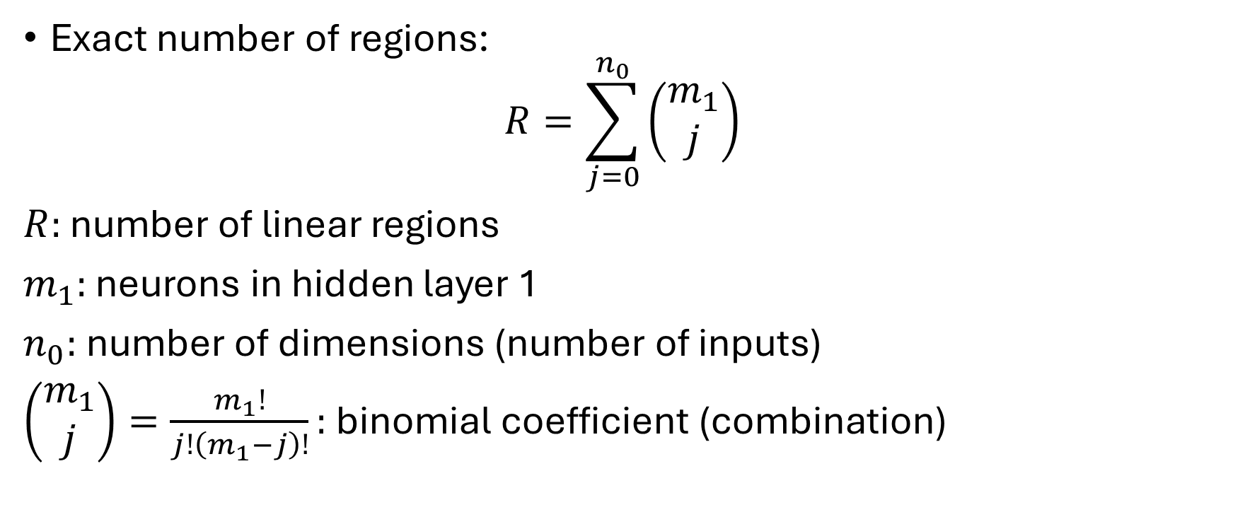
Single Hidden Layer
Exact number of regions:
$$R=\sum_{j=0}^{n_{0}}{\left(\begin{matrix}m_{1} \\ j\end{matrix}\right)}$$
$R:$ number of linear regions
$m_{1}:$ neurons in hidden layer 1
$n_{0}:$number of dimensions (number of inputs)
$\left(\begin{matrix}m_{1} \\ j\end{matrix}\right)=\frac{m_{1}!}{j!\left(m_{1}−j\right)!}:$ binomial coefficient (combination)

Slide 20
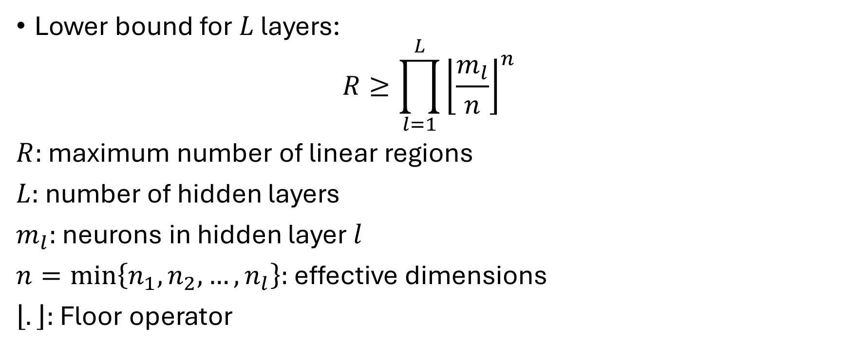
Multiple Hidden Layers
Lower bound for $L$ layers:
$$R≥\prod_{l=1}^{L}{{\left\lfloor \frac{m_{l}}{n}\right\rfloor }^{n}}$$
$R:$ maximum number of linear regions
$L:$ number of hidden layers
$m_{l}:$ neurons in hidden layer $l$
$n=min\left\{n_{1}, n_{2}, …, n_{l}\right\}:$ effective dimensions
$\left\lfloor .\right\rfloor :$ Floor operator

Slide 21
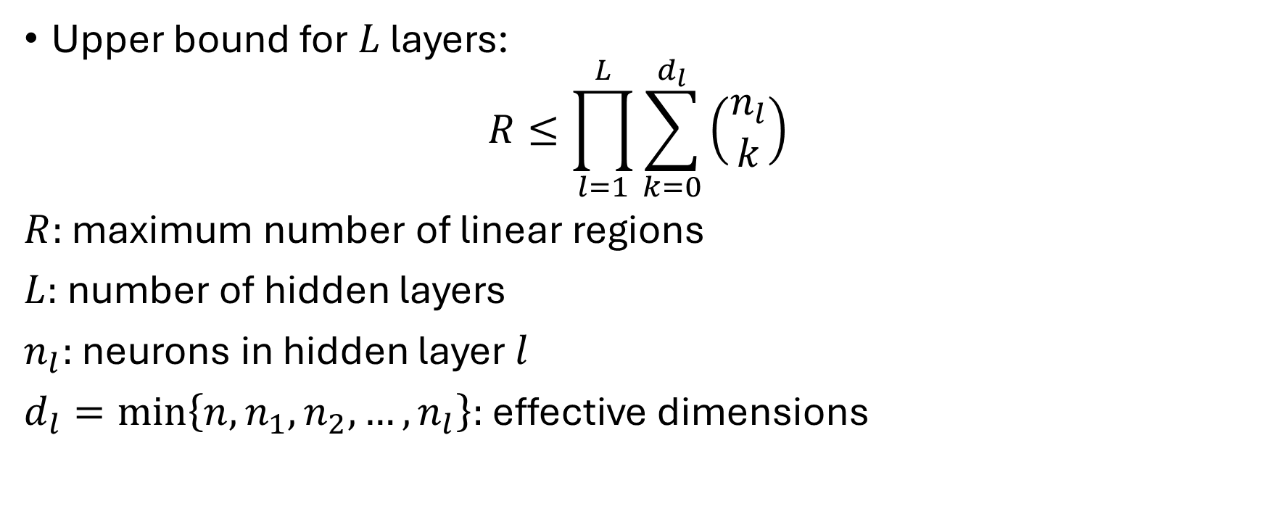
Multiple Hidden Layers
Upper bound for $L$ layers:
$$R≤\prod_{l=1}^{L}{\sum_{k=0}^{d_{l}}{\left(\begin{matrix}n_{l} \\ k\end{matrix}\right)}}$$
$R:$ maximum number of linear regions
$L:$ number of hidden layers
$n_{l}:$ neurons in hidden layer $l$
$d_{l}=min\left\{n, n_{1}, n_{2}, …, n_{l}\right\}:$ effective dimensions

Slide 22
Key Takeaways
Adding more neurons (width) increases regions only polynomially
Adding more layers (depth) increases regions exponentially
Deep networks are powerful because of this exponential increase in decision regions

Slide 23
Resources
Goodfellow (Chapter 6)
D2L (Topics: 3.1, 4.1, 4.2, 4.3, 4.6, Chapter 5)
Interesting Link:
Neural Network Zoo

