Slide 1

Deep learning
Week 5, Lecture 5
Muhammad Saqib Sohail
Fall 2025

Slide 2

Attendance
Make sure your attendance in $≥75\%$

Slide 3
Quiz and Assignment
Quiz 2
Tuesday, October 7, 2025
Assignment 2
Monday, October 6, 2025

Slide 4
Recap of Convolution Neural Networks (CNNs)

Slide 5
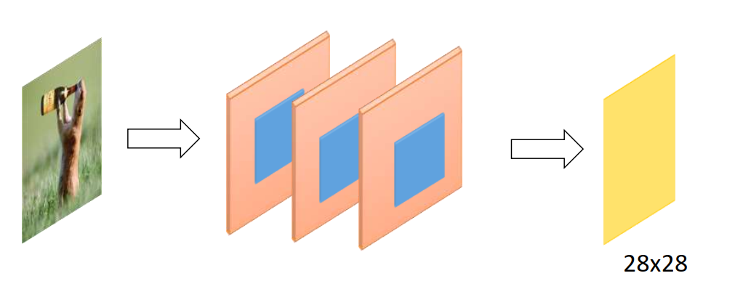
Multi-channel convolution
Multichannel convolution happens when your input has more than one channel (like an RGB image)

Slide 6

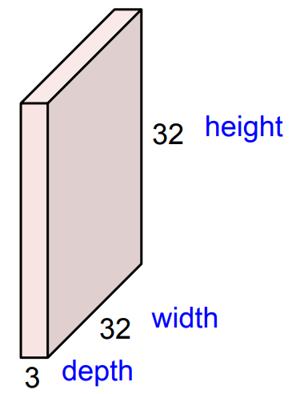
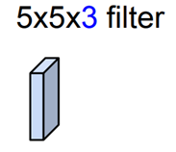
Multi-channel convolution
Suppose your input image has
height = 32, width = 32
channels = 3 (R, G, B)
Shape = 32 × 32 × 3
If you choose a 5×5 filter and input has 3 channels, then the filter has shape: 5 × 5 × 3
That is, 3 weight matrices (one for each channel), each 5×5
These are learnable parameters
Filters always extend the full depth of the input volume

Slide 7
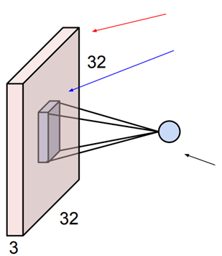


Multi-channel convolution
The filter slides across the width and height of the image
At each spatial position:
It takes the dot product of its 5×5×3 weights with the 5×5×3 patch of the image
All 3 channels are summed together to produce 1 number at that location
32x32x3 image
5x5x3 filter $w$
Scalar value: the result of taking a dot product between the filter and a small 5x5x3 chunk of the image (i.e. 5*5*3 = 75-dimensional dot product + bias)
$$w^{T}x+b$$

Slide 8
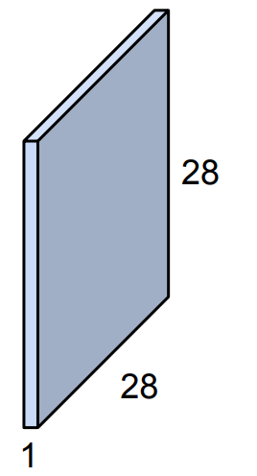
Multi-channel convolution
This produces 1 output feature map
32x32x3 image
5x5x3 filter $w$
Scalar value: the result of taking a dot product between the filter and a small 5x5x3 chunk of the image (i.e. 5*5*3 = 75-dimensional dot product + bias)
$$w^{T}x+b$$

Slide 9
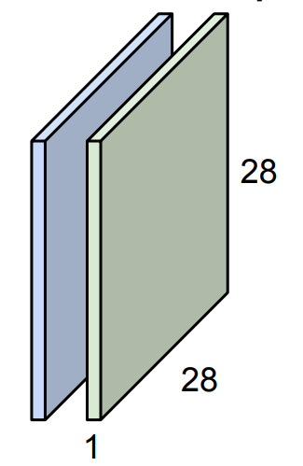
Multi-channel convolution
For a second (green) filter
32x32x3 image
5x5x3 filter $w$
Scalar value: the result of taking a dot product between the filter and a small 5x5x3 chunk of the image (i.e. 5*5*3 = 75-dimensional dot product + bias)
$$w^{T}x+b$$

Slide 10
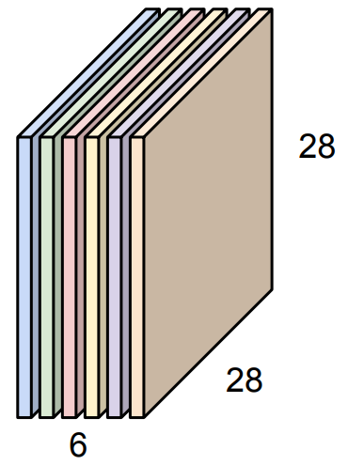
Multi-channel convolution
For N=6 such filters, we get 6 output channels
32x32x3 image
5x5x3 filter $w$
We stack these up to get a “new image” of size 28x28x6

Slide 11
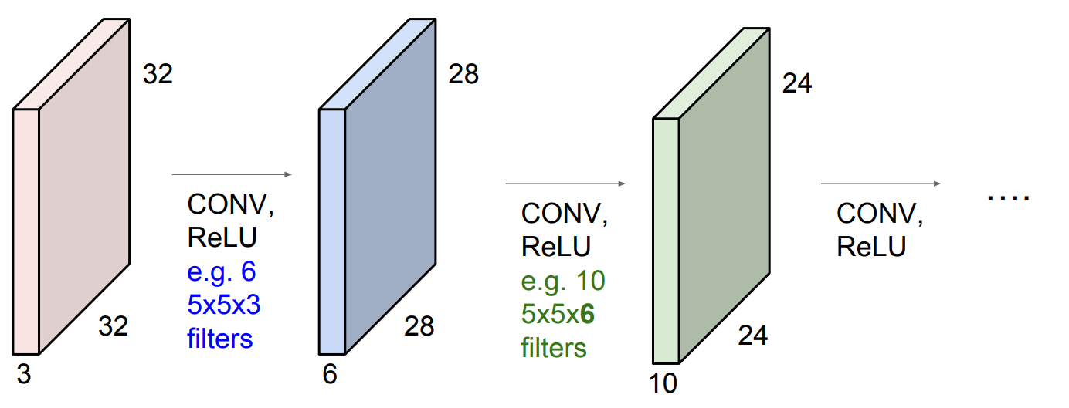
Using Multiple Conv blocks
We can stack multiples of these layers

Slide 12
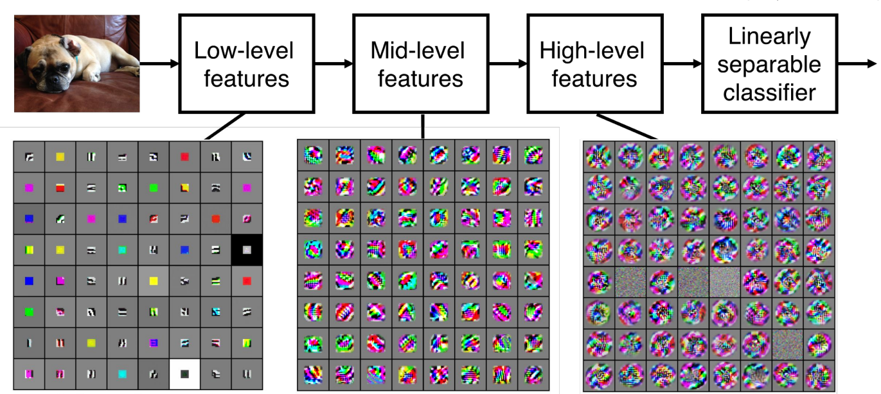
Activation map visualization
Visualization of the VGG16 model activation maps

Slide 13
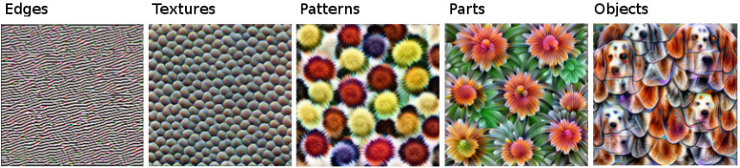
Feature Maps & Hierarchy
How CNNs Learn Visual Representations
CNNs learn hierarchical features directly from raw pixels
Early layers: Detect simple patterns like edges, lines, and corners
Middle layers: Combine simple patterns into textures, motifs, and basic shapes
Deeper layers: Recognize object parts, semantic regions, and high-level concepts (e.g. faces, wheels, eyes)

Slide 14
Feature Maps & Hierarchy
How CNNs Learn Visual Representations
This progressive abstraction enables CNNs to interpret complex images
No manual feature engineering is required
Features are learned automatically during training
Features learned by Inception V1 CNN
Trained on ImageNet data
-14 million images
-20,000 categories

Slide 15
Convolution Neural Networks (CNNs) continued…

Slide 16
Activation Functions
Common Activation Functions:
ReLU (Rectified Linear Unit)
Very fast
Mitigates vanishing gradient problem
Variants (to handle “dead neurons”):
Leaky ReLU – small slope for negative values
ELU, Swish, GELU – smoother gradients, better for deep nets
Practical Tip
Start with ReLU (default choice)
Switch to a variant if neurons stop activating (outputs stuck at 0)

Slide 17
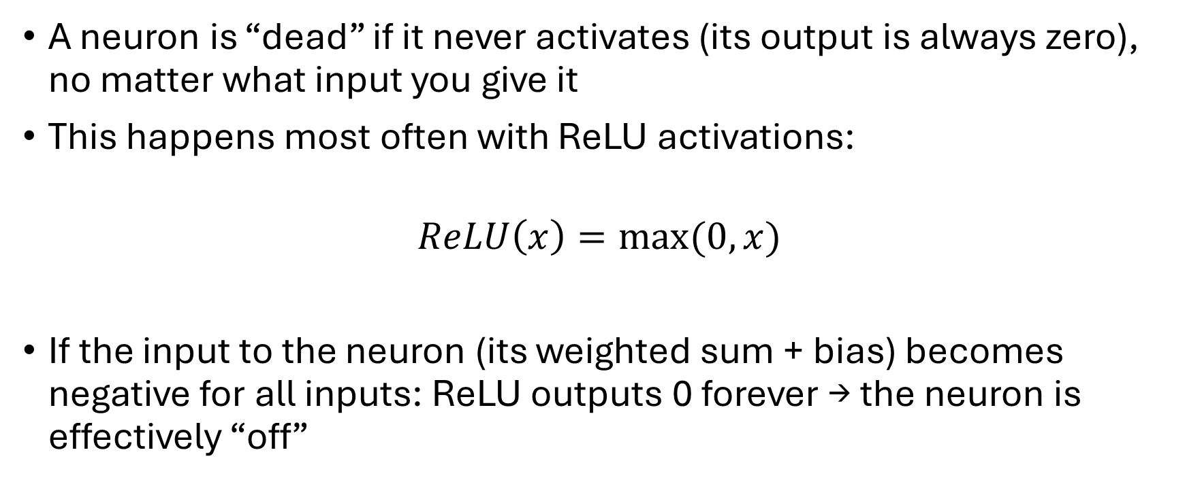
What is a dead neuron?
A neuron is “dead” if it never activates (its output is always zero), no matter what input you give it
This happens most often with ReLU activations:
$$ReLU\left(x\right)=max⁡(0,x)$$
If the input to the neuron (its weighted sum + bias) becomes negative for all inputs: ReLU outputs 0 forever → the neuron is effectively “off”

Slide 18
Why is this a problem?
A dead neuron contributes nothing to the network
It is like a permanently disconnection
During training, its gradient is always zero, so its weights stop updating
If many neurons die, the network’s capacity drops and it may underfit

Slide 19
Why does a network get dead neurons?
Bad weight initialization: large negative biases push the neuron’s input below 0
Too high learning rate: big weight updates can push the neuron’s parameters into a state where it’s always negative
ReLU’s nature: once stuck in the negative zone, the gradient is zero → it can not recover

Slide 20
Solution to dead neurons
How to Detect Dead Neurons
During training, look at activations of a layer:
If many outputs are exactly zero, you have dead neurons
Visualization: plot a histogram of activations for a layer, if it’s a spike at zero, many neurons are dead
How to Prevent Dead Neurons
Use Leaky ReLU or Parametric ReLU instead of plain ReLU
they allow small negative outputs (so gradients don’t vanish completely)
Use good weight initialization (He initialization is common with ReLU)
Lower the learning rate so weights don’t jump into “dead zones

Slide 21
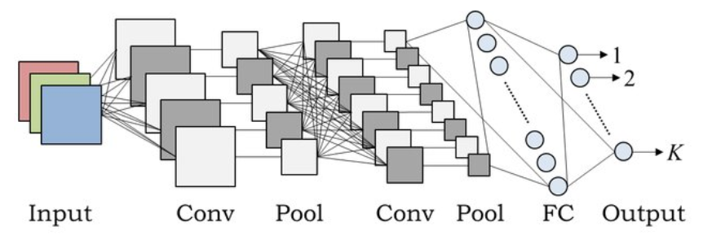
Fully Connected Layers
From Feature Maps to Predictions
After convolutions and pooling, activation maps are flattened into a vector
Passed through fully connected (dense) layers to combine learned features
Final layer often uses Softmax (for multi-class classification) or Sigmoid (for binary classification)
Modern Architectures
Rely less on large FC layers to reduce parameters and overfitting
Often use Global Average Pooling (GAP) instead, which averages each activation map → fewer weights, more generalizable

Slide 22
Recall: CNN with fully connected layer

Slide 23
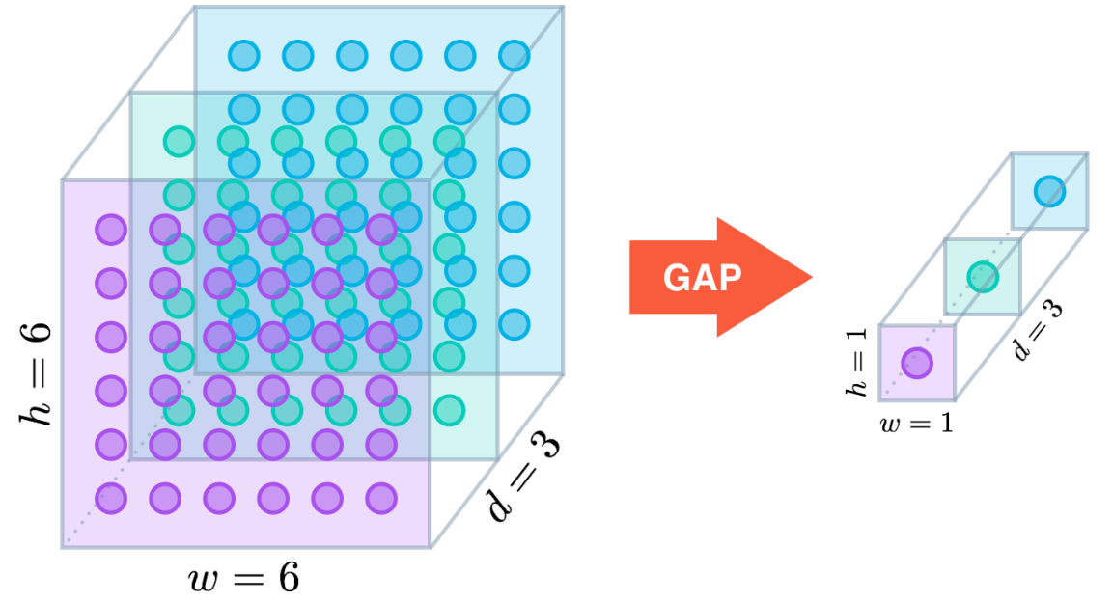
Global Average Pooling (GAP)
Instead of flattening + big fully connected layers
Apply average pooling over each activation map
Output is 1 number per activation map (channel)
Example: if you have 3 activation (feature) maps of size 6×6 → GAP → 3 values → FC (softmax over classes)

Slide 24
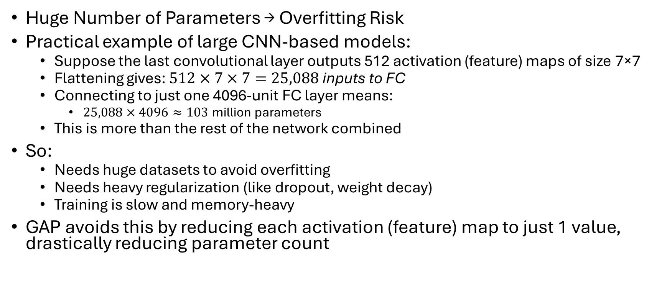
Problems with Large Fully Connected Layers
Huge Number of Parameters → Overfitting Risk
Practical example of large CNN-based models:
Suppose the last convolutional layer outputs 512 activation (feature) maps of size 7×7
Flattening gives: $512×7×7=25,088 \text{inputs} \text{to} \text{FC}$
Connecting to just one 4096-unit FC layer means:
$25,088×4096≈103$million parameters
This is more than the rest of the network combined
So:
Needs huge datasets to avoid overfitting
Needs heavy regularization (like dropout, weight decay)
Training is slow and memory-heavy
GAP avoids this by reducing each activation (feature) map to just 1 value, drastically reducing parameter count

Slide 25
Loss of Spatial Information
Flattening destroys spatial structure completely
The FC layer must re-learn relationships between pixels/features, which wastes learning capacity
GAP instead summarizes each feature map as “how strongly this feature is present anywhere”, which is more robust and interpretable

Slide 26
Why Modern CNNs Prefer GAP
Property | Large FC Layers | GAP Layer
Parameters | Very high (millions) | Much less compared to FC layer
Overfitting risk | High | Low
Preserves spatial info | No (flatten loses it) | Yes (keeps feature meaning)
Input size flexibility | Fixed | Flexible
Computational cost | High | Very low

Slide 27
Putting it all together
Typical CNN Pipeline
Example architecture for image classification: Conv → ReLU → Pool → Conv → ReLU → Pool → FC/GAP → Softmax
Key Points
Each stage builds higher-level abstractions from previous layer
Dimensionality reduces, while semantic meaning increases
Entire network is trained end-to-end:
Filters and weights are learned automatically
Objective is to minimize classification loss via backpropagation

Slide 28
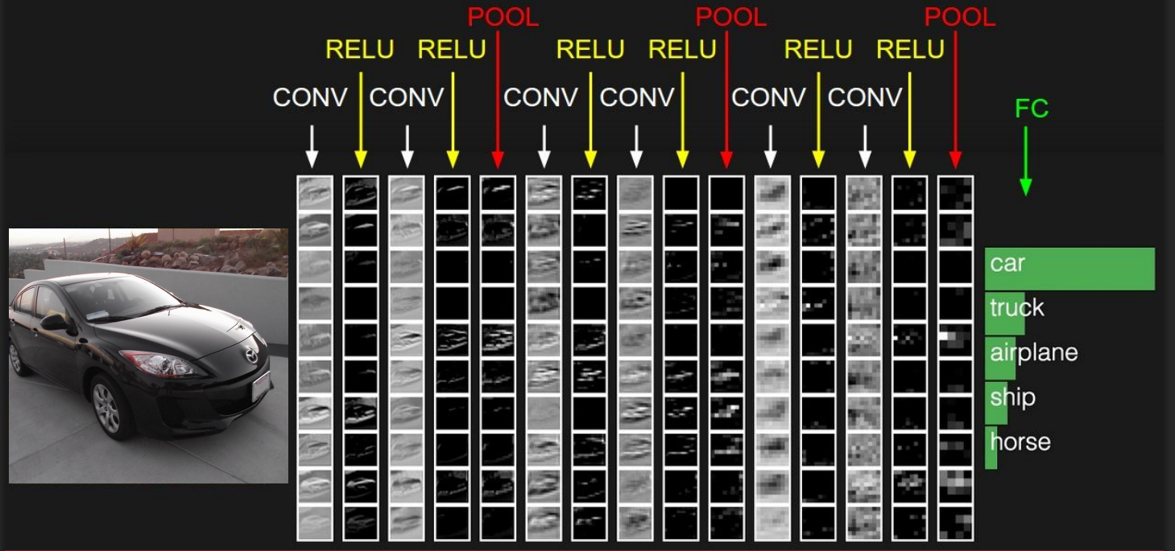
Putting it all together

Slide 29
Transfer Learning

Slide 30
Transfer Learning
What it is:
A technique where a DL model (e.g., CNN) trained on a large, general dataset (like ImageNet) is reused for a new, smaller task
Instead of training from scratch, you start with pretrained weights that already encode general visual features
ImageNet: 1.2 million images
1,000 labels

Slide 31
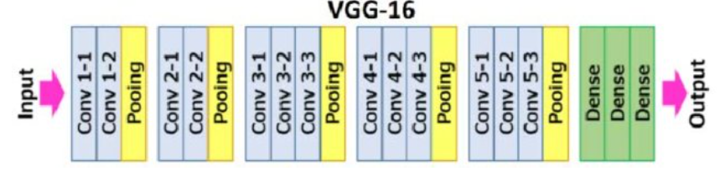
Transfer Learning
Why it works:
Early CNN layers learn universal features (edges, textures, shapes)
Later layers learn task-specific features
By reusing early layers, we save time and data while still achieving high accuracy

Slide 32
Transfer Learning
Start with pretrained CNN weights
Unfreeze some of the deeper layers (closer to the output)
Train them again with a low learning rate on your new dataset
Often combine with training a new classifier head
Allows the network to adapt existing features to your task

Slide 33
When to use Transfer Learning
Similar Domains (Input Space is Similar)
Works best when source and target data look alike
Example: ImageNet-trained CNN → medical images, satellite photos, or object detection
Why: The early layers learn generic features (edges, textures, shapes) that transfer well
Different Tasks, Same Domain
Works even if the task changes, as long as input is similar
Example: Pretrained language model (BERT) → sentiment analysis, question answering, summarization
Why: The model already knows the “language” of the domain

Slide 34
When to use Transfer Learning
Small Target Dataset
Transfer learning is especially powerful when the target dataset is small
Example: You have only 5,000 labeled medical images, but ImageNet has millions → fine-tuning avoids overfitting
Source Model Trained on Large, Diverse Data
Works well if the source task used a massive, high-quality dataset
Example: GPT/LLMs trained on internet-scale corpora → fine-tuned for legal or medical text
When Target Task Shares Low-Level Features with Source Task
For images: edges, textures, color blobs
For text: grammar, semantics, contextual embeddings
For audio: pitch, frequency patterns, temporal rhythms

Slide 35
When not to use Transfer Learning
If source and target domains are too different
e.g., natural images → ECG waveforms
If target dataset is huge, sometimes training from scratch can outperform transfer
If source model is biased or trained on poor-quality data, bad biases transfer too

